Slide 1

Exploratory Data Analysis
XYZ G2M Analysis
2021/8

Slide 2

Agenda
Introduction
EDA
2019 Forecasting
Conclusion

Slide 3
Introduction
Business Problem?
Help XYZ make a final decision on which cab company to invest in.
Data:
Dataset contains data about Two companies Yellow Cab and Pink Cab.

Slide 4
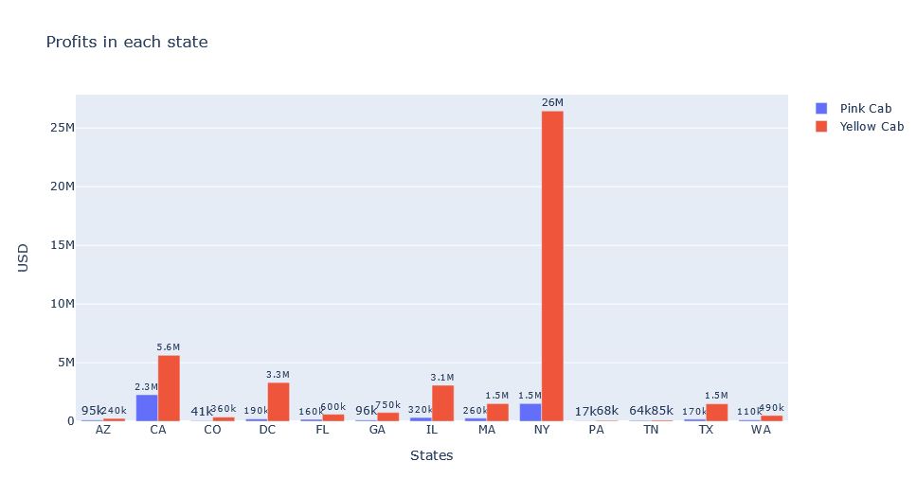
EDA (Profit per state)
-Yellow Cab outperforms Pink Cab in every State.
-Yellow Cab made the most profit in NY state, and least profit in PA state.

Slide 5
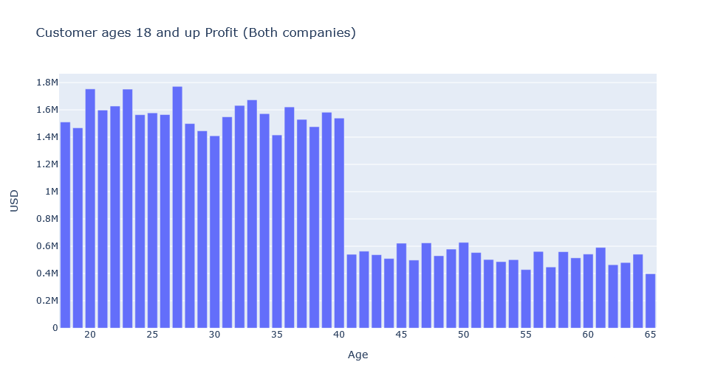
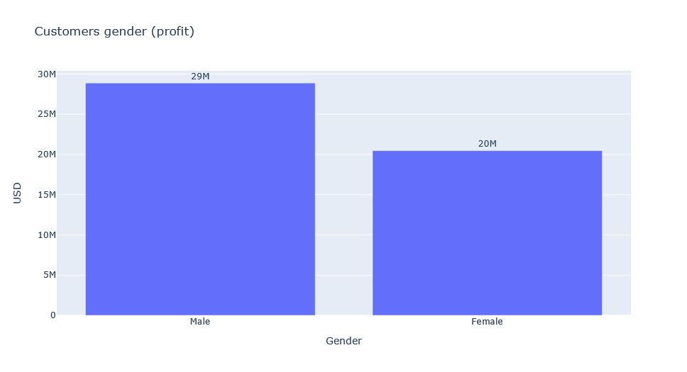
EDA (Customer groups)

Slide 6
EDA (Customer groups) cont.
- The most profit comes from customers ages between 18 to 40 years old.
- Male customers bring in about 58% of the profit.

Slide 7
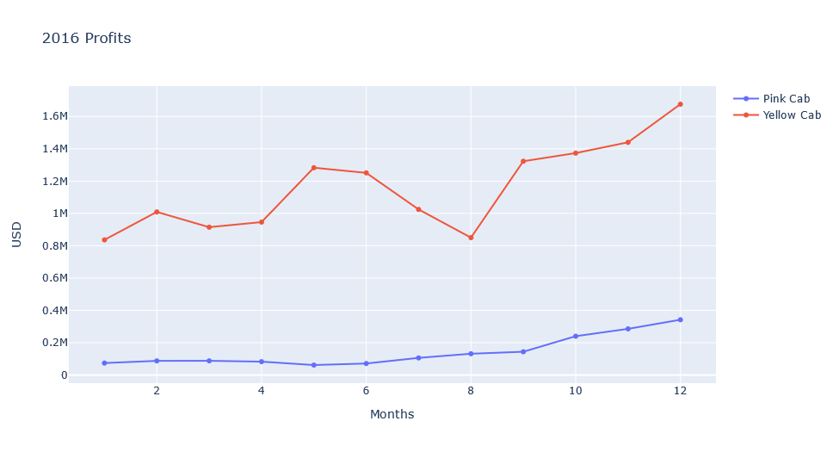
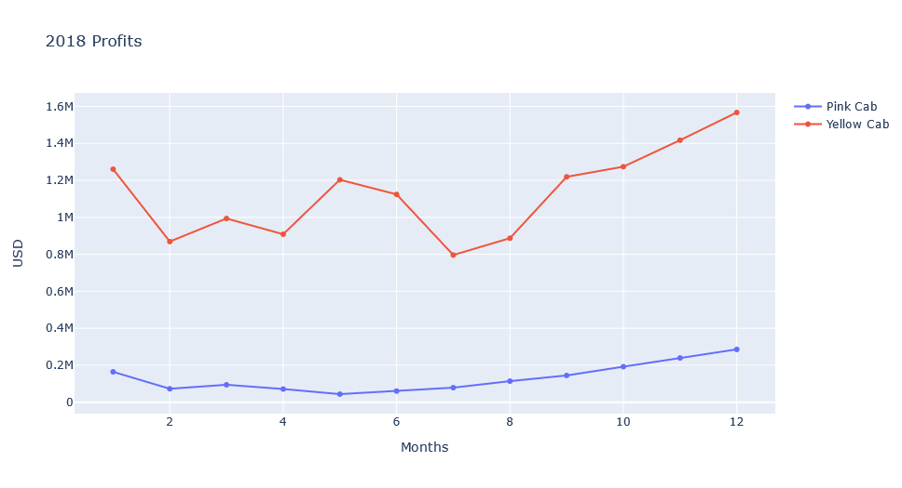
EDA(Profits per year)

Slide 8
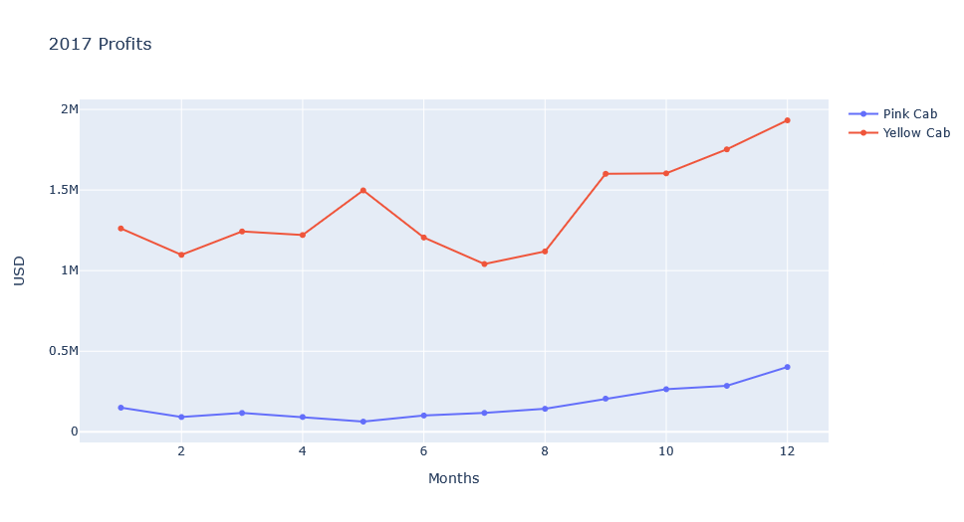
EDA(Profits per year) cont.
-Yellow Cab experience a dip in profits from May to Aug.
-Both companies experience a rise in profit after Aug with a peek in Dec.

Slide 9
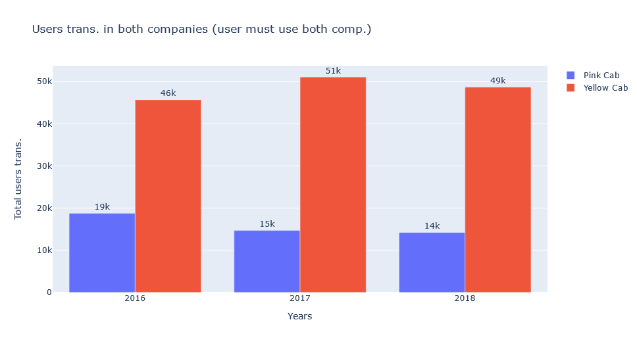
EDA (Customer usage)
- Users who uses both companies makes more transactions with Yellow Cab than Pink Cab.
- Some users stop making transactions with Pink Cab the next year as evident by the declining transaction each year.

Slide 10
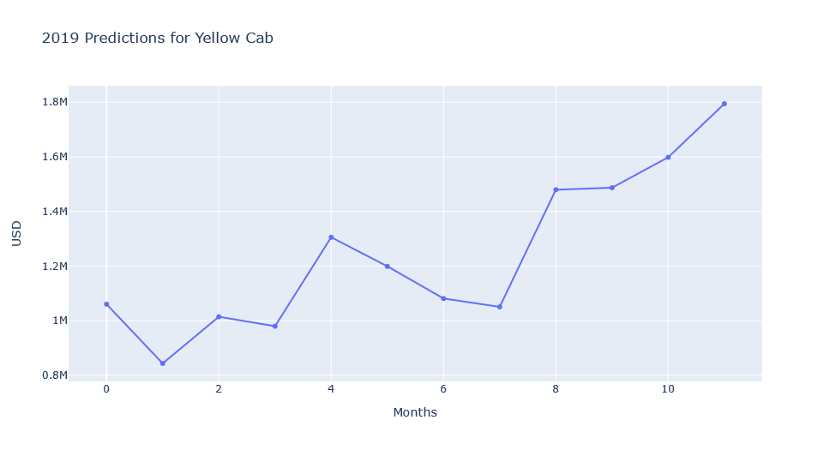
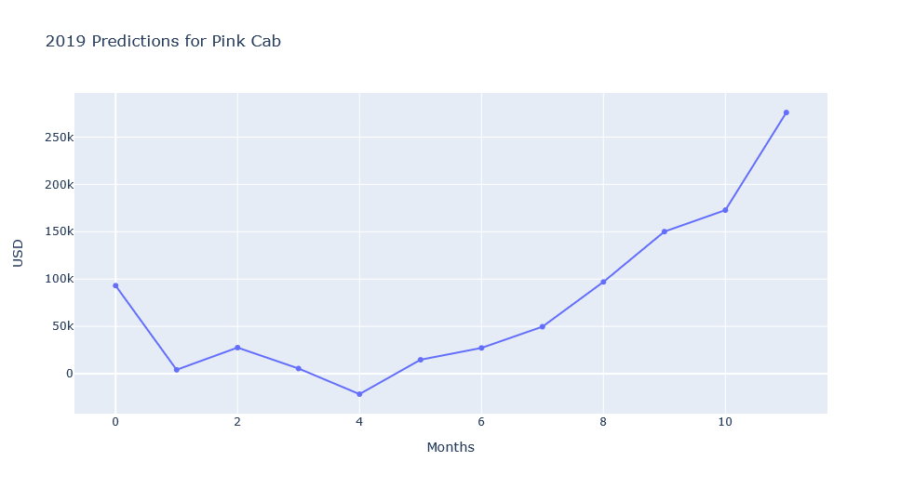
2019 Forecasting

Slide 11
Conclusion
Yellow Cab is the best option to invest in based on the following reasons:
Yellow Cab dominate Pink Cab profit wise in each state they operate in.
Yellow Cab makes as much as 8 times the profit of Pink Cab each year.
Users who use both companies stop or make less transactions with Pink Cab in favor of using Yellow Cab.

Slide 12
Thank You

