Slide 1
Suicide Detection using NLP
Amena, Hazim, and Rashed

Slide 2
Introduction
Suicide As a Mental Health Problem
Ministry of Health
Suicide Hotline
It’s a gas giant and the biggest planet in the Solar System

Slide 3
The Process
Taking Data from Reddit Posts
Cleaning Data
Divide the posts to the different topics
Building a classifier

Slide 4
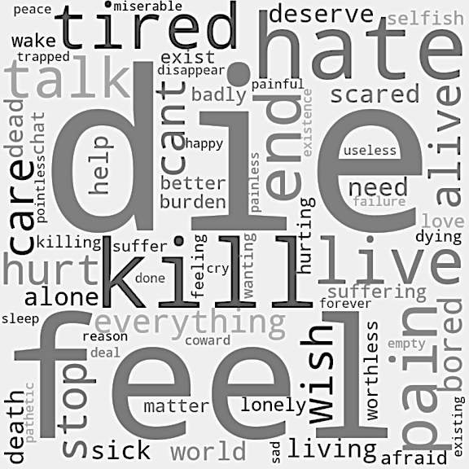
Findings
Mercury
Saturn
Mercury is the closest planet to the Sun and the smallest one
Mars
Venus
Despite being red, Mars is actually a cold place. It’s full of iron oxide dust
Jupiter
Neptune
Jupiter is a gas giant and the biggest planet in the Solar System

Slide 5
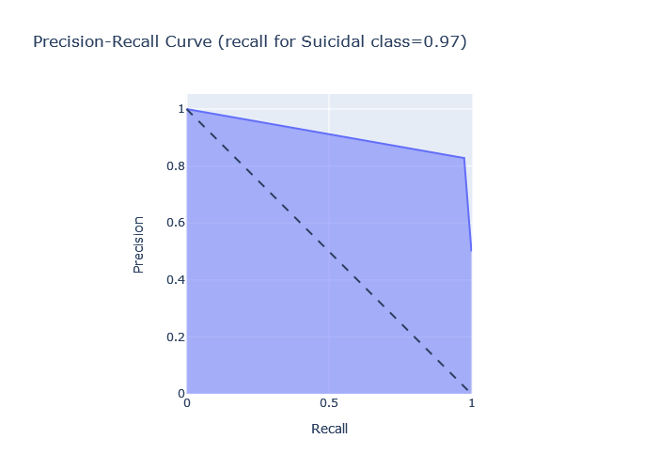
Classifier performance
Mercury
Saturn
Mercury is the closest planet to the Sun and the smallest one
Mars
Venus
Despite being red, Mars is actually a cold place. It’s full of iron oxide dust
Jupiter
Neptune
Jupiter is a gas giant and the biggest planet in the Solar System

Slide 6
Myths about Suicide
Myth
Truth
You cannot change someone’s mind about suicide
They have mixed feelings about death
Myth
Truth
Suicidal people are attention seekers
They are asking for help from people.
Myth
Truth
Talking about suicide give people the ides
Talking about it can help in saving lives

Slide 7
Conclusion
Certain words, patterns, and emotions.
Make sure to never dismiss anyone feelings.
Normalize talking about mental health.
Talk to your loved ones whenever you are feeling down.

Slide 8
Future Recommendation
Analyze people emotions from their social media feeds
Automated Robot that suggest articles based on the post
Gather Arabic posts from Twitter to represent our society
Raise awareness and talk more about it.

Slide 9
Thank you for Listening

