Slide 1
Animal Shelter
Amena Alsamah
Hazim Bukhari
Rashed Alhilal

Slide 2
The Problem
Who
Al-Riyadh Animal Shelter
01
How to solve it
Classification
02
Why
Reduce stray animals.
03
The final goal
Help animals find home.
04

Slide 3
The Process
First step
Third Step
Collect Data from Austin Animal shelter
Fit different models
Second Step
Fourth Step
Visualize the data
Choose Features
Deployed the model

Slide 4
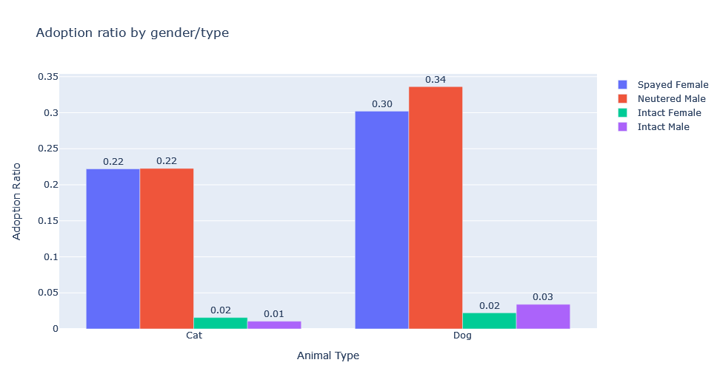
Findings

Slide 5
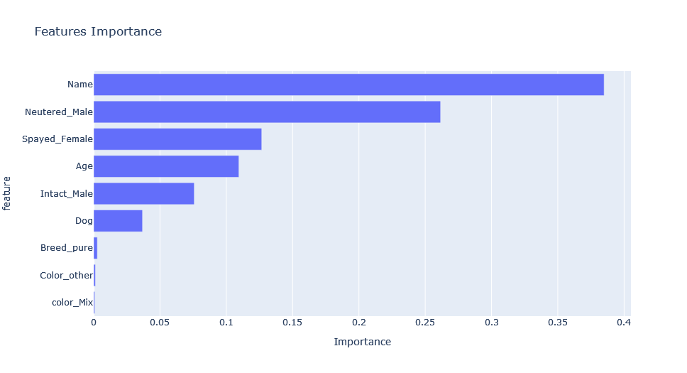
Findings

Slide 6
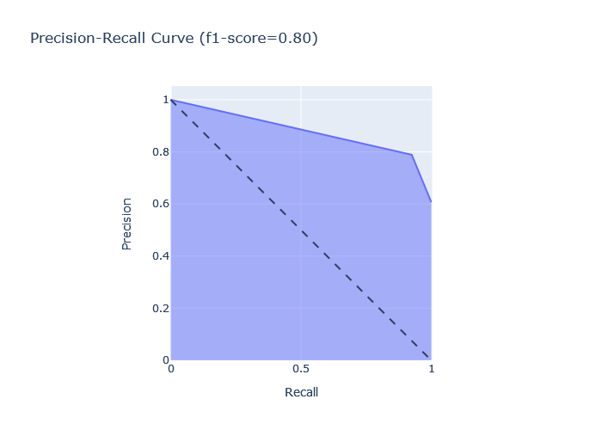
Findings

Slide 7
Conclusion
Gender/Type
Age
Name
Animal type
B
C
A
D

Slide 8
Future Recommendation
Personality
Medical Record

Slide 9
Thank You for Listening

