Slide 1

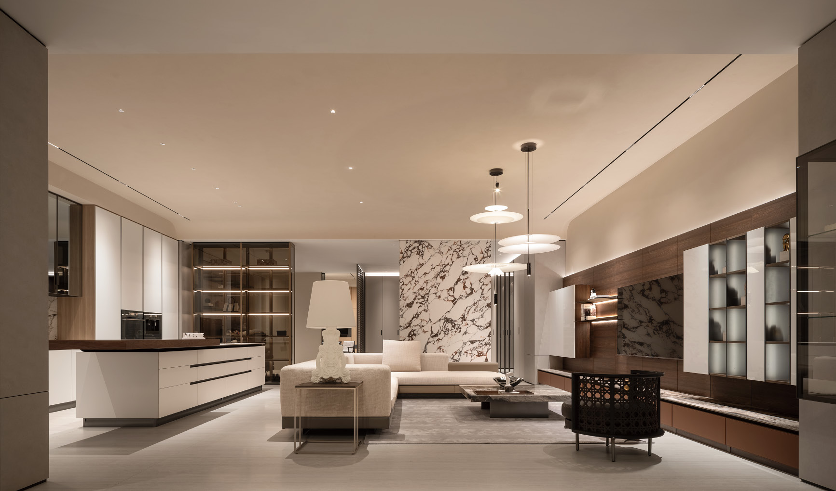

Slide 2
Company Profile
-In 2019, the core team structure of the company was formed, and the business direction was focused on the whole house customization field. After 4 years of market experience with accumulation, the company has been officially registered and established in Singapore in 2023.
-With a professional production base located in China, it will be upgraded to the whole house high-end customization system has been optimized and adjusted in style and product structure, fully transforming towards modern minimalism.

Slide 3
Brand positioning
-Simplicity and luxury, high-end customized paint free wooden system home furnishings for the whole house, and differentiation from many solid wood and mixed oil custom brands in the market. It is more diverse in texture, color, shape, and fashion performance, which can better meet personalized customization needs.
Product advantages
-High quality/high cost-effectiveness/efficient systematization
-Widely adaptable to modern home décor
-First tier brand high-quality environmentally friendly materials

Slide 4
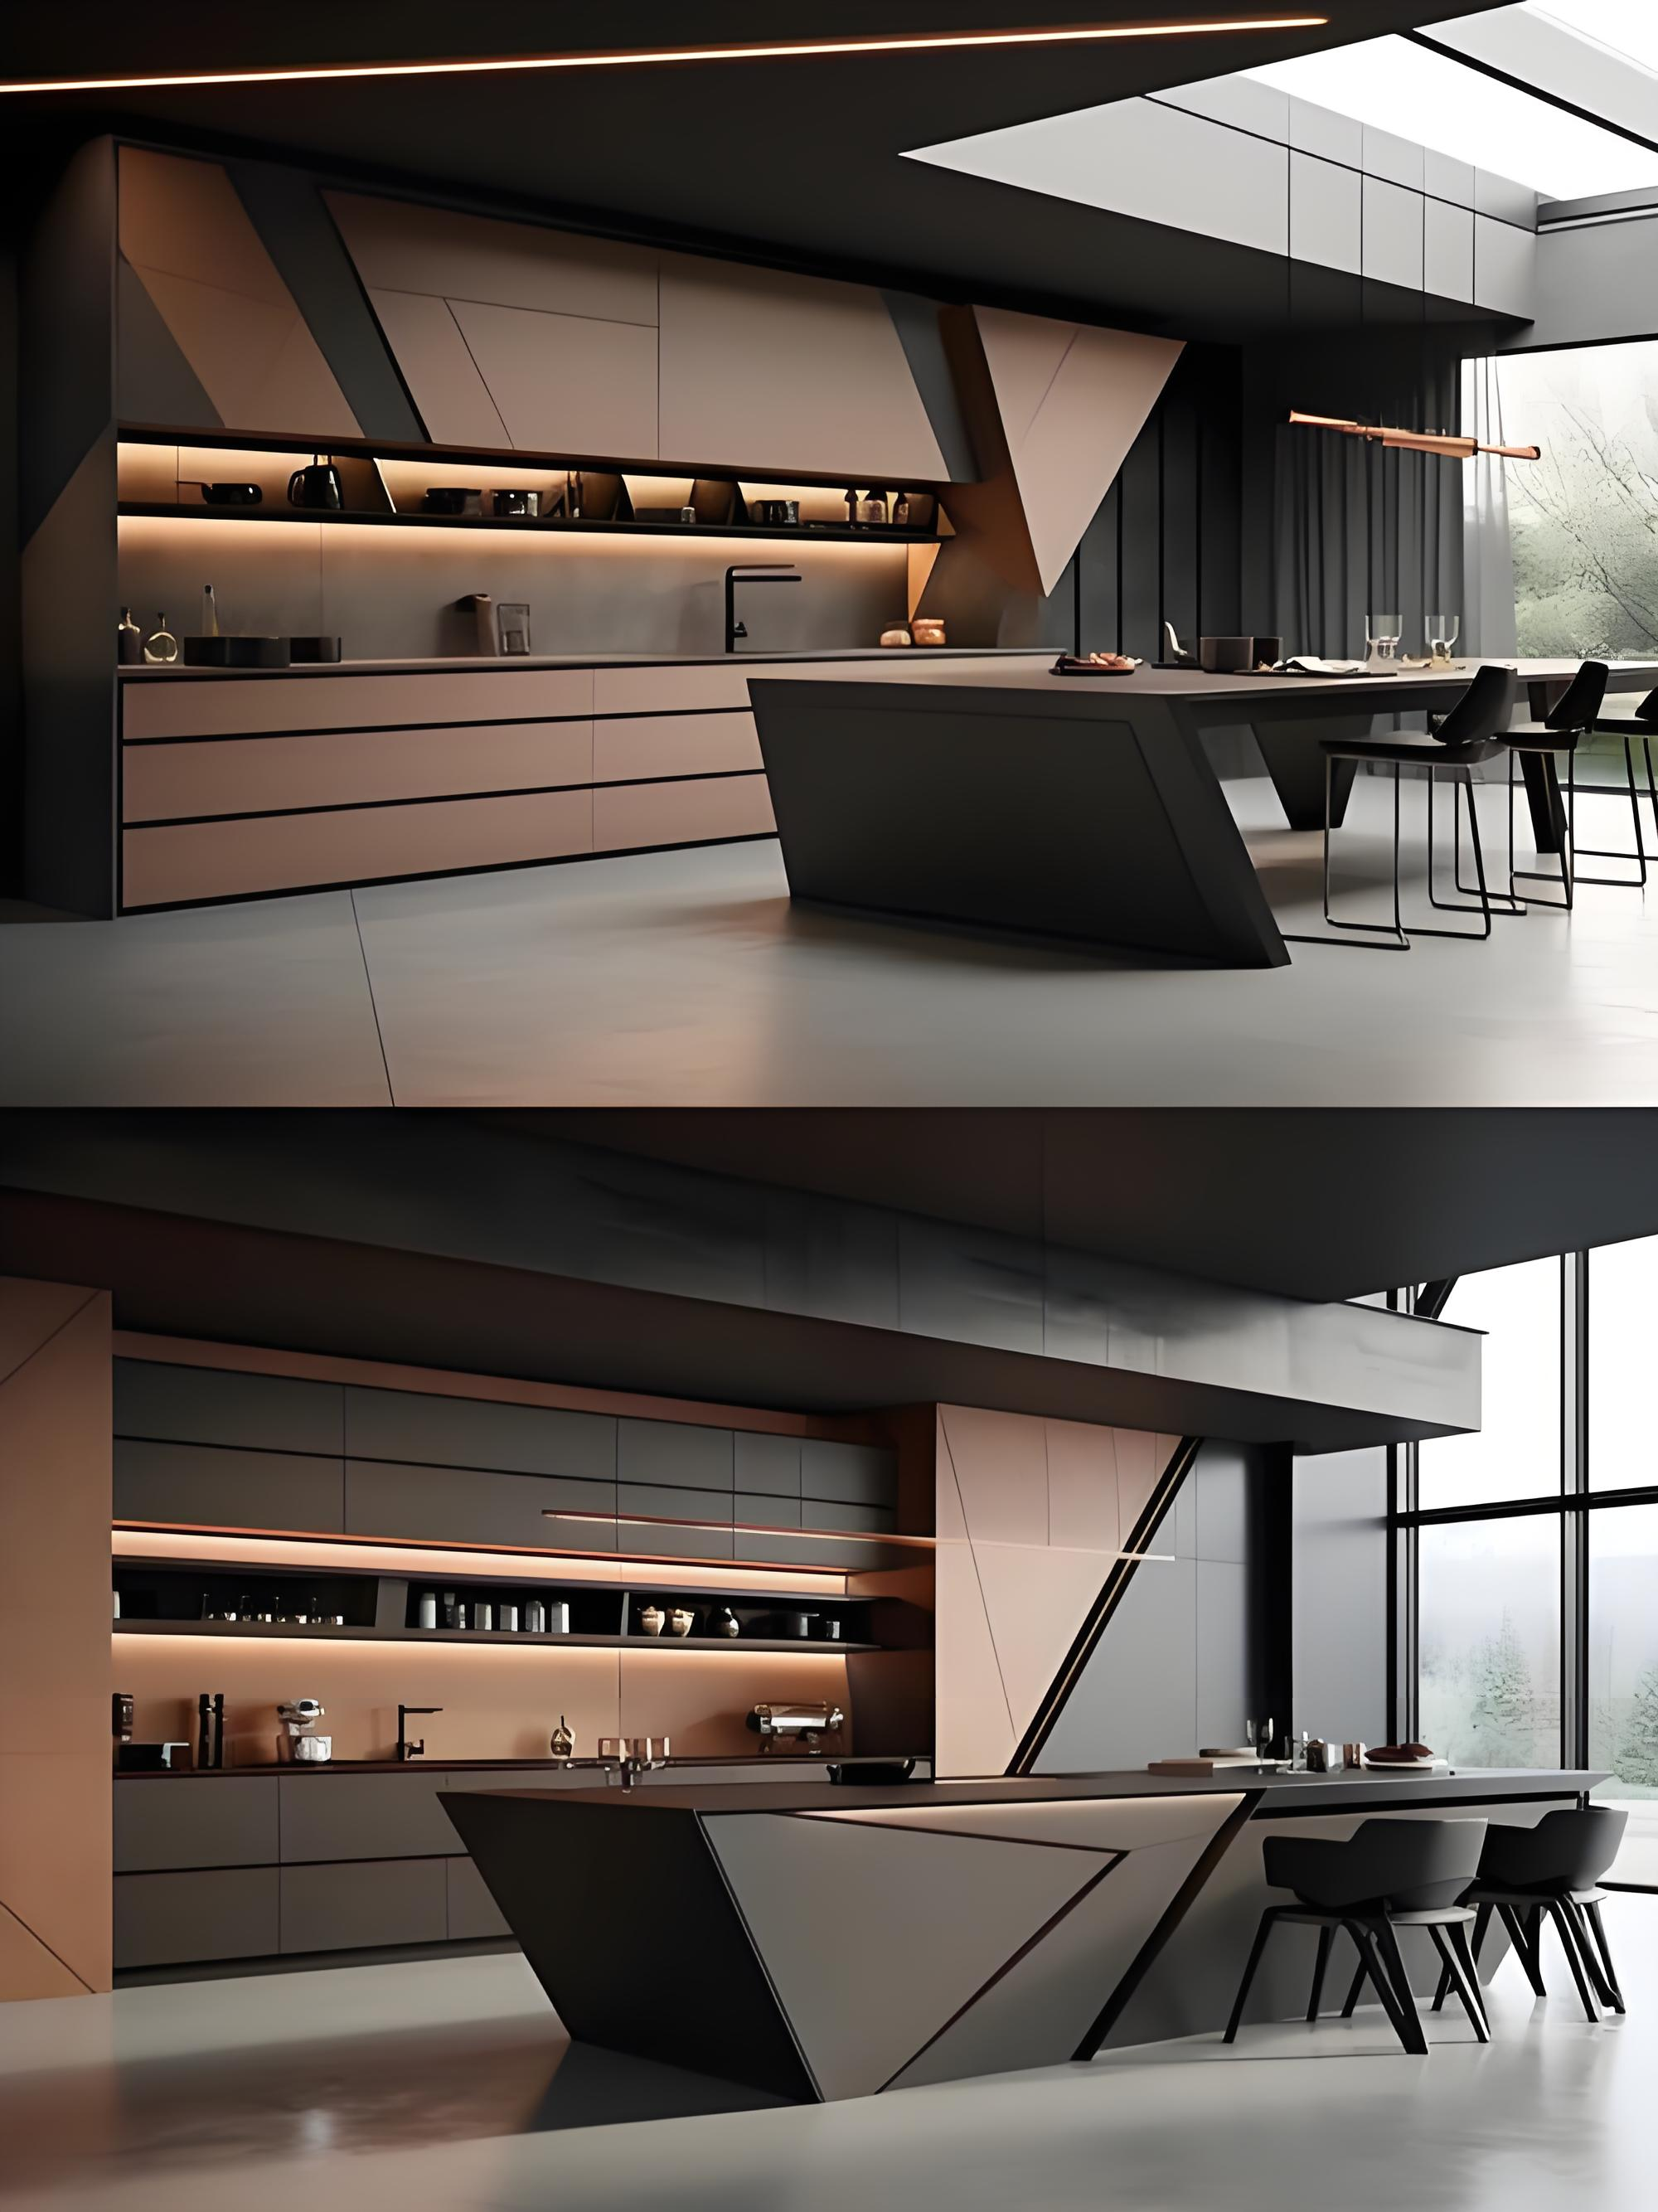
Our advantages of whole house customization
Formaldehyde emission meets ENF&F4☆ standards
We use MDI glue, which has a low glue usage and the equipment applies glue evenly, MDI glue has almost no formaldehyde, and the equipment evenly applies glue, which minimizes the amount of formaldehyde.
MDI glue high-temperature hot pressing technology
We use fully automated equipment and high-temperature hot pressing technology to adhere the surface finish on the board, making the surface treatment smoother and high quality.
Edge banding technology
Our PUR/Laser edge sealing is much stronger than ABS/EVA edge sealing for hand cabinets, resulting in lower formaldehyde emissions, less cracking of board corners, better quality, and safer use.
High precision
Our products are produced using machines, with consistent internal and external materials and more precise dimensions.

Slide 5
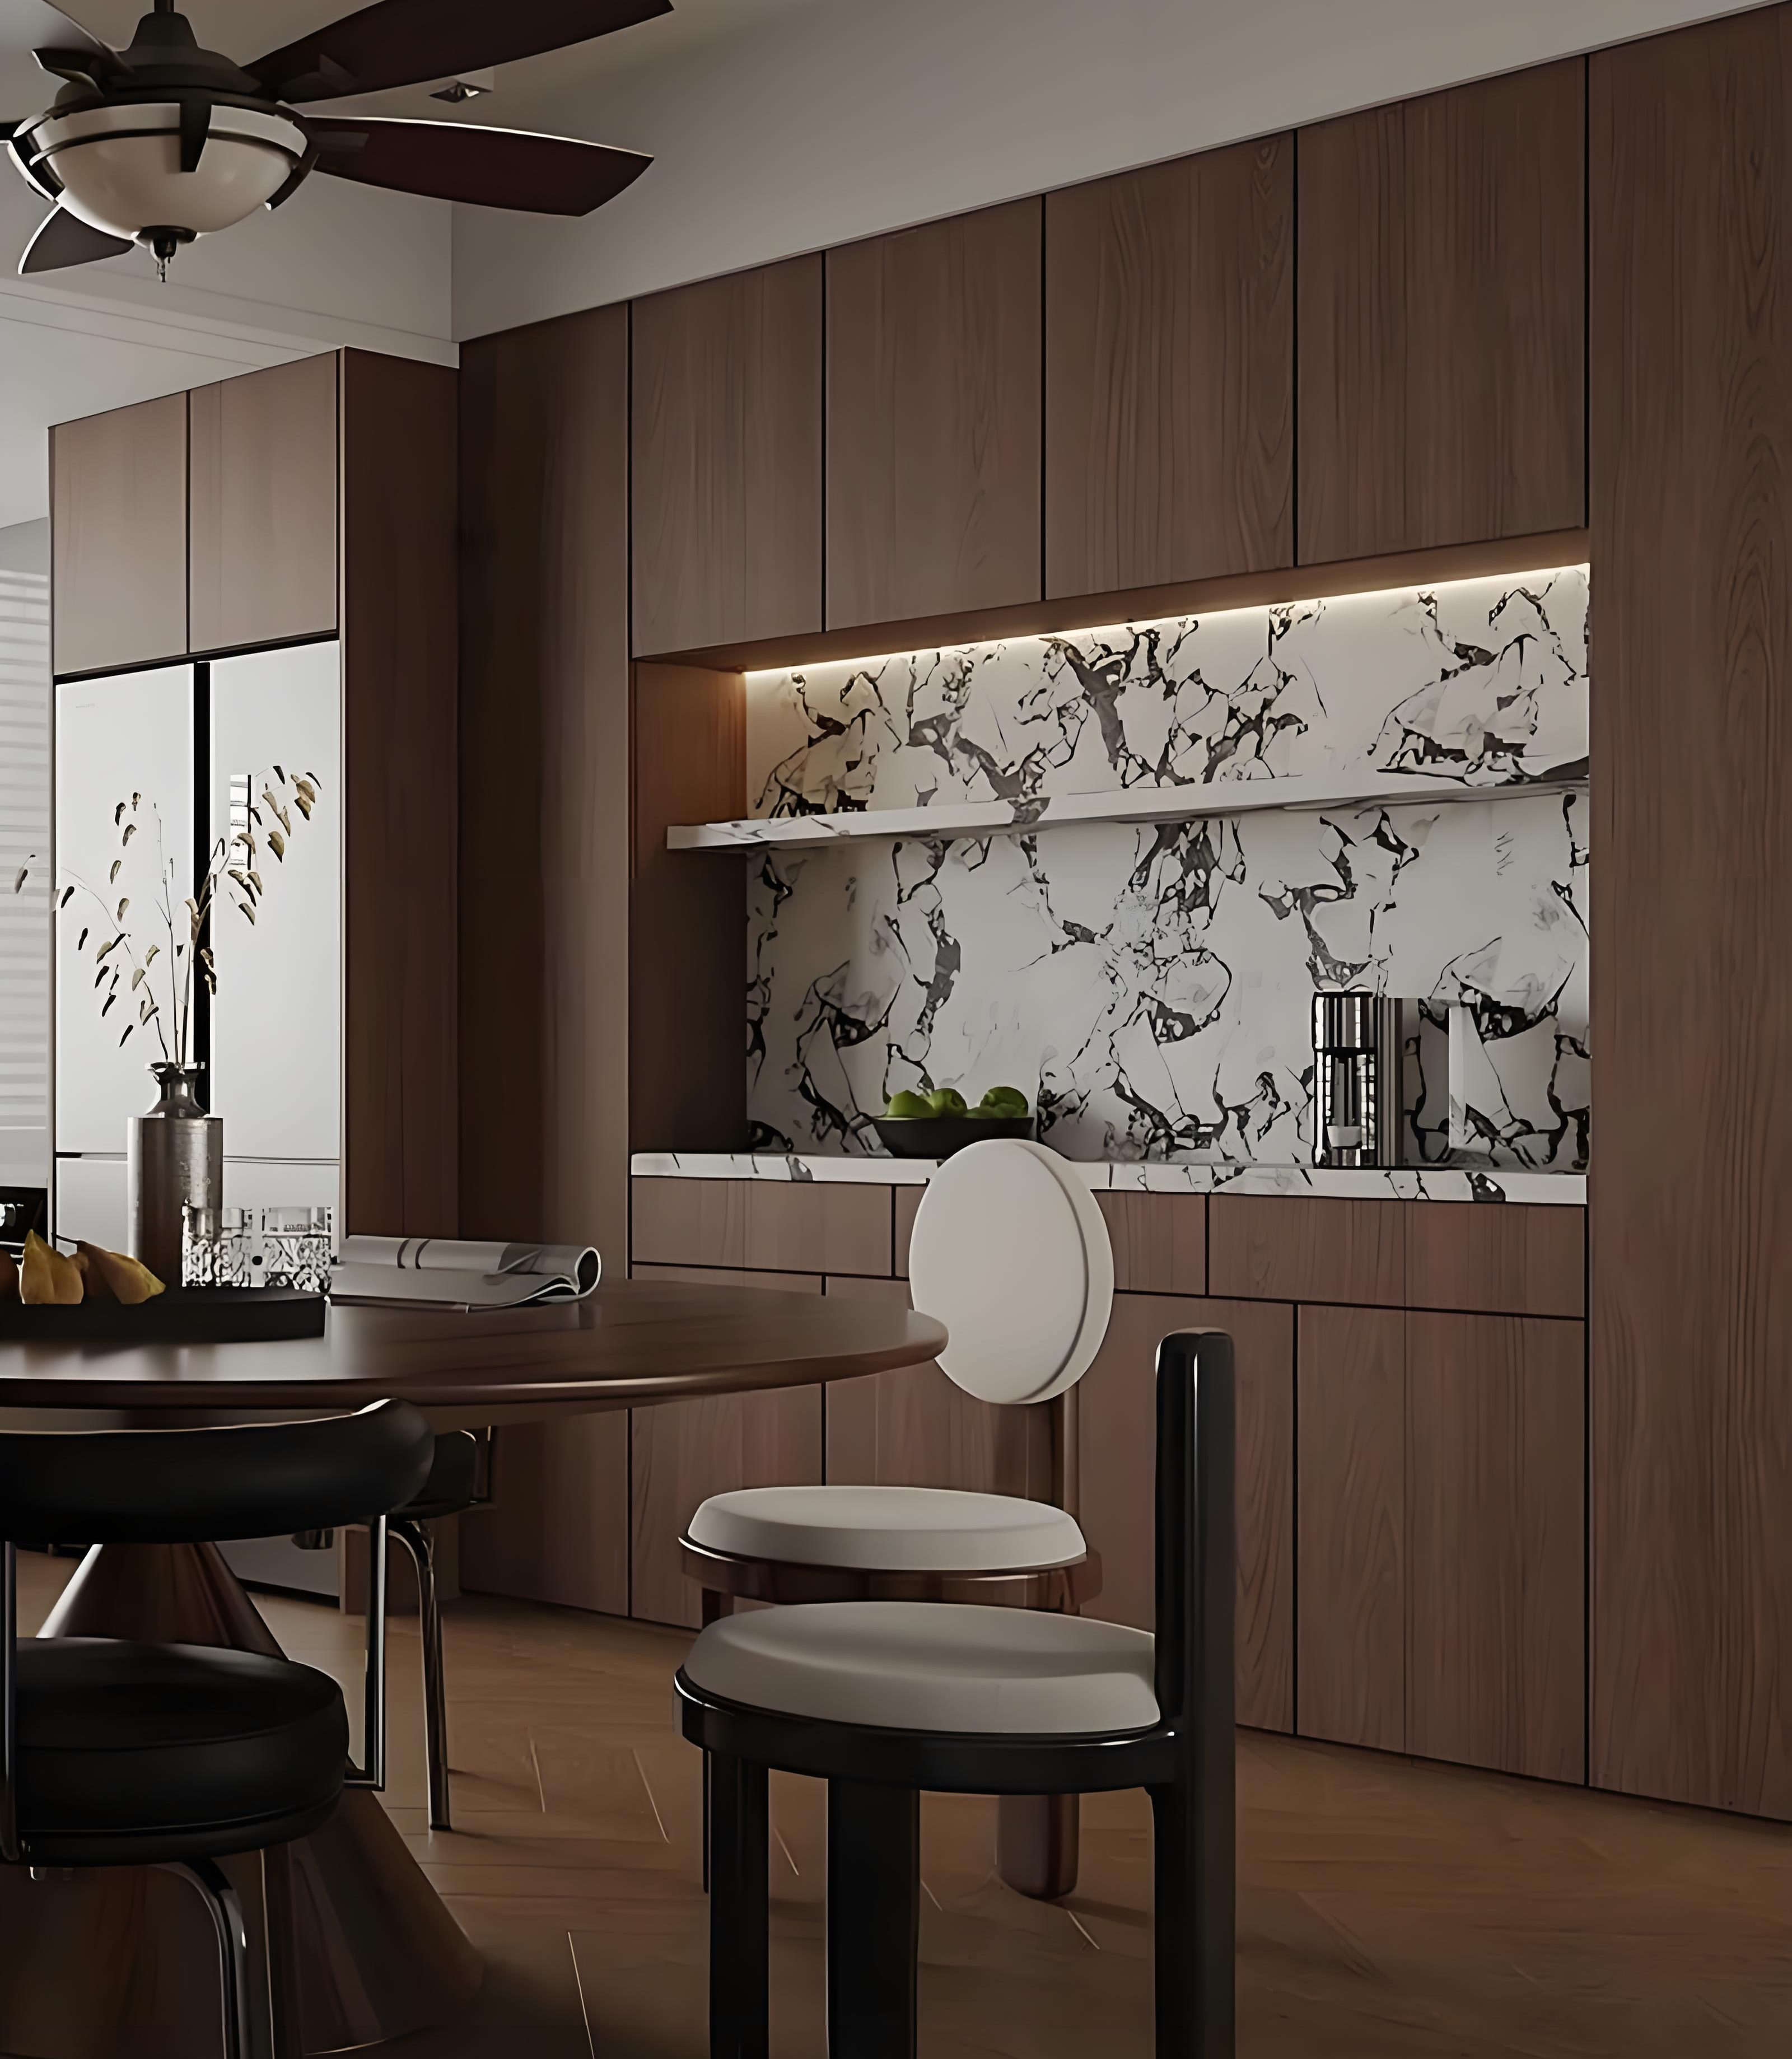
Start
Confirm Order
Est 1 week
Draft Measurement
Est 2 Days
Free Design Until Approved
Est 1-2 weeks
Final Measure
Est 2 Days
Confirm Details & Sign
Est 2 Days
Production
Est 4-6 Weeks
Transport
Est 2-3 weeks
Install
Est 1week
Our customization process

Slide 6
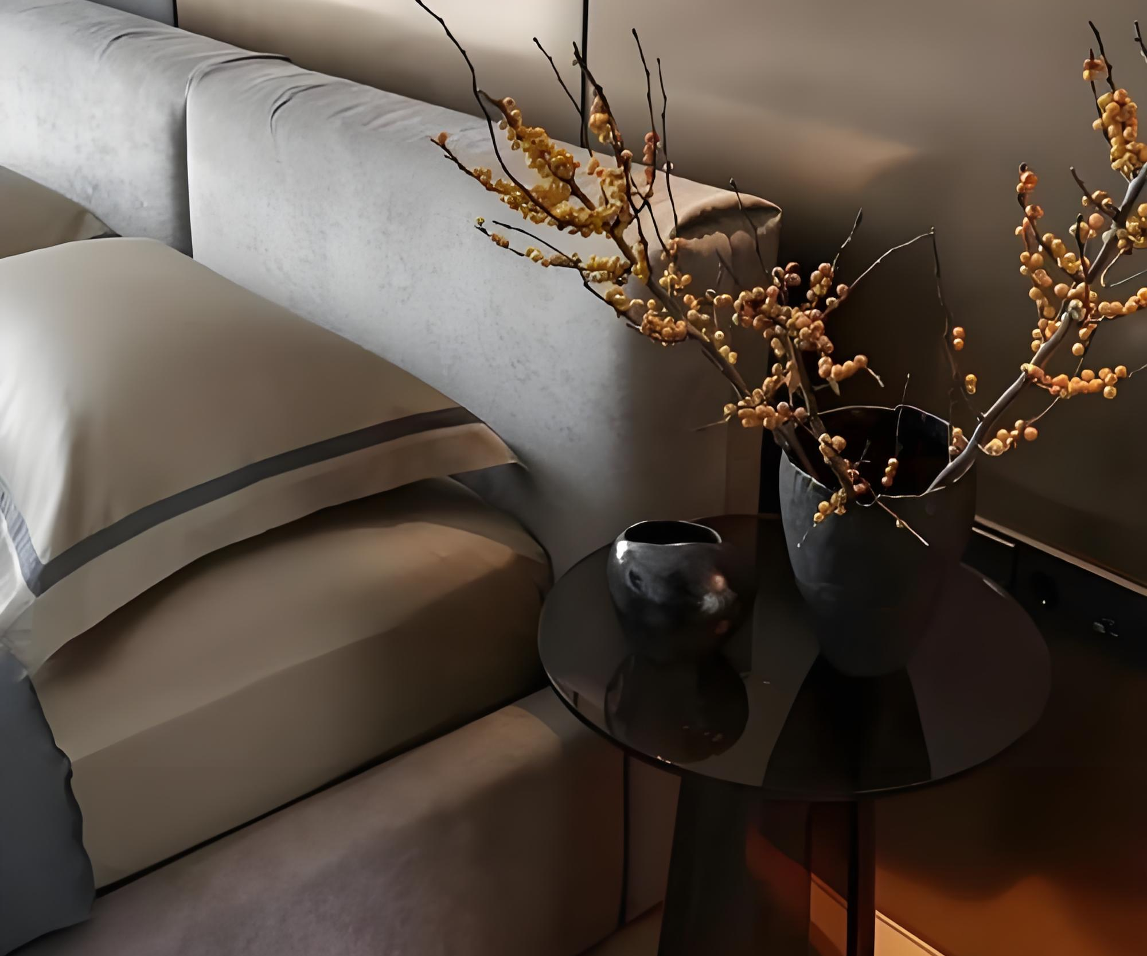
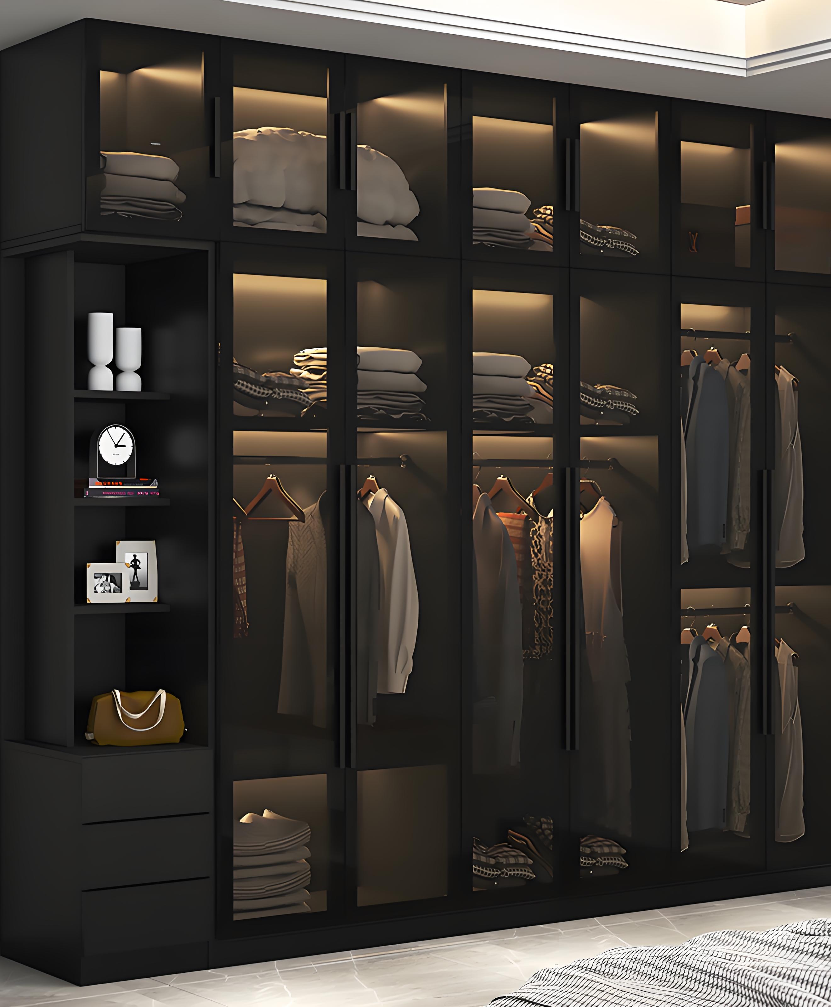
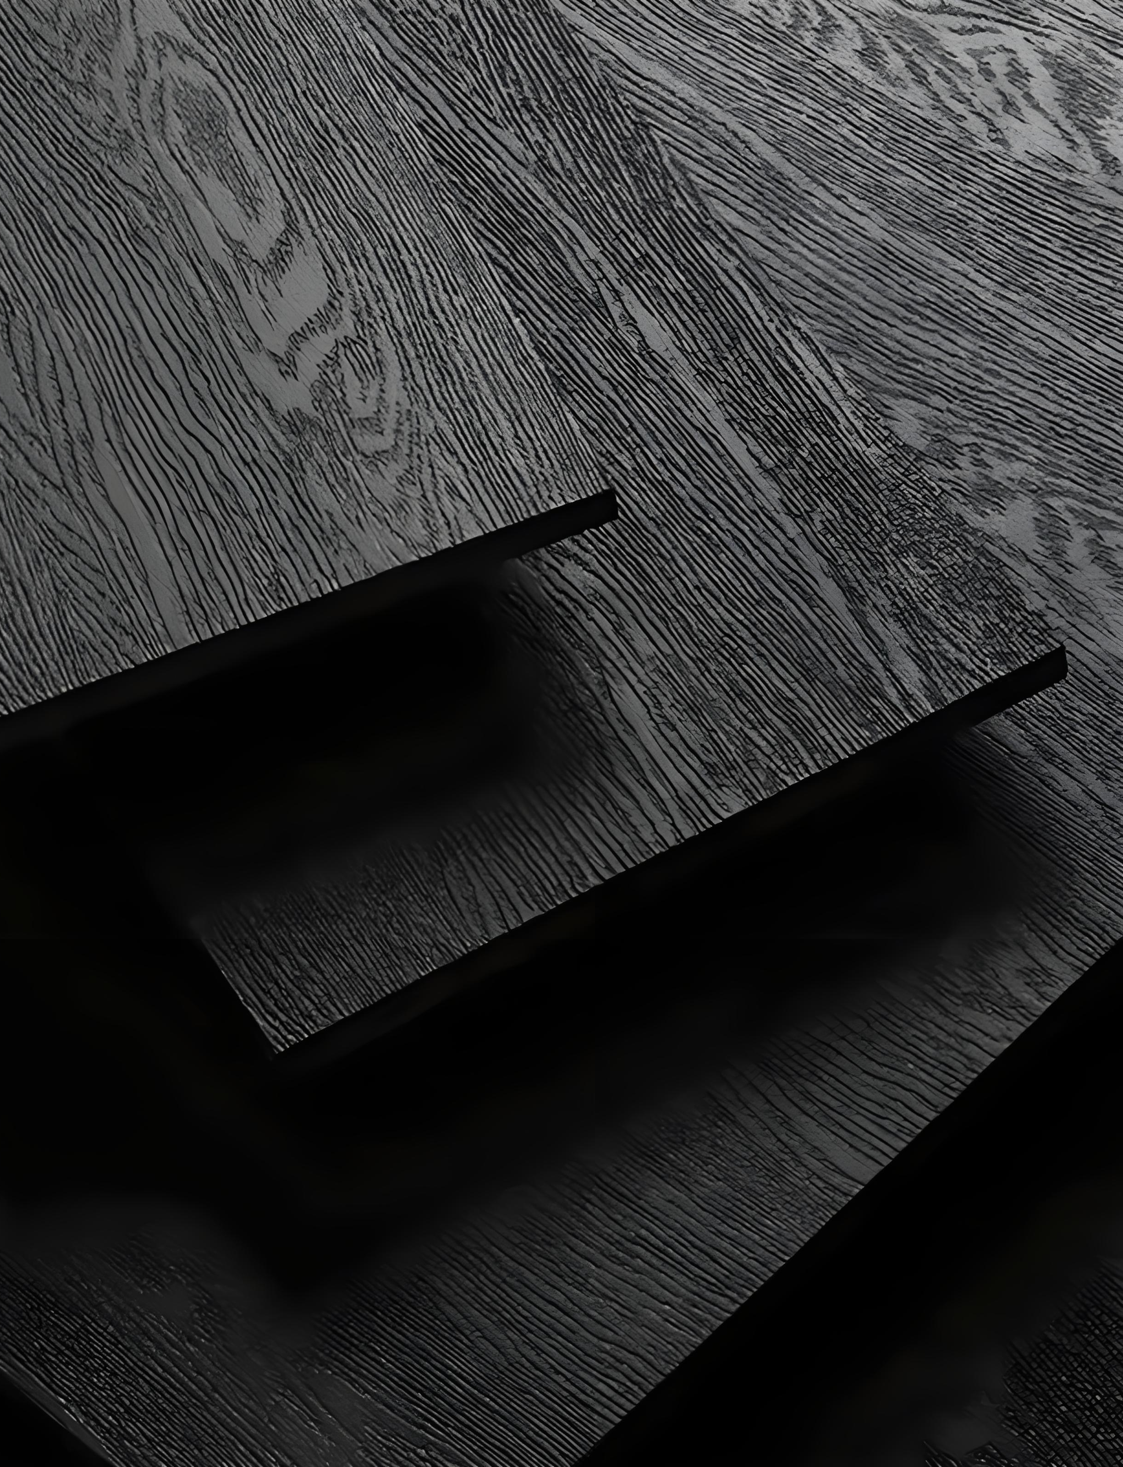
Our main products
CABINET/WARDROBE : Compress Board, Plywood, OSB
FLOORING: VINYL/SPC FLOORING
WALL PANEL: PVC WALL PANEL

Slide 7
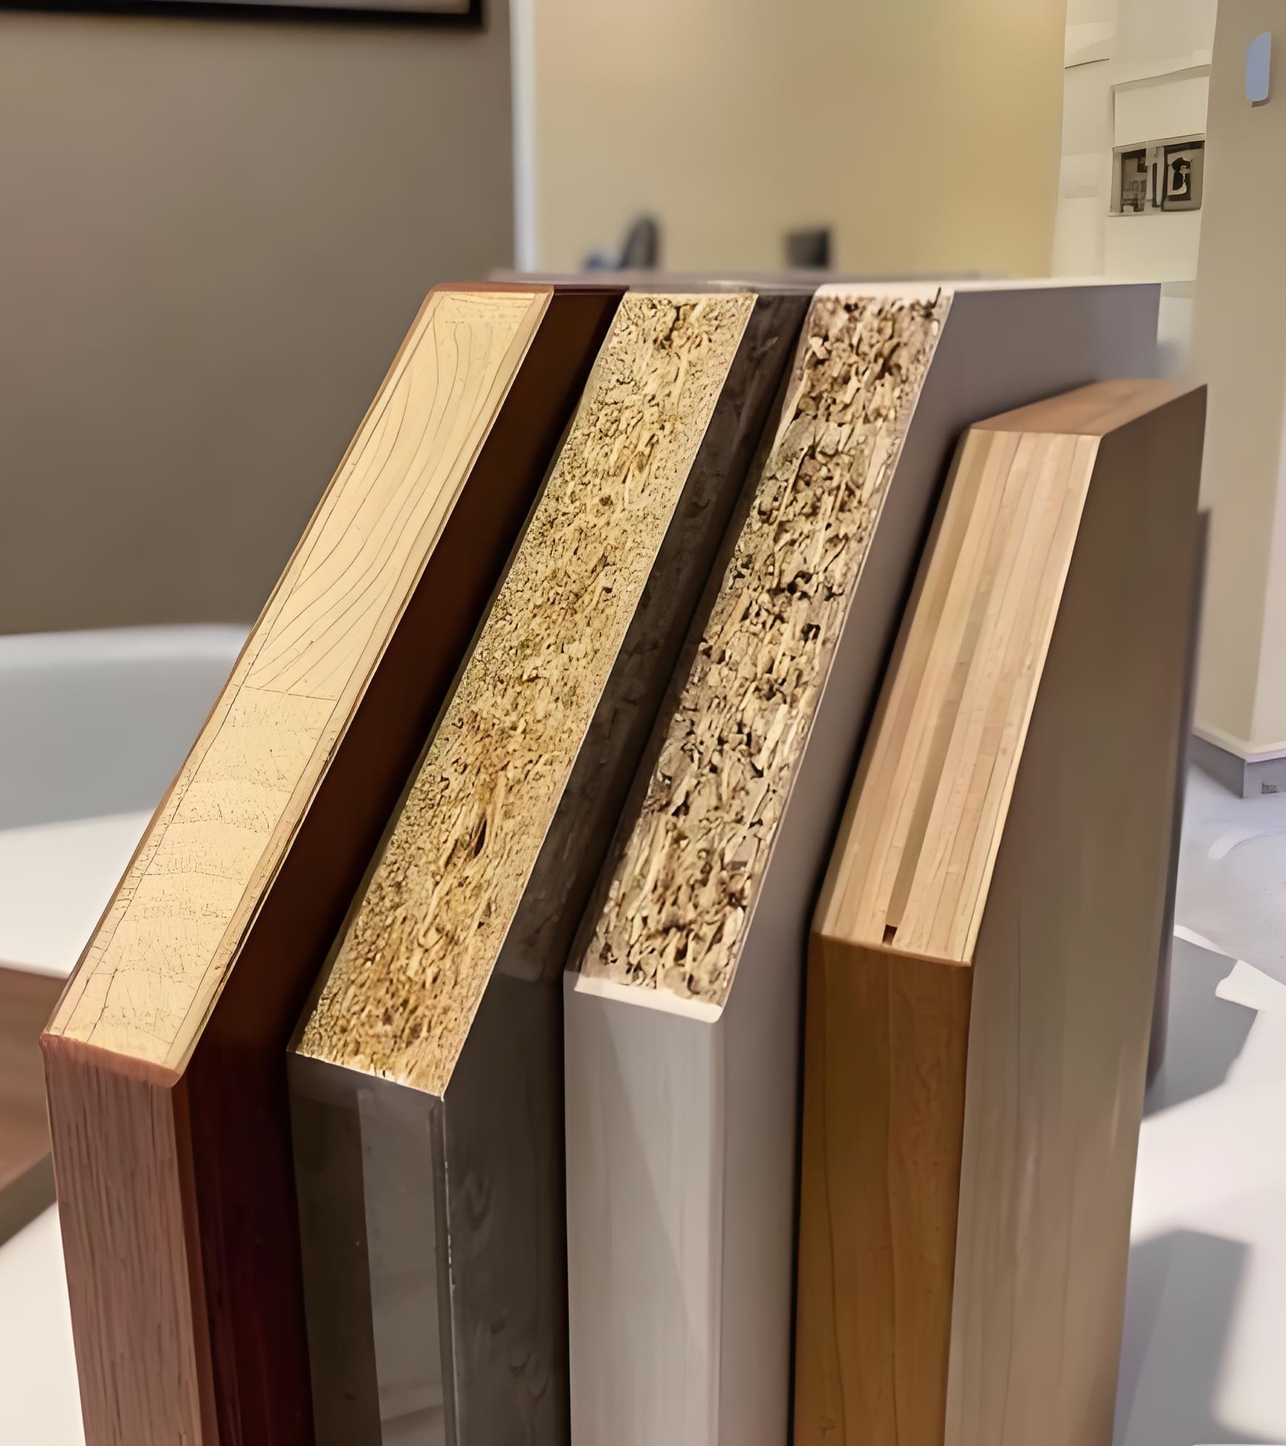
Introduction to raw material boards
Material Types:
-Compress Board,
-OSB (ordinary/imported),
-Plywood(multi-layer) board
Maximum Door Height (mm): 2700
Board thickness (mm): 9, 12, 18, 22, 25
Surface treatment: PET, Double veneer and baking paint process
Process Tech: Arcs, Grilles, Various door shapes (special door shapes can only use density boards)

Slide 8
Introduction to raw material boards
Compress Board (default use):
Stable quality, longest market test time, environmental protection level meets F4☆, international whole house customization brands basically only use it as a substrate, such as Poliform, Boffi.
OSB: cabinet door use, feature: no need for straightener.
Multi-layer board: moisture-proof

Slide 9
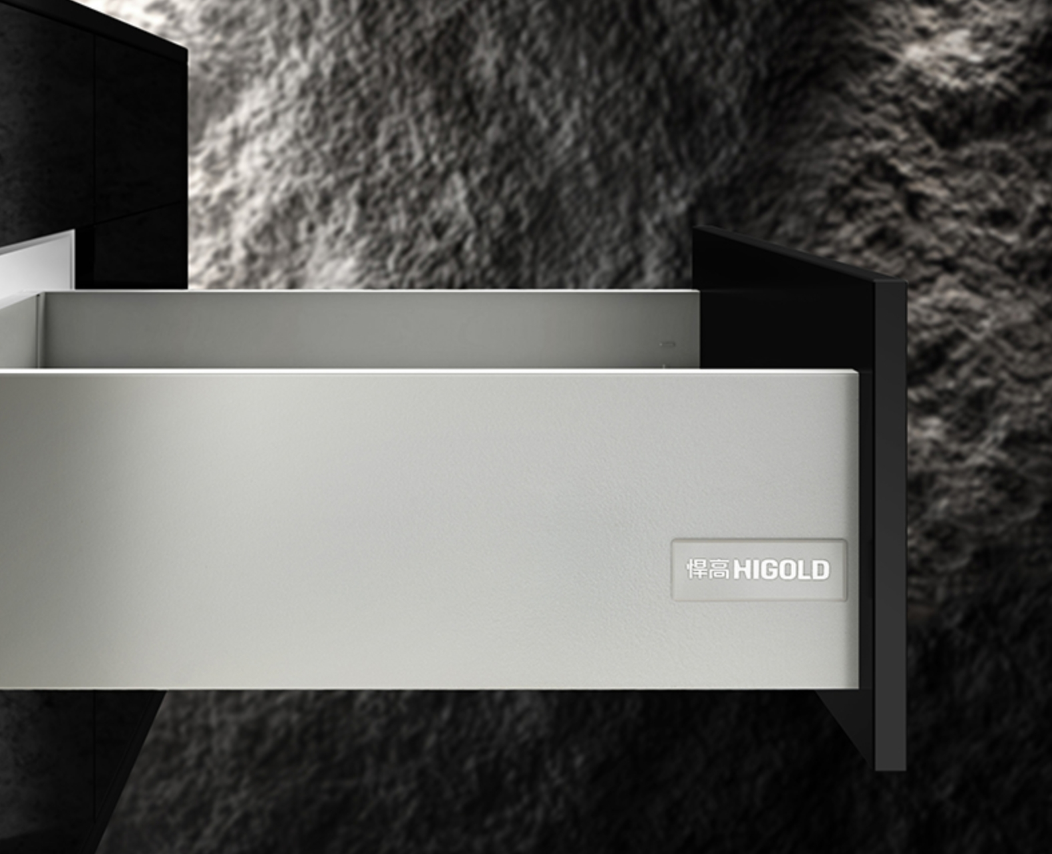
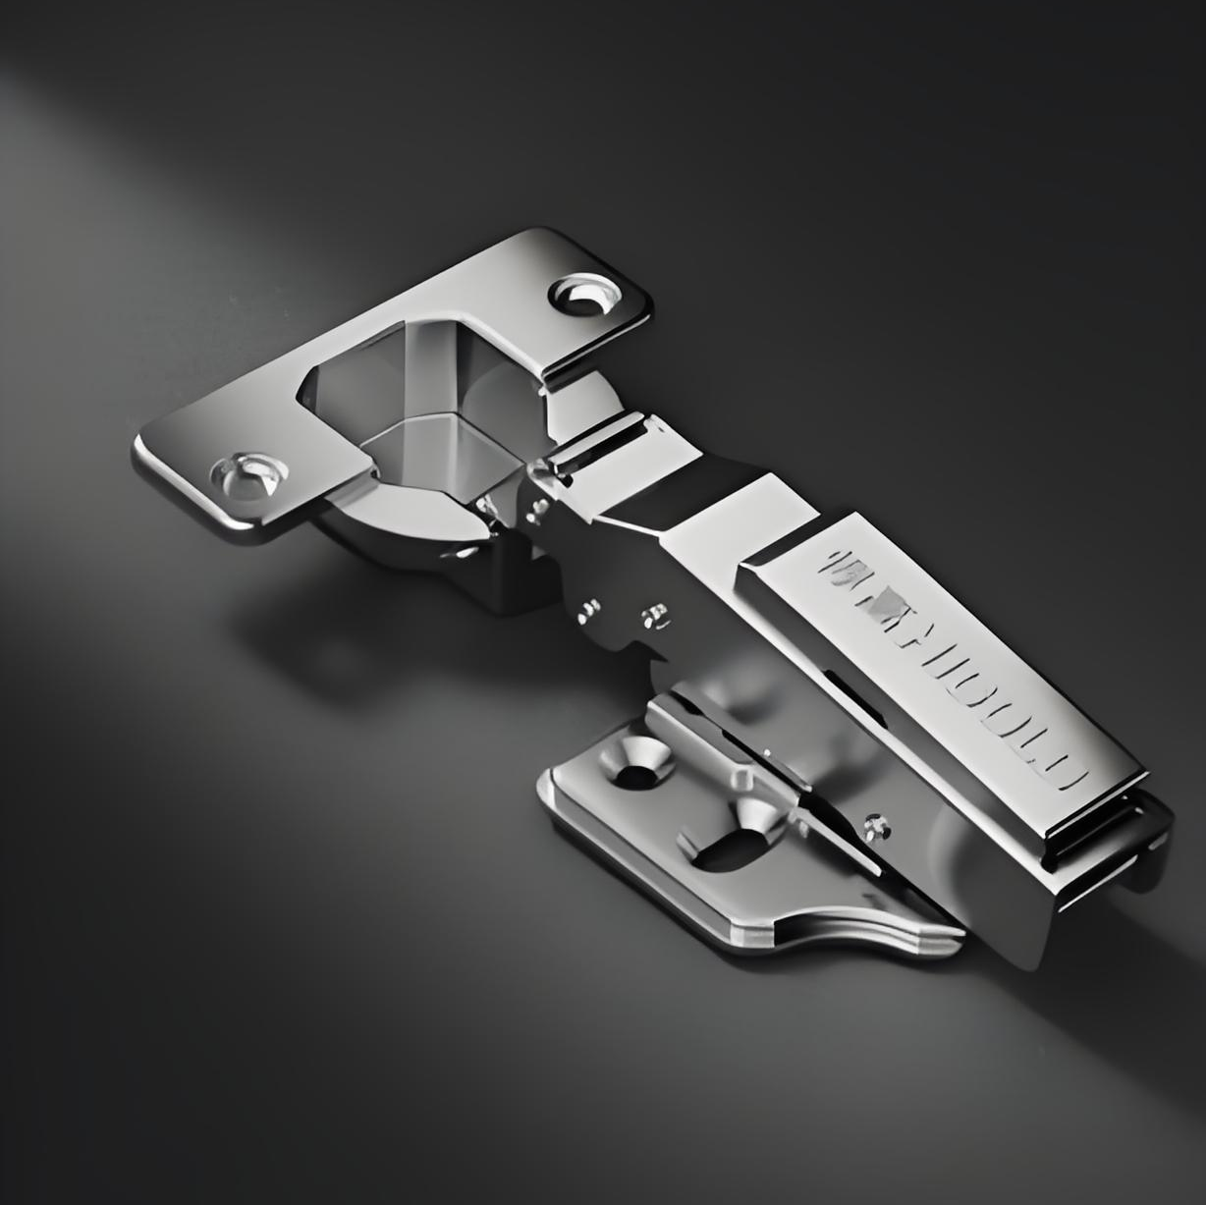
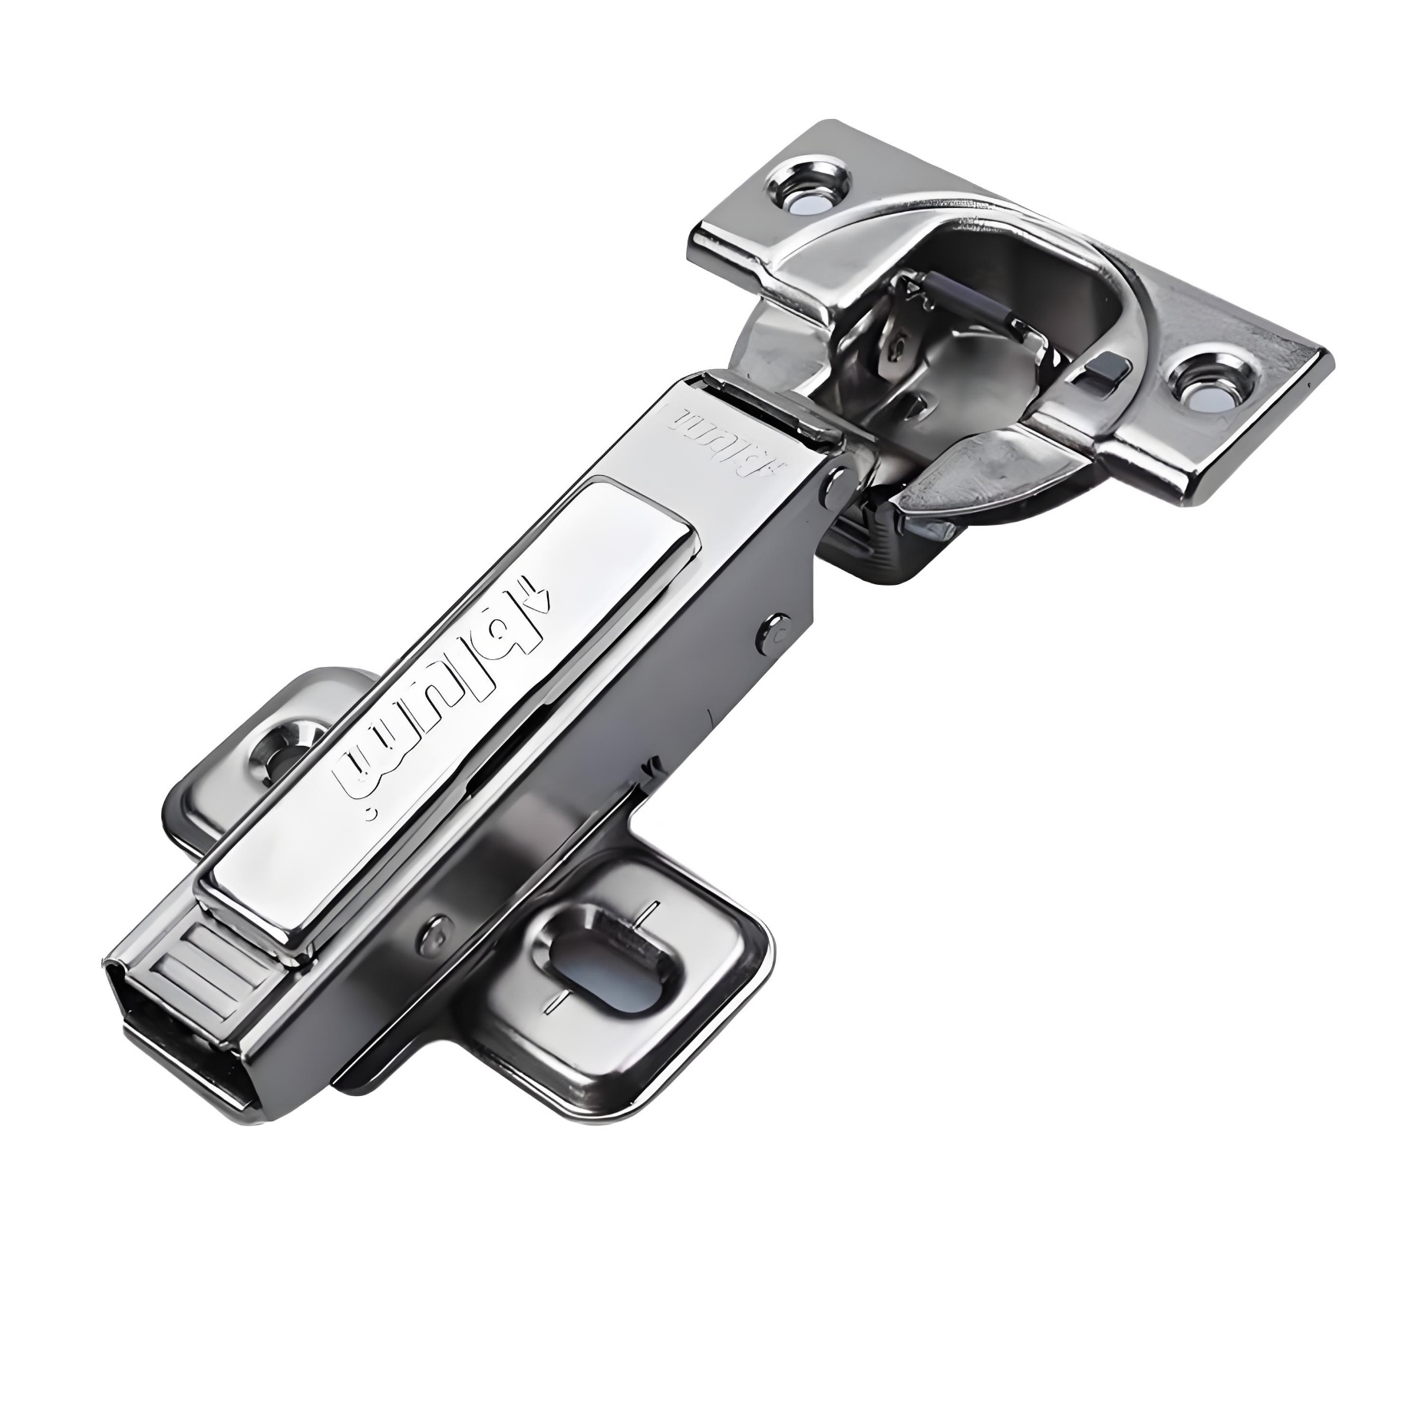
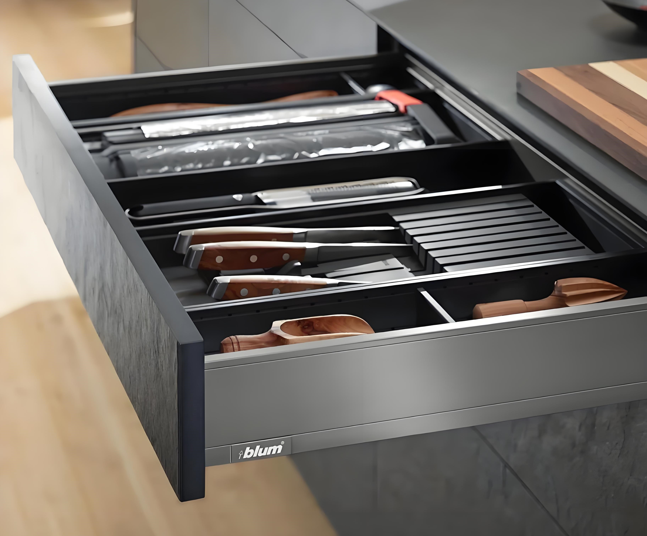
Hardware Introduction- Ordinary hardware
we default to using Chinese brands (with a 20-year warranty): DTC, Jusen.
SG market recommendation: Blum/Higold Hinge
Soft function tools: Kitchen basket/Wardrobe storage basket (Higold).

Slide 10
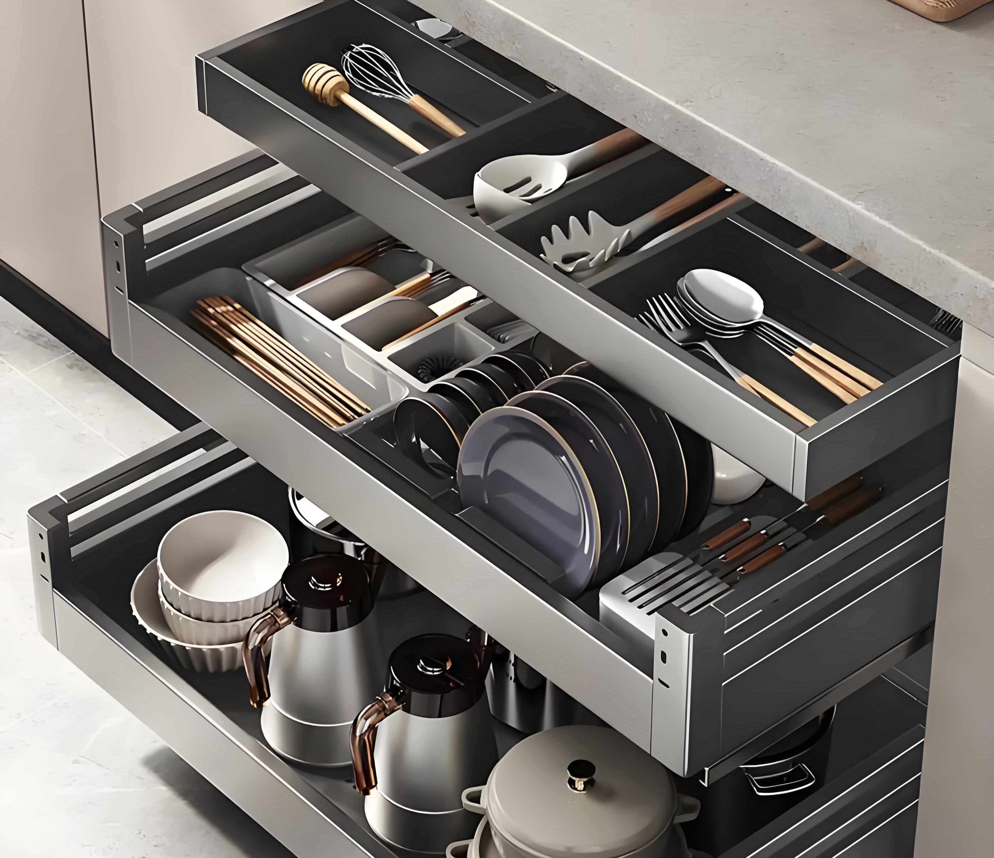
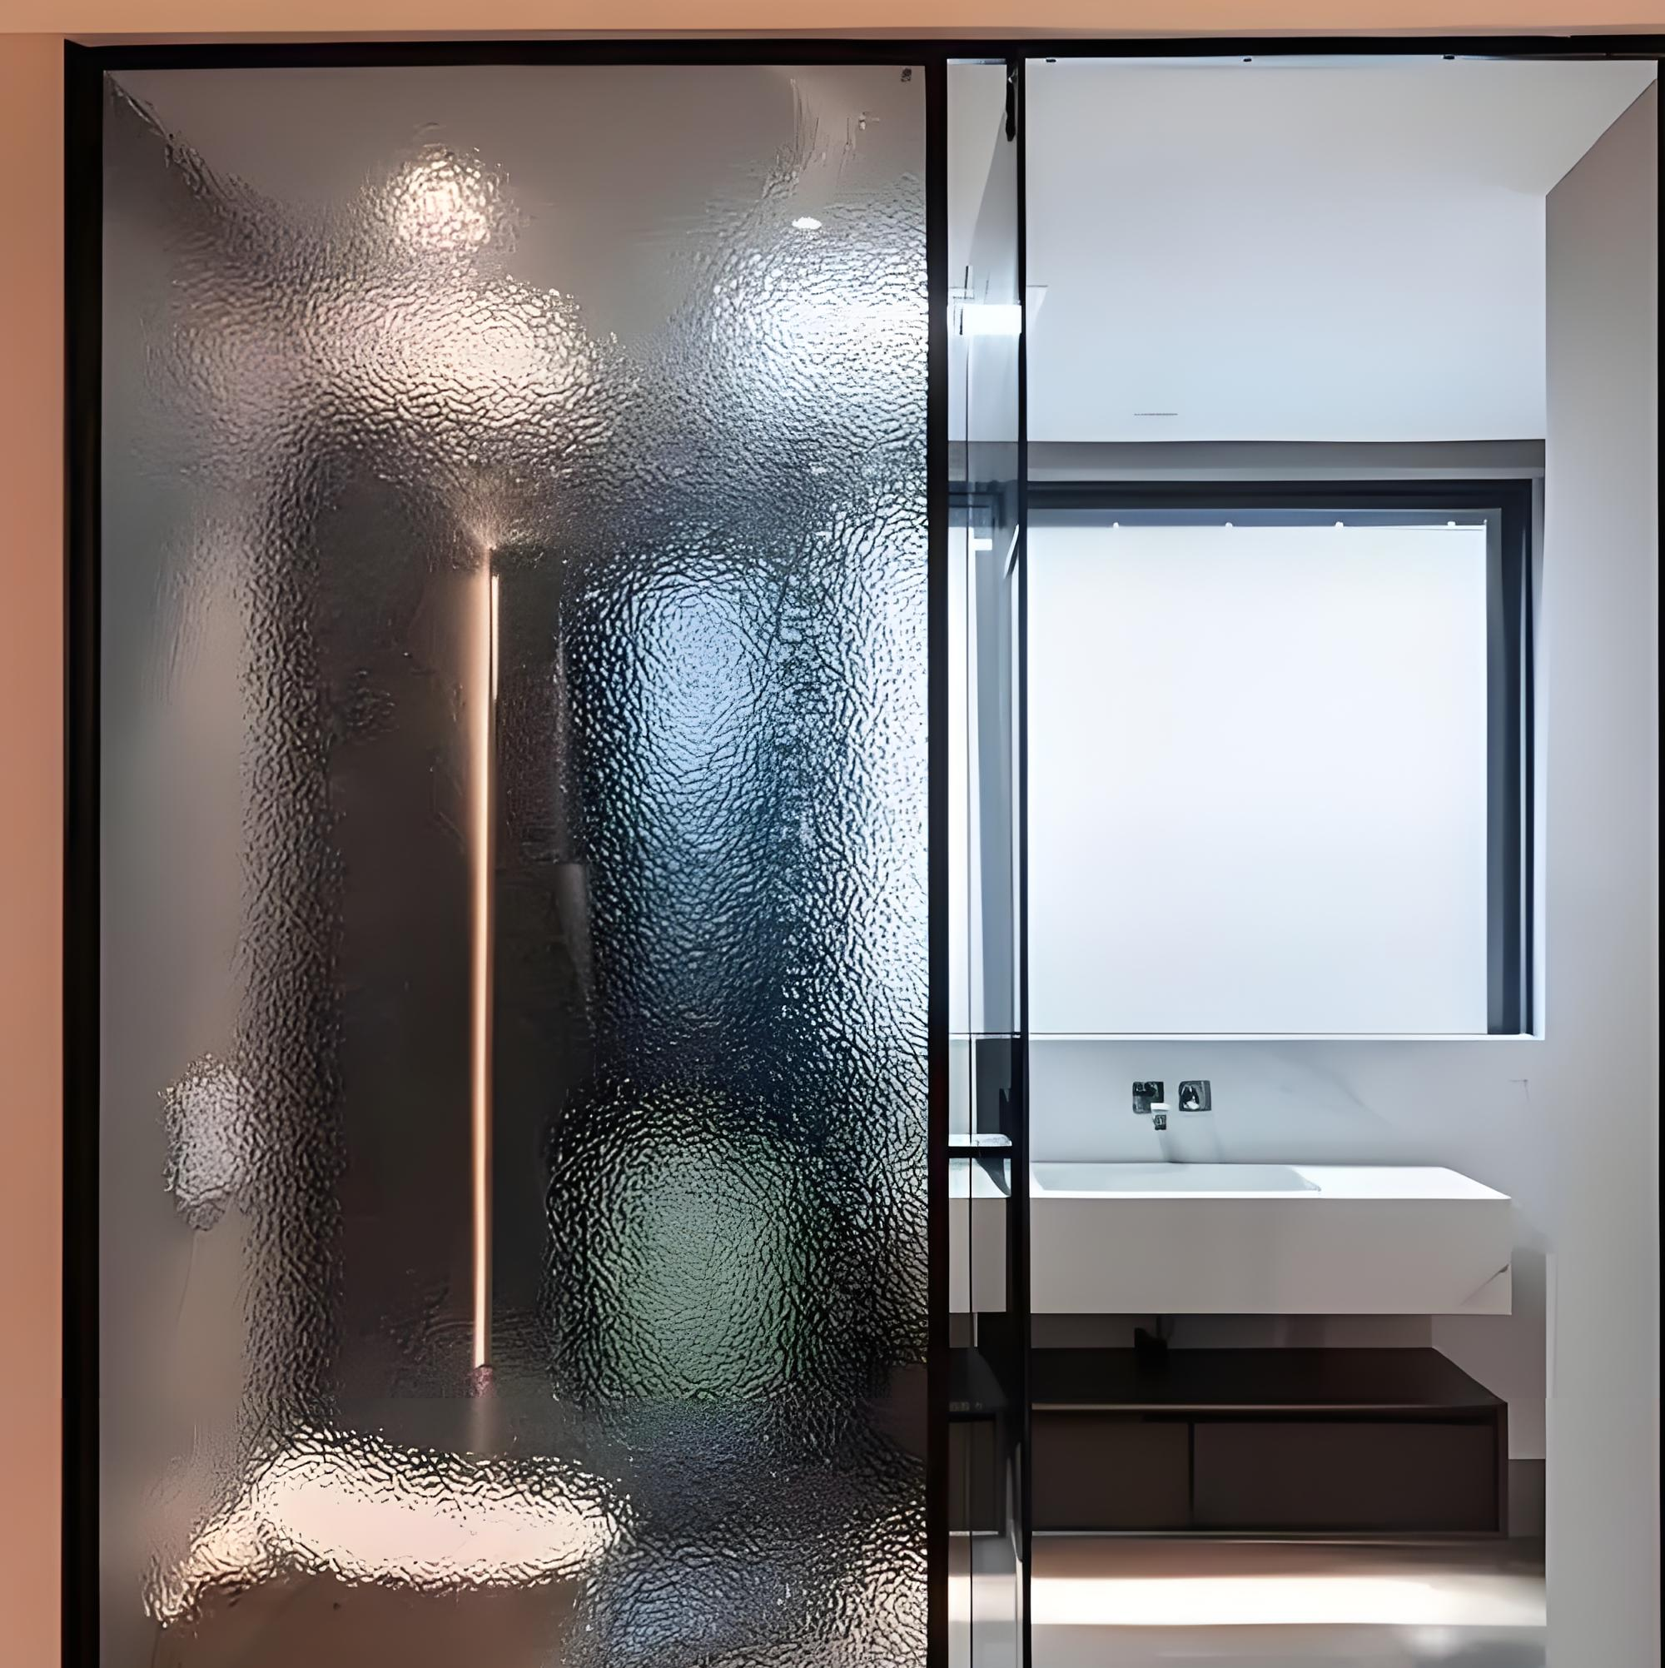
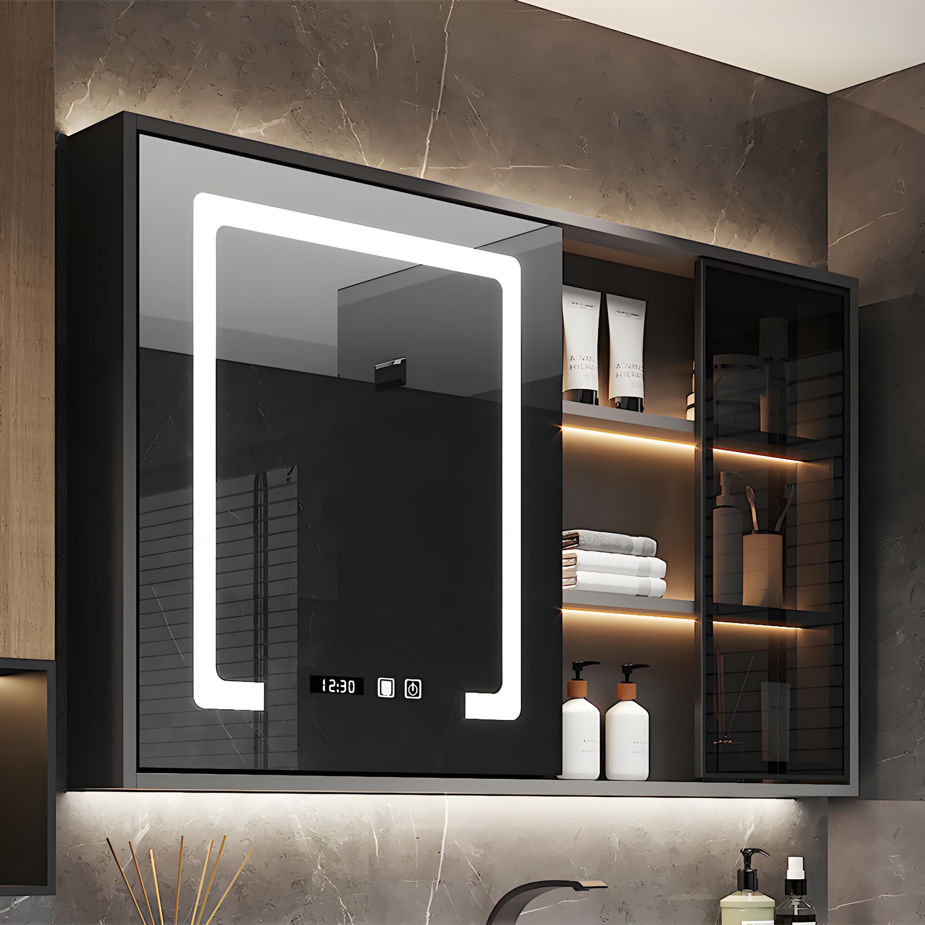
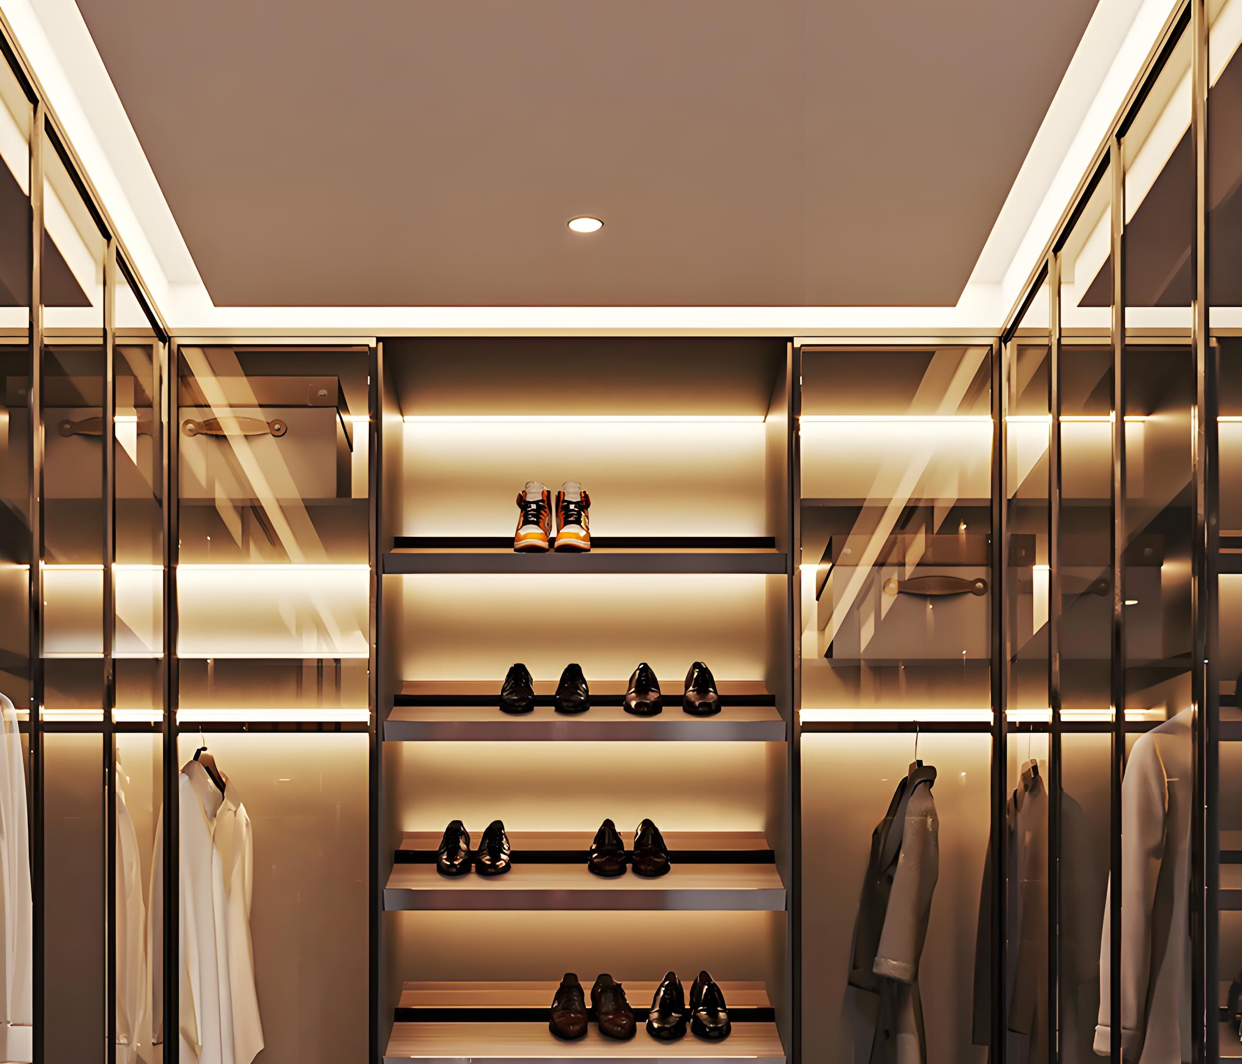
Hardware Introduction- Other hardware
Wardrobe Dehumidifier
Mirror Cabinet (Multifunctional intelligent mirror)
Glass Door: Aluminum frame glass door. Glass colors available: Black, White, Brown, Gray, and other customized colors
Lighting System: light strip, transformer, hand swept induction switch

Slide 11
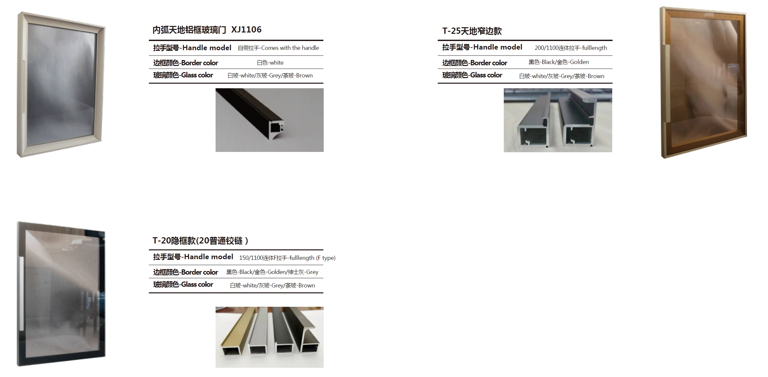
Details Introduction-Glass Door

Slide 12
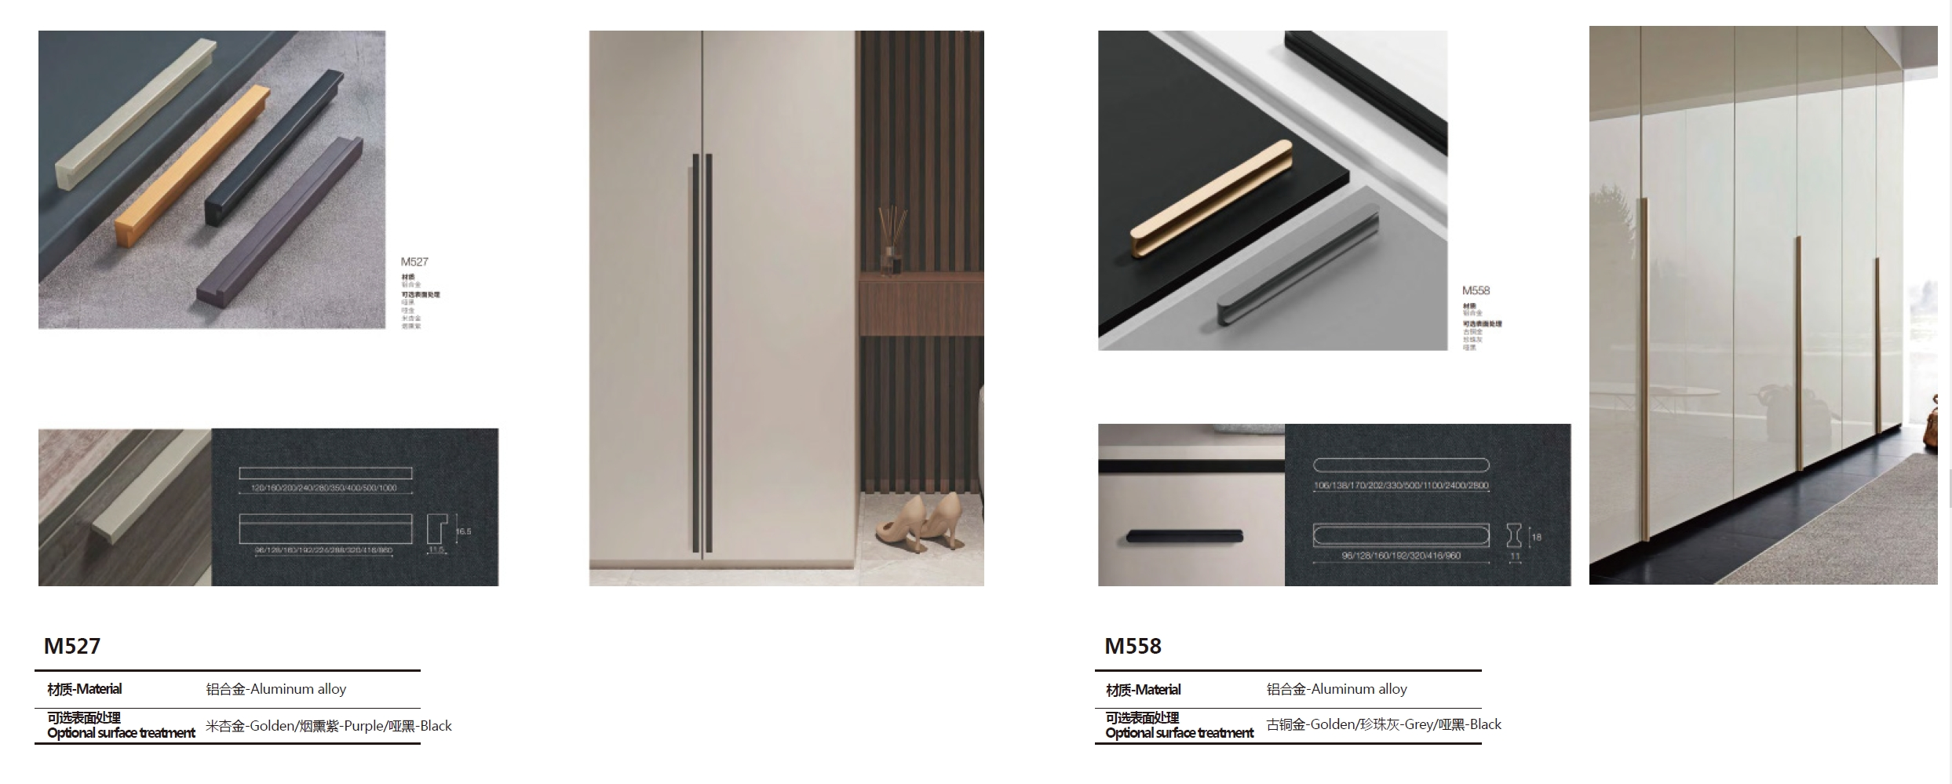
Details Introduction-Handle

Slide 13
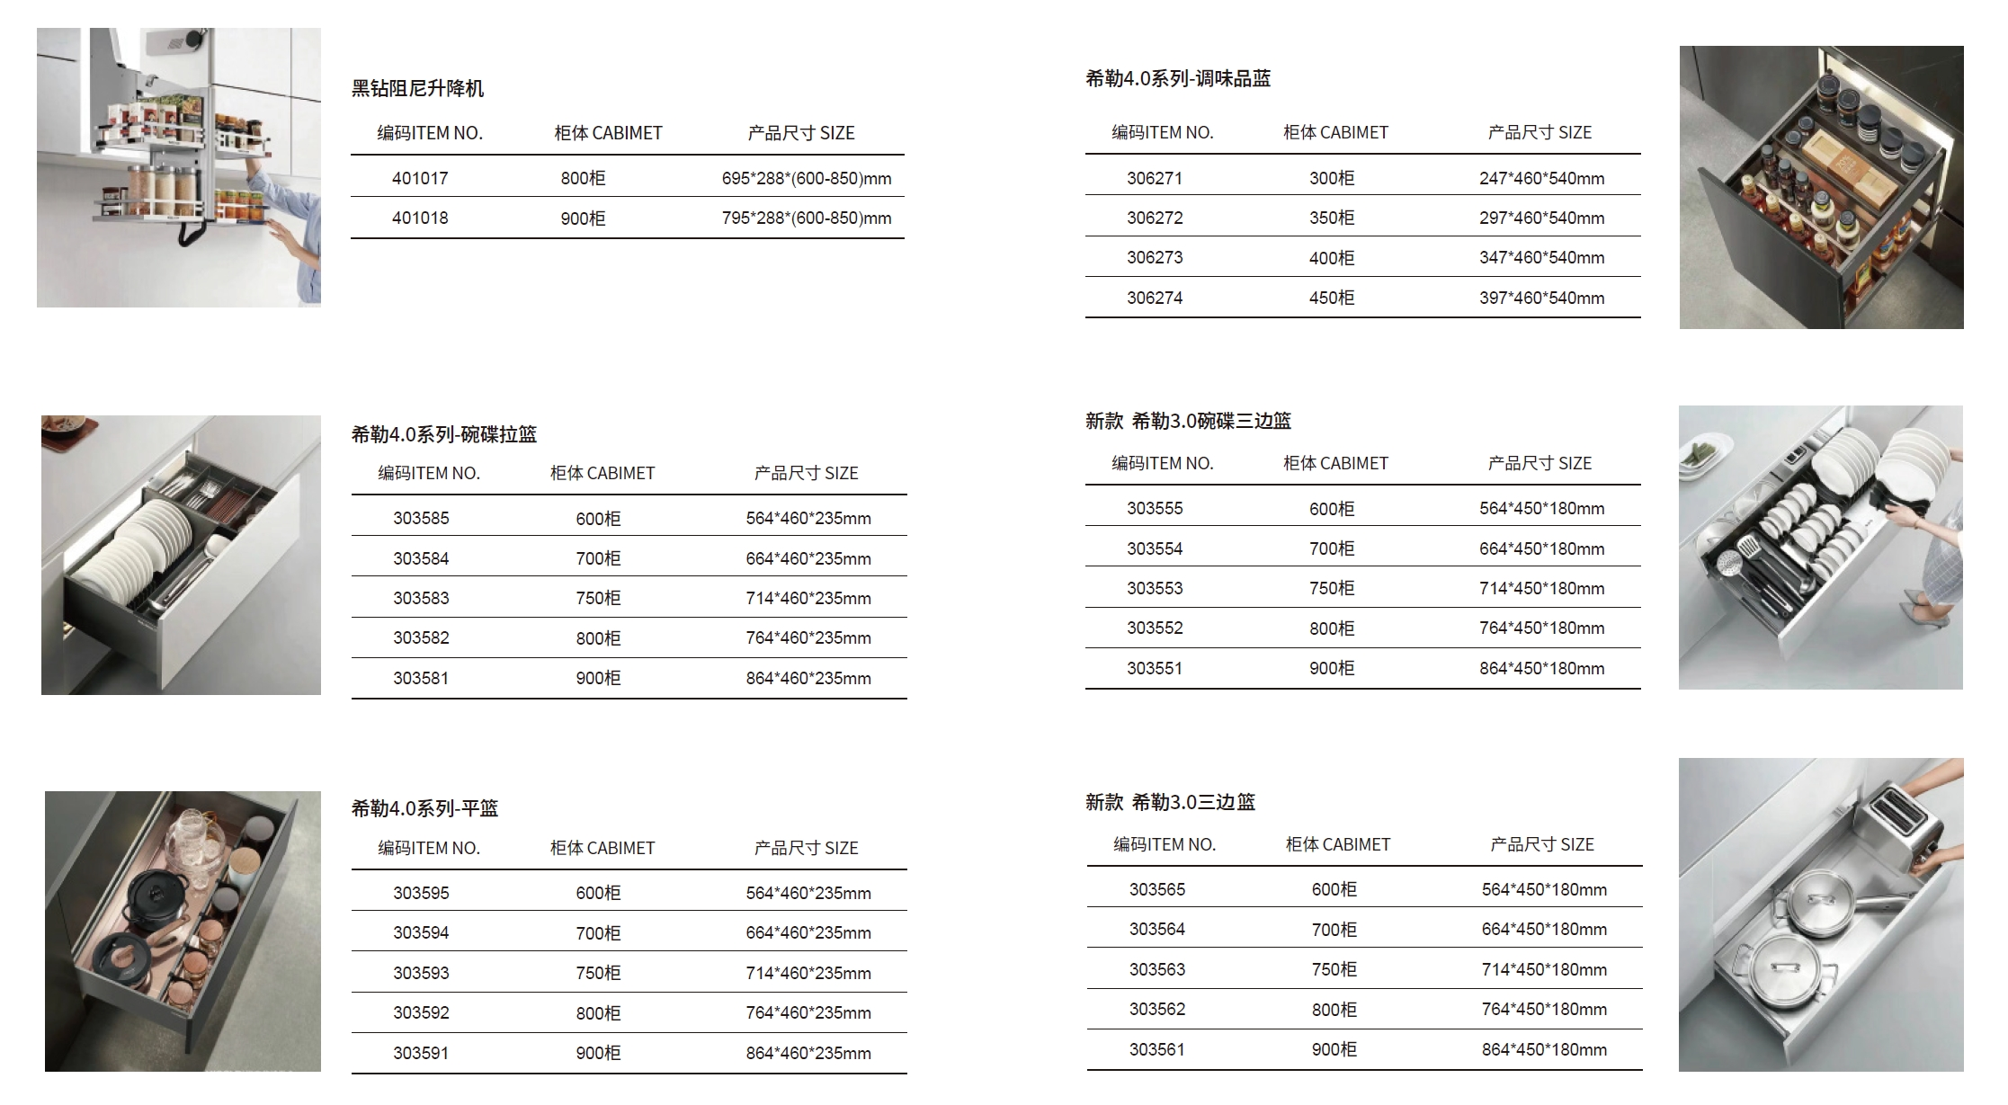
Details Introduction-Kitchen Hardware

Slide 14
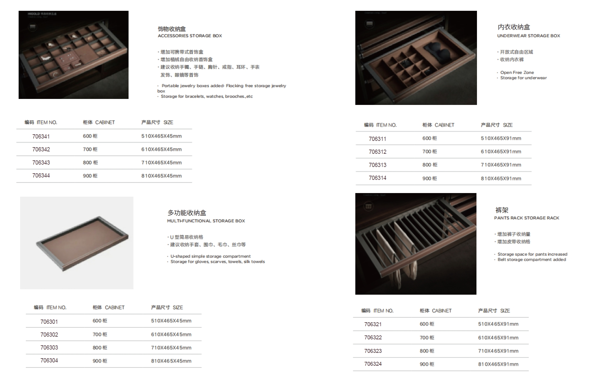
Details Introduction-Functional Hardware

Slide 15
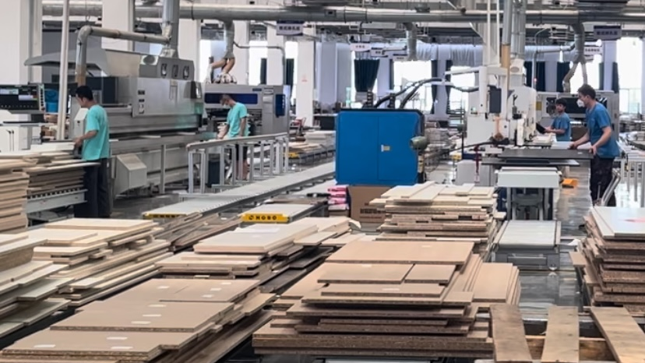
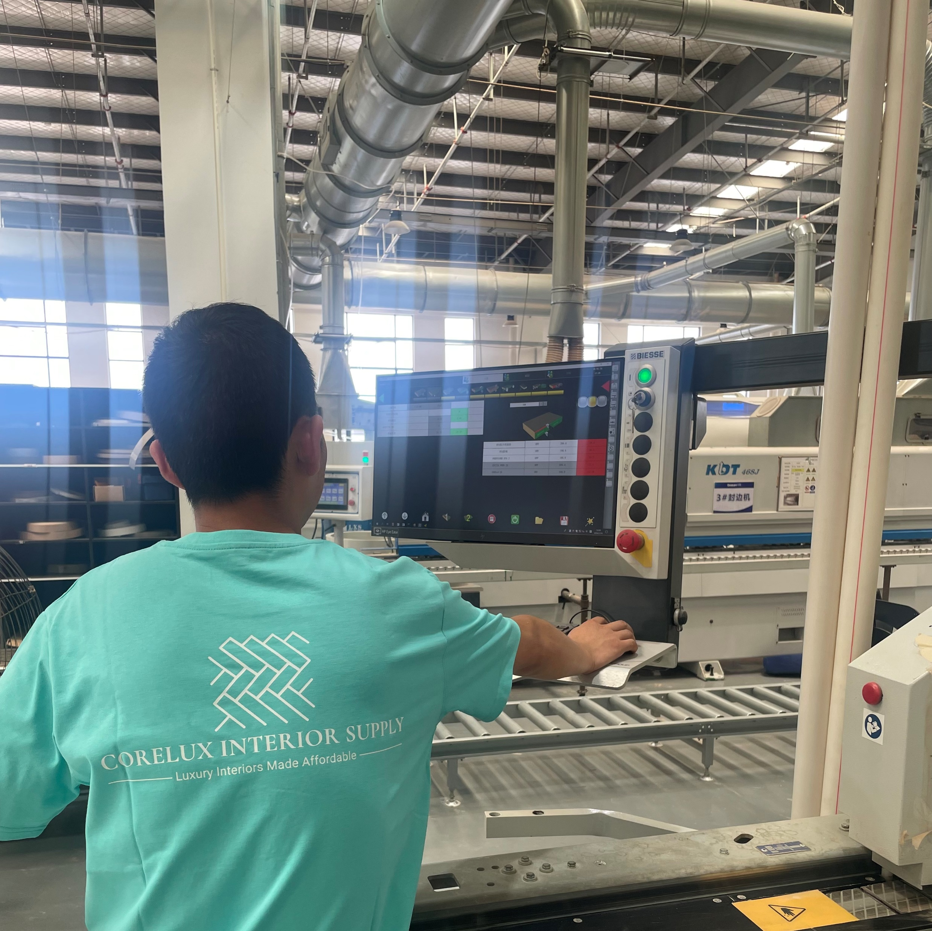
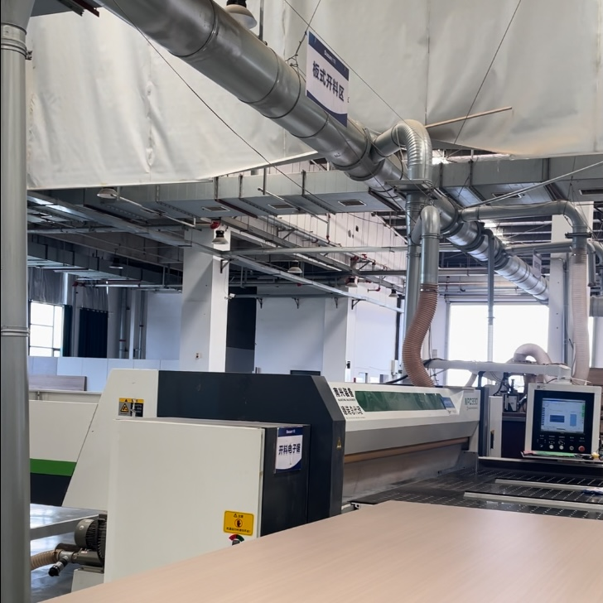
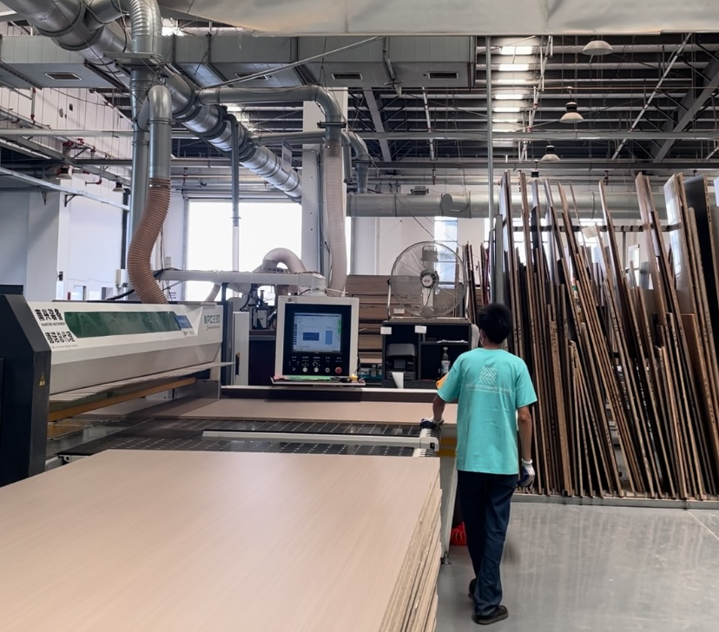
Our factory in China

Slide 16
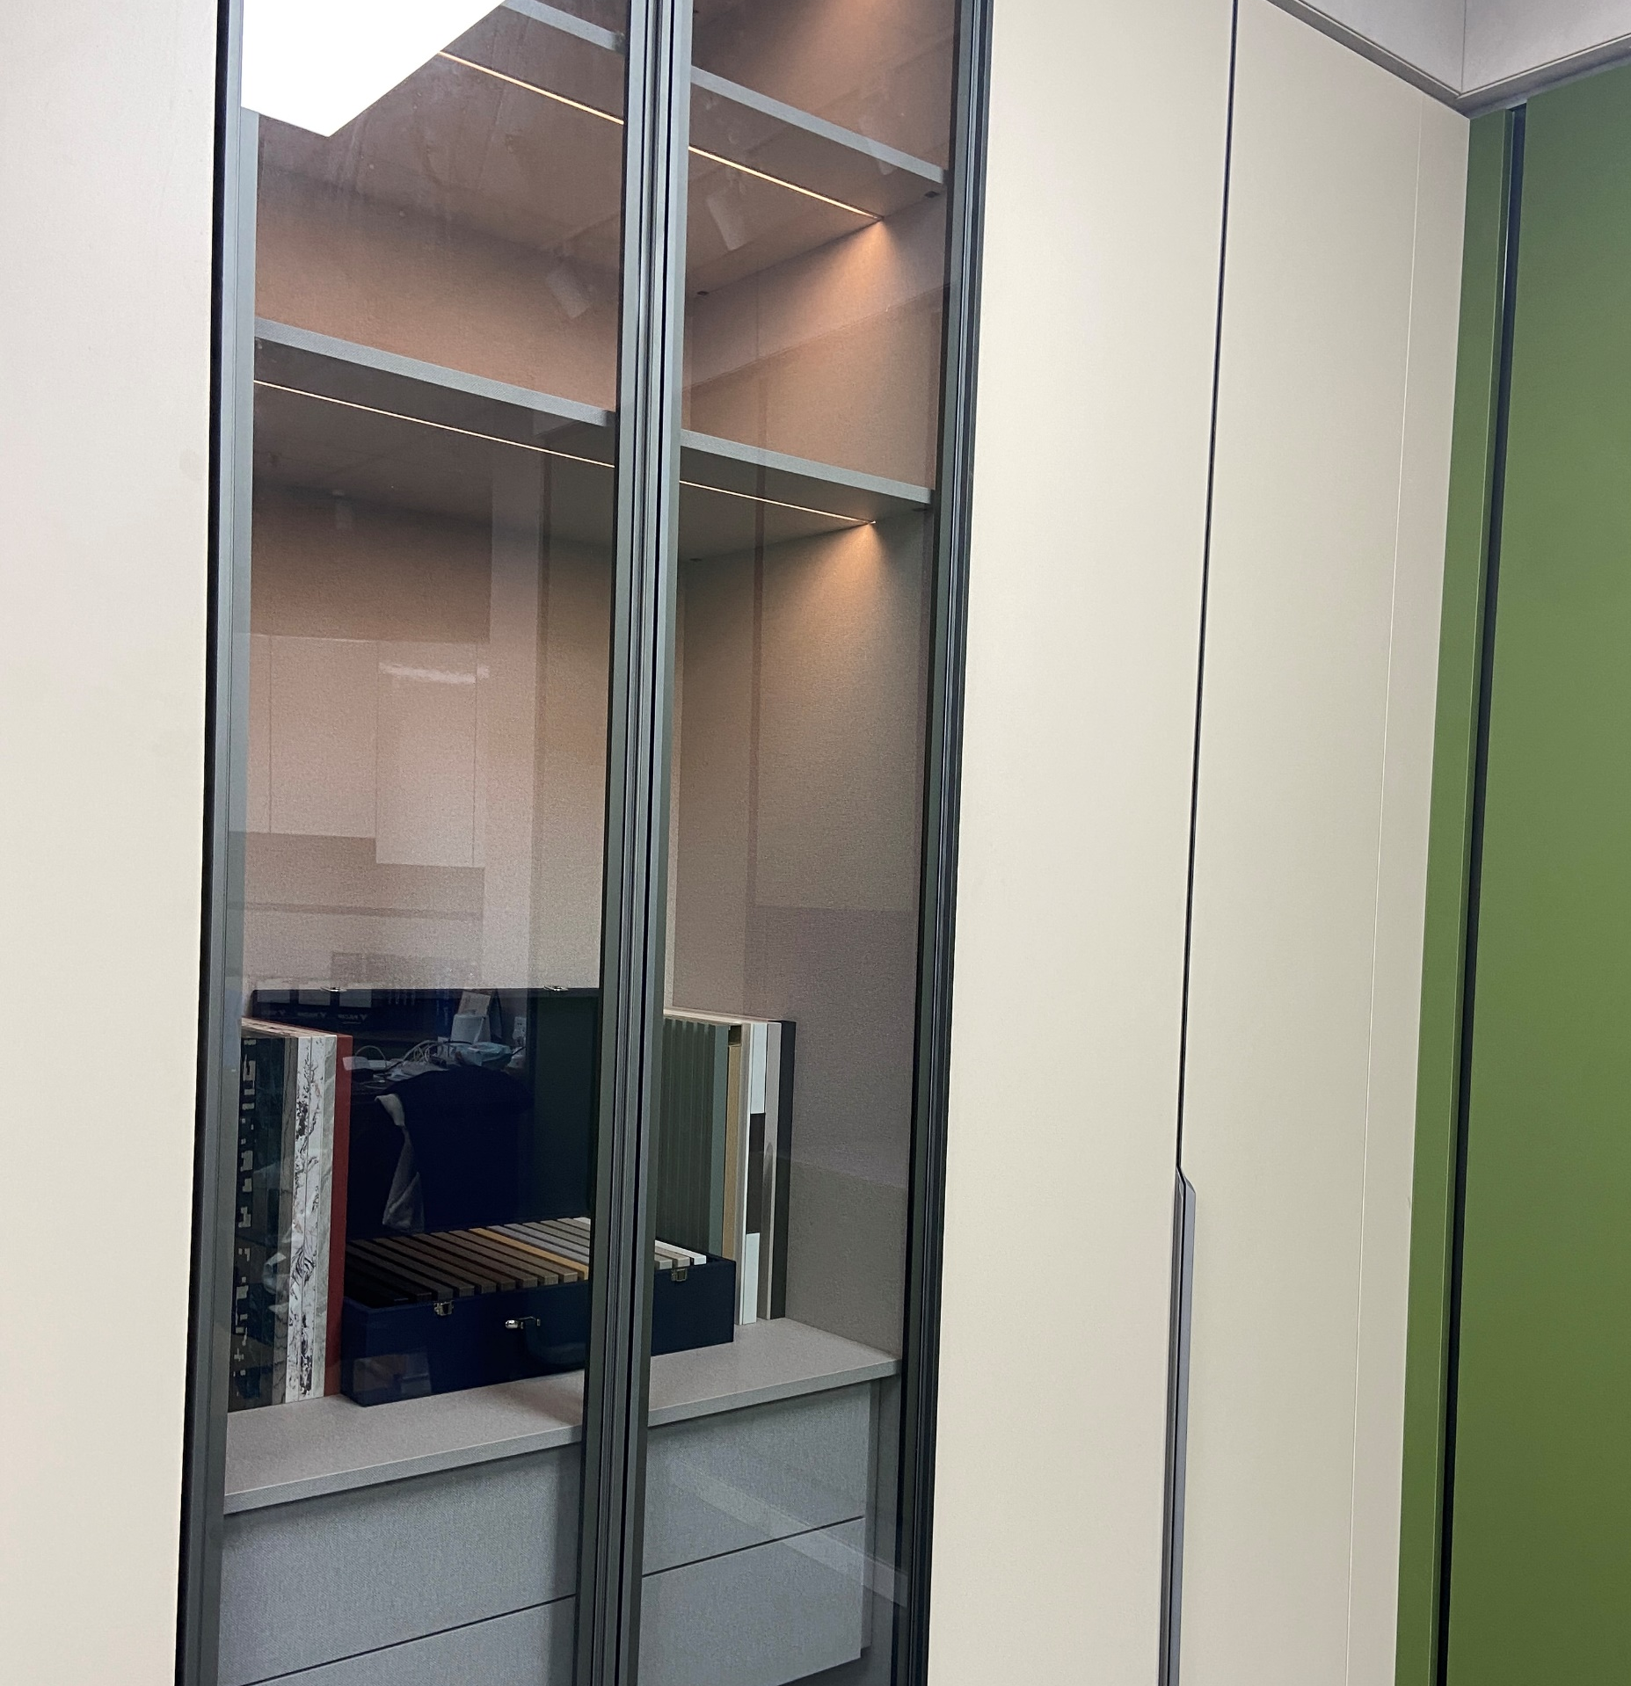
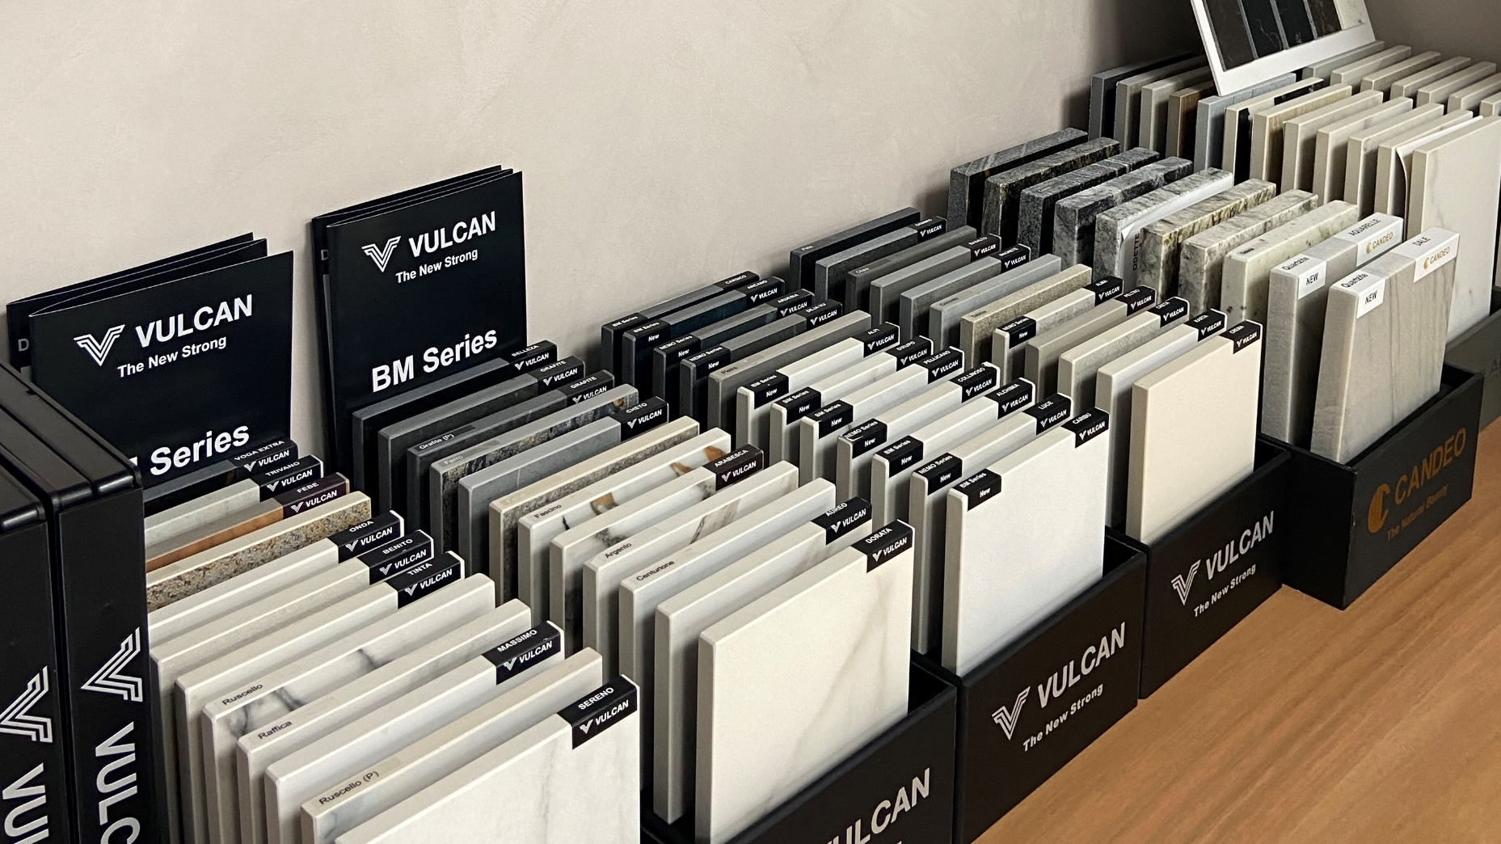
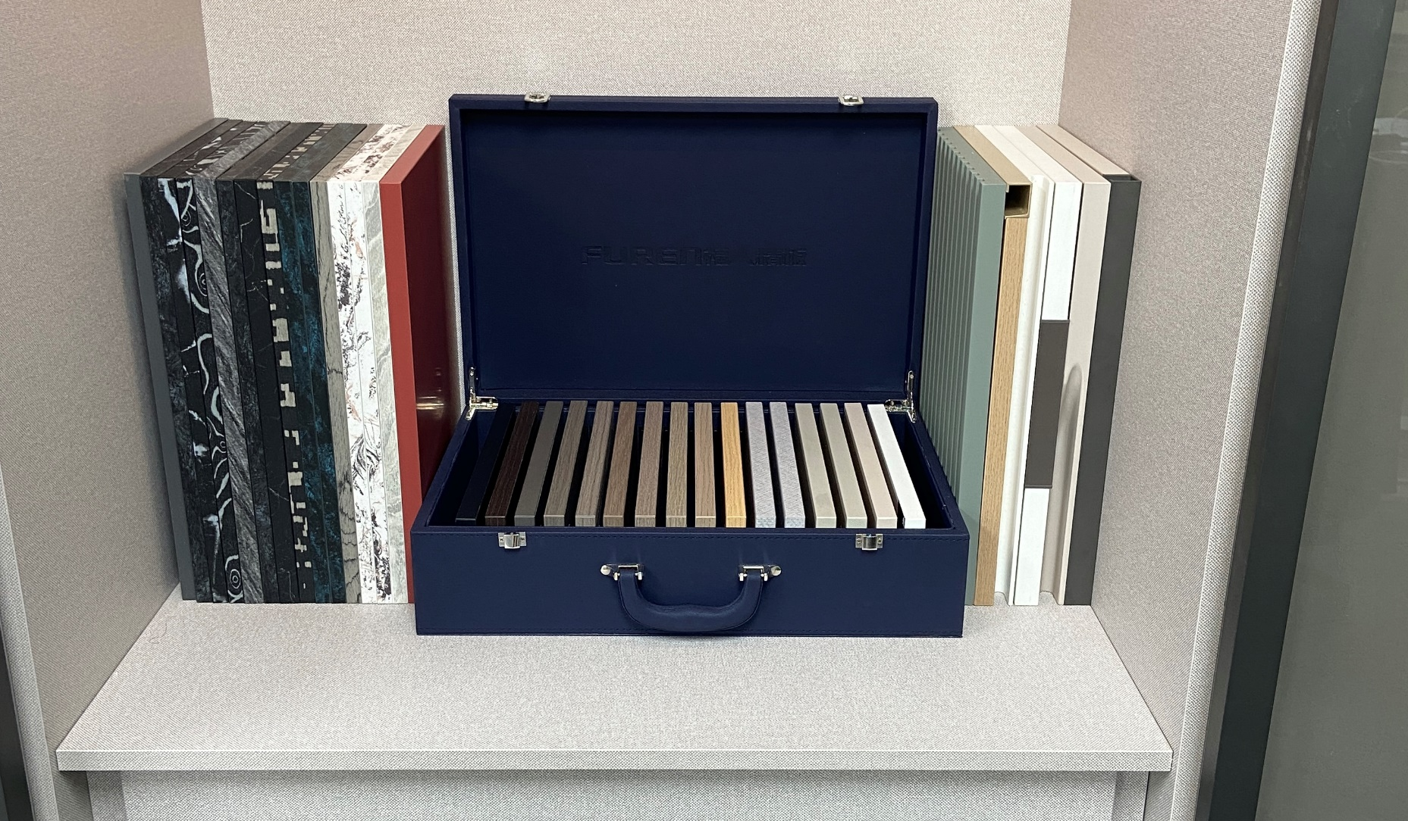
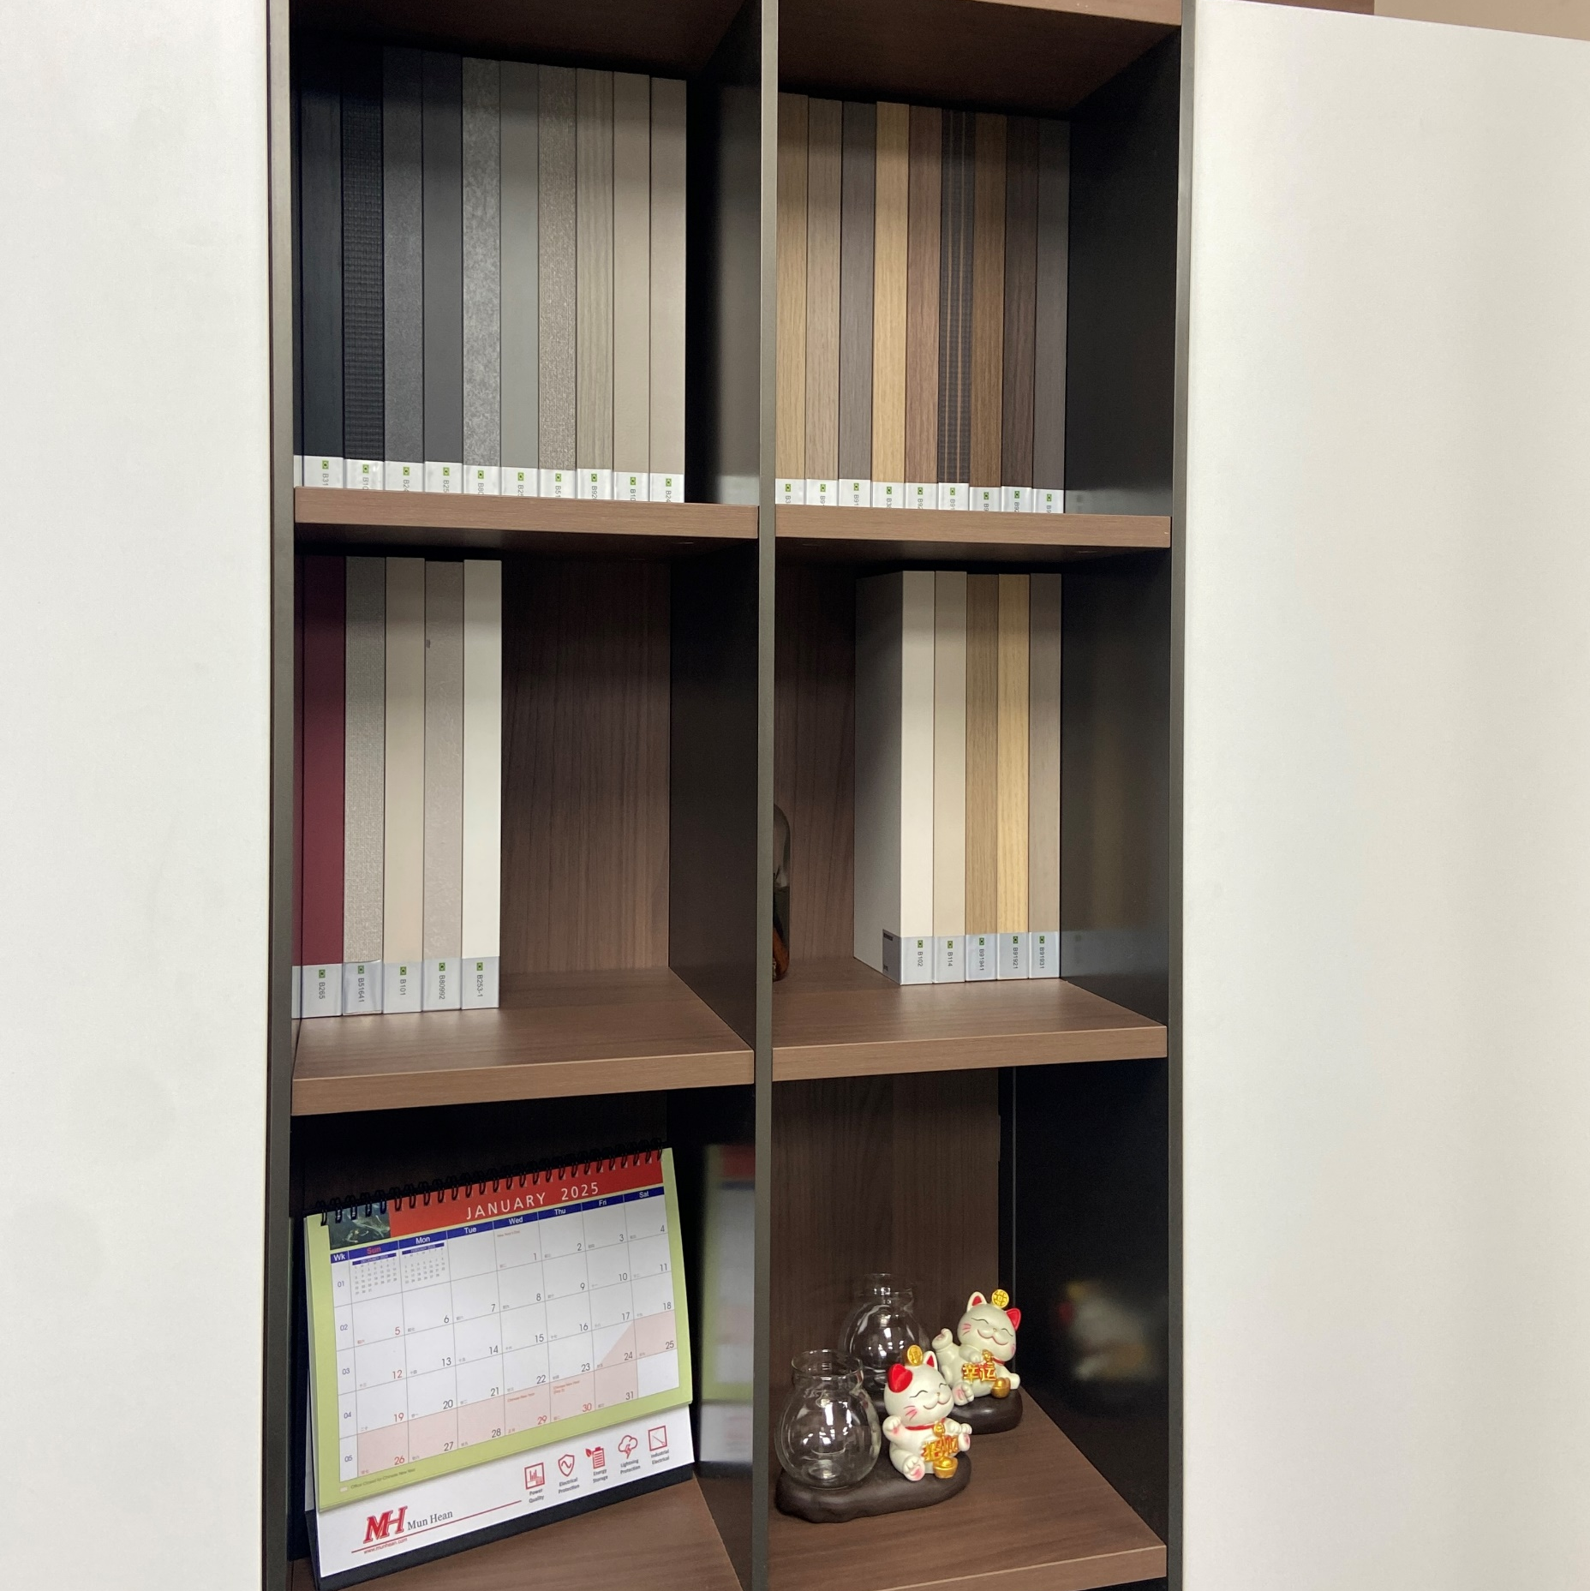
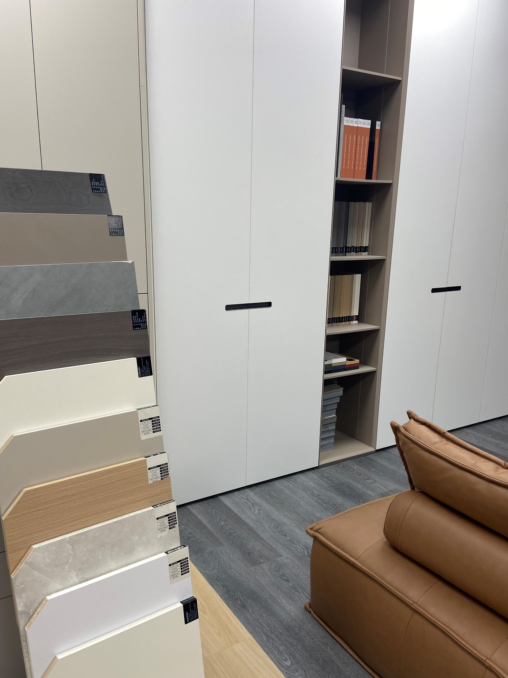
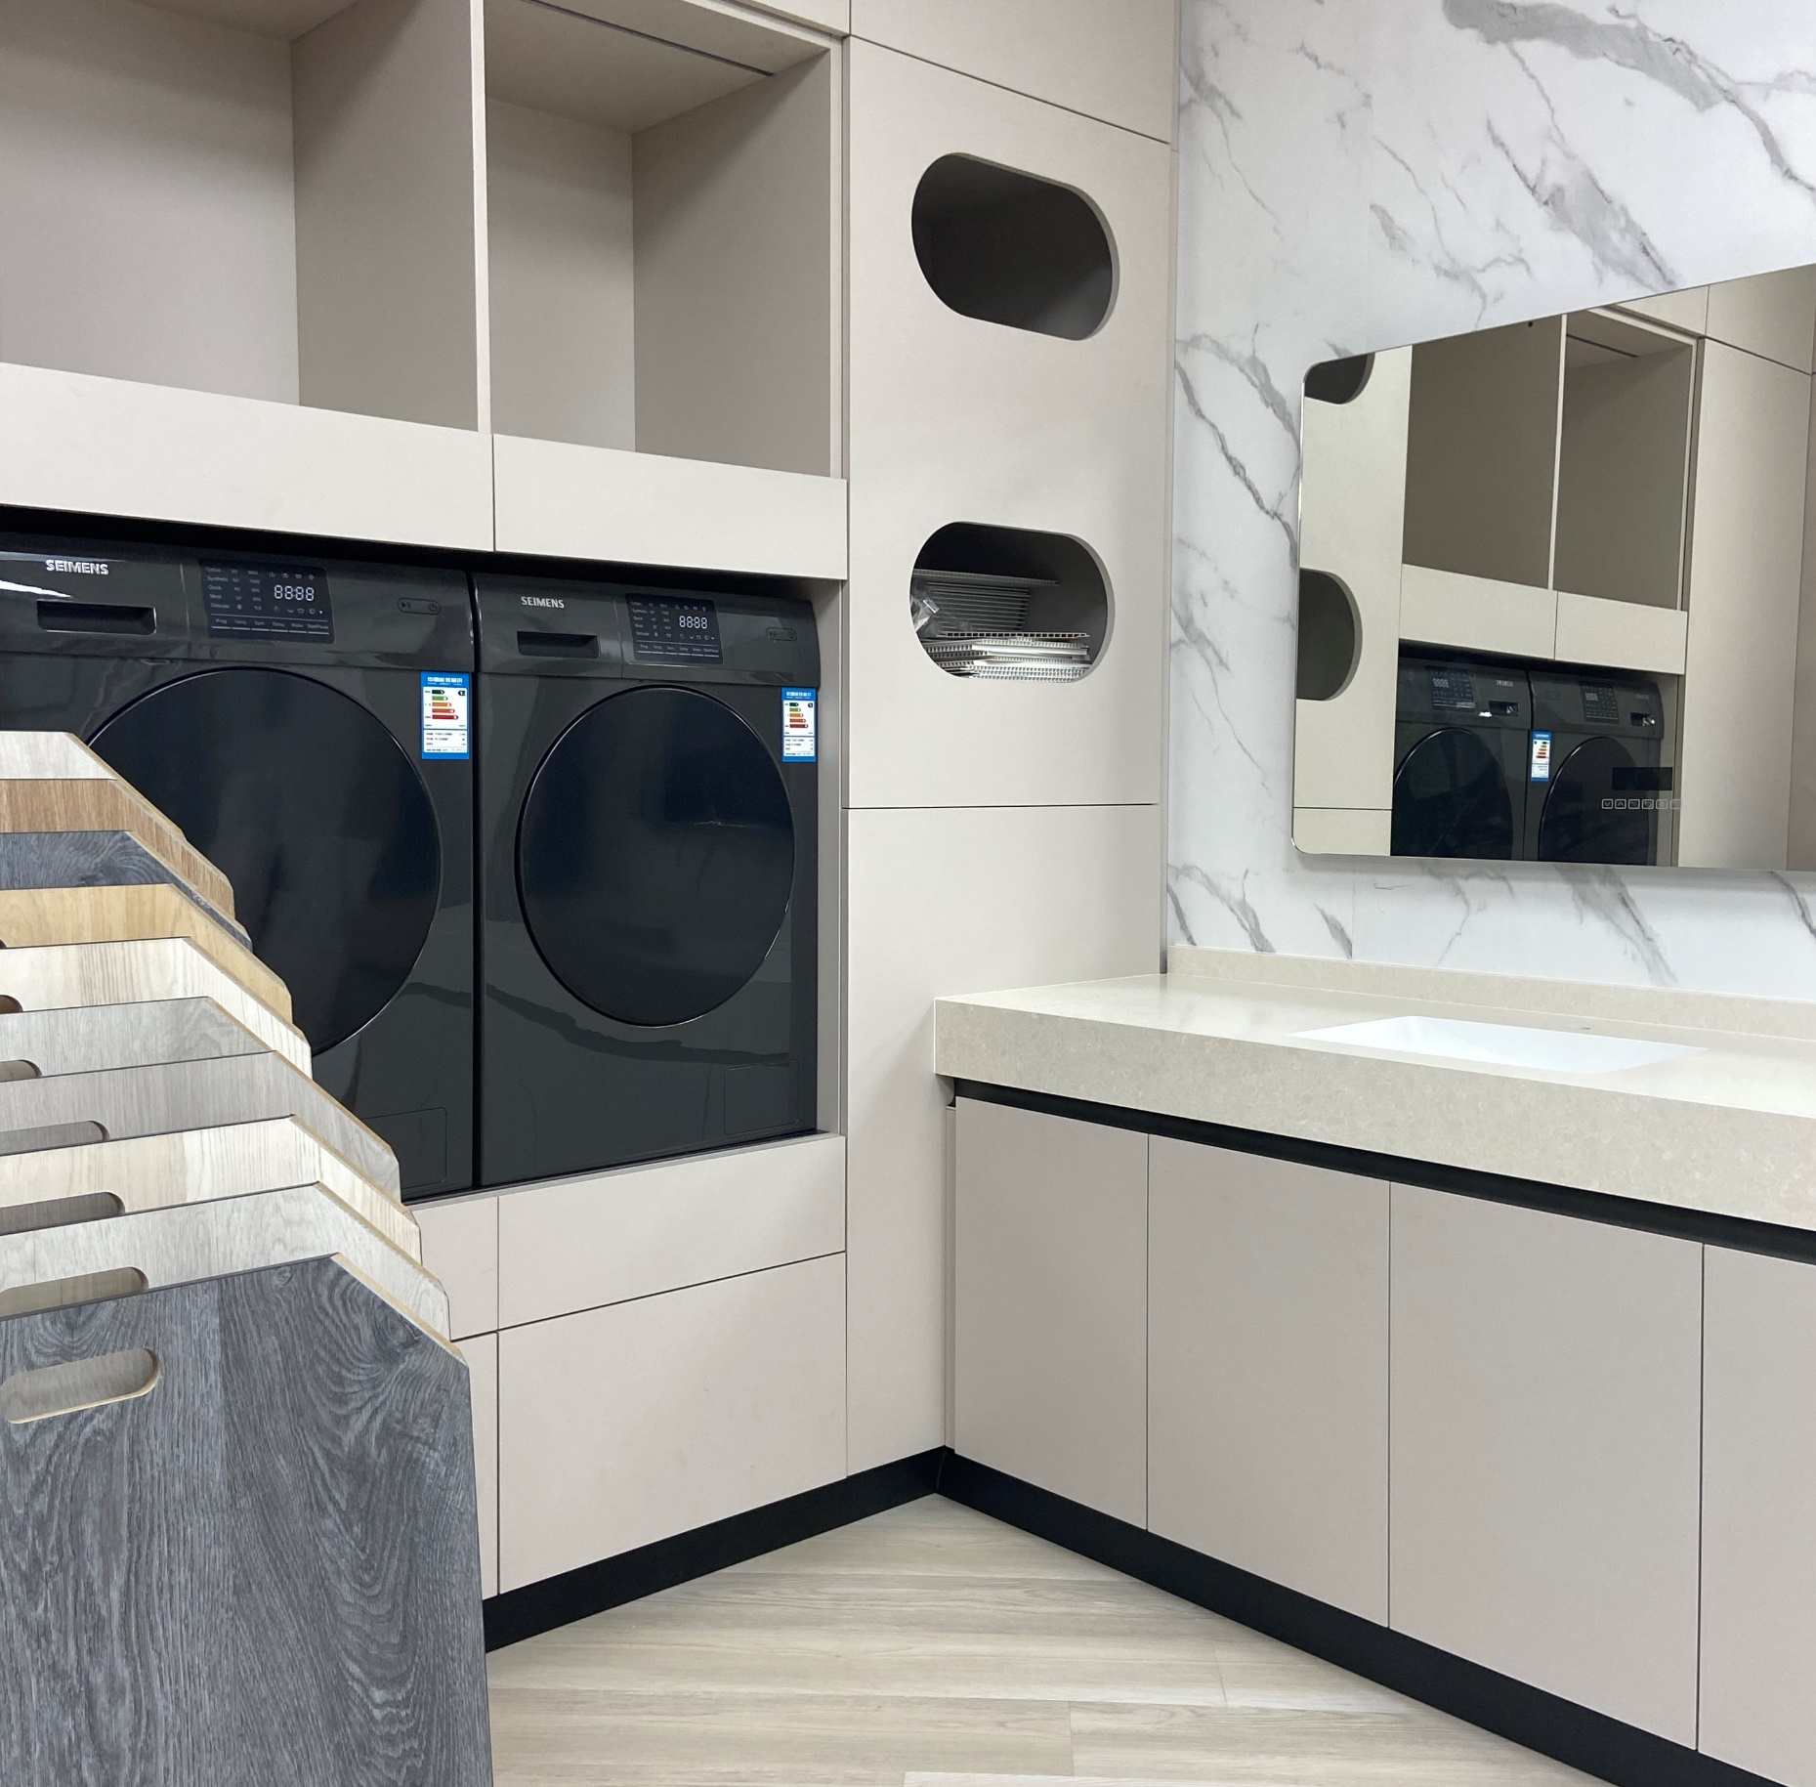
Our show room in Singapore

Slide 17
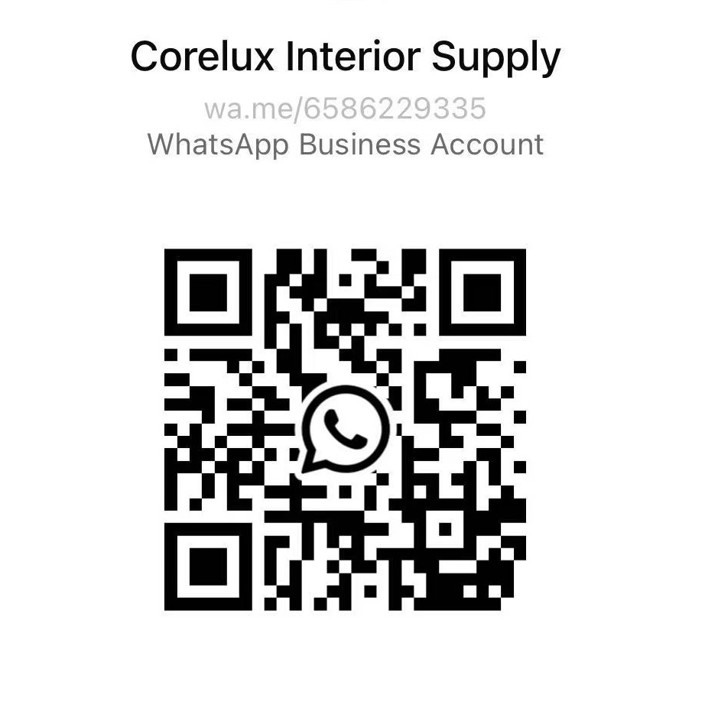
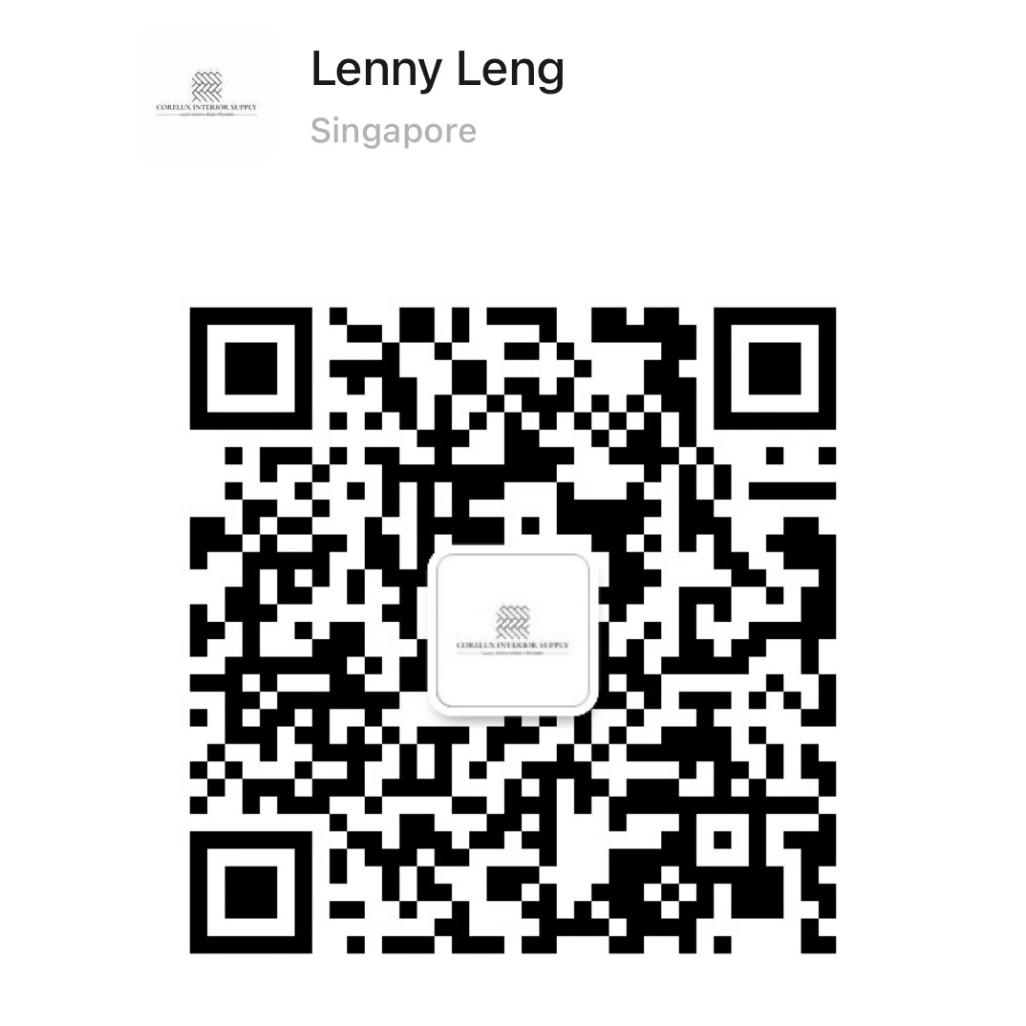
Contact Us
Show room Address: 2 Jurong East Street 21, #03-183 IMM Building, Singapore.
Contact Number: +65 8622 9335/+65 9896 6812
E-mail: coreluxinteriorsupply@gmail.com
Website: www.corelux.com.sg

