Slide 1
Story_combined
File created on: 7/22/24 4:54:36 PM GMT+8

Slide 2
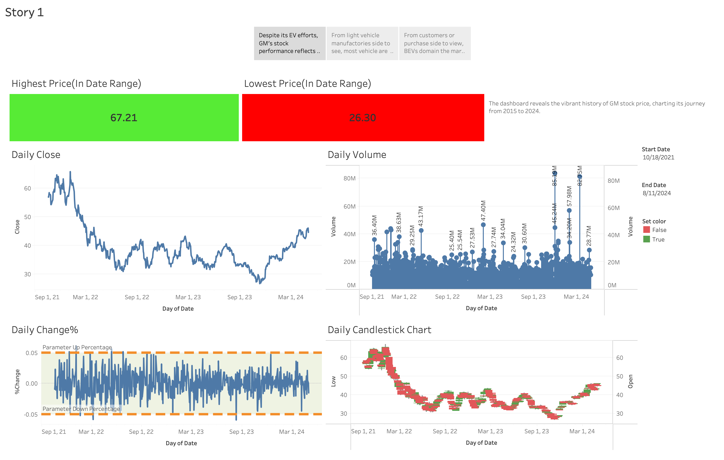

Slide 3
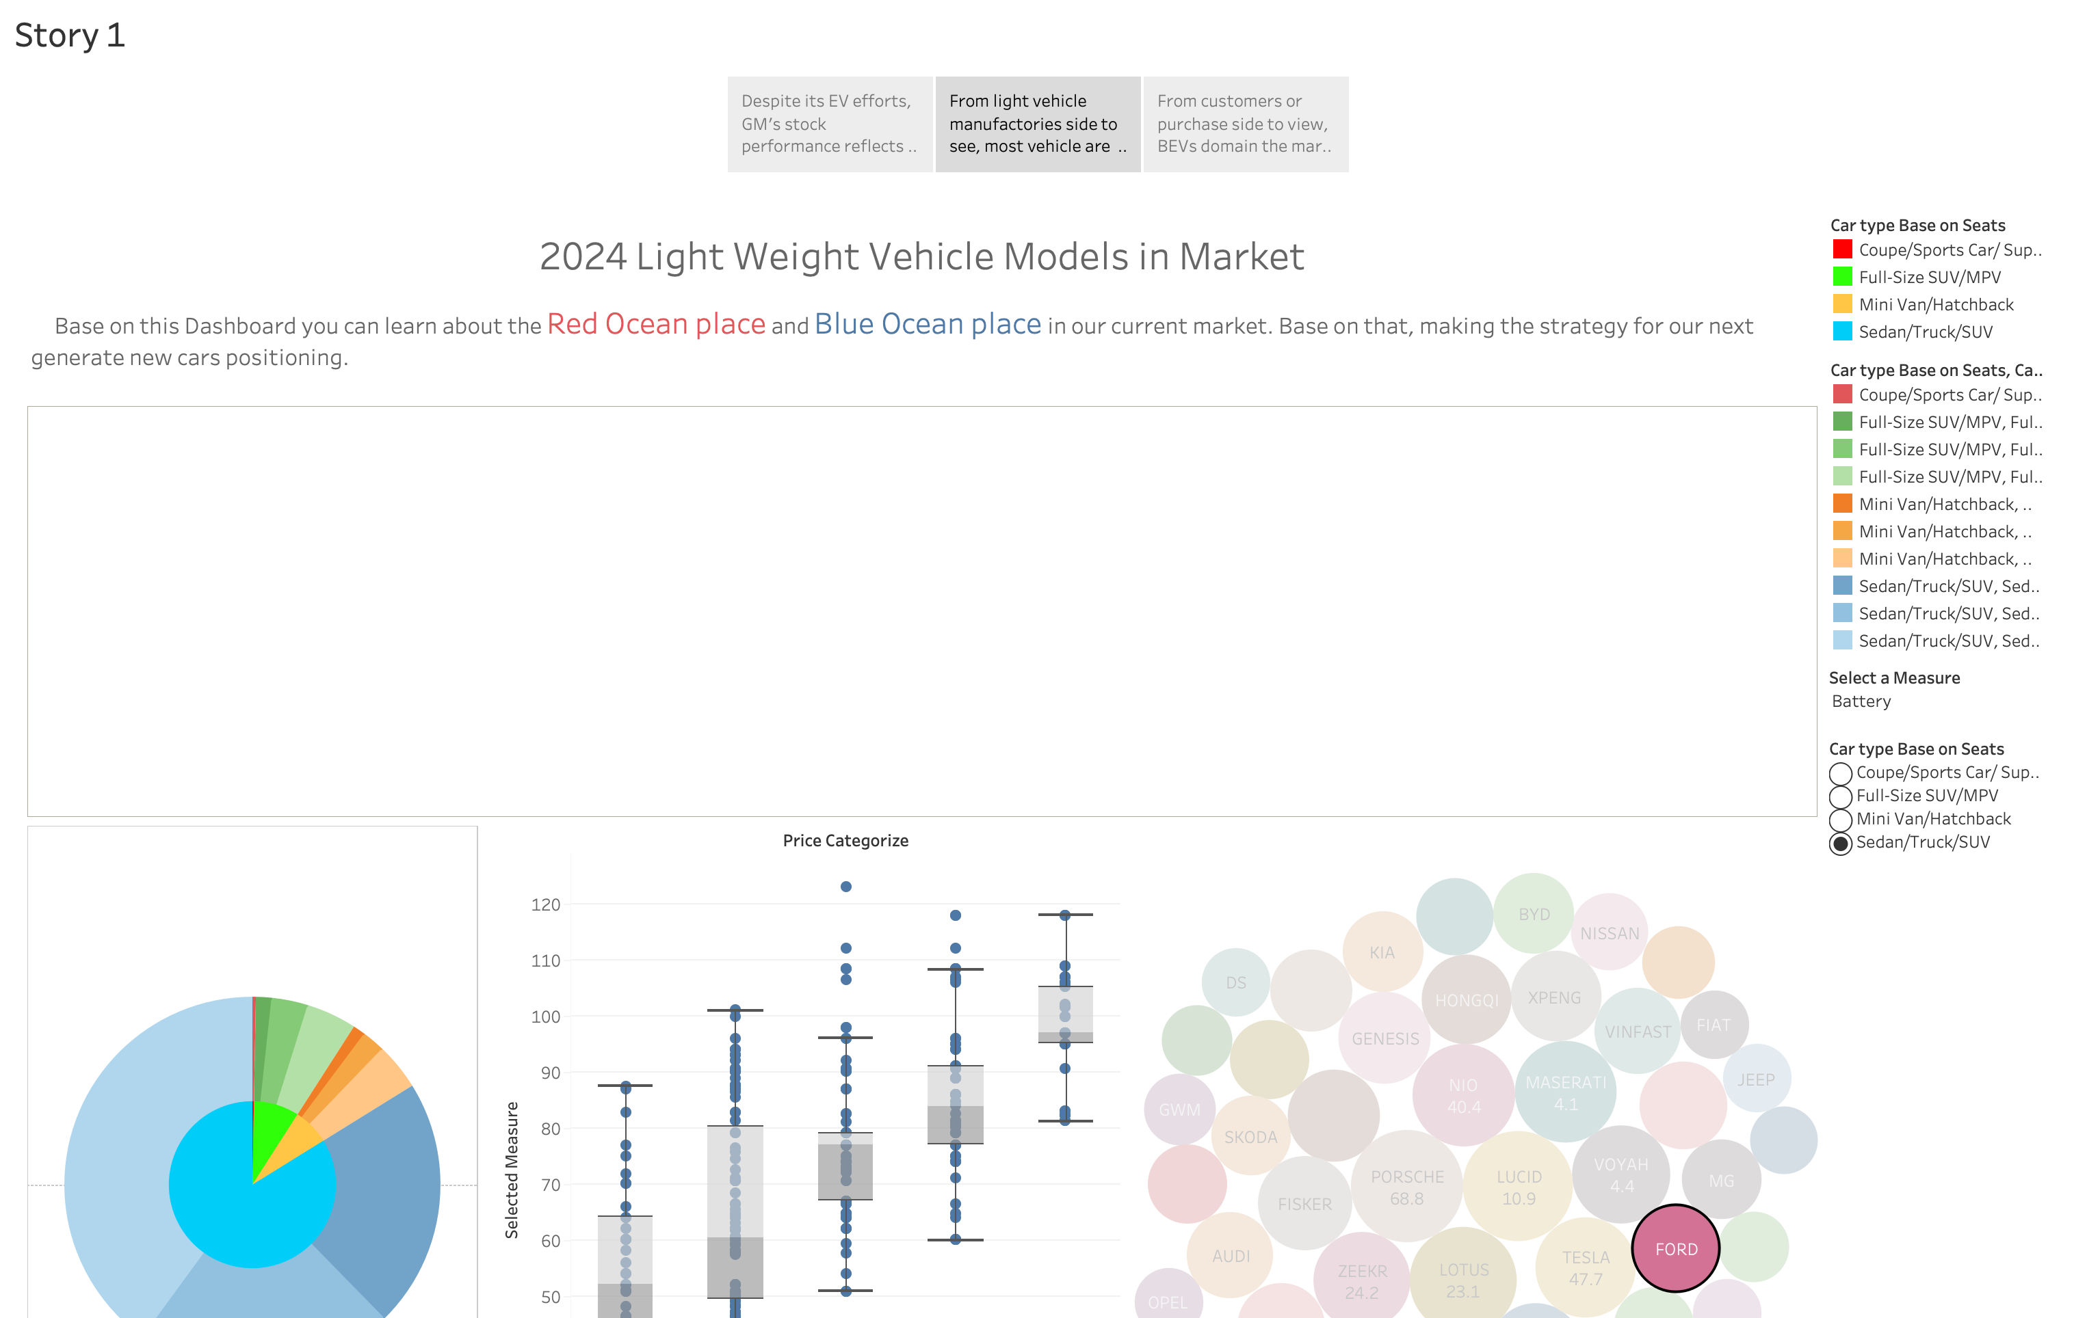

Slide 4
