Slide 1

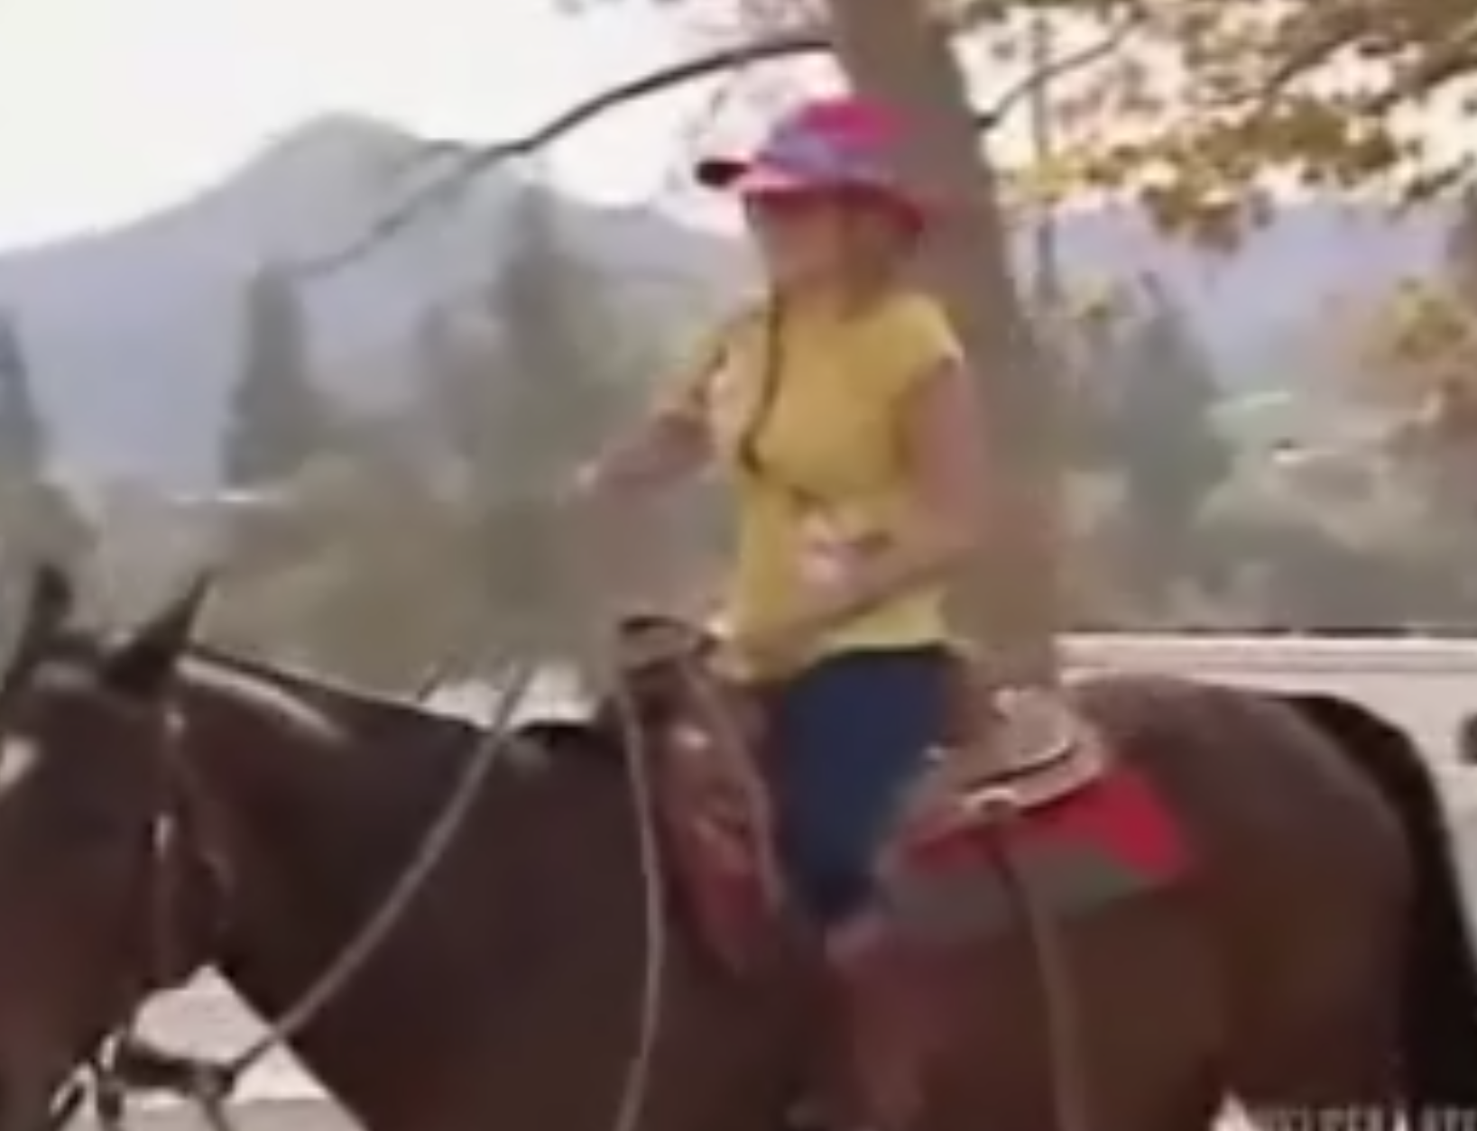
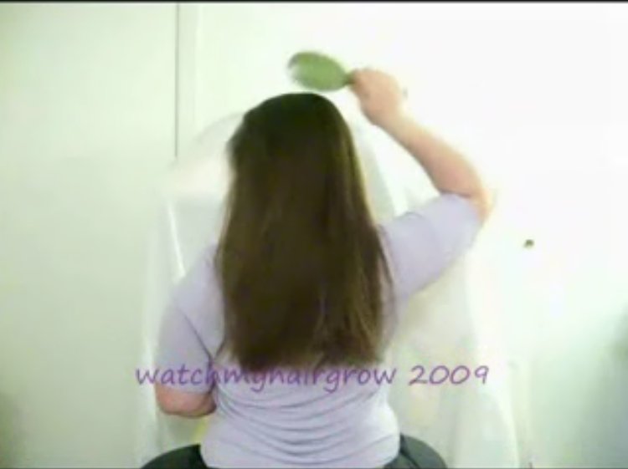
Supports Videos
Visual Encoder
Multi-Modal
Temporal Transformer
Brush hair
LLM
Enhanced
Text Encoder
Stage 1: a person raises a brush to their head
Stage 2: moves the brush through their hair repeatedly
Stage n: ……

Slide 2
Multi-Modal
Temporal Transformer
Layer
Norm

Slide 3
Video Frames
Stage 1: a person raises a brush to their head
Stage 2: moves the brush through their hair repeatedly
Stage n: ……

