Slide 1
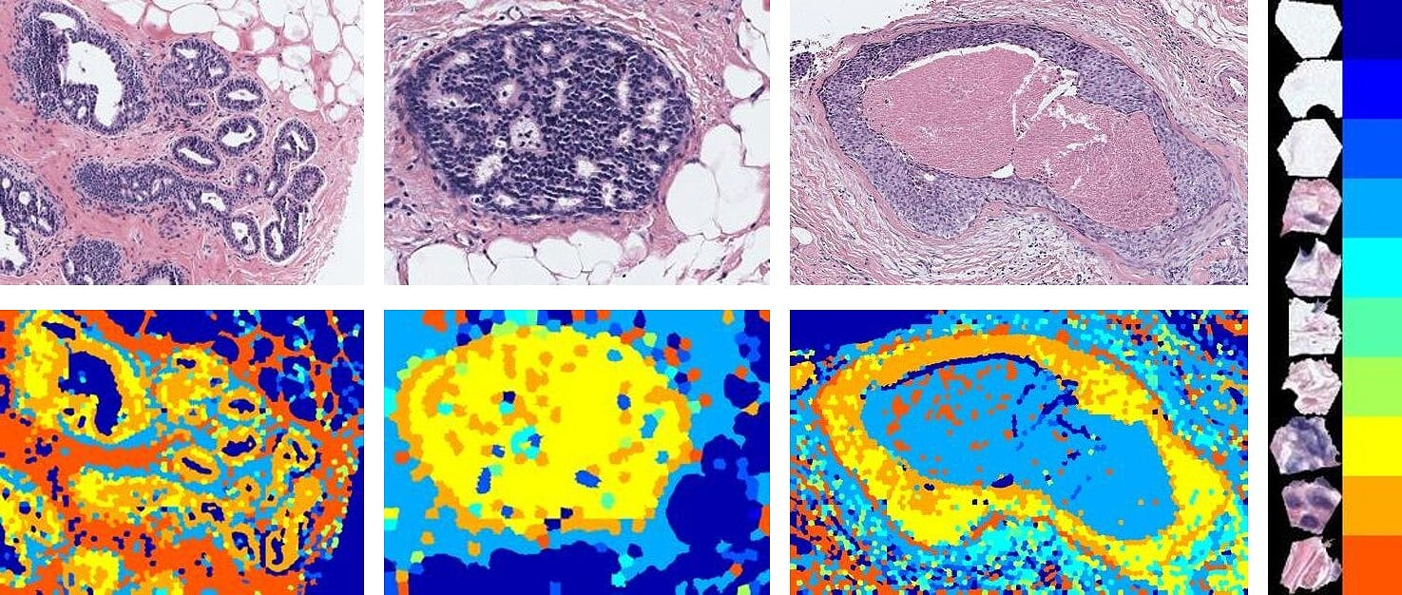
Machine Learning with Applications in Biomedical Imaging
Ezgi Mercan

Slide 2
Machine Learning

Slide 3



General ML Pipeline
Data
Feature Extraction
Features
$$𝒳$$
Model
$$𝓎$$
ML Algorithm
$𝒳$, $𝓎$
Evaluation
Performance

Slide 4
Unsupervised Machine Learning

Slide 5
Histopathology Example
Feature extraction
k-means
Hierarchical clustering

Slide 6
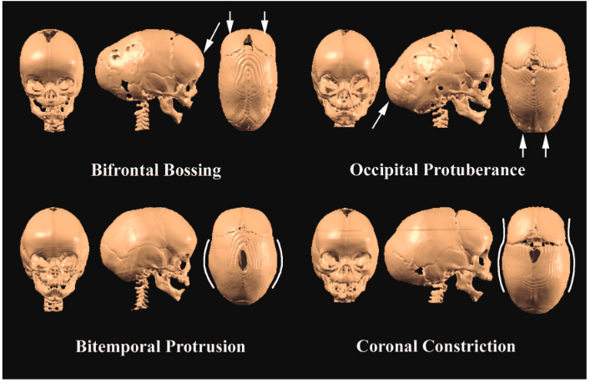
Craniofacial Example
Sagittal craniosynostosis subtypes

Slide 7
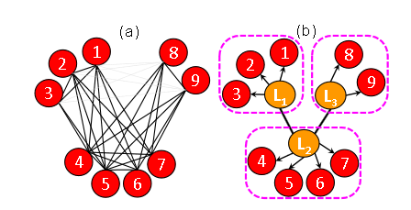
Computational Biology Example
MGL / gene pathways

Slide 8
Supervised Machine Learning
Concepts of training/test/validation sets
Training error / Test error
Overfitting
Evaluation metrics
Parameter / model selection

Slide 9
Regression
Linear regression
LASSO / dimensionality reduction / feature selection
Fit / significance / interpretations

Slide 10
Cleft Example
Modeling the impact of cleft severity on nose deformity

Slide 11
Cranial Growth Example
Predicting landmark location based on age
Dimensionality reduction + noise removal with PCA

Slide 12
Classification
Logistic Regression
SVM
K-nearest neighbor
Decision trees
Neural networks

Slide 13
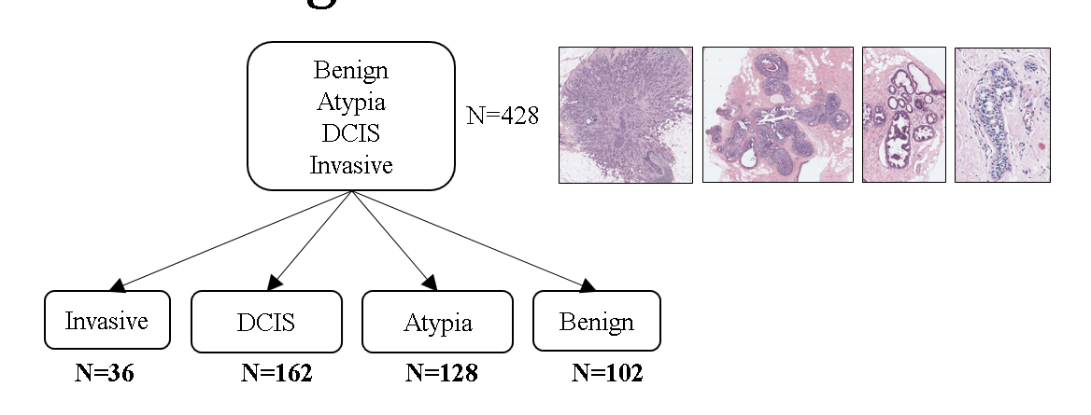
Histopathology Example

Slide 14
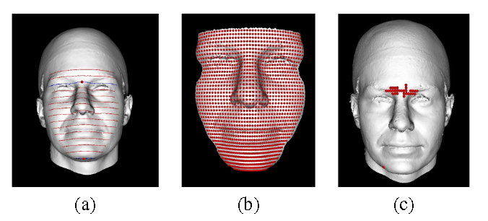
FaceBase Example
LASSO
Feature selection embedded in the model

Slide 15
(Deep) Neural Nets
Why all the rage
GPU / training requirements
Data
Fine-tuning a pre-trained one

Slide 16
Convolutional Neural Nets
Images
Remind convolution
Visual cortex analogy
Re-purposing pre-trained ones

Slide 17
Interpretability

Slide 18
Trade-offs
Model complexity
Show how kNN beats some complex models
Interpretability
Evaluation pitfalls
Data requirements, noise

