Slide 1
Homework 1
Titanic disaster analysis

Slide 2
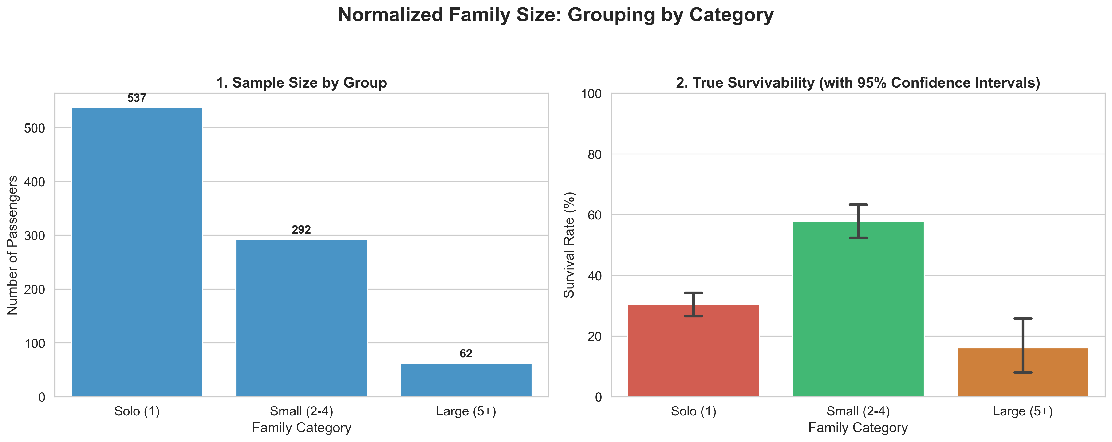
The Family Size Paradox: Were families safer?
The Solo Risk: Over 60% of passengers traveled alone, but they faced a low ~30% survival rate.
The "Sweet Spot": Small families (2-4 people) had the highest survivability at 57%.
The Large Family Trap: Survival plummeted to 16% for families of 5 or more.
Statistical Certainty: 95% Confidence Intervals confirm this is a ship-wide trend, not a small-sample fluke.

Slide 3
Survival heavily favored small, agile groups. Solo travelers lacked help and faced a low 30% survival rate, while massive families acted as fatal anchors, perishing together when they couldn't find enough lifeboat seats. The absolute "sweet spot" for survival was a small family of two to four people.

Slide 4
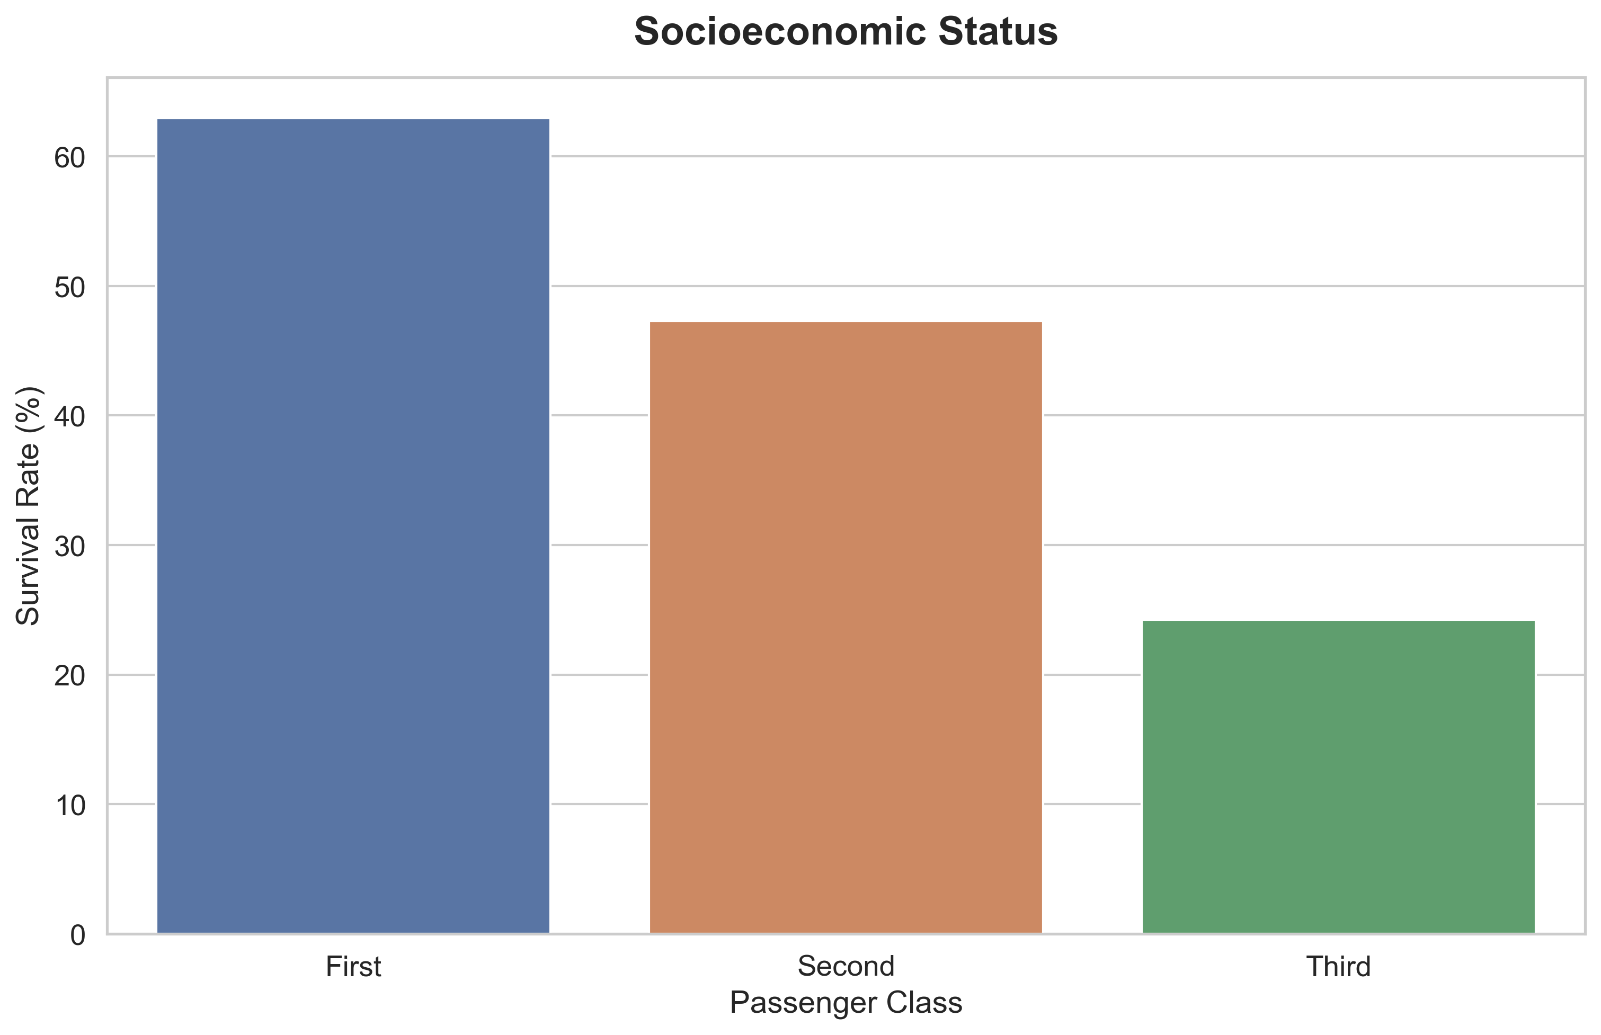
Socioeconomic Status and its impact. Hypothesis: Higher class means higher survivability. - The Baseline: Survival favored the wealthy. 1st-class survival (63%) was nearly triple the rate of 3rd-class survival (24%). - The Reality: The defining factor wasn't just status—it was ship geometry. A 1st-class ticket bought premium real estate directly below the Boat Deck.

Slide 5
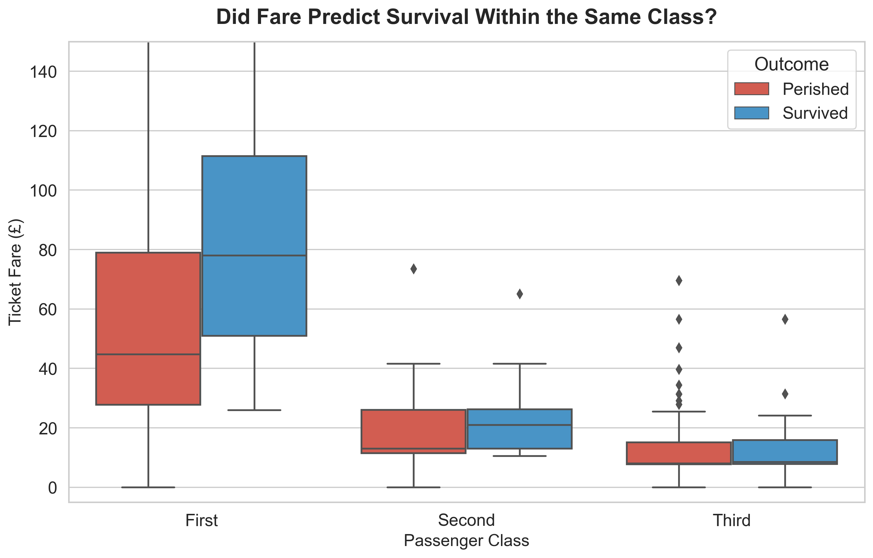
Micro-Economics of Survival: Did Your Exact Fare Matter?
The "Hidden Wealth" Trend: We established that passenger class dictated survival. But zooming in, your exact fare mattered too. Within the same class, survivors consistently paid a higher median ticket price than those who perished.
The 1st-Class Disparity: First-class survivors paid a median fare of ~£75; victims paid ~£45. That £30 premium likely secured the ultimate luxury: a cabin directly adjacent to the grand staircases, cutting response time to seconds.
The Steerage Exception: In 3rd class, the median fare (~£8) was identical for both survivors and victims. When you are trapped at the very bottom of the ship behind locked gates, paying a slight premium yielded absolutely zero survival advantage.

Slide 6
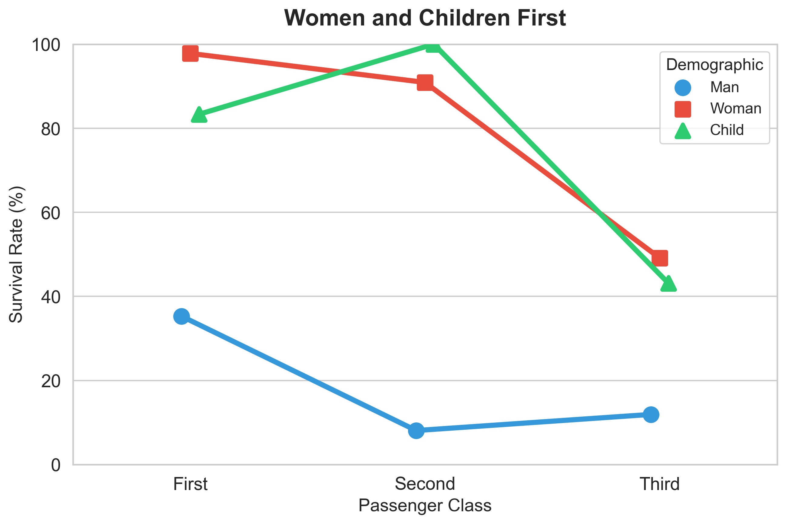
While the "Women and Children First" maritime protocol was the primary driver of survival during the Titanic disaster, the actual execution of this protocol was heavily stratified by socioeconomic status (Passenger Class). The Protocol Overruled Wealth: The "Women and Children First" rule was strictly enforced. This is proven by the fact that a woman in Third Class (~49% survival) or a child in Third Class (~43%) still had a significantly better chance of surviving than the wealthiest men in First Class (~35%). The "Steerage" Penalty: The advantage of being a woman or child severely diminished for those housed in the lower decks. A woman's chance of survival essentially halved—dropping from nearly 98% in First Class to just 49% in Third Class. The Second-Class Anomaly: The green line reveals a fascinating historical threshold: 100% of the children in Second Class survived. This creates a sharp, tragic contrast with Third Class, where over half the children perished due to locked gates and navigating the deep lower decks. The Absolute Ceiling for Men: Socioeconomic status provided only a marginal safety net for men. While First Class men fared better than Third Class men (35% vs. 12%), their overall survival remained exceptionally low across the board, showing that men largely stepped aside regardless of how much their ticket cost.

