Slide 1
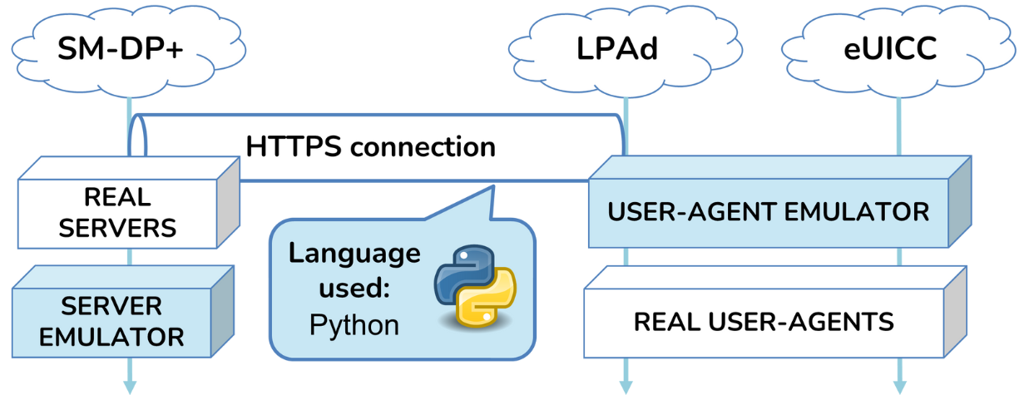
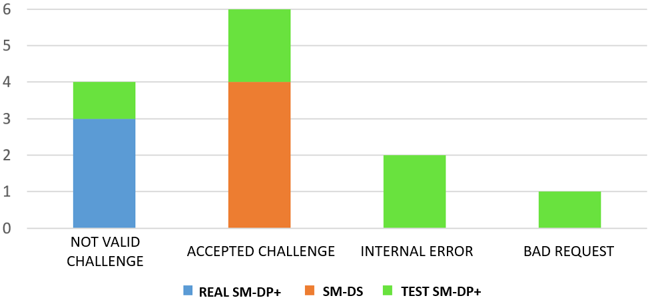
eSIM Security: Analysis Through User-Agent and SM-DP+ Server Development
Matteo Fanfarillo Lorenzo Valeriani Giuseppe Bianchi
MOTIVATION
eSIMs represent a technology that has been gaining significant traction in recent years.
GOAL
Identify the critical issues and vulnerabilities of the protocol that defines the operation of eSIMs (RSP protocol) and its respective implementations.
STRATEGY
RESULTS
EXAMPLE: use of a malformed challenge

