Slide 1
AODV in MATLAB
CpE 6420 Project Presentations
Stuart Miller

Slide 2
Agenda
Background
Examples
Traffic Statistics
Future Work
Conclusions
Demo

Slide 3
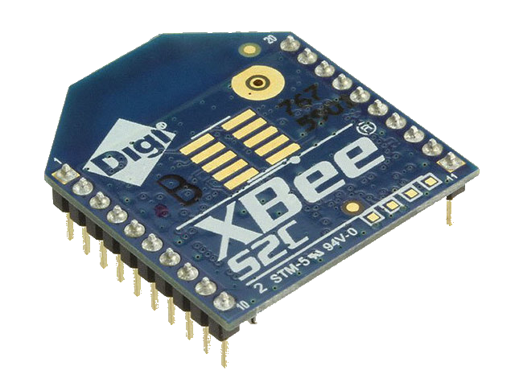
AODV Routing Algorithm
Routing protocol for ad-hoc wireless networks
Outlined in RFC 3561
C. Perkins, E. Belding-Royer, S. Das, "Ad hoc On-Demand Distance Vector (AODV) Routing", RFC 3561, July 2003. (https://www.rfc-editor.org/rfc/rfc3561.txt)
Utilized by Zigbee specification

Slide 4
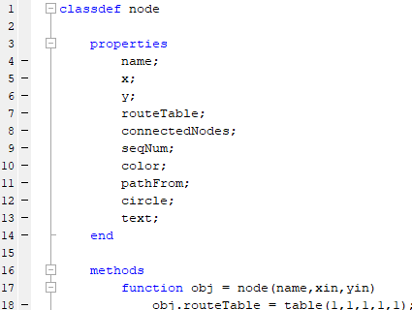
AODV Principles
Reactive routing protocol
Reduces network-wide broadcasts
Lower overhead
Discovers routes only as necessary
Relies on flooding for route discovery
Each node maintains its own route table

Slide 5
AODV Route Messages
Route Request (RREQ)
Sent when a node doesn’t have a valid path to the destination, triggers flooding
Route Reply (RREPL)
Sent back to source when the destination is reached or an intermediate node has a route to the destination.
Route Error (RERR)
Send back up the path of propagation by a node when its link to the intended destination breaks
Data
Just normal packets containing actual information

Slide 6
Approach
Implement in MATLAB, make use of high-quality GUI environment
Focus on resiliency throughout node movement (broken links, etc.)
Serve as more of a demonstration tool rather than an in-depth simulation
Focus on showing step-by-step progress of algorithm

Slide 7
Agenda
Background
Examples
Traffic Statistics
Future Work
Conclusions
Demo

Slide 8
Example 1
Sending node D -> G
All routing tables start empty
D floods with RREQ
G replies with RREPL
Data sent once route established
Subsequent transmissions require no new overhead

Slide 9
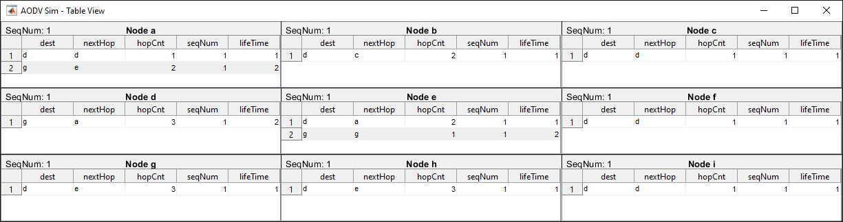
Example 1
Reverse routes set up during flooding
Forward route set up during reply

Slide 10
Example 2
Sending node C -> G
Intermediates nodes have route info from Ex. 1
C floods with RREQ
D,A,&G all reply with RREPL
C picks reply with smallest hop count to destination
Data sent once route established

Slide 11
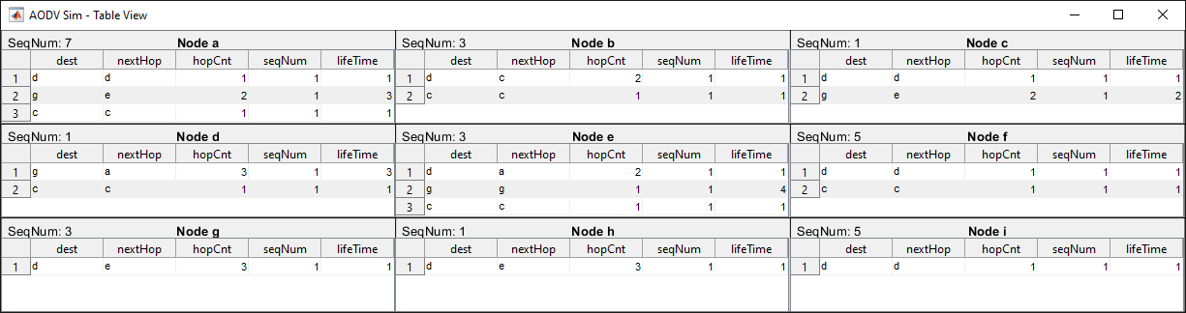
Example 2
More routes added

Slide 12
Example 3
Sending node D -> G again
Node E has been moved, breaking links
D tries sending normally
A can’t reach E anymore, so replies with RERR
A now knows no routes, so must flood
C knows a route to G so replies
D sends to G

Slide 13
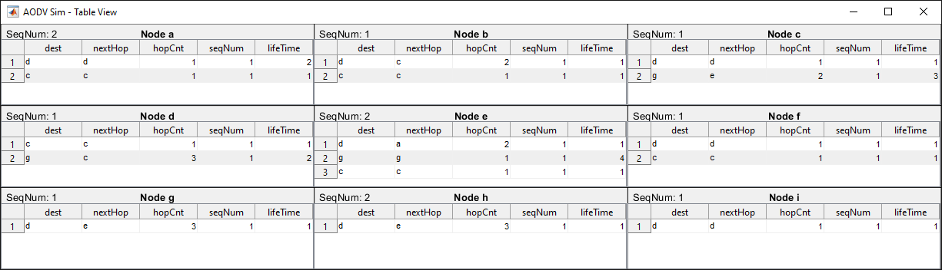
Example 3
The RERR canceled out A->G
The sequence numbers changed

Slide 14
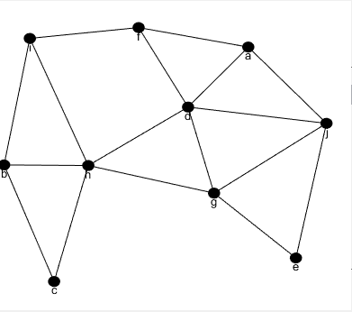
Example 4
Much shuffling, routes have almost all changed
Multiple route cancellations
Once C receives a reply, it sends out data, to the node with the lowest hop count to destination, expecting it to make it
Floods multiple times
D’s route to F is still valid though

Slide 15
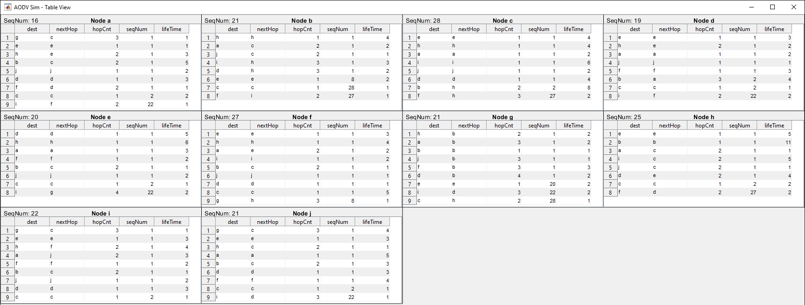
Example 4

Slide 16
Agenda
Background
Examples
Traffic Statistics
Future Work
Conclusions
Demo

Slide 17
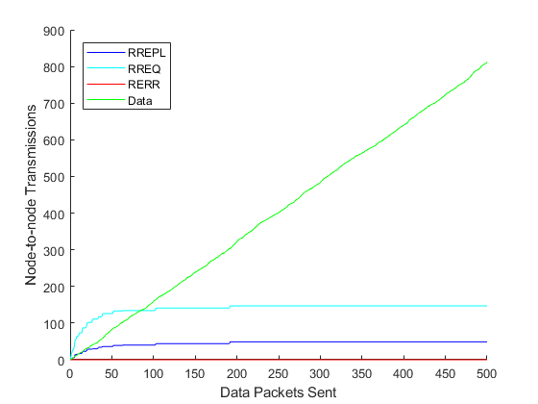
Static Network
500 random packets sent
No movement, nodes remain in the same place
No RERRs

Slide 18
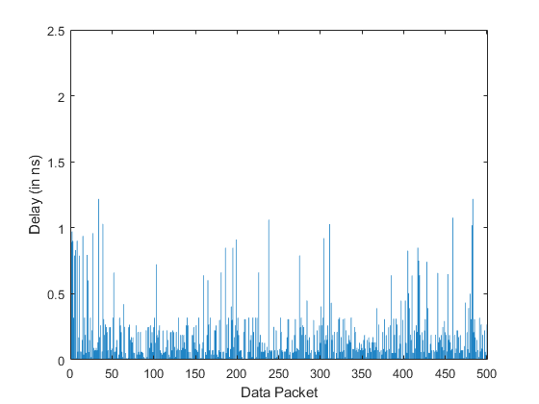
Static Network
No movement
Propagation delays

Slide 19
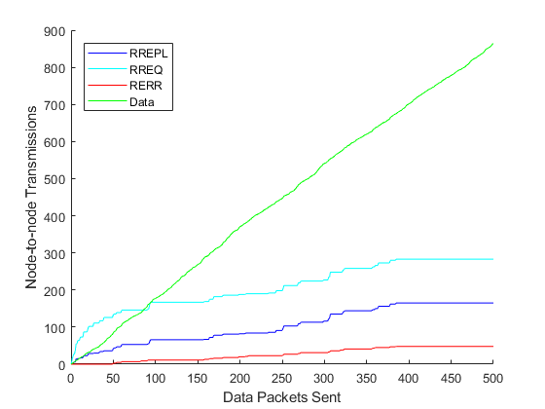
Mobile Network
500 random packets sent
Movement every 50 packets

Slide 20
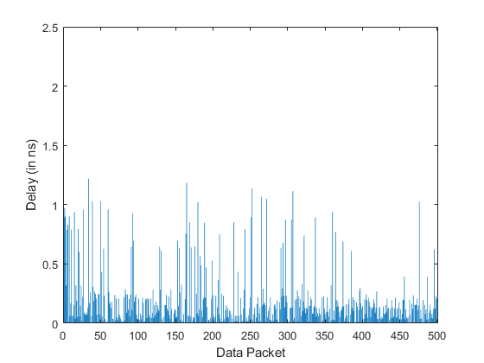
Static Network
Movement every 50 packets
Propagation delays

Slide 21
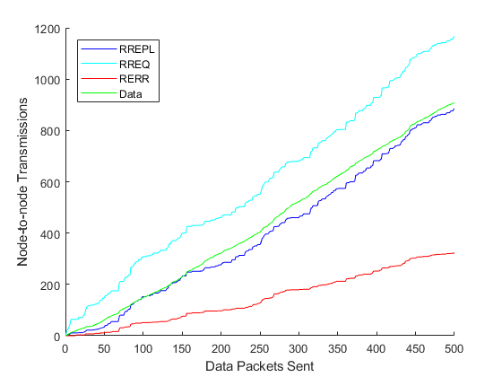
Highly Mobile Network
500 random packets sent
Movement every 5 packets sent

Slide 22
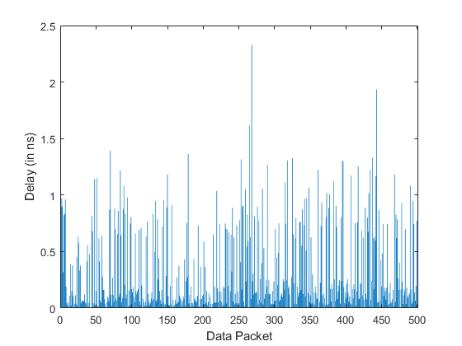
Static Network
Movement every 50 packets sent
Propagation delays

Slide 23
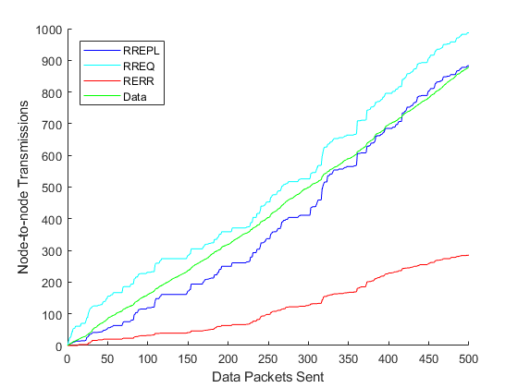
One-Dimensional Network
500 random packets sent
Movement every 5 packets sent
Nodes only move in the X direction

Slide 24
One-Dimensional Network
Two-Dimensional Network
One-Dimensional Network

Slide 25
Agenda
Background
Examples
Traffic Statistics
Future Work
Conclusions
Demo

Slide 26
Future Work
Compare to other protocol like DSDV or DSR
Implement other sources of delay such as queuing

Slide 27
FONTS
Background
Examples
Traffic Statistics
Future Work
Conclusions
Demo

Slide 28
Conclusions
Highly congested networks are a burden for any protocol
AODV handles link breakage with minimal overhead in simplistic cases
Works best when there aren’t multiple routes to choose or cancel out

Slide 29
Agenda
Background
Examples
Traffic Statistics
Future Work
Conclusions
Demo

Slide 30
Demo

Slide 31
Questions?

