Slide 1
AODV in MATLAB
CpE 6420 Project Presentations
Stuart Miller

Slide 2
FONTS
Background
Examples
Traffic Statistics
Future Work
Conclusions

Slide 3
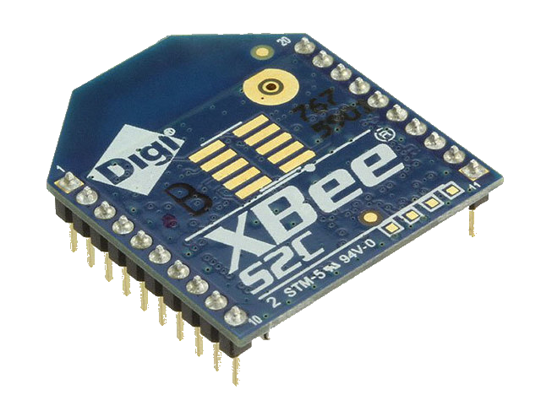
AODV Routing Algorithm
Rouyting protocal for ad-hoc wireless networks
Outlined in RFC 3561
C. Perkins, E. Belding-Royer, S. Das, "Ad hoc On-Demand Distance Vector (AODV) Routing", RFC 3561, July 2003. (https://www.rfc-editor.org/rfc/rfc3561.txt)
Utilized by Zigbee specification

Slide 4
AODV Route Messages
Route Request (RREQ)
Sent when a node doesn’t have a valid path to the destination, triggers flooding
Route Reply (RREPL)
Sent back to source when the destination is reached or an intermediate node has a route to the destination.
Route Error (RERR)
Send back up the path of propagation by a node when its link to the intended destination breaks
Data
Just normal packets containing actual information

Slide 5
Example 1
Sending node D -> G
All routing tables start empty
D floods with RREQ
G replies with RREPL
Data sent once route established
Subsequent transmissions require no new overhead

Slide 6
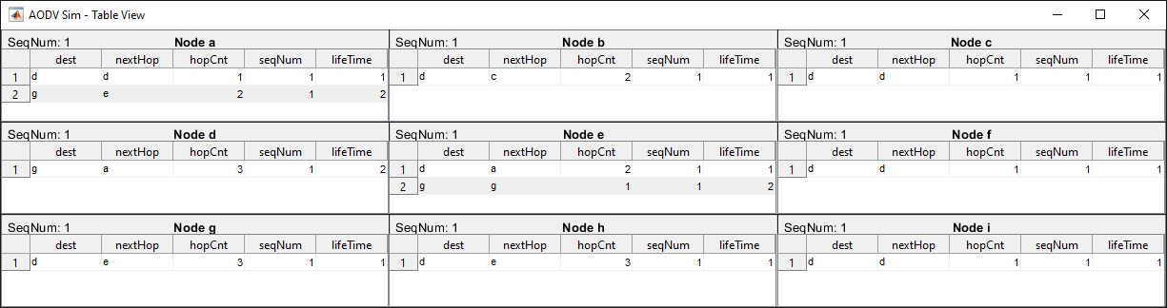
Example 1
Reverse routes set up during flooding
Forward route set up during reply

Slide 7
Example 2
Sending node C -> G
Intermediates nodes have route info from Ex. 1
C floods with RREQ
D,A,&G all reply with RREPL
C picks reply with smallest hop count to destination
Data sent once route established

Slide 8
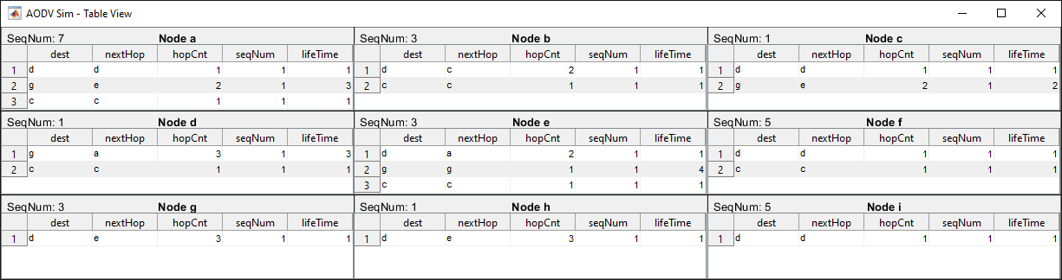
Example 2
More routes added

Slide 9
Example 3
Sending node D -> G again
Node E has been moved, breaking links
D tries sending normally
A can’t reach E anymore, so replies with RERR
A now knows no routes, so must flood
C knows a route to G so replies
D sends to G

Slide 10
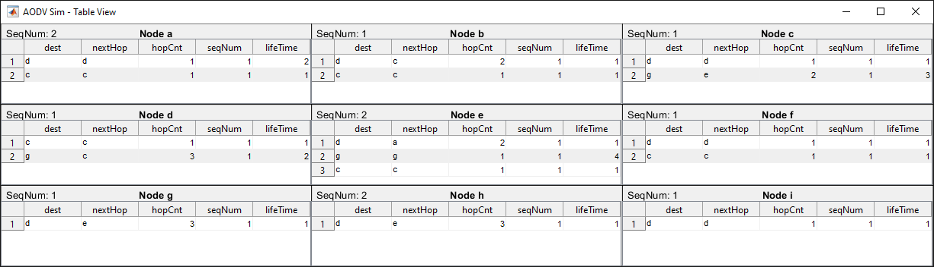
Example 3
The RERR canceled out A->G
The sequence numbers changed

