Slide 1
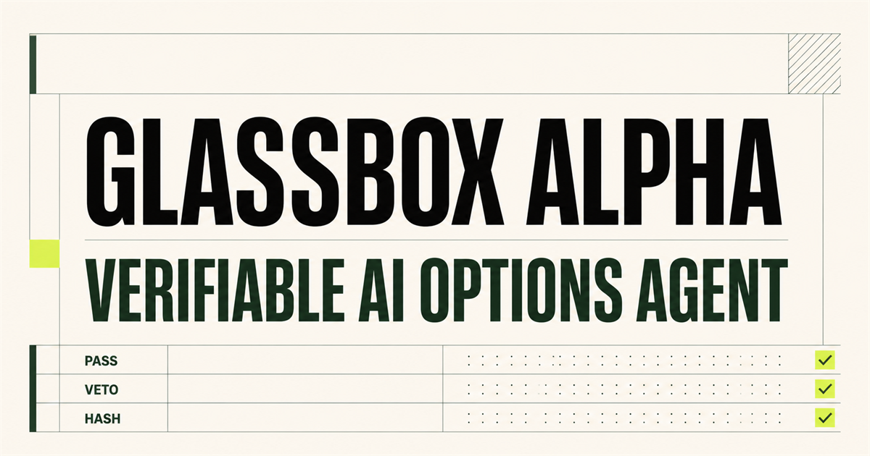
ALPACA AI TRADING AGENTS HACKATHON
GlassBox
Alpha
A verifiable AI options agent
AI may veto.
It can never change the trade.
PAPER ONLY
SPY / QQQ defined-risk options
32 deterministic checks
Hash-chained Trade Passports
01
Notes:
Narration:
GlassBox Alpha is a paper-only autonomous options agent built on Alpaca. Its central design rule is simple: AI may reject a trade, but it can never rewrite one. This keeps model judgment useful while deterministic code retains financial authority.
[Sources]
- Project README: D:/Python/GlassBoxAlpha/README.md
- Project architecture: D:/Python/GlassBoxAlpha/docs/ARCHITECTURE.md

Slide 2
The core risk is unrestricted model authority
Typical agent
GlassBox Alpha
The model can choose the ticker, size, price, and action in one step.
Code creates one immutable candidate. AI receives veto-only authority.
A persuasive output can become an execution decision before independent controls verify it.
A separate risk kernel retains the final decision and records every observed boundary.
Probabilistic judgment. Deterministic authority.
02
Notes:
Narration:
Many trading agents let a language model choose the ticker, size, price, and execution action in one step. That creates an authority problem. GlassBox Alpha separates those responsibilities. Code constructs one bounded trade, the model receives veto-only access, and a separate risk kernel makes the final execution decision.
[Sources]
- Project README: D:/Python/GlassBoxAlpha/README.md
- Risk design: D:/Python/GlassBoxAlpha/src/glassbox_alpha/risk.py

Slide 3
One candidate passes through seven controlled stages
1
2
3
4
5
6
7
Alpaca
bars
Features
Candidate
AI critic
ALLOW / VETO
32 risk
checks
Atomic
paper order
Trade
Passport
The candidate is hashed before AI review and checked again immediately before execution.
Completed bars only • fixed economics • idempotent order identity
03
Notes:
Narration:
The workflow starts with completed five-minute Alpaca bars. A deterministic feature engine measures trend, momentum, and RSI. The candidate factory then selects an exact SPY or QQQ long option or debit spread. The proposal is hashed before the critic sees it. After the critic, all thirty-two checks run again before any atomic paper order can be submitted.
[Sources]
- Architecture: D:/Python/GlassBoxAlpha/docs/ARCHITECTURE.md
- Strategy implementation: D:/Python/GlassBoxAlpha/src/glassbox_alpha/strategy.py

Slide 4
The AI critic can only reduce action
Immutable
symbol / strikes / expiry / size / price
ALLOW
or
Evidence-bound
all cited evidence IDs must be provided
VETO
Fail-closed
timeout / bad schema / mutation = VETO
No trade editing. No execution tool.
Rechecked
deterministic limits run after the model
04
Notes:
Narration:
The AI critic has only two valid outputs: allow or veto. It cannot alter symbols, strikes, expiry, quantity, price, or maximum loss, and it has no order tool. Timeouts, malformed output, unsupported evidence, or a changed candidate identifier all become a veto. The model can reduce action, never expand it.
[Sources]
- Critic implementation: D:/Python/GlassBoxAlpha/src/glassbox_alpha/critic.py
- Critic tests: D:/Python/GlassBoxAlpha/tests/test_core.py

Slide 5
Thirty-two checks run after the model
Each gate records its observed value, limit, outcome, and explanation.
32
1.00%
0
deterministic gates
max options exposure
live trading paths
identity, economics, structure, liquidity and state
default portfolio boundary before a new entry
paper mode is enforced in configuration and execution
Any failure produces ABSTAIN. Unknown order state engages the kill switch.
05
Notes:
Narration:
The deterministic risk kernel contains thirty-two independently recorded checks. It recomputes trade economics instead of trusting the proposal, verifies the competition account and paper environment, enforces one percent total options exposure by default, and rejects stale or illiquid quotes. Any failed check produces abstain, with the observed value and limit preserved for review.
[Sources]
- Risk kernel: D:/Python/GlassBoxAlpha/src/glassbox_alpha/risk.py
- Configuration defaults: D:/Python/GlassBoxAlpha/src/glassbox_alpha/config.py

Slide 6
Alpaca execution stays paper-only and atomic
READ
SUBMIT
SUPERVISE
Account, clock, completed bars, contracts, chain snapshots and positions
One atomic MLeg limit order through the official Alpaca CLI
Reconcile exact positions and close the whole structure together
→
→
alpaca-py
paper endpoint only
profit • loss • time • signal
Ambiguous broker response → persistent kill switch → manual reconciliation
06
Notes:
Narration:
Alpaca provides the account, clock, completed bars, option contracts, chain snapshots, and positions. Approved entries and exits use single atomic multi-leg limit orders through the official Alpaca CLI, with the SDK available as an explicit fallback. Live trading is absent from the codebase, and ambiguous broker responses engage a persistent kill switch until reconciliation.
[Sources]
- Alpaca integration: D:/Python/GlassBoxAlpha/src/glassbox_alpha/broker.py
- Alpaca CLI docs: https://docs.alpaca.markets/us/docs/alpacas-cli
- Alpaca options docs: https://docs.alpaca.markets/us/docs/options-trading

Slide 7
Every decision becomes a tamper-evident Trade Passport
PASSPORT 1
PASSPORT 2
Previous-record hash
Evidence
+ candidate
AI verdict
+ 32 checks
PASSPORT 3
Each record commits to the one before it. Silent history edits become detectable.
HASH 01
Order payload
+ result
HASH 02
HASH 03
Audit output: inputs • limits • verdict • action • outcome
07
Notes:
Narration:
Every cycle creates a Trade Passport. It records market evidence, the immutable candidate hash, the AI verdict, every risk observation, the order payload, and the outcome. Each record includes the previous record hash, so silent edits become detectable. The audit trail explains both why the agent acted and why it refused to act.
[Sources]
- Audit implementation: D:/Python/GlassBoxAlpha/src/glassbox_alpha/audit.py
- Architecture: D:/Python/GlassBoxAlpha/docs/ARCHITECTURE.md

Slide 8
Judges can reproduce approval and abstention
CLEAN
APPROVED PREVIEW
24 / 24
AI VETO
ABSTAIN
automated tests
STALE QUOTE
ABSTAIN
VALID
WIDE SPREAD
ABSTAIN
hash chain
Not a promise of returns — a verifiable boundary for financial AI.
08
Notes:
Narration:
Judges can reproduce four credential-free scenarios: a clean approval, an AI veto, a stale quote, and an excessive spread. The project includes twenty-four automated tests, a verifiable audit chain, and a production-built decision replay. GlassBox Alpha is not a promise of returns. It is a verifiable boundary for using probabilistic AI in financial execution.
[Sources]
- Automated tests: D:/Python/GlassBoxAlpha/tests/test_core.py
- Credential-free replay: D:/Python/GlassBoxAlpha/site/app/page.tsx
- Project README: D:/Python/GlassBoxAlpha/README.md

