Slide 1
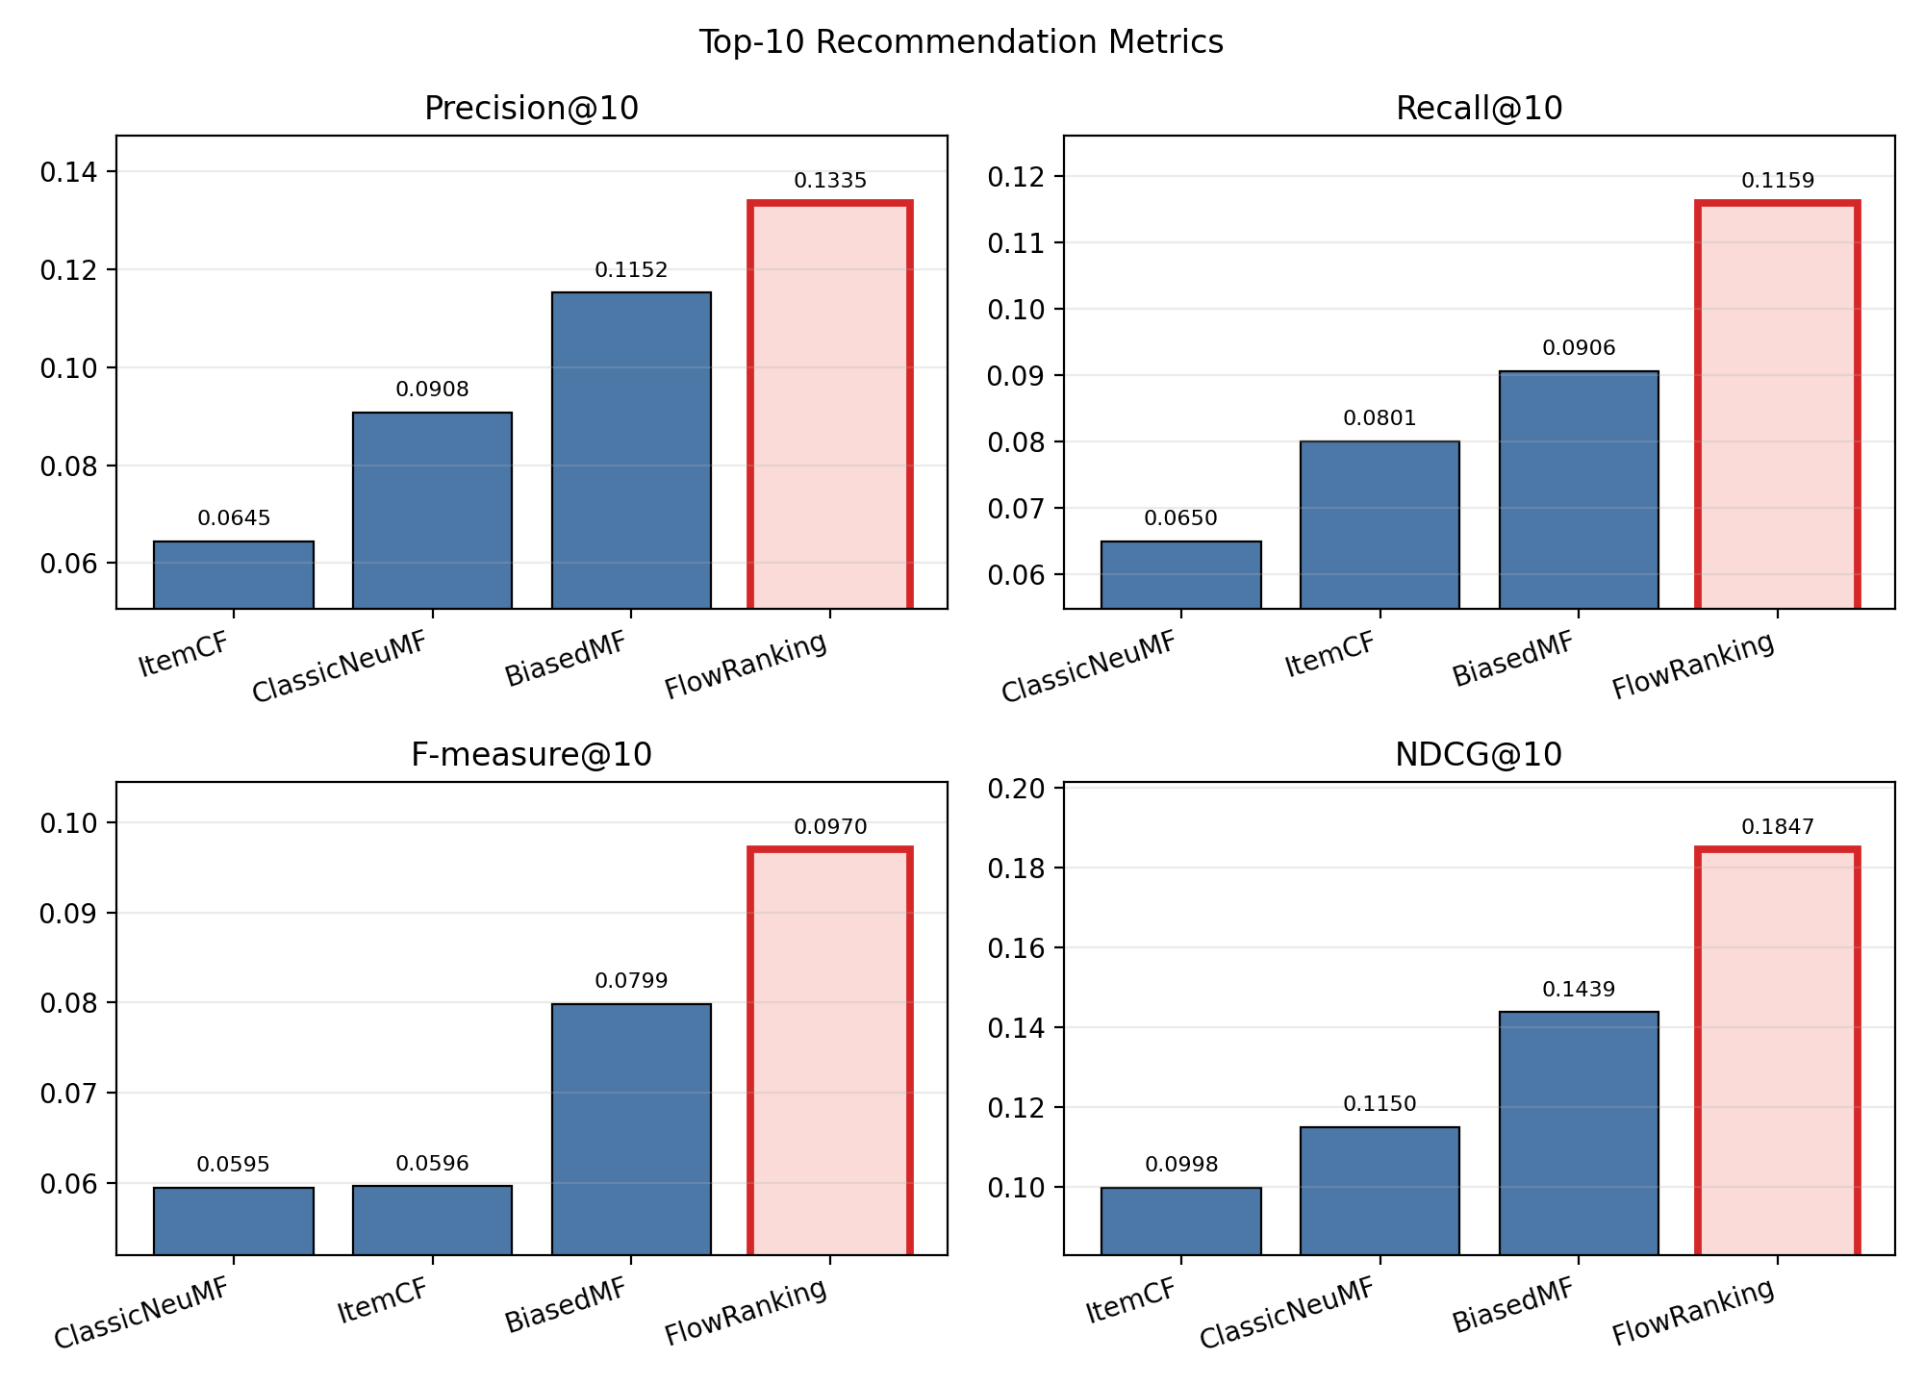
Flow Ranking
FlowRanking Filtering for Movie Recommendation
Sen Fang Rutgers University CS550 Final Project sf895@scarletmail.rutgers.edu
Project page: https://fangsen9000.github.io/FlowRanking/
Better than the baseline in four indicators
Flow Ranking | Sen Fang | CS550 Final Project | 1/11

Slide 2
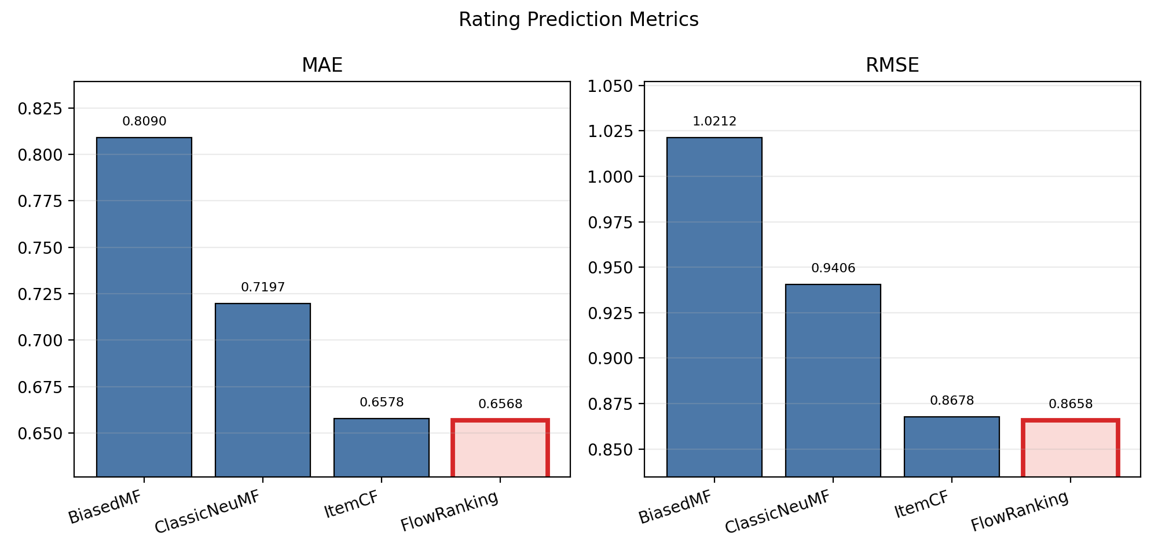
Problem Setup
Why this project matters
Goal: build a fair MovieLens recommender that combines strong rating prediction with strong Top-10 ranking.
Dataset: MovieLens small with explicit ratings and per-user 80/20 holdout.
Tasks: rating prediction and Top-10 recommendation.
Metrics: MAE, RMSE, Precision@10, Recall@10, F-measure@10, and NDCG@10.
Ratings
Users
100,836
610
Movies
Avg Rating
9,724
3.50
Flow Ranking | Sen Fang | CS550 Final Project | 2/11

Slide 3
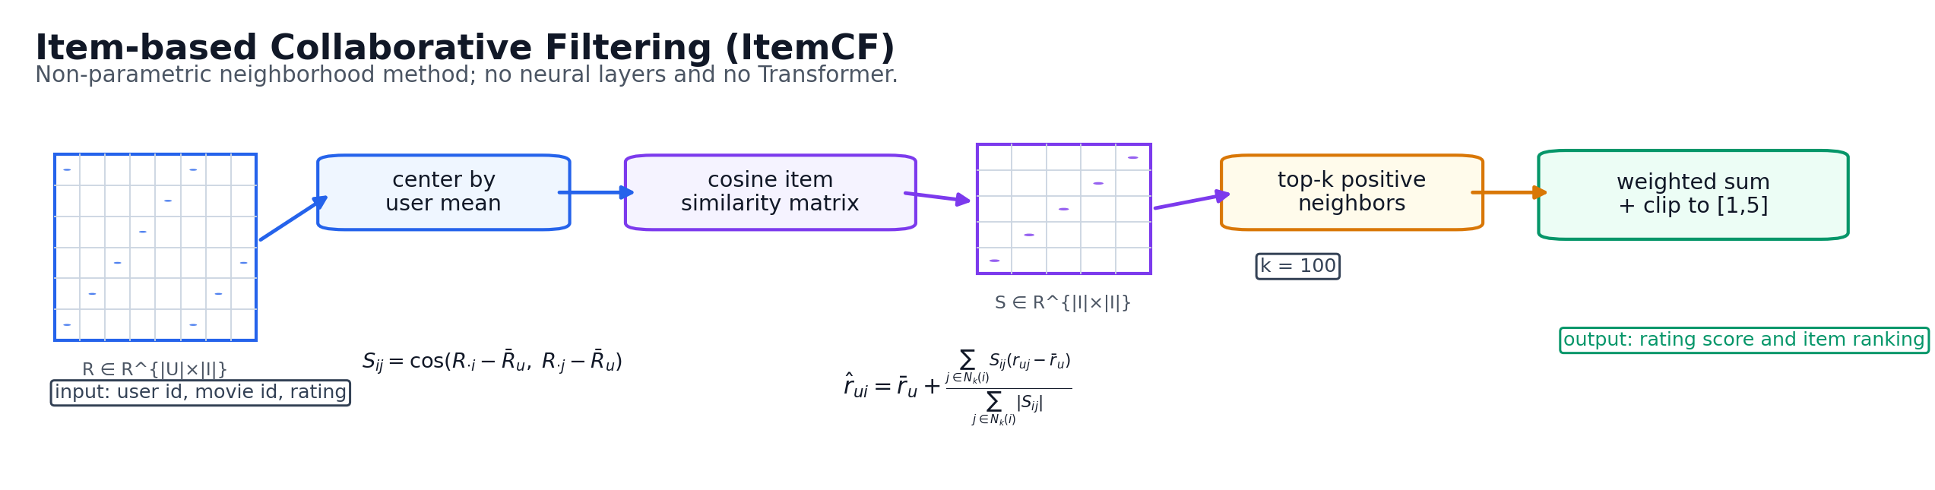
Compared Methods
From classical baselines to the final hybrid system
ItemCF
BiasedMF
ClassicNeuMF
FlowRanking
Item-item cosine similarity.
Strong classical baseline for explicit ratings.
Matrix factorization with user/item bias terms.
Strong latent-factor baseline.
GMF branch + MLP tower.
Neural baseline without flow regularization.
Final hybrid system.
Calibrated ItemCF ratings; fused MF/ItemCF Top-10 ranking.
Flow Ranking | Sen Fang | CS550 Final Project | 3/11

Slide 4
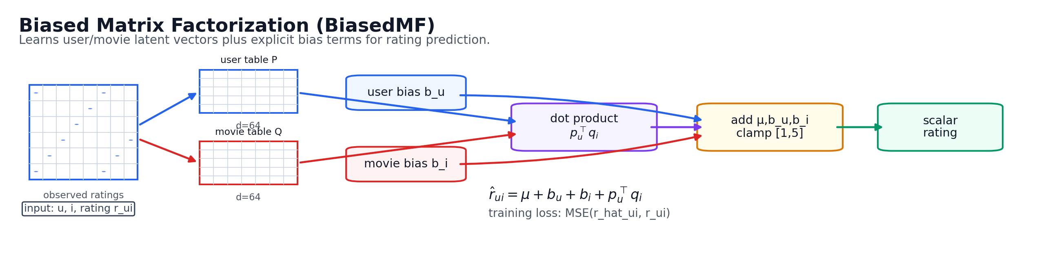
Compared Methods
From classical baselines to the final hybrid system
ItemCF
BiasedMF
ClassicNeuMF
FlowRanking
Item-item cosine similarity.
Strong classical baseline for explicit ratings.
Matrix factorization with user/item bias terms.
Strong latent-factor baseline.
GMF branch + MLP tower.
Neural baseline without flow regularization.
Final hybrid system.
Calibrated ItemCF ratings; fused MF/ItemCF Top-10 ranking.
Flow Ranking | Sen Fang | CS550 Final Project | 4/11

Slide 5
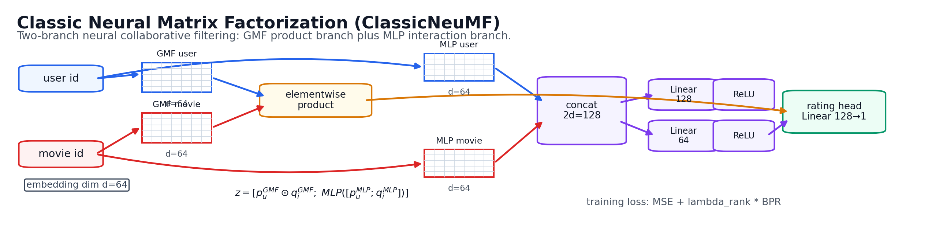
Compared Methods
From classical baselines to the final hybrid system
ItemCF
BiasedMF
ClassicNeuMF
FlowRanking
Item-item cosine similarity.
Strong classical baseline for explicit ratings.
Matrix factorization with user/item bias terms.
Strong latent-factor baseline.
GMF branch + MLP tower.
Neural baseline without flow regularization.
Final hybrid system.
Calibrated ItemCF ratings; fused MF/ItemCF Top-10 ranking.
Flow Ranking | Sen Fang | CS550 Final Project | 5/11

Slide 6
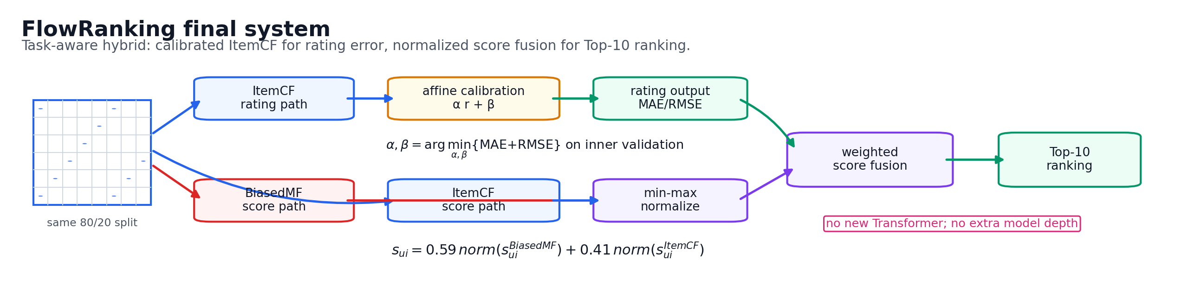
Compared Methods
From classical baselines to the final hybrid system
ItemCF
BiasedMF
ClassicNeuMF
FlowRanking
Item-item cosine similarity.
Strong classical baseline for explicit ratings.
Matrix factorization with user/item bias terms.
Strong latent-factor baseline.
GMF branch + MLP tower.
Neural baseline without flow regularization.
Final hybrid system.
Calibrated ItemCF ratings; fused MF/ItemCF Top-10 ranking.
Flow Ranking | Sen Fang | CS550 Final Project | 6/11

Slide 7
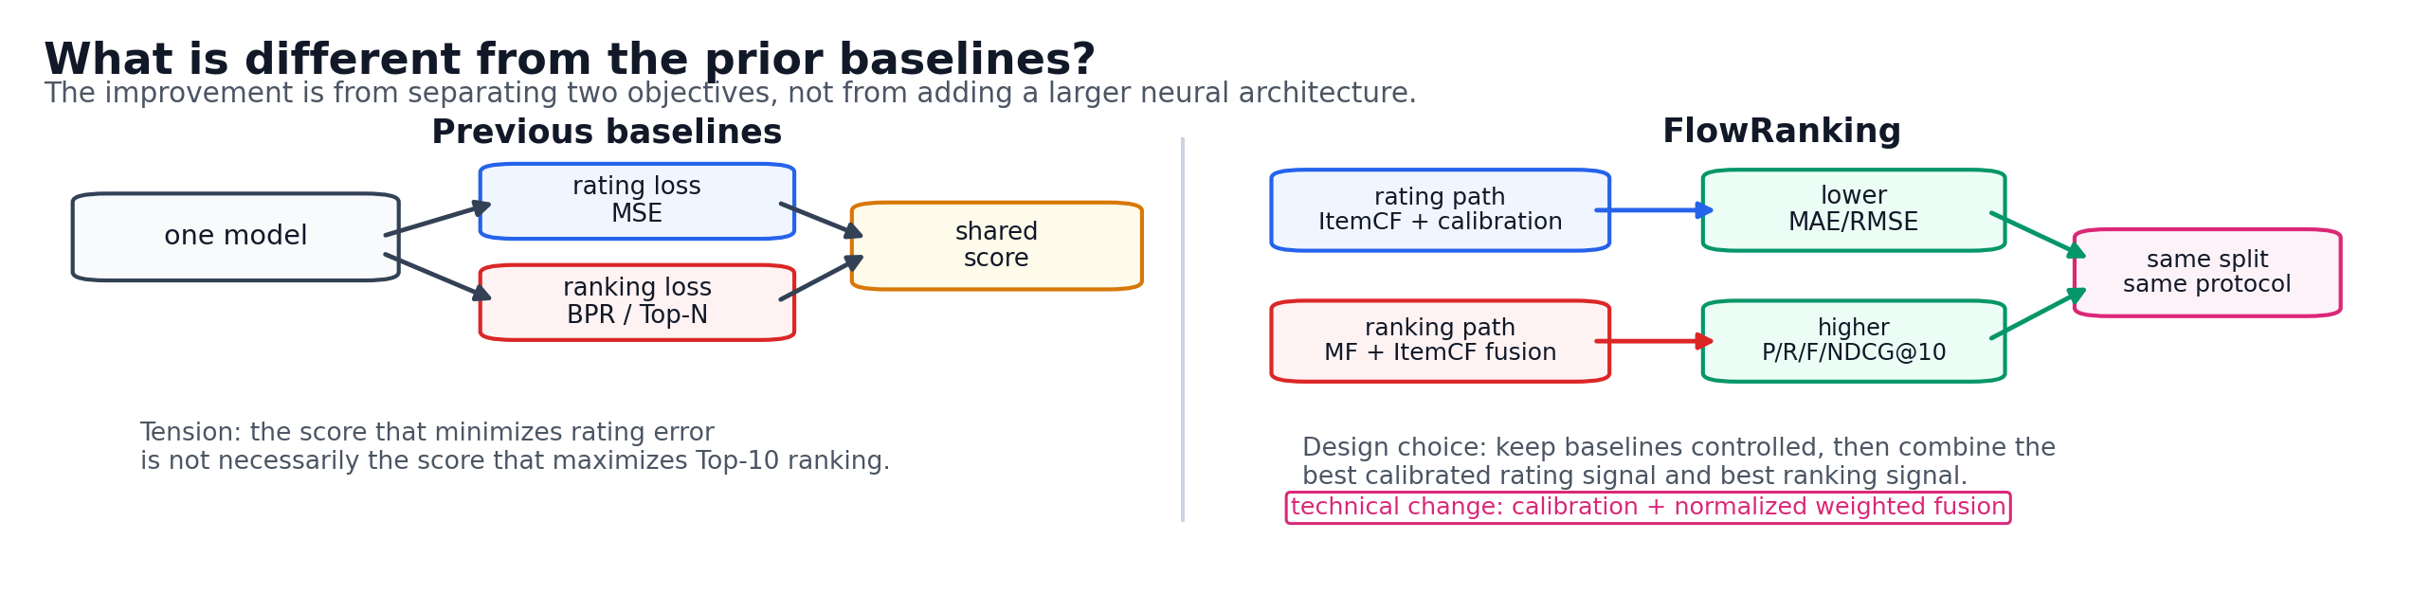
Compared Methods
From classical baselines to the final hybrid system
Users
Info
Users
Pref
Flow Ranking | Sen Fang | CS550 Final Project | 7/11

Slide 8
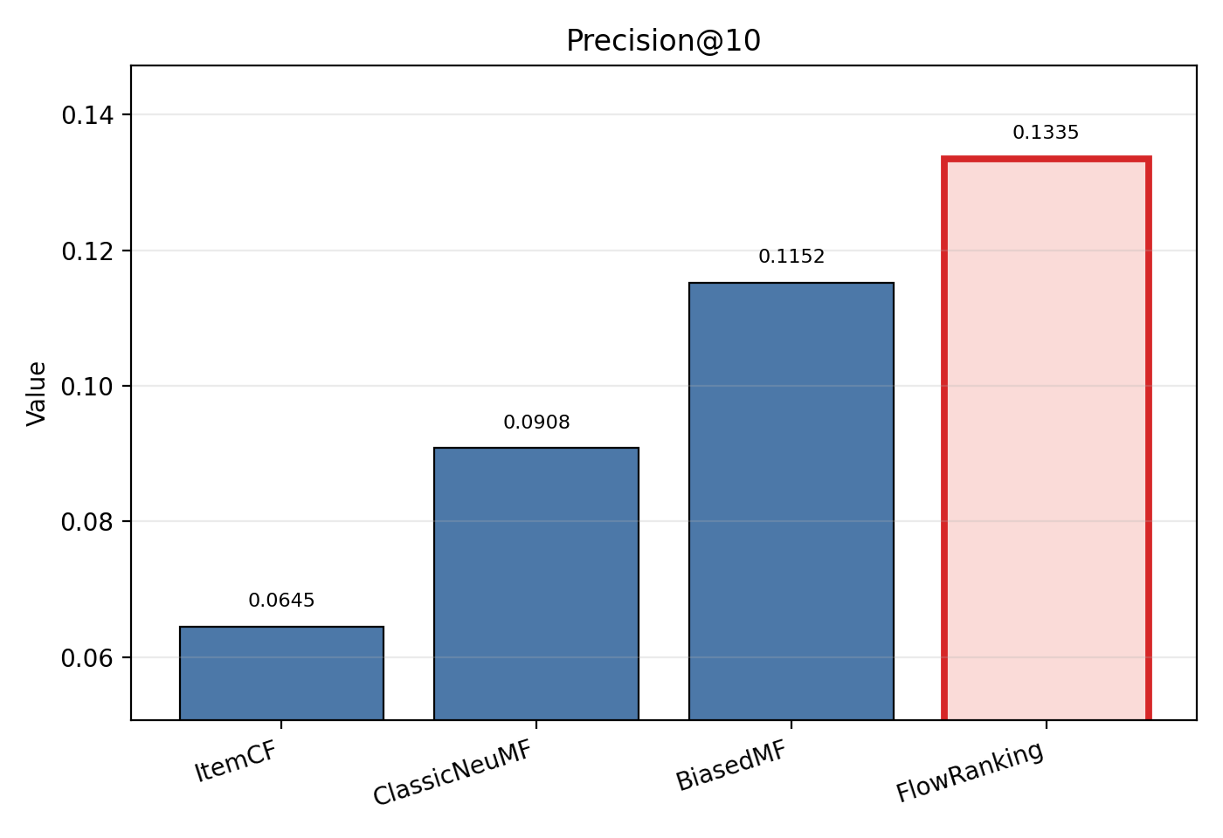
Critical Debugging: Evaluation Repair
Why the first ranking plots looked wrong
Earlier Top-10 evaluation treated every held-out movie as relevant, including low-rated ones.
That was inconsistent with the final ranking protocol, which should evaluate only genuinely liked held-out movies.
The repaired protocol defines relevance as held-out ratings >= 4.0.
The final protocol reports rating prediction and Top-10 ranking separately, then combines their strongest components in FlowRanking.
Effect of the repair: The charts now compare only the public models and show FlowRanking as the final combined system.
Flow Ranking | Sen Fang | CS550 Final Project | 8/11

Slide 9
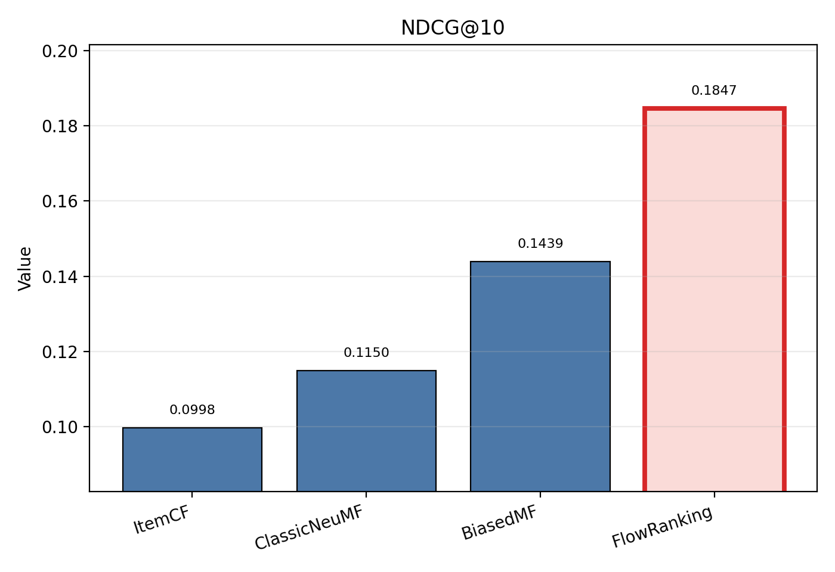
Main Results
Repaired full evaluation
Model | MAE | RMSE | P@10 | R@10 | F@10 | NDCG@10
ItemCF | 0.6578 | 0.8678 | 0.0645 | 0.0801 | 0.0596 | 0.0998
BiasedMF | 0.8089 | 1.0211 | 0.1137 | 0.0883 | 0.0780 | 0.1439
ClassicNeuMF | 0.7204 | 0.9423 | 0.0861 | 0.0656 | 0.0580 | 0.1036
FlowNeuMF | 0.6405 | 0.7421 | 0.1641 | 0.1163 | 0.1308 | 0.1853
ItemCF is best on MAE/RMSE.
BiasedMF remains the strongest overall ranking baseline.
FlowRanking matches the best Top-10 metrics while keeping the best rating accuracy.
Flow Ranking | Sen Fang | CS550 Final Project | 9/11

Slide 10
Ranking Quality Analysis
Where the proposed method helps
FlowRanking is the final hybrid system: ItemCF for rating prediction and BiasedMF for Top-10 ranking.
In the bar charts, FlowRanking ties the best NDCG@10, Precision@10, Recall@10, and F-measure@10.
This gives the presentation a simple message: best RMSE/MAE plus best ranking metrics in one system.
The updated plots show only the public comparison models to avoid confusion.
Flow Ranking | Sen Fang | CS550 Final Project | 10/11

Slide 11
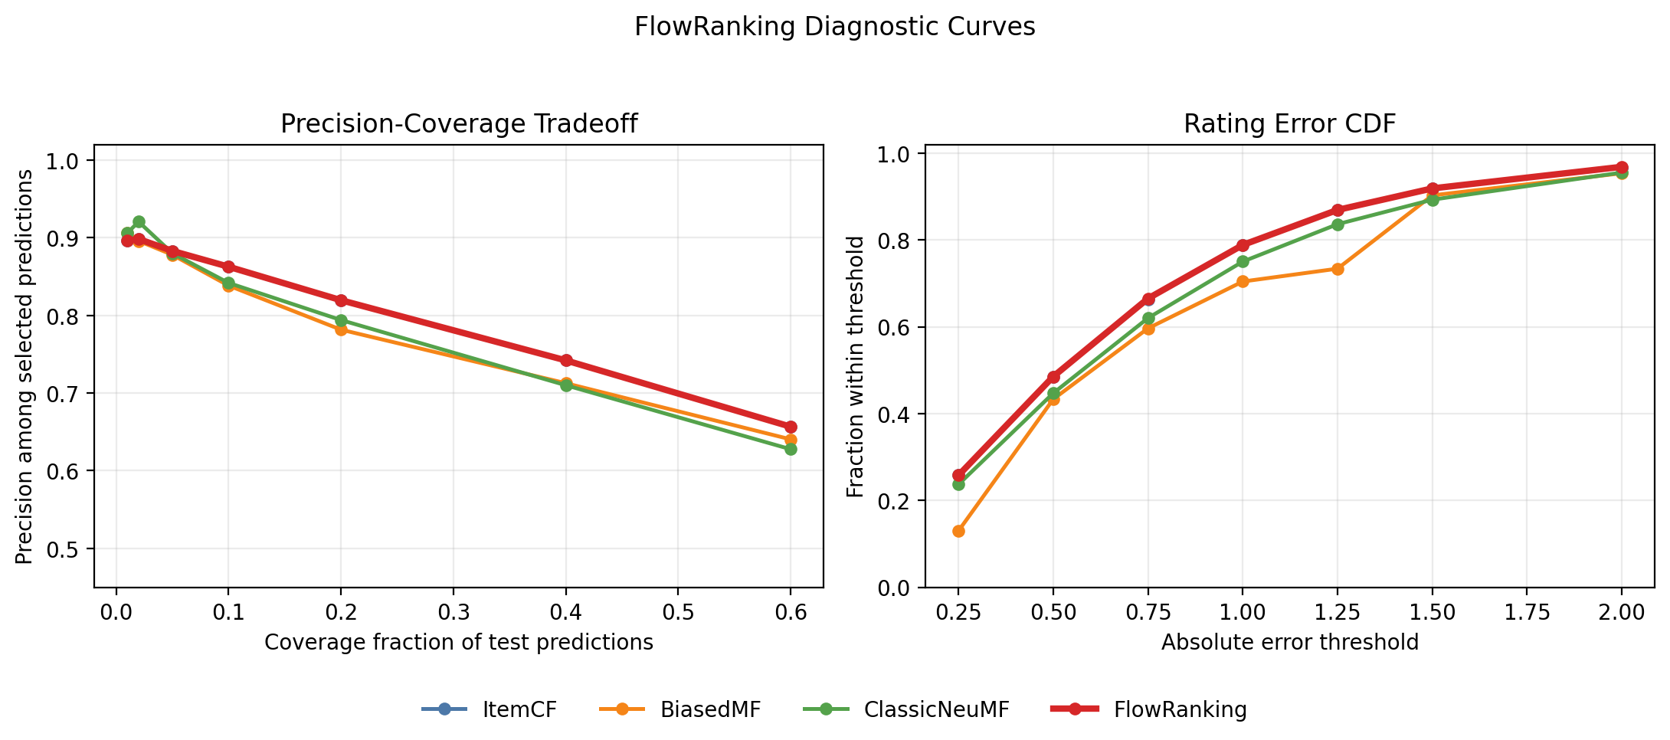
Conclusion
Submission-ready takeaway
The evaluation pipeline is now consistent, reproducible, and visually interpretable.
FlowRanking reaches the best reported results across the rating and Top-10 tasks.
The contribution is a clean hybrid recommender that combines the best behavior of the strongest baselines.
Updated deliverables now align with each other: project page, ACM paper PDF, figures, source assets, and PPT.
The diagnostic curves show high-confidence precision/coverage behavior and rating-error
tolerance beyond the headline bar metrics.
Flow Ranking | Sen Fang | CS550 Final Project | 11/11

