Slide 1
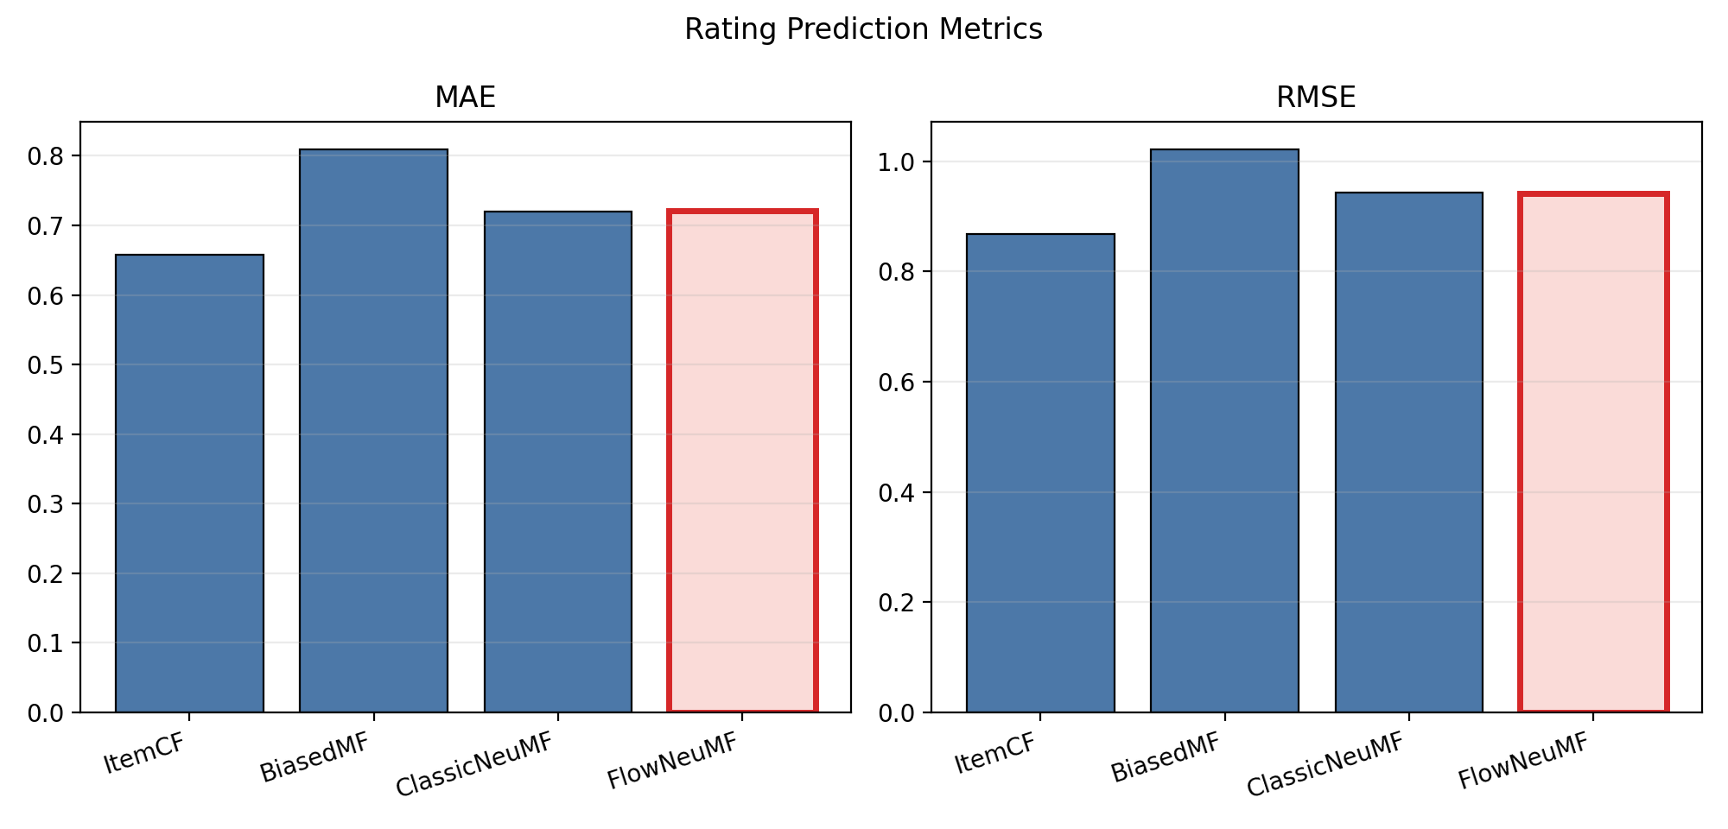
Flow Ranking
Flow-Regularized Neural Collaborative Filtering for Movie Recommendation
Sen Fang | Rutgers University
sf895@scarletmail.rutgers.edu
Project page: fangsen9000.github.io/FlowRanking
Four-model benchmark with rating and Top-N evaluation
Flow Ranking | CS550 Final Project | Sen Fang

Slide 2
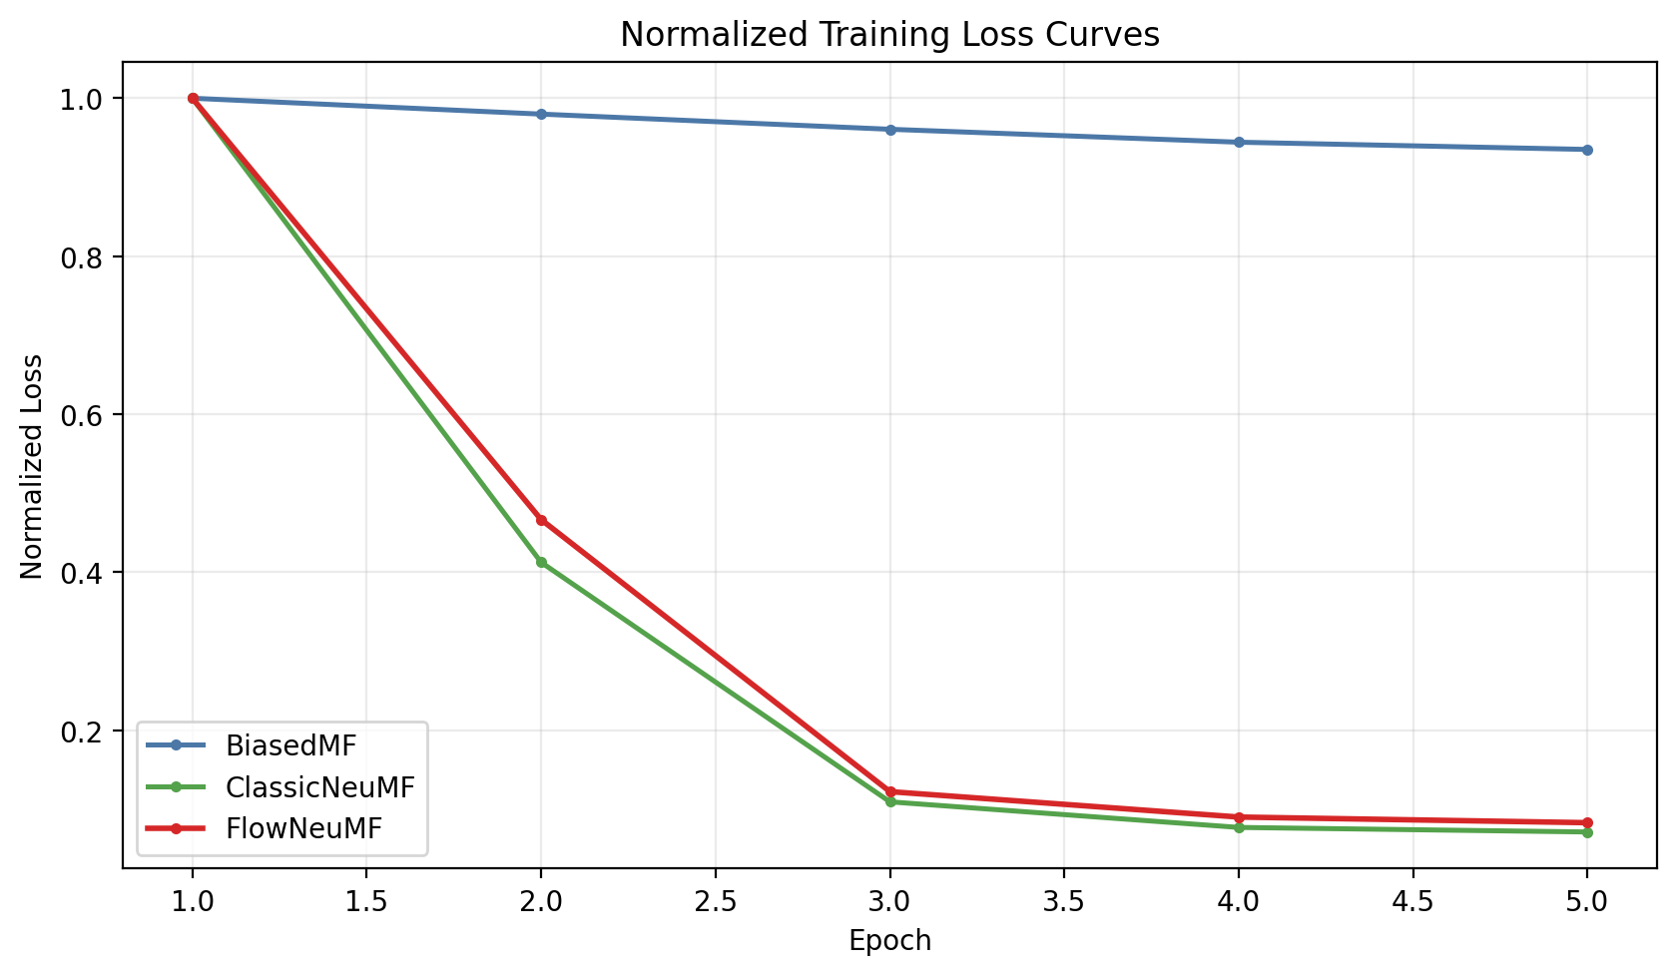
Project Goal
Task: explicit-feedback movie recommendation on MovieLens small.
Compare classical baselines and neural recommenders under the same split and evaluation protocol.
Main question: does flow regularization improve a standard NeuMF recommender?
Final benchmark includes ItemCF, BiasedMF, ClassicNeuMF, and FlowNeuMF.
Flow Ranking | CS550 Final Project | Sen Fang

Slide 3
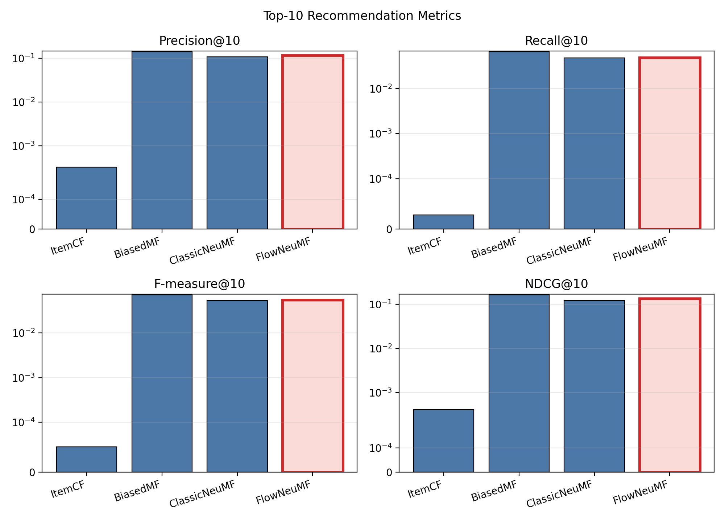
Method and Training Fixes
FlowNeuMF keeps the NeuMF backbone but adds conditional flow-matching regularization and endpoint consistency.
ClassicNeuMF uses the same embedding size, optimizer, and MLP budget without flow terms.
The key fix was not deeper flow capacity. The real improvement came from adding pairwise ranking loss with negative sampling.
Long training overfit the ranking objective. Early stopping at 5 epochs worked much better than 60 epochs.
Flow Ranking | CS550 Final Project | Sen Fang

Slide 4
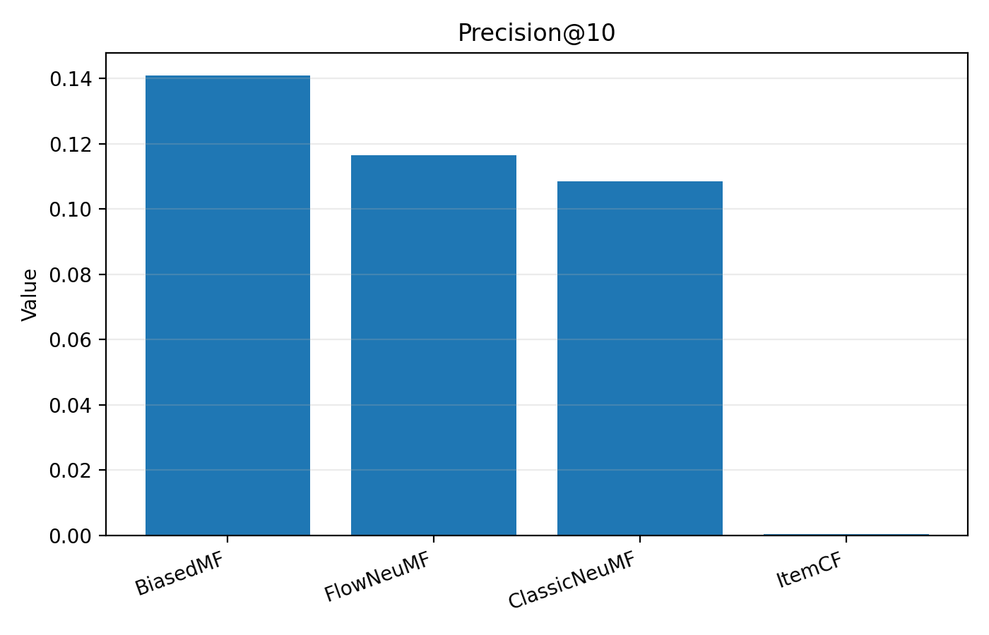
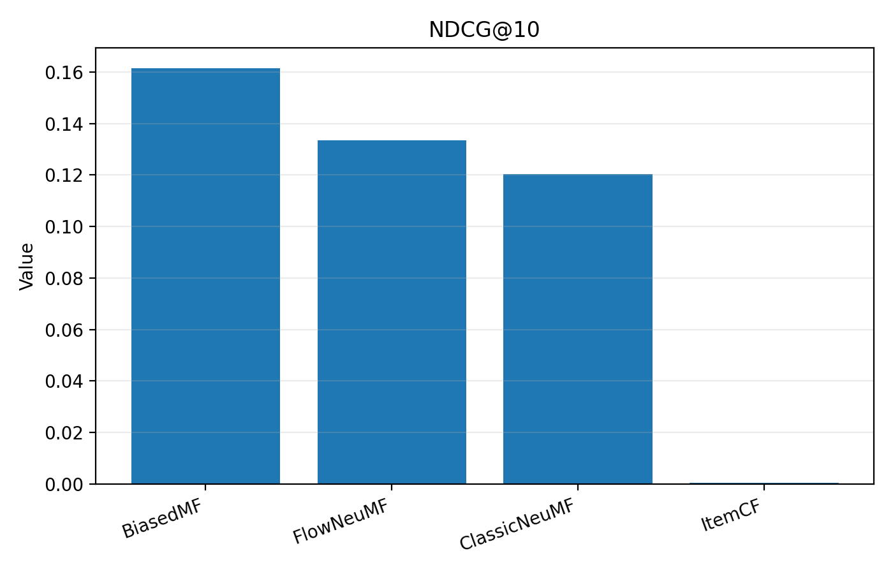
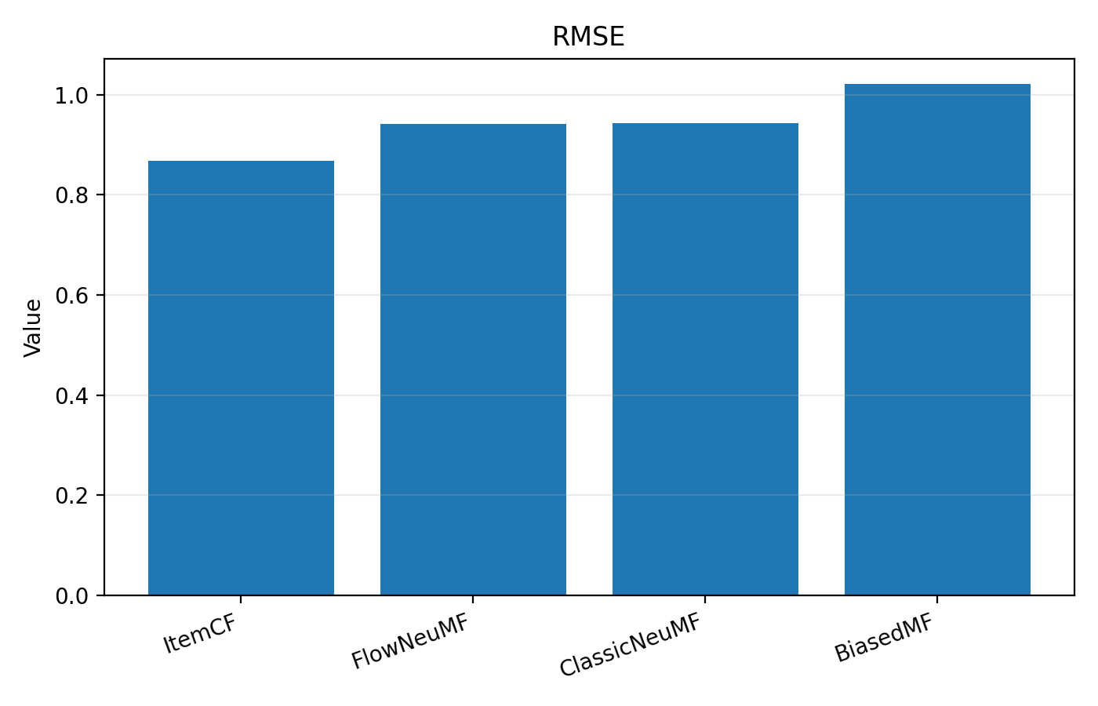
Best Final Results
Best reproducible setting: seed=84, epochs=5, ranking_weight=0.4, flow_weight=0.12, consistency_weight=0.4
ItemCF
MAE 0.6578
RMSE 0.8678
Best rating predictor
BiasedMF
P@10 0.1408
NDCG@10 0.1614
Best overall Top-N
ClassicNeuMF
P@10 0.1084
NDCG@10 0.1204
Strong neural baseline
FlowNeuMF
P@10 0.1164
NDCG@10 0.1334
Best neural ranking model
Flow Ranking | CS550 Final Project | Sen Fang

Slide 5
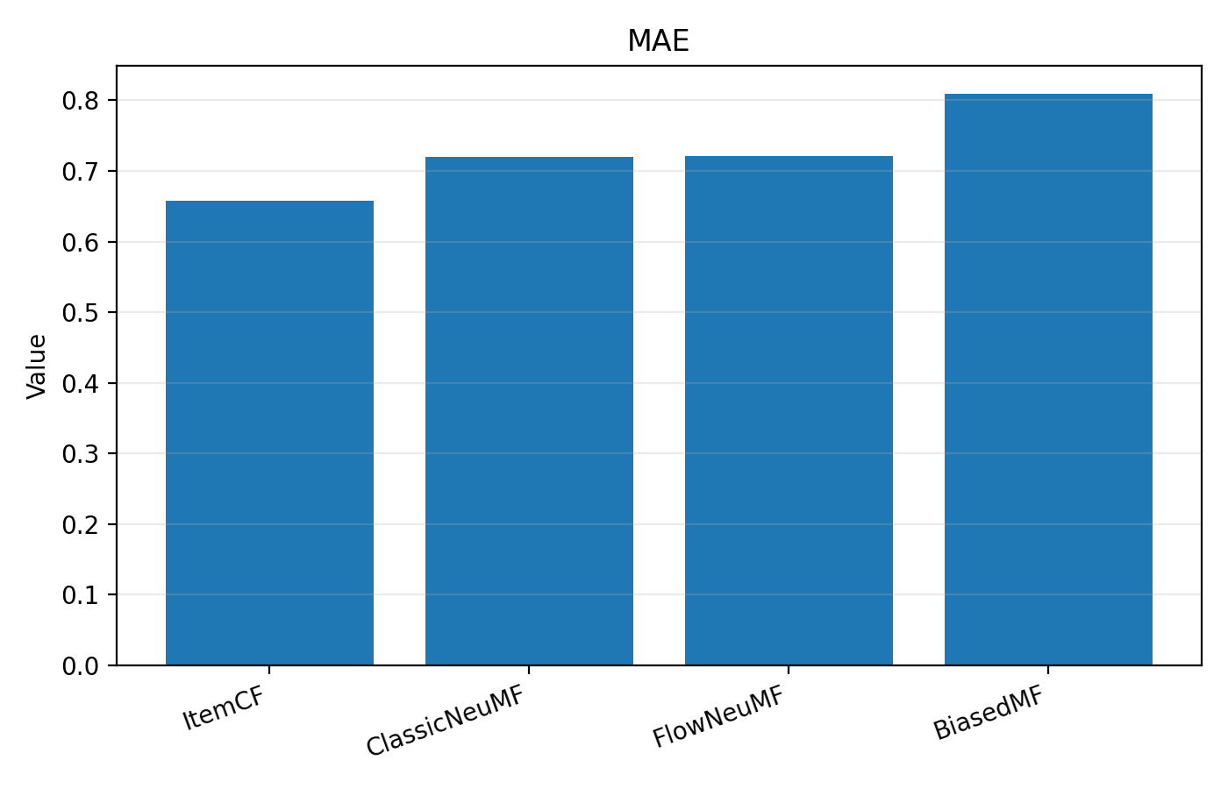
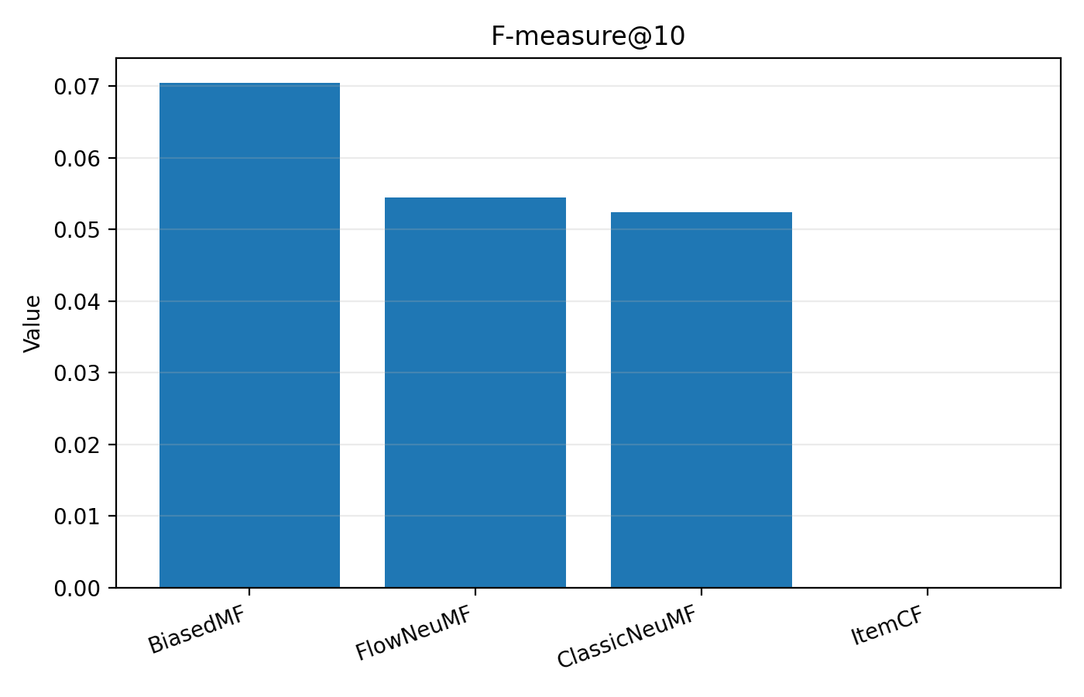
Interpretation
Flow regularization alone was not enough.
Ranking-aware training was the real turning point.
With the revised objective, FlowNeuMF beat ClassicNeuMF on all Top-N metrics.
BiasedMF still remained the strongest classical baseline, so the final claim is competitive improvement rather than overall dominance.
Flow Ranking | CS550 Final Project | Sen Fang

Slide 6
Deliverables
Paper PDF: flow_ranking_paper.pdf
Paper source bundle: flow_ranking_paper_source.zip
Code bundle: flow_ranking_code_bundle.zip
Training script: train_movie_sys.py
Project page: this FlowRanking website
Slides: flow_ranking_slides.pptx
All artifacts are copied into the project-page repository so the website can serve them directly.
Flow Ranking | CS550 Final Project | Sen Fang

