Slide 1
COMPSCI 2XB3 Final Project Proposal
Earthquake risk ?
Kan Hailan
Kim Jihwan
Sembakutti Kalindu
Tao Haoyang
Ye Fang
Lab section: L01
Group number: GR01
Notes:
Hayyan

Slide 2
Introduction（highlights）
Notes:
Damien

Slide 3
Motivation
Notes:
Damien

Slide 4
Prior Work
Notes:
Damien

Slide 5
Input/output and Proposed Solutions
Notes:
Damien

Slide 6
Algorithmic Challenges
Notes:
Damien

Slide 7
Conclusion
Notes:
Damien

Slide 8
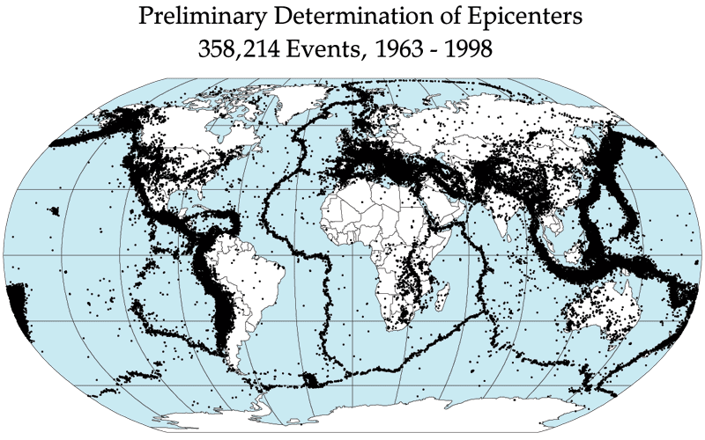
Thanks you !
Group members: Kan Hailan
Kim Jihwan
Sembakutti Kalindu
Tao Haoyang
Ye Fang
Notes:
Hayyan

