Slide 1
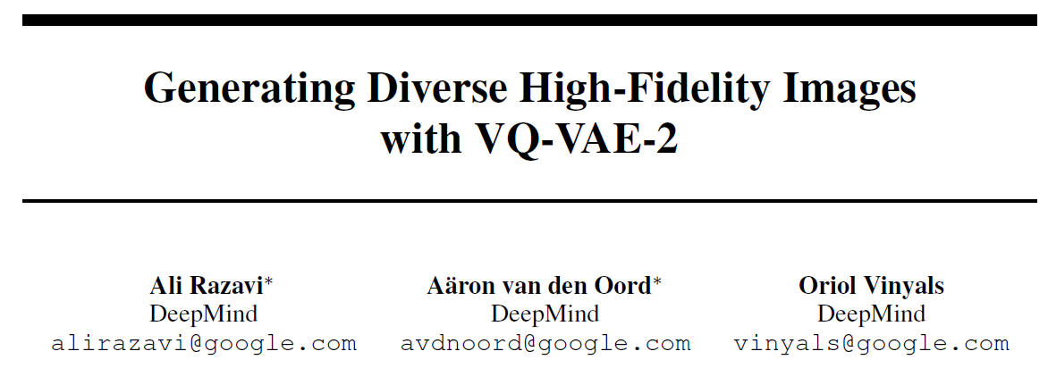

Slide 2
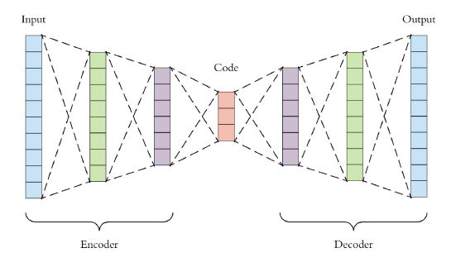
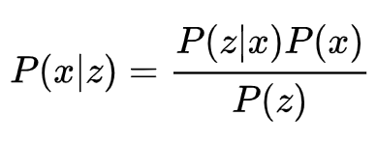
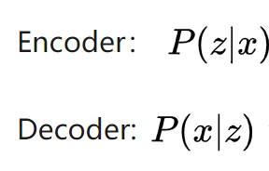
Auto-Encoders

Slide 3
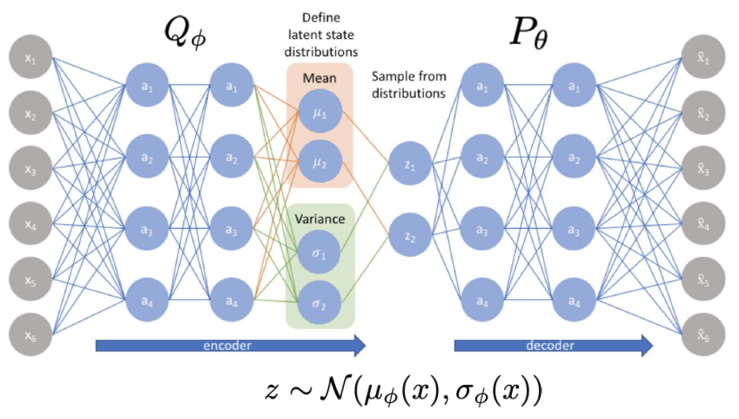
Variational Auto-Encoders
KL divergence

Slide 4
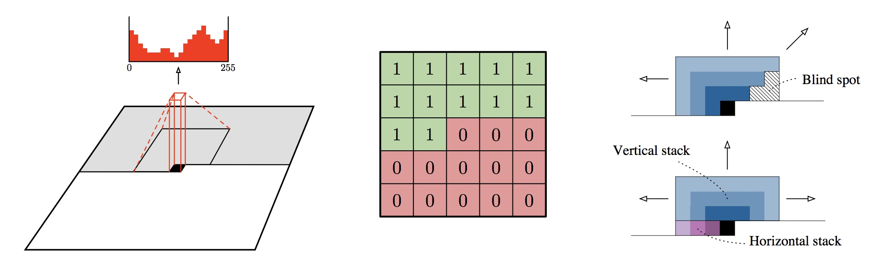
PixelCNN

Slide 5
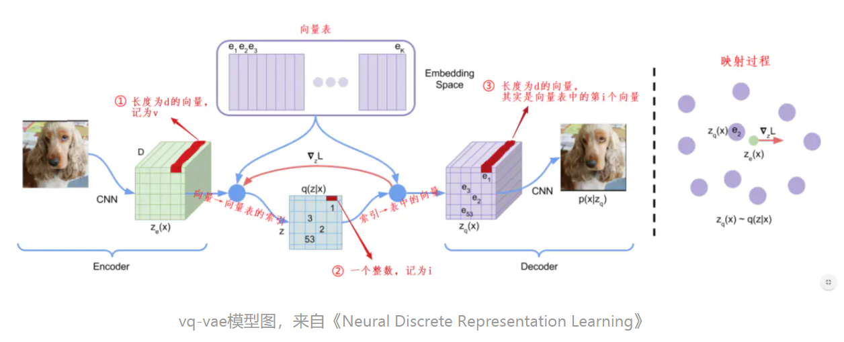
VQ-VAE Compression and Quantization

Slide 6
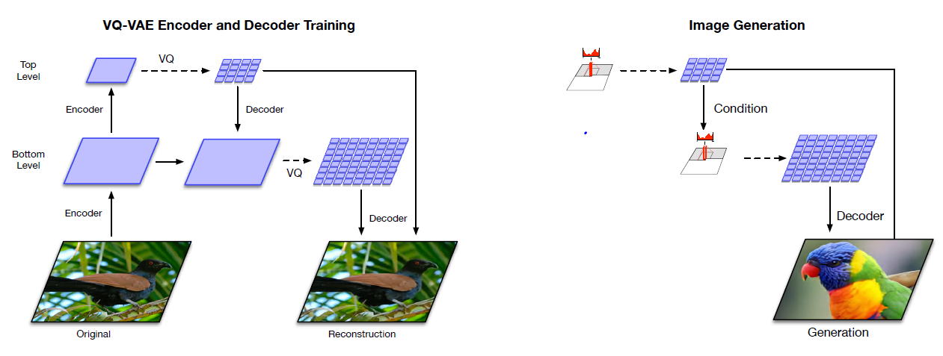
VQ-VAE-2

Slide 7
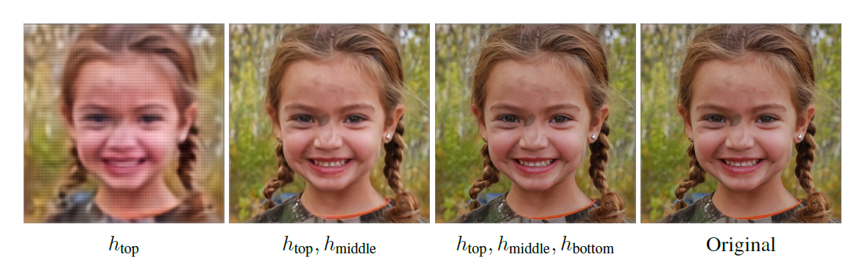

Slide 8
Reference
https://www.jianshu.com/p/57bb6fdc143a
https://zhuanlan.zhihu.com/p/68339385
https://lilianweng.github.io/lil-log/2018/08/12/from-autoencoder-to-beta-vae.html#vq-vae-and-vq-vae-2

