Slide 1
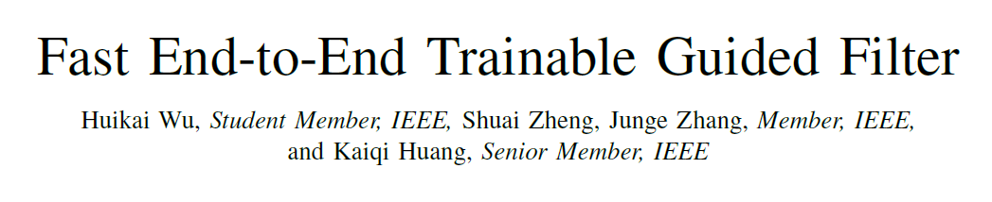

Slide 2
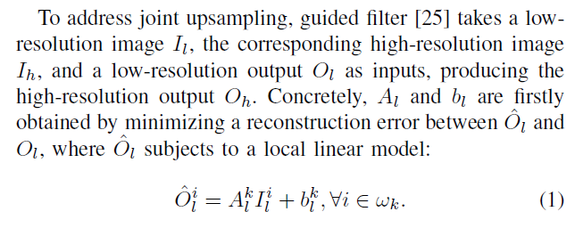

Background

Slide 3
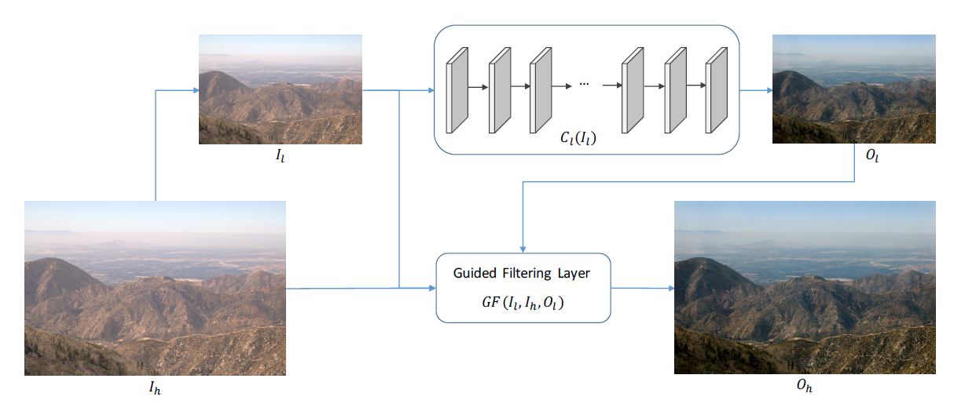
Deep Guided Filtering Network

Slide 4
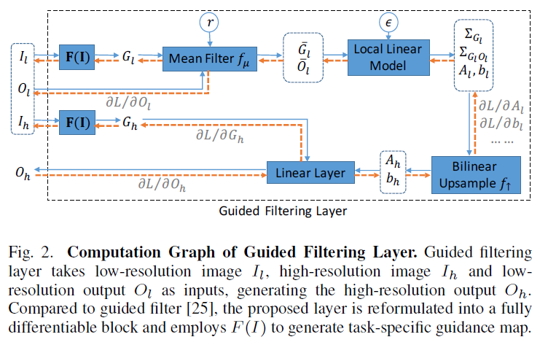
Guided Filtering Layer

Slide 5
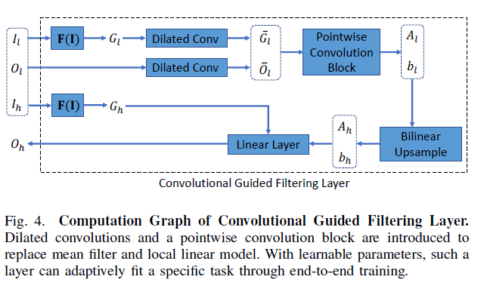
Convolutional Guided Filtering Layer

Slide 6

Four Variants of Deep Guided Filtering
${DGF}_{s}$ : original guided filter , without any training
${DGF}_{b}$ : Guided filtering layer
${DGF}_{b}^{c}$ : Convolutional Guided Filtering Layer
${DGF}^{c}$ : fit different tasks, the learnable F(I).

Slide 7
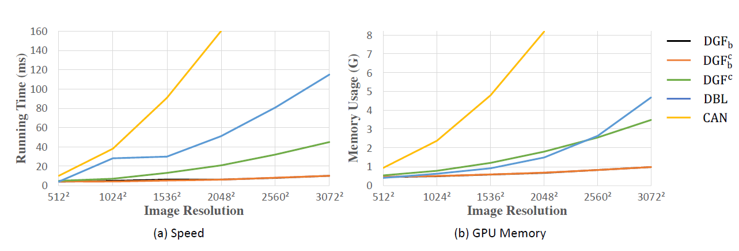
Speed and Memory Usage Comparison

Slide 8
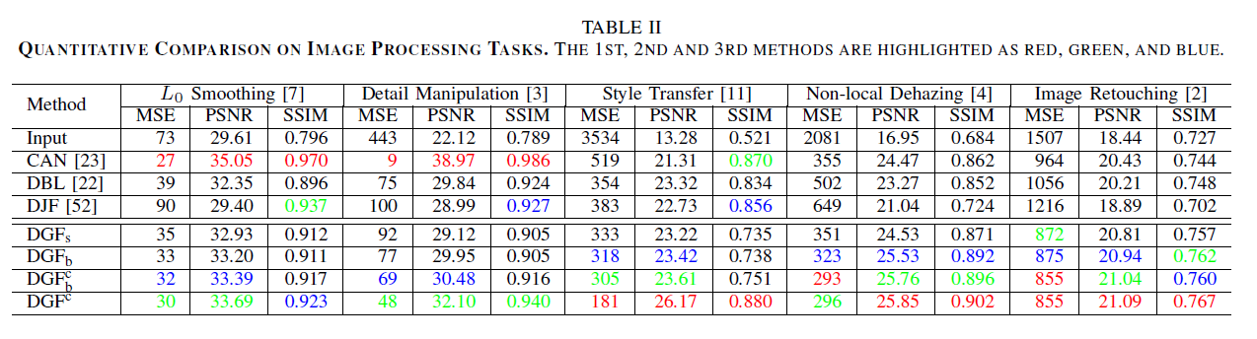
Experiments

Slide 9
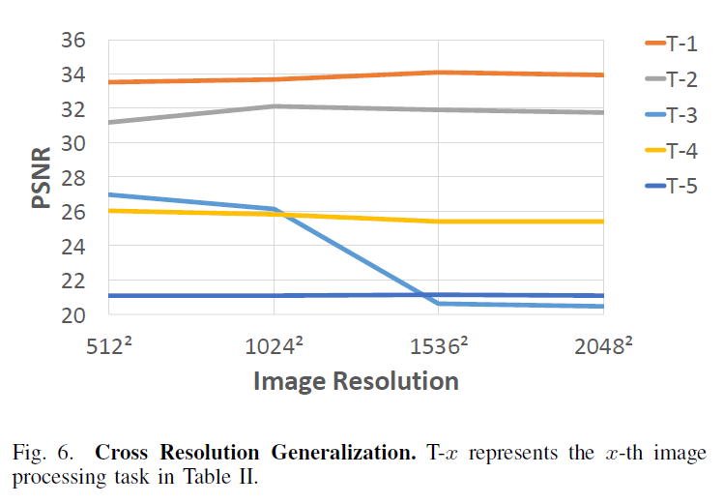
Cross Resolution Generalization

Slide 10
