Slide 1
FCUOS
FC
UOS
Click To Boot

Slide 2




Boot Manager
Disk Mode
Boot from disk
Sandbox Mode
Boot from sandbox

Slide 3
12:00
2021-1-1，Monday
点击屏幕以解锁

Slide 4







Slide 5





WLAN
Sound
Battery
Game mode
Signal

Slide 6








Google Chrome
Settings
Apps
Notepad
Weather
Files
Doge

Slide 7
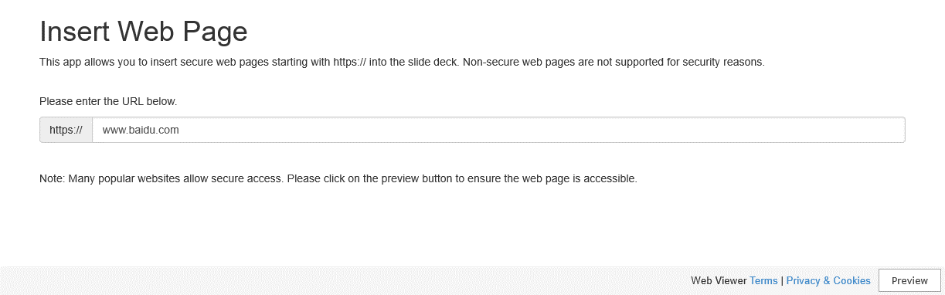

Slide 8

FCUOS Settings
WLAN
Connected FCUOS_Virtual_Wifi
Internet
Helps

Slide 9


FCUOS App Center
Minecraft Classic
Mojang
Virtual Machine
Custom Application
> Get
> Run
> Get
> Run
> Run
*Remember!Please set the name of Custom App to “CAPP.pptx”.Put Apps under “Application” Folder.

Slide 10

Notepad

Slide 11
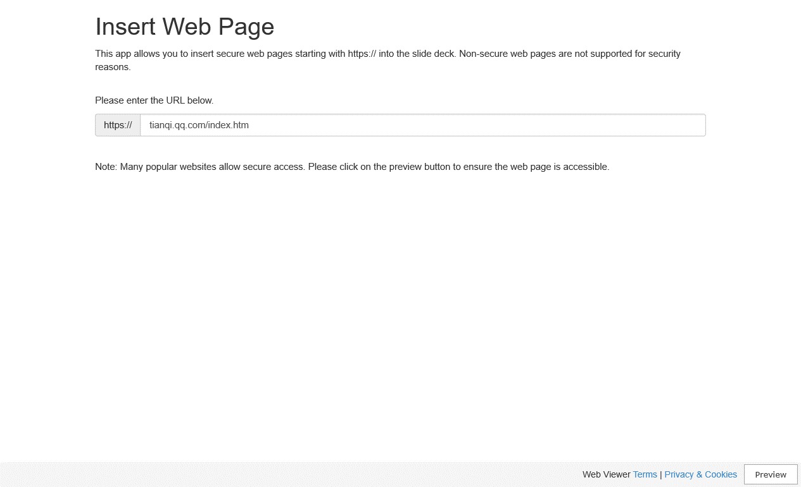

Slide 12






Slide 13
WLAN
Sound
Battery
Game Mode
Signal

Slide 14
Doge
Google Chrome
Settings
Applications
Weather
Files

Slide 15


Desktop Mode
Touch Mode

Slide 16


Slide 17
FCUOS Settings
WLAN
Connected FCUOS_Virtual_Wifi
Internet
Helps

Slide 18
FCUOS App Center
Minecraft Classic
Mojang
Virtual Machine
Custom Application
> Get
> Run
> Get
> Run
> Run
* Remember!Please set the name of Custom App to “CAPP.pptx”.Put Apps under “Application” Folder.

Slide 19
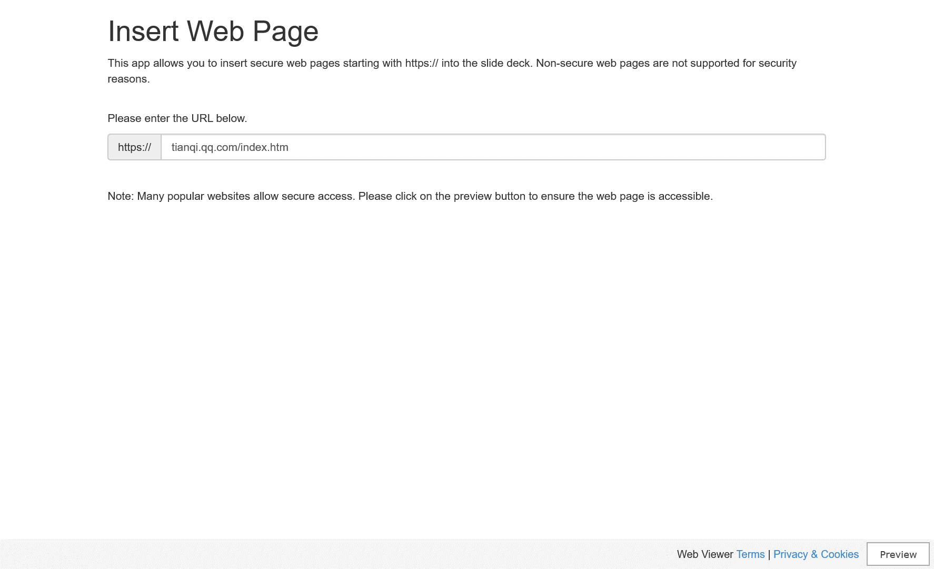

Slide 20
Doge
Adminstrator

