Slide 1
CCRT Hematologic Toxicity Prediction
Patient Dataset Overview & Project Architecture
N=200 Synthetic EMR Cohort | LSTM + Temporal Attention | CTCAE v5.0 Grading
Concurrent Chemoradiation Therapy | Lung Cancer | Stage III

Slide 2
Patient Dataset Summary (N=200)
200
63.6
73% / 27%
5
48
37%
Total Patients
Mean Age (yrs)
Male / Female
Chemo Regimens
CBC Measures (6 vars x 8 weeks)
Gr3+ Neutropenia
Variable | Type | Values / Range | N features
Demographics | Baseline | age, sex, bmi, ecog_ps | 4
Cancer Stage | Baseline | stage (IIIA/B/C), t_stage (T1-4), n_stage (N0-3) | 3
Lab Values | Baseline | creatinine (0.50-1.48), albumin (2.5-5.0) | 2
RT Treatment | Treatment | total_dose (60-66Gy), fraction_dose | 2
Chemotherapy | Treatment | regimen (EP/TP/GP/DP/wPTX), dose, cycles (2-4) | 3
CBC (raw) | Time-series | WBC, ANC, ALC, AMC, PLT, Hb x Week 0-7 | 48
CBC (derived) | Engineered | delta, slope, pct_change, cv, nadir, ratios | ~52
Targets | Binary | grade3_neutropenia, anemia, thrombocytopenia, leukopenia, lymphopenia | 5

Slide 3
Patient Demographics & Clinical Characteristics
Age Distribution
Sex
Male: 146 (73%)
Female: 54 (27%)
ECOG PS
PS 0: 50 (25%)
PS 1: 112 (56%)
PS 2: 38 (19%)
BMI
Range: 16.0-31.6
Mean: 23.5
<18.5: 13 (6%)
18.5-25: 129 (64%)
25-30: 56 (28%)
>30: 2 (1%)
Range: 40 - 82 years
(30, 50] ███░░░░░░░░░░░░░░░░░░░░░░ 12 (6%)
(50, 60] ██████████████░░░░░░░░░░░ 59 (30%)
(60, 70] █████████████████████░░░░ 85 (42%)
(70, 80] █████████░░░░░░░░░░░░░░░░ 38 (19%)
(80, 90] █░░░░░░░░░░░░░░░░░░░░░░░░ 6 (3%)
Mean: 63.6 | Median: 64.0 | SD: 8.3
Cancer Stage (AJCC)
IIIA: ██████████████████ 92 (46%)
IIIB: ██████████████ 74 (37%)
IIIC: ██████ 34 (17%)
T-Stage:
T1: 20 T2: 56 T3: 70 T4: 54
N-Stage:
N0: 9 N1: 39 N2: 97 N3: 55
Treatment
RT Total Dose:
60 Gy: 78 (39%)
63 Gy: 80 (40%)
66 Gy: 42 (21%)
Chemo Cycles: 2-4 (median: 3)
Chemotherapy Regimen
EP ████████████████ 65 (32%)
TP ███████████████ 62 (31%)
GP ███████ 30 (15%)
weekly_paclitaxel ███████ 28 (14%)
DP ███ 15 (8%)

Slide 4
CBC Time-Series Data & Hematologic Toxicity Outcomes
CBC Variables (6 measures x 8 timepoints)
WBC (10^3/uL): White Blood Cell count [2.4 - 13.0]
ANC (10^3/uL): Absolute Neutrophil Count [1.4 - 9.1]
ALC (10^3/uL): Absolute Lymphocyte Count [0.5 - 3.9]
AMC (10^3/uL): Absolute Monocyte Count [0.1 - 1.0]
PLT (10^3/uL): Platelet count [94.0 - 437.0]
Hb ( g/dL): Hemoglobin [6.6 - 20.5]
Timepoints: Week 0 (baseline) through Week 7
Input for prediction: Week 0, 1, 2 only
Baseline CBC Statistics (Week 0)
Variable | Mean | SD | Min | Median | Max
WBC | 6.65 | 2.08 | 2.44 | 6.46 | 12.98
ANC | 4.11 | 1.49 | 1.36 | 3.98 | 9.06
ALC | 1.69 | 0.56 | 0.48 | 1.64 | 3.89
AMC | 0.46 | 0.15 | 0.14 | 0.46 | 1.04
PLT | 238.53 | 65.78 | 94.00 | 236.00 | 437.00
Hb | 12.98 | 2.15 | 6.60 | 12.85 | 20.50
Grade 3+ Toxicity Outcomes (CTCAE v5.0)
Neutropenia (ANC < 1.0): ██████████████████░░░░░░░ 37.3% (n=224)
Leukopenia (WBC < 2.0): ██████████████████░░░░░░░ 37.0% (n=222)
Lymphopenia (ALC < 0.5): █████████████████░░░░░░░░ 35.7% (n=214)
Thrombocytopenia (PLT < 50): █████░░░░░░░░░░░░░░░░░░░░ 10.3% (n=62)
Anemia (Hb < 8.0): ███░░░░░░░░░░░░░░░░░░░░░░ 6.0% (n=36)
CTCAE v5.0 Grading Criteria
Neutropenia (ANC): Grade 1: <2.0 | Grade 2: <1.5 | Grade 3: <1.0 | Grade 4: <0.5
Anemia (Hb): Grade 1: <LLN | Grade 2: <10 | Grade 3: <8.0 | Grade 4: life-threatening
Thrombocytopenia: Grade 1: <LLN | Grade 2: <75 | Grade 3: <50 | Grade 4: <25
Leukopenia (WBC): Grade 1: <LLN | Grade 2: <3.0 | Grade 3: <2.0 | Grade 4: <1.0
Lymphopenia (ALC): Grade 1: <LLN | Grade 2: <0.8 | Grade 3: <0.5 | Grade 4: <0.2
Primary endpoint: Grade 3+ Neutropenia during CCRT (Week 0-7)

Slide 5
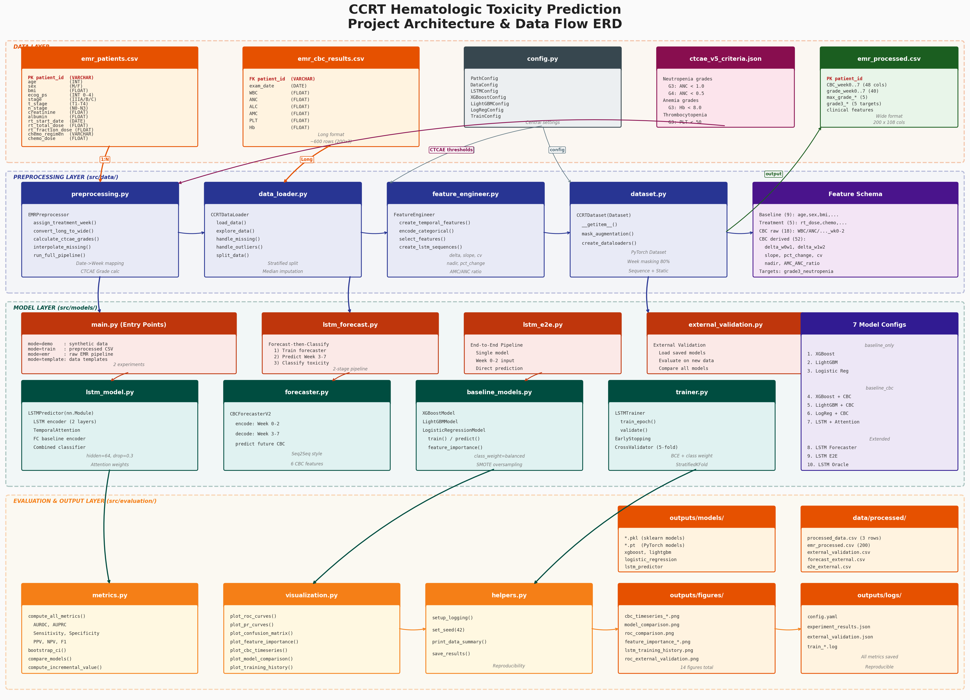
Project Architecture - ERD Overview

Slide 6
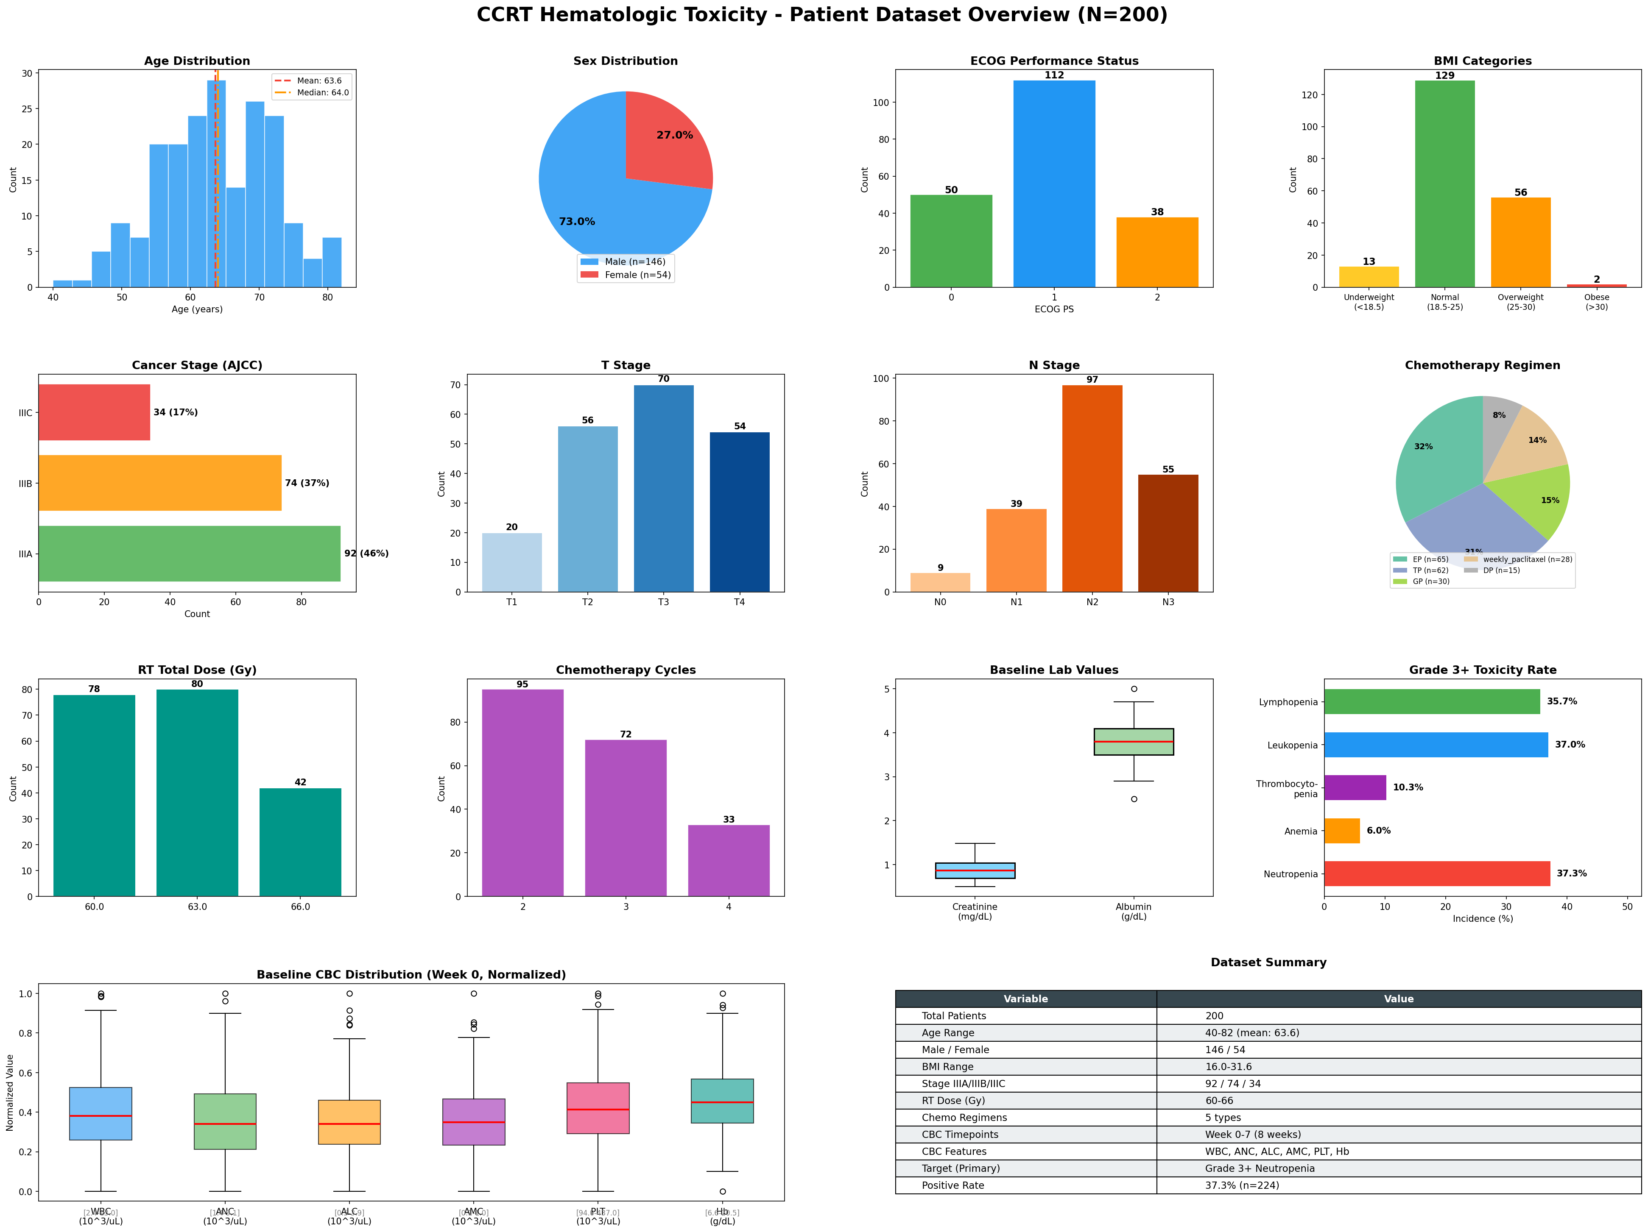
Patient Dataset - Visual Dashboard

Slide 7
Data Pipeline & Model Architecture
1. DATA LAYER
emr_patients.csv (200 rows x 16 cols)
PK: patient_id | demographics + stage + treatment
emr_cbc_results.csv (~600 rows, long format)
FK: patient_id | exam_date + 6 CBC variables
ctcae_v5_criteria.json
Grade thresholds for 5 toxicity types
▼
2. PREPROCESSING LAYER
preprocessing.py: Date -> Week mapping, Long -> Wide pivot, CTCAE Grade calc
data_loader.py: CSV loading, missing value imputation (median), outlier clipping (IQR)
feature_engineer.py: Temporal features (delta, slope, cv, nadir, ratios)
dataset.py: PyTorch CCRTDataset with 80% masking augmentation (Week 3-7)
Output: emr_processed.csv (200 rows x 108 columns)
▼
3. MODEL LAYER
Baseline Models: XGBoost + LightGBM + Logistic Regression
LSTM: LSTMPredictor (2-layer LSTM + Temporal Attention + FC baseline encoder)
Forecaster: CBCForecasterV2 (Seq2Seq: Week 0-2 -> predict Week 3-7)
Training: 5-fold Stratified CV, EarlyStopping, SMOTE, class weights
Entry: main.py (4 modes) | lstm_forecast.py | lstm_e2e.py | external_validation.py
▼
4. EVALUATION LAYER
metrics.py: AUROC, AUPRC, Sensitivity, Specificity, PPV, NPV, F1, Bootstrap CI
visualization.py: ROC/PR curves, confusion matrix, feature importance, CBC plots
helpers.py: Logging, seed setting, result serialization
Output: 14+ figures, config.yaml, experiment_results.json

Slide 8
Entity Relationships & Key Schema
emr_patients
emr_cbc_results
emr_processed
PK patient_id VARCHAR
--- Demographics ---
age INT
sex M/F
bmi FLOAT
ecog_ps INT (0-4)
--- Staging ---
stage IIIA/B/C
t_stage T1-T4
n_stage N0-N3
--- Lab ---
creatinine FLOAT
albumin FLOAT
--- Treatment ---
rt_start_date DATE
rt_total_dose FLOAT
rt_fraction_dose FLOAT
chemo_regimen VARCHAR
chemo_dose FLOAT
chemo_cycles INT
FK patient_id VARCHAR
exam_date DATE
--- CBC Values ---
WBC FLOAT
ANC FLOAT
ALC FLOAT
AMC FLOAT
PLT FLOAT
Hb FLOAT
~600 rows (long fmt)
PK patient_id VARCHAR
--- CBC Wide Format ---
{var}_week{0..7} FLOAT (48)
--- CTCAE Grades ---
{tox}_grade_week{0..7} (40)
max_grade_{tox} (5)
--- Targets ---
grade3_neutropenia BINARY
grade3_anemia BINARY
grade3_thrombocytopenia BINARY
grade3_leukopenia BINARY
grade3_lymphopenia BINARY
--- Clinical (merged) ---
age, sex, bmi, etc. (16)
200 rows x 108 columns
1 : N ──►
merge ──►
Entity Relationships:
emr_patients (1) ──── (N) emr_cbc_results via patient_id [1 patient has multiple CBC exam records over 8 weeks]
emr_patients + emr_cbc_results ──merge──► emr_processed [Long-to-Wide pivot + CTCAE grade calculation + feature merge]
emr_processed ──split──► train/val/test sets (80/10/10) [Stratified by grade3_neutropenia to preserve class balance]

