Slide 1
Predicting Adverse Events after COVID‐19 Vaccination
GROUP 4
LIN Lirong
GUO Yuchen
YUAN Fangxu
LONG Yuepeng
LEI Lijun

Slide 2
Content
Introduction
Methodology
Hospitalization Prediction
Onset Time Prediction
Conclusion and Discussion

Slide 3
Introduction

Slide 4
Introduction
COVID-19 virus —— a global epidemic
To prevent virus outbreak, vaccination is the most effective and cost-efficient strategy
Vaccine:
Pfizer/BioNTech, Moderna (mRNA vaccines requiring two doses)
J&J/Janssen (Viral vector vaccine requiring only one dose)

Slide 5
Introduction
Vaccine's efficacy and post-vaccination adverse events have become a global issue.
Cases of adverse reactions are collected by Vaccine Adverse Event Reporting System.
Potential side effects:
Arm: pain, redness, swelling, etc.
Rest of body: fatigue, headache, muscle pain, fear of cold, fever, nausea, etc.

Slide 6
Introduction
The goal of our study:
Predict when adverse events will occur in the body of the vaccine recipient following types of vaccine, and identify triggers and people at risk.
Determine the severity of symptoms and predict the vaccinees most likely to require hospitalisation.
These may help develop a better safety concerns and allocate medical resources.

Slide 7
Introduction
To achieve the goal, we need to do:
For onset time prediction:
Employ baseline patient variables such as gender, age, and medication history as input features and multiple algorithms, including linear regression models, random forest, and neural network.
For hospitalisation:
Apply dimensionality reduction methods including Principal Component Analysis (PCA) and Nave Bayes to lower the dimensionality of the original data

Slide 8
Methodology

Slide 9
Methodology
Dataset
Extraction
Interpretation
Hospital Prediction
Principal component analysis
Onset Time Prediction
Ordinary least squares
Regularized regression
Random forest
ANN

Slide 10
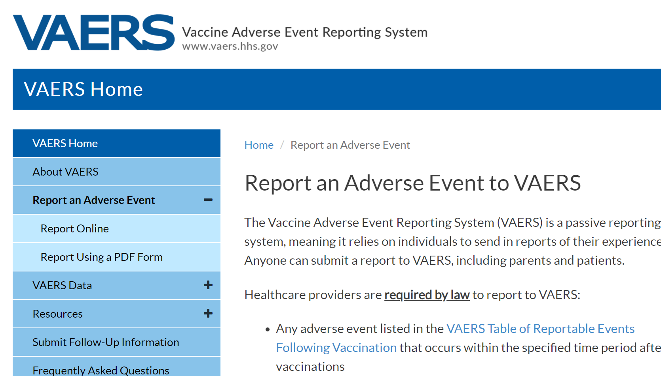
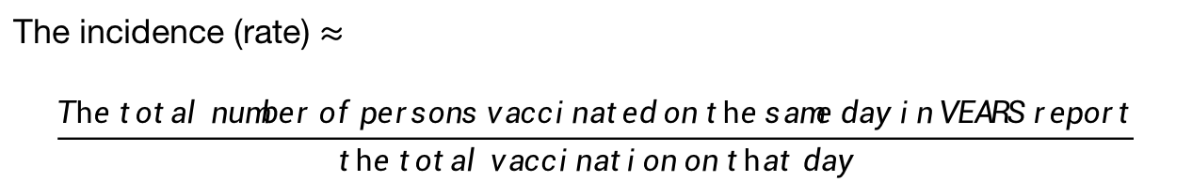
Data extraction and interpretation
"VAERS ID"
names of the symptoms
a dictionary
an array of
0 (did not occur)
1 (occurred)
assigned each individual
each reported symptoms
A dataset provided by VAERS for the period 2021/1/1 - 2021/9/10
an indexed list
The incidence (rate) $≈$
$$\frac{The total number of persons vaccinated on the same day in VEARS report}{the total vaccination on that day}$$

Slide 11
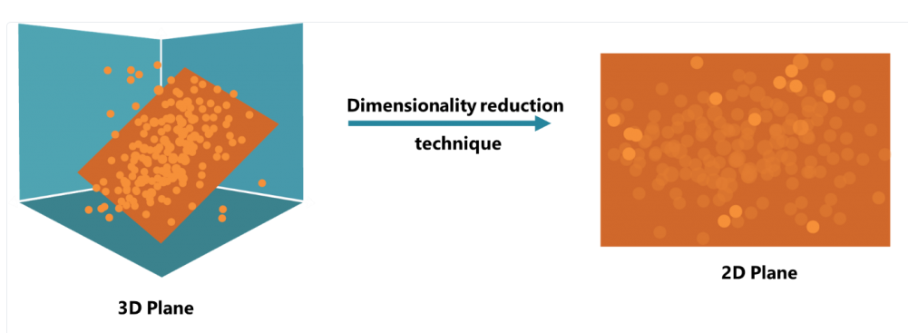
Principal component analysis
PCA is an unsupervised learning method for multivariate statistical analysis.
The main principle is to project high-dimensional data into a lower dimensional space to extract the main factors of multivariate things and reveal their essential features.
It can efficiently identify the main parts of the data and reduce the dimensionality of the original complex data.

Slide 12
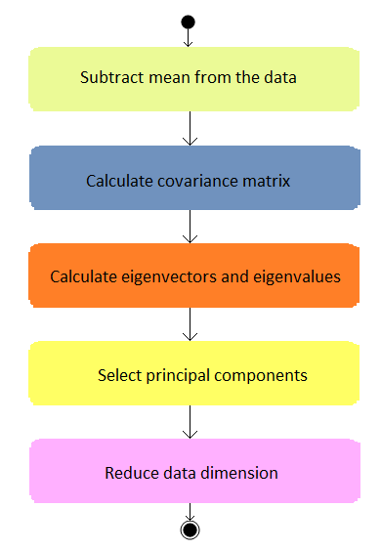
Principal component analysis
The steps of PCA algorithm
The PCA method is computationally simple and easy to implement.
The weakness is that it is less interpretative, as the new principal components are combinations of the original features and do not correspond one-to-one.

Slide 13
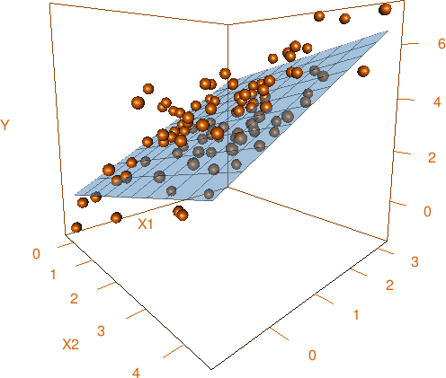
Ordinary least squares
OLS is a linear least squares method used to estimate unknown parameters in linear regression models.
It selects the parameters of a linear function of a set of explanatory variables by means of the principle of least squares, which minimizing the sum of squares of the residuals between the value of the predicted variable and the predictor variable observed in a given data set.

Slide 14
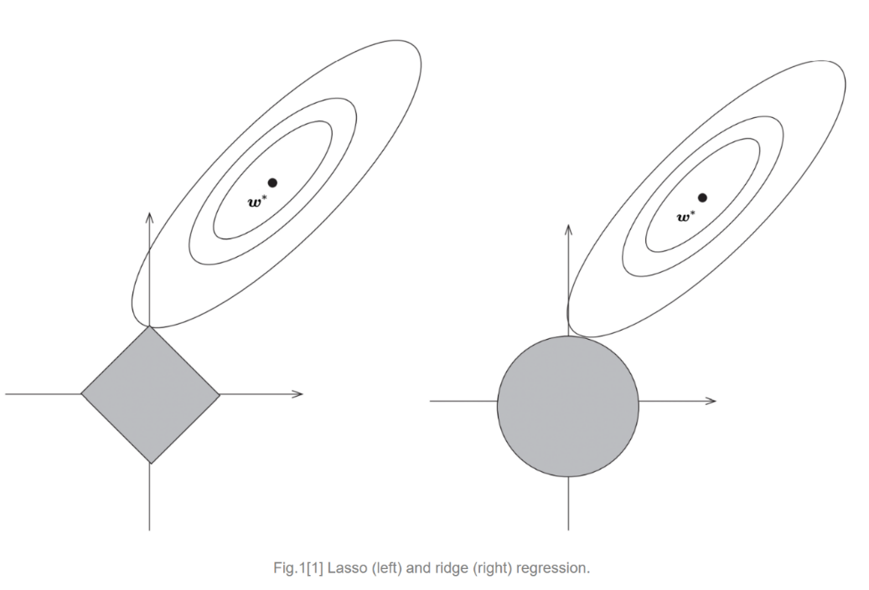
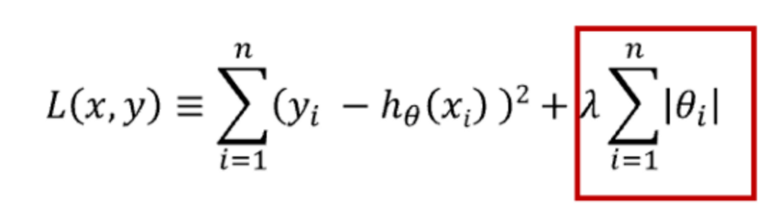
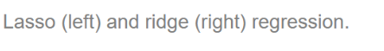
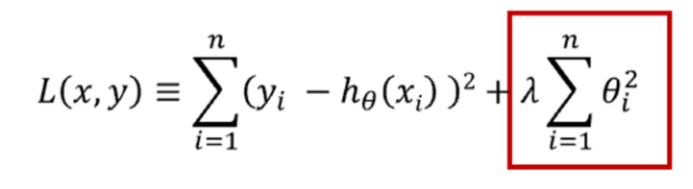
Regularized regression
(including Lasso, Ridge, and Elastic Net)
Regularisation is a common way of dealing with overfitting and refers to the addition of a constraint term after the regression model cost function.
Two different types of regularisation terms:
1. the sum of the absolute values of all parameters (L1 norm), called Lasso regression
2. the sum of the squares of all parameters (L2 norm), called Ridge regression

Slide 15
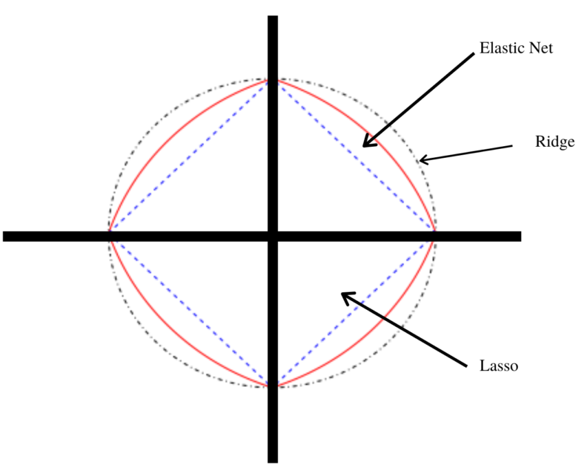
Regularized regression
(including Lasso, Ridge, and Elastic Net)
Elastic Net is a hybrid of Lasso regression and Ridge regression techniques.
It uses L1 and L2 regularization and also achieves the effects of both techniques.

Slide 16
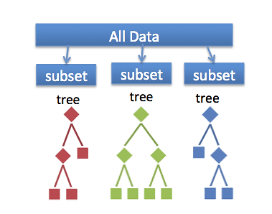
Random forest
Random forests are integrated learning methods for classification, regression that operate by constructing multiple decision trees at training time.
For classification tasks, the output of Random Forest is the class selected by most trees.
For regression tasks, the average or mean prediction of individual trees is returned.

Slide 17
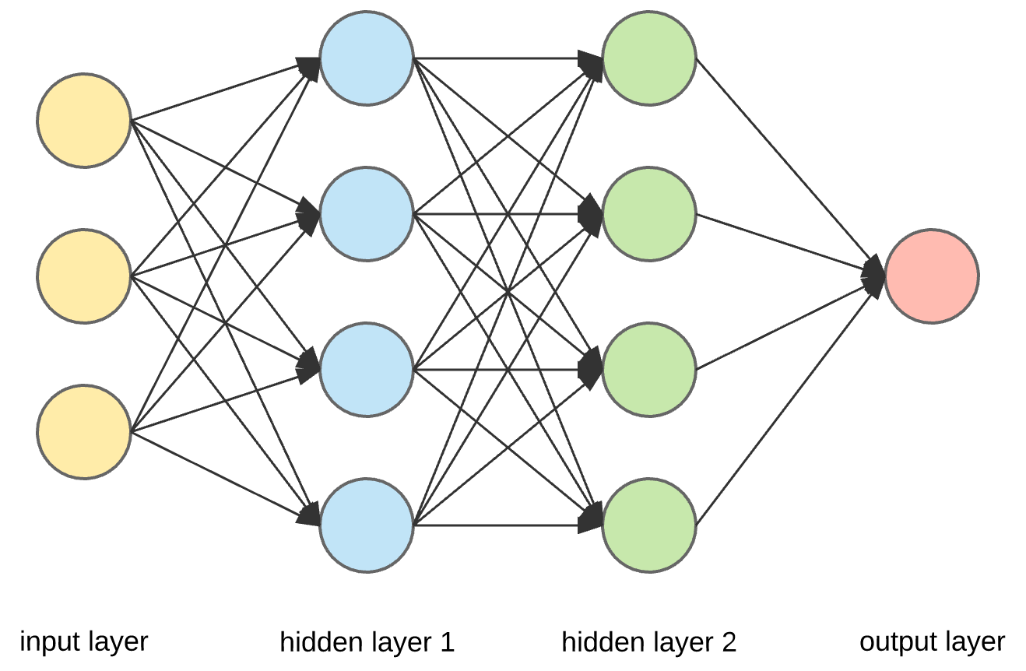
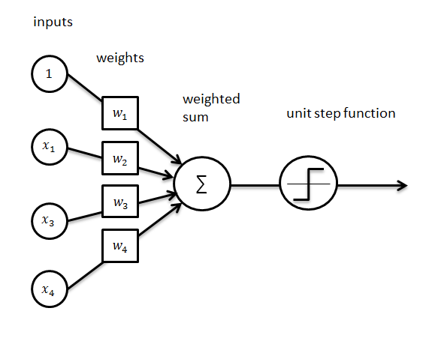
Artificial neural network
ANN is a complex network structure formed by a large number of interconnected processing units (neurons).
It is an information processing system based on a mathematical model that simulates the activity of neurons and is built to mimic the structure and function of neural networks in the brain.

Slide 18
Hospitalization Prediction

Slide 19
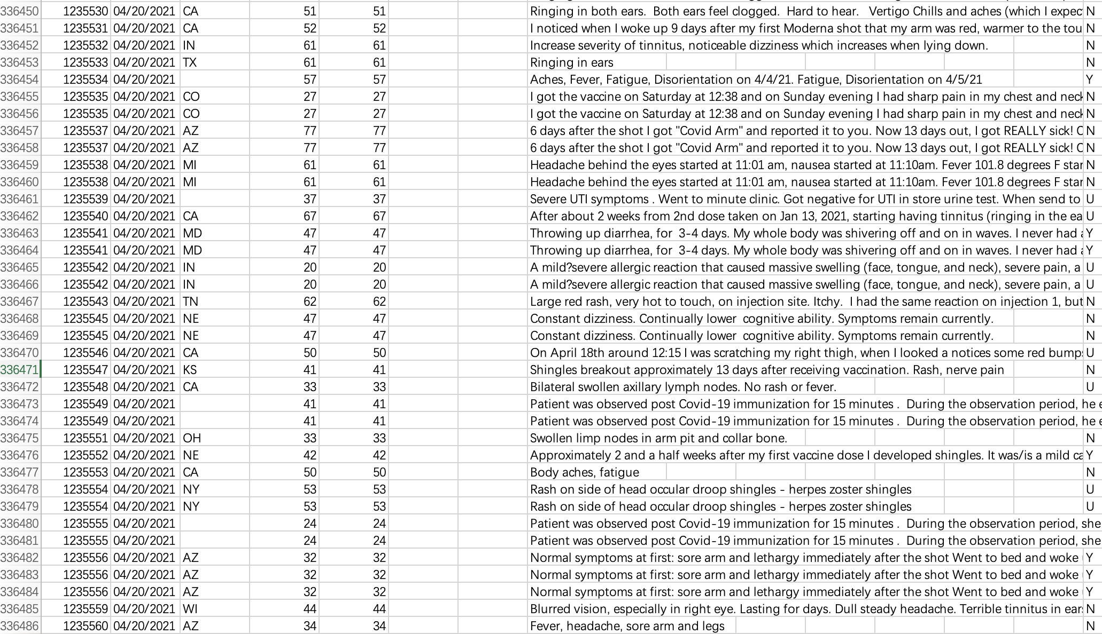
In our dataset, from January 1, 2021, to April 20, 2021, a total of 245,908 persons reported adverse events in the VAERS system producing 336,486 adverse events.
Notes:
In this part, our main task is to use machine learning approaches to classify the patients with needs for hospitalization for treatment after COVID-19 vaccination and find the significant symptoms. Firstly Let's look at the dataset. In our dataset, from January 1, 2021, to April 20, 2021, about two hundred and forty-five thousands people reported adverse events in the VAERS system producing over three hundred and thirty-six thousands adverse events.

Slide 20
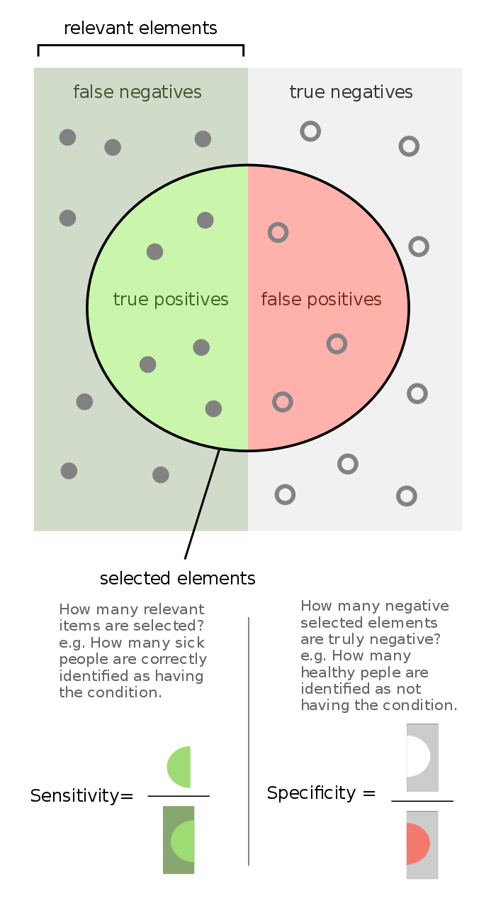
Firstly, there are 6725 unique symptoms. However, on average each patient only self-reported 5 symptoms resulting in a high dimensional and highly sparse input feature matrix.
Secondly, since most patients with self-reported adverse effects do not need hospitalization, the output labels are highly imbalanced. Even if we predicted all the outcomes as no need for hospitalization, the accuracy can still be up to 95%.
Sensitivity = Recall = TP/P = TP/(TP+FN)
Specificity = TN/N = TN/(TN+FP)
Notes:
So with the dataset, when we want to find the significant symptoms that cause hospitalization. Here coms two difficulties.
In the experient, we use the sensitivity and specificity to value our method, because these two metrics are common evaluation criteria in a clinical setting.
what we called zero probability problem

Slide 21
Sparse PCA
Naive Bayes
To solve the problem of high dimensional sparse features, we used sparse PCA to reduce the dimensionality of features from 6725 to 5 or 10.
Then we used the transformation to obtain the low dimensional features of all training set samples, and logistic regression with balanced class weights to compute the risk of hospitalization.
To tackle the zero-probability problem, we used Naïve Bayes classifier with sparse constraint for the Bernoulli distribution model and Laplace smoothing.
The risk of hospitalization is then computed. And the significant symptoms are selected according to the posterior probabilities.
Notes:
we focus on the significant symptoms that would lead to patients' needs for hospitalization, we only used the symptoms reported by patients with the need for hospitalization to obtain the principal components.
we used the transformation to obtain the low dimensional features of all training set samples, and logistic regression with balanced class weights to compute the risk of hospitalization.

Slide 22
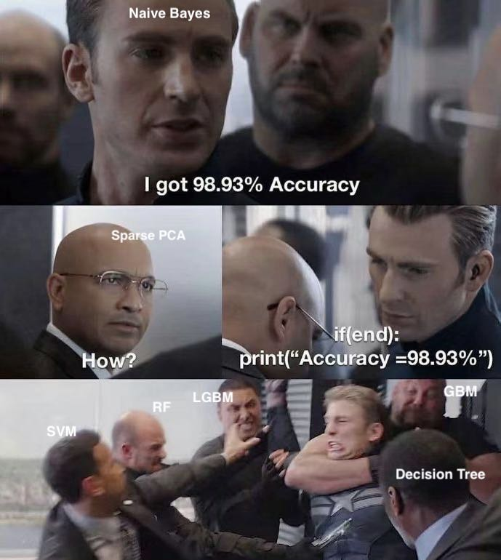
Results

Slide 23
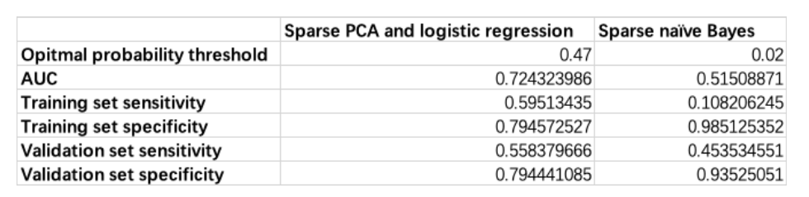
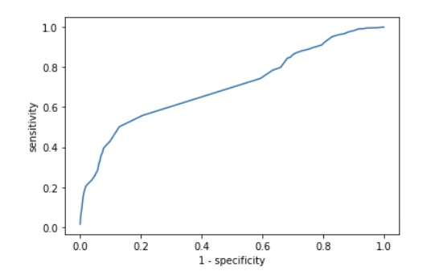
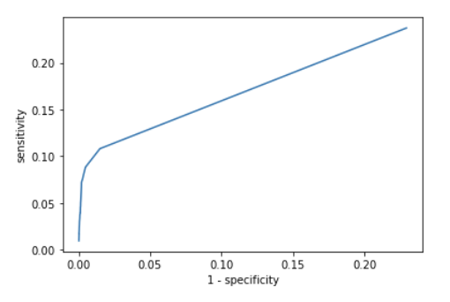
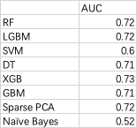
Results
Specificity = TN/N = TN/(TN+FP)
Sensitivity = TP/P = TP/(TP+FN)
Sparse PCA
Naive Bayes
*The AUC scores of baselines are condunct from Md Martuza Ahamad et.
They only consider 126 symptoms, the true value of 6725 symptoms must be
a lot less than that.
Notes:
This is the true figure. It seems that Naive Bayes model get a better specificity with 98% than Sparse PCA. however specificity is used to measure the probability that hospitalization did not occur in the result. Our aim is to extract the important features that lead to hospitalisation. So we should facous on sensitivity.
For AUC, we compared our model with other baselines and found that our sparse PCA approach still gave good results

Slide 24
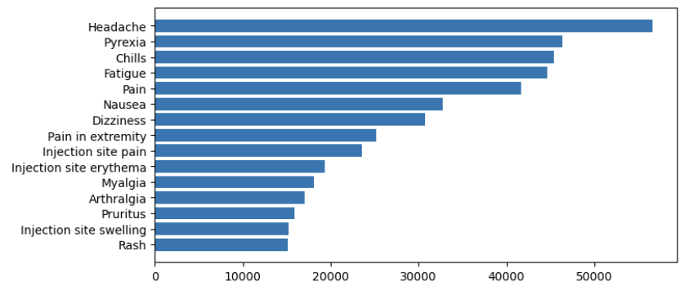
Results
Top 20 symptoms from Sparse PCA
Top 20 Symptoms from Naive Bayes
'Chills',
'Blood test',
'Pyrexia',
'Computerised tomogram', 'Unevaluable event',
'Dyspnoea',
'Pain',
'Nausea',
'Fatigue',
'Myalgia',
'Vomiting',
'Death',
'SARS-CoV-2 test negative', 'Hyperhidrosis',
'Malaise',
'Diarrhoea',
'Arthralgia',
'Pain in extremity',
'Abdominal pain',
'White blood cell count increased'
'Pyrexia',
'Pain',
'Fatigue',
'Chills',
'Headache',
'Nausea',
'Injection site pain',
'Injection site erythema',
'Pain in extremity',
'Dizziness',
'Myalgia',
'Arthralgia',
'Pruritus',
'Rash',
'Injection site swelling',
'Dyspnea',
'Injection site pruritus',
'Vomiting',
'Erythema',
'Asthenia'.
Notes:
And here are top 20 symptoms extracted from two models;
The symptoms with yellow masks are the overlapped symptoms. When we compared symptoms extracted from Naive Bayes with the most common symptoms, we can find the the symptoms are exactly the most common symptoms. Remember that our tast is to extract the most significant symptoms, so that's the reason why naive bayes model does not do well in sensitivity.

Slide 25
Onset Time Prediction

Slide 26
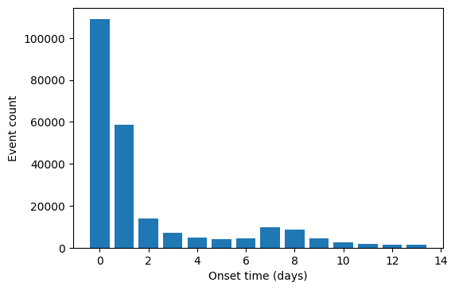
Onset Time Prediction
Since a person could report multiple adverse events, only the first reported event for every person was used
242719 reports in the onset prediction dataset, nearly 75% of which were reported the onset time within 3 days

Slide 27
Preprocessing Predictors
Age, gender, vaccine manufacturer, current disease, medication usage, allergy history, pre-existing illnesses...
Some of them are binary variables (0 or 1)
“Age” must be a continuous variable (needs normalization)
Min-max normalization was applied
How to encode allergy history? What symptoms should we care?
17 most-common symptoms were selected and encoded as Boolean variables (True or False)
Vaccine manufacturers was encoded as 3 dummy variables
One Boolean variable for each manufacturer

Slide 28
Predictor Importance
27 predictors in total, some of which were not important
Different metrics were used in different models:
P values (from T-test) for OLS
Standardized coefficients for regularized regressions
Mean of decrease in accuracy for Random Forest
Sum of coefficients for ANN
Predictor importance were likely to differ when predicting different durations of onset time
Onset time <= 3 days – “Shorter” dataset
Onset time > 3 days – “Longer” dataset

Slide 29
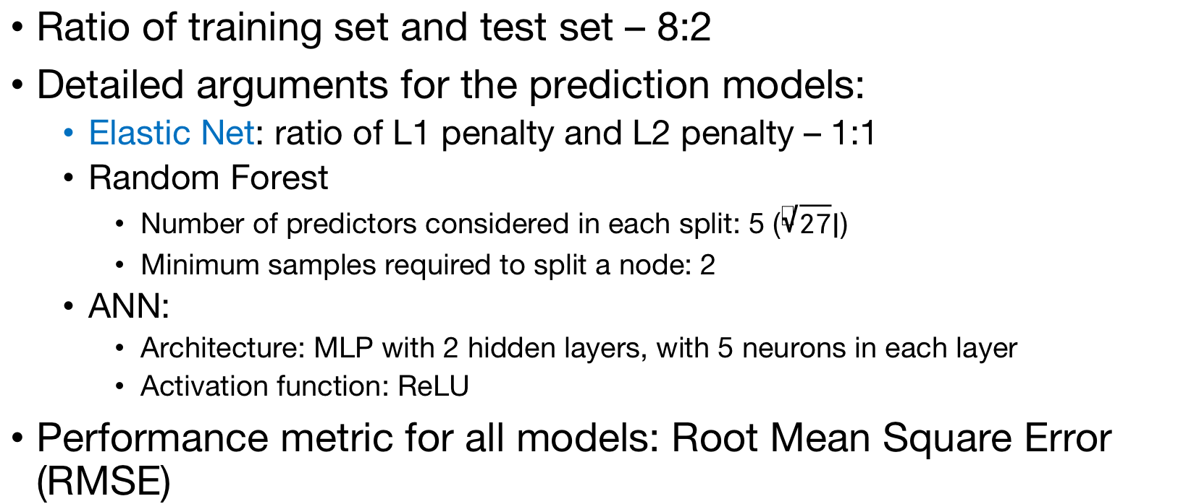
Dataset Splitting & Model Arguments
Ratio of training set and test set – 8:2
Detailed arguments for the prediction models:
Elastic Net: ratio of L1 penalty and L2 penalty – 1:1
Random Forest
Number of predictors considered in each split: 5 ($\left\lfloor \sqrt{27}\right\rfloor$)
Minimum samples required to split a node: 2
ANN:
Architecture: MLP with 2 hidden layers, with 5 neurons in each layer
Activation function: ReLU
Performance metric for all models: Root Mean Square Error (RMSE)

Slide 30
Results - Performance
 | Training RMSE | Test RMSE
OLS | 5.37476826 | 5.34608356
Lasso | 5.37477033 | 5.34600854
Ridge | 5.37476781 | 5.34606870
Elastic Net | 5.37477033 | 5.34600854
Random Forest | 4.85620750 | 5.55952327
Neural Network | 5.36143203 | 5.33521479
RMSE all around 5 days
ANN was slightly better (highly due to non-linear model)
Still not good enough for application in real scenarios
More predictors may be needed

Slide 31
Results - Key Predictors
 | Key predictors (shorter onset) | Key predictors (longer onset)
OLS | Age Other medication Disability Gender Hypertension | Age Gender Disability Allergic history Other medication
Lasso | Other medication Age Disability Gender Hypertension | Age Gender Allergic history Other medication Disability
Ridge | Other medication Age Disability Gender Hypertension | Age Gender Allergic history Other medication Disability
Elastic Net | Other medication Age Disability Gender Hypertension | Age Gender Allergic history Other medication Disability
Random Forest | Age Current illness Allergic history Thyroid Hypertension
Neural Network | Hyperlipidemia Allergic history Age Dementia Migraine
Most key predictors were common agreements among all models
Key predictors for predicting longer onset time were slightly different from those for predicting shorter onset time
RF and ANN highlighted some other predictors that were not key predictors for linear regressions

Slide 32
Conclusion and Discussion

Slide 33
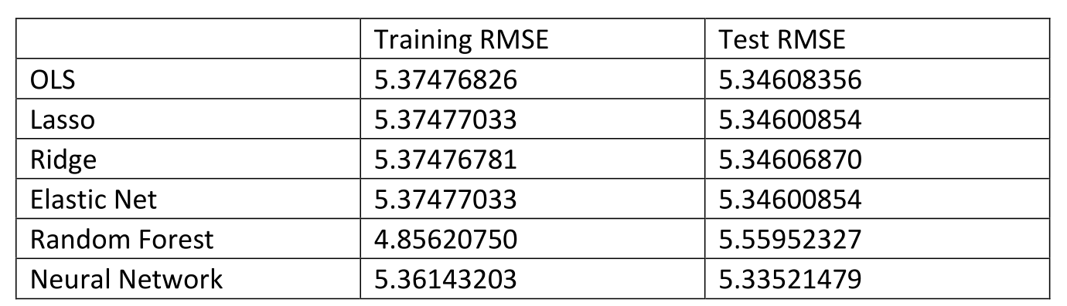
Conclusion
For onset time prediction:
Neural network slightly outperformed other algorithms in predicting the event onset time
Notes:
In this study, for onset time prediction, neural network slightly outperformed other algorithms in predicting the event onset time and this may due to the hidden layer exploited the interactions between predictors and improve the prediction performance.

Slide 34
Conclusion
For hospital prediction:
When selecting features that require hospitalization, sparse PCA get higher scores in Sensitivity and AUC than SVM and naïve Bayes
 | SVM | Sparse PCA | Sparse Naïve Bayes
Sensitivity | 0.42 | 0.56 | 0.45
AUC | 0.6 | 0.72 | 0.52
Notes:
For hospital prediction, when selecting features that require hospitalization, sparse PCA get higher score in Sensitivity and AUC than SVM and naïve Bayes.
Machine learning with high dimensional sparse features with highly imbalanced labels is always a challenging problem. In future work, we will keep exploring methods that can handle this problem effectively.

Slide 35
Discussion
People are reluctant to get vaccinated for the various reasons:
A lack of availability to the vaccine
An unwillingness to consider Covid-19 as a threat
Fear of side effects
A lack of faith in the vaccination or the agency that developed it
By accomplishing the onset time prediction and hospitalization prediction, we can:
Improving our understanding of safety issues
Rationalize medical resources
Notes:
Nowadays, the epidemic is not getting better around the world, and even in such a serious situation, many people still choose not to get vaccinated. Experts say there are various reasons for this, including a lack of availability to the vaccine, an unwillingness to consider Covid-19 as a threat, fear of side effects, a lack of faith in the vaccination or the agency that developed it and so on.
By accomplishing the onset time prediction and hospitalization prediction in this study, we can improve our understanding of safety issues and rationalize medical resources.

Slide 36
Discussion
Later, by optimizing the neural network and expanding the database, we can:
Recommend the most suitable vaccine based on the information of the vaccinated person
Predict the need for hospitalization based on side effects after vaccination
We can help those people who are worried about adverse effects following immunization to some level.
Notes:
Later, by optimizing the neural network and expanding the database, we can:
Better predict the different kinds of adverse reactions of different types of vaccines received by the prepared vaccine recipient through his information, and then recommend the most suitable vaccine to him.
Even if symptoms develop after the vaccination, we can predict whether the vaccinated person needs to be hospitalized by describing the symptoms.
We may not be able to increase vaccine production or change people’s minds about the Covid-19, but we can help those who are afraid of the side effects that come with vaccination by helping to alleviate those fears and thereby expand vaccination coverage to protect themselves and others.

Slide 37
Thanks!

