Slide 1
A brief talk about network for Academic Salon
嵇晨

Slide 2
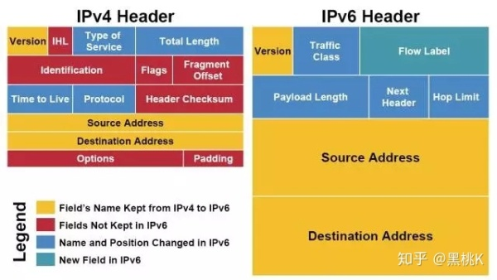
IPv4 and IPv6

Slide 3
Difference from v4 and v6
Description | IPv4 | IPv6
Number | 2^32 | 2^128
Message-passing protocol | ARP | Neighbor Solicitation
Payload Recognition | × | √（Flow Label)
Circuit Address | 127.0.0.1 | ::1
For more details please refer to https://blog.csdn.net/chao199512/article/details/86139714

Slide 4
IPv4→IPv6
Dual IP Stack
Tunneling
NAT64

Slide 5
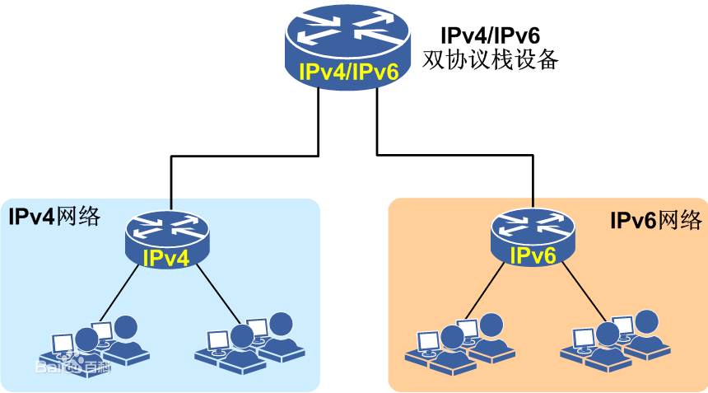
Dual IP Stack(1 on 1,2 on 2)

Slide 6
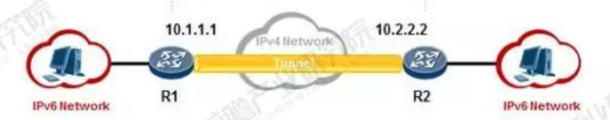
Tunneling
Reveal IPv6 in public network
Easy to be robbed
Difficult to configure and maintenance

Slide 7
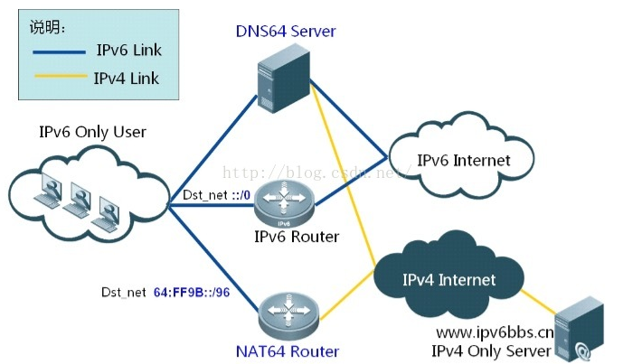
NAT64
Usually used to transform v6 to v4
The process of transforming consumes time and comes with low efficiency

Slide 8
Difficulties in IPv4→IPv6
Differ too much from each other
Shortages of techniques above
No profits, too many costs for ISP
CIDR and NAT make IPv4 survive

Slide 9
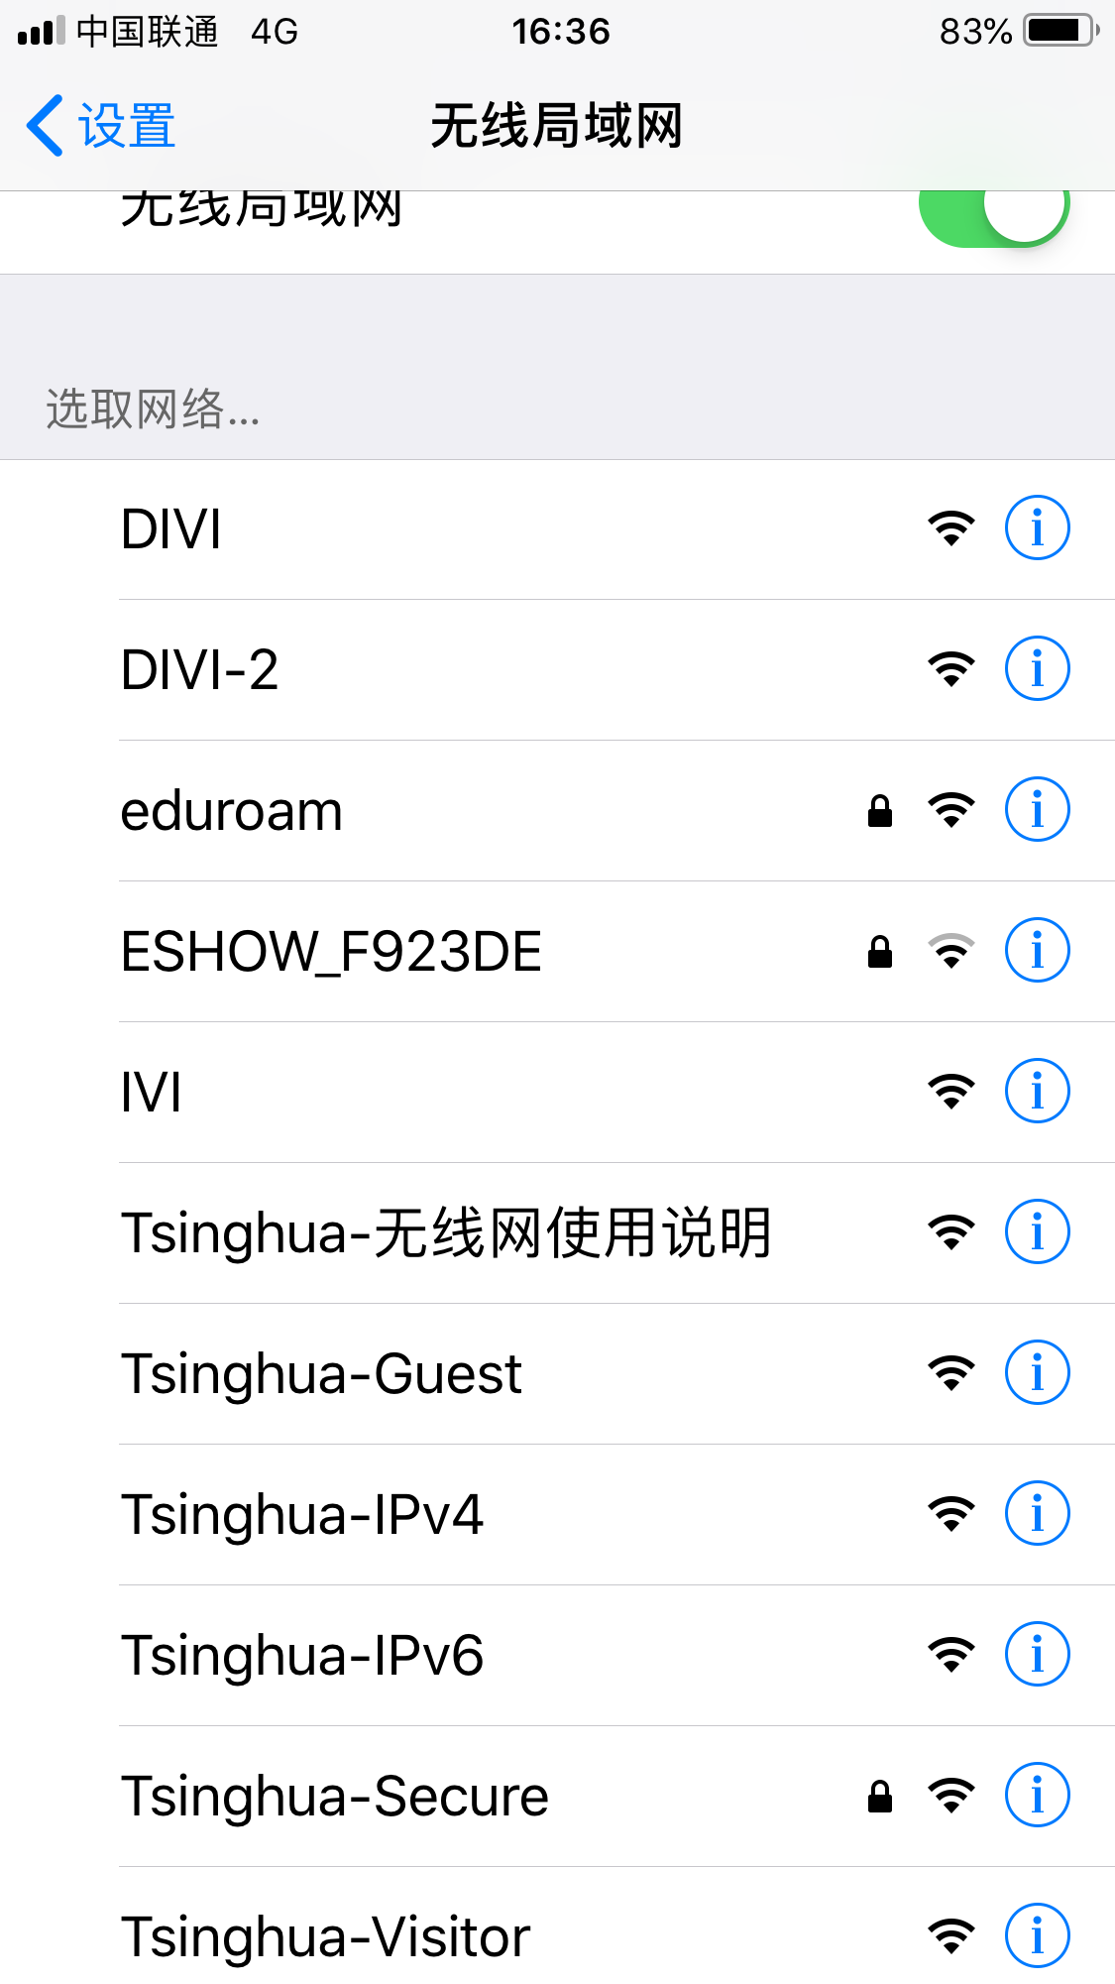
Campus Network in THU

Slide 10
IVI
Proposed by Professor Li Xing, researcher of CNGI-CERNET2 from THU
A translation technique between IPv4 and IPv6(IV and VI)
Embed IPv4 address into IPv6 address to make an IPv6 address X with specific-prefix
Access IPv6 resources directly and access IPv4 resources indirectly by XLAT devices
One to one

Slide 11
DIVI(Division IVI)
Updated from IVI
Address division multiplexing
Embed PSID which present the properties of port segment into IPv6 address
Design a strict sort of port mapping algorithms
one to N
DIVI-2( DIVI(5G) )

Slide 12
Campus Network
IP detect and limitation
White lists
VPN

Slide 13
VPN(Virtual Private Network)
Remote access technique
Make use of public network to build private network
A VPN server is needed in the intranet
Can be encrypted
PPTP、L2TP、IPSec
AVPN、IVPN、EVPN
Efficient netflow characteristics

Slide 14
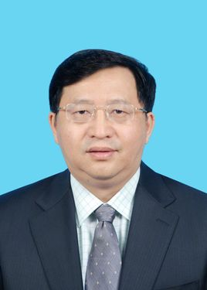
GFW(Great Firewall)
Designed by Fang Bin Xing, the former president of BUPT
IP Blockade of National Entry Gateway
Keyword filtered blockade in backbone routers
Domain hijacking
HTTPS Certificate filtering
DNS deceive

Slide 15
SS(Shadowsocks)
Based on socks agent(Socks5)
Mutant from Socks
Aimed at GFW to some extent

Slide 16
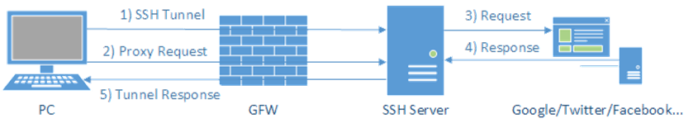
Standard Socks(SSH)

Slide 17
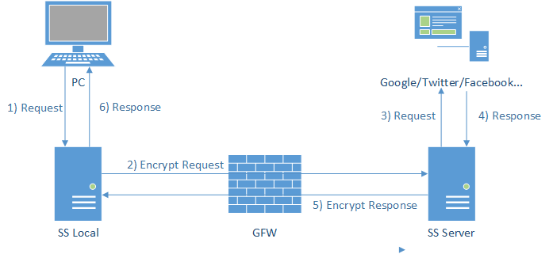
SS
Industrial-level encryption algorithms(aes、md5)
Symmetric or asymmetric encryption algorithms
Usually be discerned as common flow by GFW

Slide 18


Technique only!

