Slide 1
Intelligent Information Retrieval
2019/8/28

Slide 2
Overview
Information Retrieval
ELK Stack
Elasticsearch
Logstash
Kibana
Related works & thoughts
RESTful API
SQL Access
Intelligent Information Retrieval
Intelligent Information Retrieval

Slide 3
Information Retrieval

Slide 4

What is Information Retrieval (IR)
Narrow-sense:
IR = Search Engine Technologies (i.e. IR =
Google, Yahoo, Bing, Ask, Baidu, Sogou, ...
Library info search, enterprise search, in-site search, desktop search...
PicSearch, Greplin, Blekko, SkyScanner, KooXoo, Qunar, ...
Intelligent Information Retrieval

Slide 5
What is IR? (cont.)
Broad-sense: IR ~ Information Management
General problem: how to manage information?
How to find useful information? (retrieval & recommendation)
Beyond search engine:
e.g. in news feed, movie, travel, e-commerce, financial...scenarios
e.g. in social media platform, e.g. Twitter, Facebook, YouTube, WeChat, Weibo, Zhihu, ......
How to organize information? (classification & filtering)
e.g. automatically assign email to different folders
How to discover information (or even knowledge) from the data? (mining)
e.g. discover correlation of events
Intelligent Information Retrieval

Slide 6
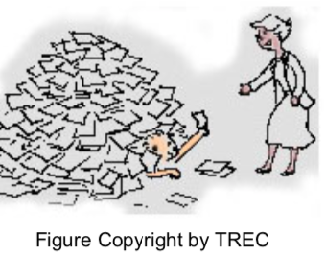
What is IR? (cont.)
Goal:
Find documents relevant to an information need
from a large document set
And now:
Beyond relevance
Multi-modal documents
Users’ (implicit) information need
Heterogeneous environment
Intelligent Information Retrieval

Slide 7
IR is Hard!
Under/over-specified query
Ambiguous: “buying CDs” (certificate deposit? or compact disc?)
Incomplete: what kind of CDs?
What if “CD” is never mentioned in document?
Vague semantics of documents
Ambiguity: word-sense, structural
e.g.“bank”
Incomplete: Inferences required
E.g.“windows”“apple”
A difficult task even for human beings!
Only 80% agreement in human judgments
Intelligent Information Retrieval

Slide 8
IR is “Easy”!
IR CAN be easy in a particular case
Ambiguity in query/document is RELATIVE to the database
So, if the query is SPECIFIC enough, just one keyword may get all the relevant documents
PERCEIVED IR performance is usually better than the actual performance
Users can NOT judge the completeness of an answer
E.g. Web Search vs. Machine Translation
Intelligent Information Retrieval

Slide 9
ELK Stack

Slide 10



ELK Stack
Version: 7.3.0

Slide 11
MAJOR HIGHLIGHTS OF ELASTICSEARCH
BUILT ON TOP OF LUCENE
Built on top of Lucene, which is a full-featured information retrieval library, so it provides the most powerful full-text search capabilities of any open source product.
DOCUMENT-ORIENTED
Stores real world complex entities as structured JSON documents and indexes all fields by default
FULL-TEXT SEARCH
Elastic Search implements a lot of features, such as customized splitting text into words, customized stemming, facetted search, and more.
SCHEMA FREE
Elastic Search is schema free—instead, it accepts JSON documents, as well as tries to detect the data structure, index the data, and make it searchable.
RESTFUL API
Elastic Search is API driven; actions can be performed using a simple Restful API.
PER-OPERATION PERSISTENCE
Elastic Search records any changes made in transactions logs on multiple nodes in the cluster to minimize the chance of data loss.
Notes:
﻿现在大部分数据库在提取可用知识方面显得异常无能。的确，它们能够通过时间戳或者精确匹配做过滤，但是它们 能够进行全文搜索，处理同义词和根据相关性给文档打分吗？它们能根据同一份数据生成分析和聚合的结果吗？最重要的 是，它们在没有大量工作进程（线程）的情况下能做到对数据的实时处理吗？

Slide 12
Well-suited environments for ES
Searching a large number of products for the best match with a specific phrase
Auto-completing a search box on partially-typed words, which are based on previous searches.
Accounting for misspellings in searches
Storing a large quantity of semi-structured (JSON) data in a distributed fashion
Elastic Search is generally fantastic at providing approximate answers from data, such as scoring the results by quality.
Finding approximate answers is a property that separates elastic Search from more traditional databases.

Slide 13
Related Works

Slide 14
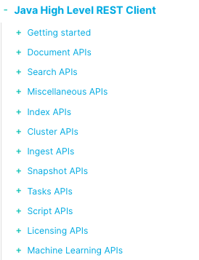
Java High Level REST Client
Depends on the Elasticsearch core project
Works on top of the Java Low Level REST client
Main goals:
expose API specific methods
accept request objects as an argument
return response objects
Call APIs
Synchronous – direct return response
Asynchronous – listener

Slide 15
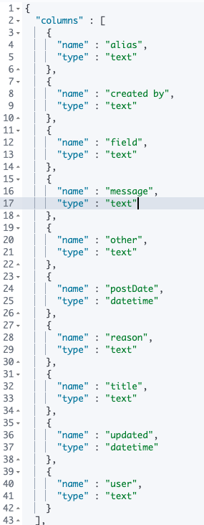

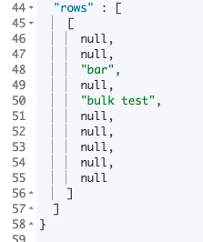
SQL Access
Use SQL in ES
Result format

Slide 16

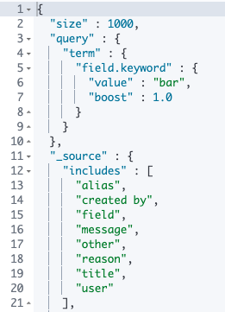
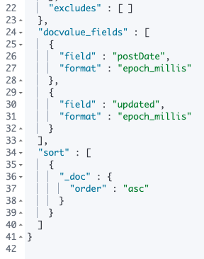
SQL Access
Translate SQL to DSL
Result format

Slide 17
Intelligent Information Retrieval

Slide 18
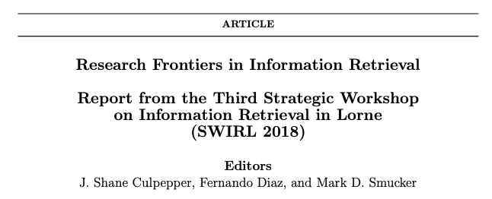
Intelligent? HOW?
Empower IR with ML/DL/NLP…
Precision & Recall
Ambiguous keywords
Vague search results
Relevance problems
…
An emerging and promising area
https://sigir.org/wp-content/uploads/2018/07/p034.pdf

Slide 19
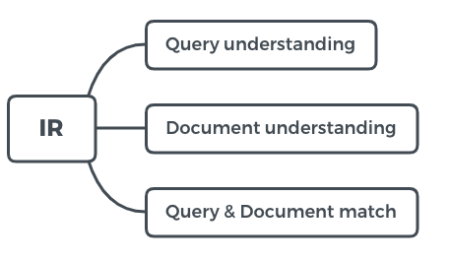
Recap
Fairness, Accountability, Confidentiality and Transparency in Information Retrieval

Slide 20
Conversational Information Seeking(CIS)
Task-oriented sequence of exchanges between one or more users and an information system
Complex information seeking and exploratory information gathering
Focuses on dialog settings with variable communication channels
Motivation:
Conversations are a natural form for humans to seek information
The increasing variety of devices that are accessible anytime/anywhere (perhaps without screen or keyboard)
The maturity of speech interfaces
Recent developments in general representation learning

Slide 21
Proposed Research
User Models
Finding Information
Engagement
Domain generality and specificity
Failure modes
Evaluation
Multi-modal conversation
Cross-device conversation
Collaborative information seeking

Slide 22
Challenges
Boundaries of individual components
how to bootstrap such systems with reasonable effort
how to ensure they are responsive as a whole
how to perform component-wise diagnosis, and at what level to consider their robustness
Ethical challenges
Trust in information, biases, and transparency, will likely be exacerbated by the inherent narrowing of the communication channel between the systems with their users.

Slide 23
Learnable Information Retrieval
The availability of massive data and powerful computing
The impact of neural net approaches in many fields such as vision and NLP is undeniable
The neural revolution in IR empowers the end-to-end learning of an entire search engine from data
Motivation:
Existing systems are shallow in their representation and comprehension of text and other media
This shallow understanding limits our ability to perform more complex IR tasks such as conversational search, summarization, and multimodal interaction, as well as search tasks that require deeper understanding of documents contents and the user information need

Slide 24
Proposed Research
Data Efficiency
Data Representation
Reinforcement Learning
End to end learning
Machine Reasoning
Error Analysis / Explainability

Slide 25
Challenges
Existing high baselines
A key challenge in developing new models is to be able to produce competitive or superior performance with respect to the baselines.
A great challenge is to use machine learning methods to automatically capture important features in representations, which have been manually engineered in traditional models
Potentially has better performance
Low data resources
Representation learning, and supervised machine learning in general, is based heavily on labeled training data
A related challenge is to design learning methods that require less training data

Slide 26
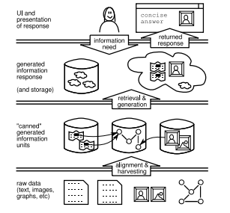
Generated Information Objects(GIO)
In modern devices, search results may be presented on a small screen or as a spoken response.
Generate a single response that consists of multiple information units
Motivation:
Often information changes over time, demanding approaches that ensure the consistency and freshness of information
GIO framework helps to identify underlying patterns and share best practices regarding representation, storing of derived information and retrieval, recombining and recycling partial answers.

Slide 27
Proposed Research
Harvesting
Representation
Dynamic changes
Connections
Storage
Efficient access
Condensing
Text generation
Ease of use
Recycling
Privacy

Slide 28
Challenges
Knowledge Graph Representation in GIOs
Adversarial GIOs Low data resources
Merging of Heterogeneous GIOs
Resource Location Across Turn-based Conversational Information Seeking
Deriving Explanations from GIOs
Context and Personalization
Evaluation

Slide 29
Q&A

