Slide 1
Bigtable: A Distributed Storage System for Structured Data
Reporter：宋奇谦 谭笠志

Slide 2
Outline：
Motivation
Goals
Data Model
Building Blocks
Implementation
Refinements
Performance Evaluation
Real Applications
Conclusions

Slide 3
Motivation
Google needs a distributed storage system for managing large variety of structured datas
Massive service request: How to query data quickly?
Existing commercial databases can’t satisfy Google's require-
ments

Slide 4
Goals
wide applicability
scalability
high performance
high availability

Slide 5
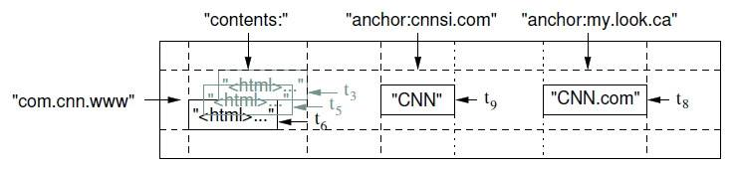
Data Model
A Bigtable is a sparse, distributed, persistent multidimensional sorted map
(row:string, column:string, time:int64) → string
Bigtable maintains data in lexicographic order by row key
The row range for a table is dynamically partitioned, and each row range is called a tablet
Column keys are grouped into sets called column families,which form the basic unit of access control.
Each cell in a Bigtable can contain multiple versions of the same data; these versions are indexed by timestamp

Slide 6
Building Blocks(1)
GFS:
Bigtable uses the distributed Google File System(GFS) to store log and data files
A Bigtable cluster typically operates in a shared pool of machines that run a wide variety of other distributed applications, and Bigtable processes often share the same machines with processes from other applications

Slide 7
Building Blocks(2)
Google SSTable:
The Google SSTable file format is used internally to store Bigtable data
An SSTable provides a persistent, ordered immutable map from keys to values,where both keys and values are arbitrary byte strings
An SSTable can be completely mapped into memory, which allows us to perform look ups and scans without touching disk(access fast)

Slide 8
Building Blocks(3)
Chubby:
Bigtable relies on a highly-available and persistent distributed lock service called Chubby
Bigtable uses Chubby for a variety of tasks:
(1) to ensure that there is at most one active master at any time;
(2) to store the bootstrap location of Bigtable data ;
(3) to discover tablet servers ;
(4) finalize tablet server deaths;
(5) to store Bigtable schema information(the column family information for each table);
(6) to store access control lists;

Slide 9
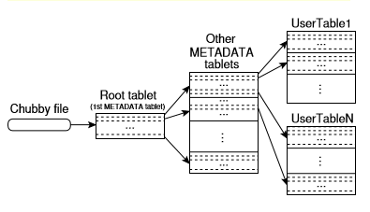
Implementation(1)
The Bigtable implementation has three major components: a library that is linked into every client, one masterserver, and many tablet servers
Tablet Location :
We use a three-level hierarchy analogous to that of a B+tree to store tablet location inform-
ation

Slide 10
Implementation(2)
Tablet Assignment:
Each tablet is assigned to one tablet server at a time. The master keeps track of the set of live tablet servers, and the current assignment of tablets to tablet servers, including which tablets are unassigned. When a tablet is unassigned, and a tablet server with sufficient room for the tablet is available, the master assigns the tablet by sending a tablet load request to the tablet server

Slide 11
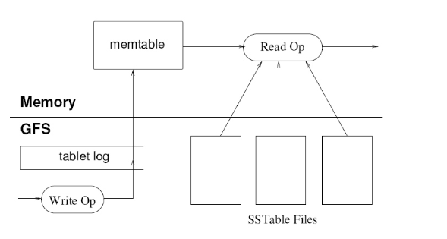
Implementation(3)
Tablet Serving:
Updates
Write
Read

Slide 12
Implementation(4)
Compactions:
.

Slide 13
Refinements(1)
Locality groups:
Clients can group multiple column families together into a locality group. A separate SSTable is generated for each locality group in each tablet. Segre-
gating column families that are not typically accessed together into separate locality groups enables more efficient reads
Compression:
Many clients use a two-pass custom compression scheme. The ﬁrst pass uses Bentley and McIlroy's scheme , which compresses long common strings across a large window. The second pass uses a fast compression algorithm that looks for repetitions in a small 16 KB window of the data

Slide 14
Refinements(2)
Caching for read performance:
Tow levels of caching:
The Scan Cache: read the same data repeatedly
The Block Cache: read data that is close to the data they recently read
Bloom filters:
reduce the number of disk accesses
save space
fast

Slide 15
Refinements(3)
Commit-logimplementation
Speedinguptabletrecovery
Exploiting immutability

Slide 16
Performance Evaluation(1)
Experimental environment:
We set up a Bigtable cluster with N tablet servers to measure the performance and scalability of Bigtable as N is varied. The tablet servers were configured to use 1 GB of memory and to write to a GFS cell consisting of 1786 machines with two 400 GB IDE hard drives each. N client machines generated the Bigtable load used for these tests. (We used the same number of clients as tablet servers to ensure that clients were never a bottleneck.)

Slide 17
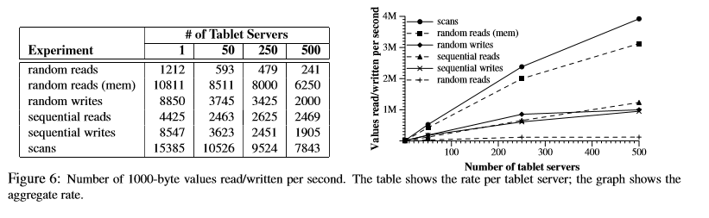
Performance Evaluation(2)
experimental result:
Single tablet-server performance:
Lowest than others;
Random reads from memory are much faster;
Random and sequential writes perform better than random reads;
There is no significant difference between the performance of random writes and sequential writes;
Sequential reads perform better than random reads;
Scans are even faster;
Scaling: performance does not increase linearly;

Slide 18
Real Applications(1)
Google Analytics:
Google Analytics (analytics.google.com) is a service that helps webmasters analyze traffic patterns at their web sites. It provides aggregate statistics, such as the number of unique visitors per day and the page views per URL per day, as well as site-tracking reports, such as the percentage of users that made a purchase, given that they earlier viewed a specific page.

Slide 19
Real Applications(2)
Google Earth:
Google Earth allows users to navigate across the world’s surface: they can pan, view, and annotate satellite imagery at many different levels of resolution. This system uses one table to preprocessdata, and a different set of tables for serving client data.

Slide 20
Real Applications(3)
Personalized Search:
Personalized Search stores each user’s data in Bigtable. Each user has a unique userid and is assigned a row named by that userid. All user actions are stored in a table.
Personalized Search generates user profiles using a MapRe-
duce over Bigtable. These user profiles are used to person-
alize live search results.

Slide 21
Conclusions
Finally, we have found that there are significant advantages to building our own storage solution at Google. We have gotten a substantial amount of flexibility from designing our own data model for Bigtable. In addition, our control over Bigtable's implem-
entation, and the other Google infrastructure upon which Bigtable depends, means that we can remove bottlenecks and inefficiencies as they arise.

Slide 22
Thanks!

