Slide 1
On Cooperative Settlement Between Content, Transit, and Eyeball Internet Service Providers
Paper Sharing
DIAO SHUO

Slide 2
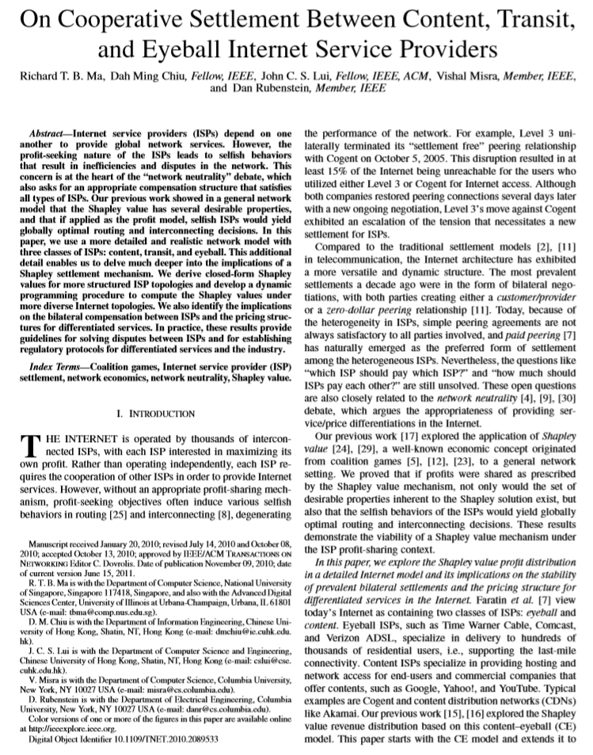
AGENDA
1.Introduction
1.1 Authors
1.2 Publish
2.Basic Concepts & Formula
2.1 Calculate Shapley value of ISP
2.2 Internet model
2.3 Concepts
2.4 Shapley value / cost distribution
3.Implications

Slide 3





1.Introduction
1.1 Authors
1.Richard T. B. Ma B.Sc. & M.Phil. CS
2.Dah Ming Chiu B.Sc. EE
3.John C. S. Lui Ph.D. CS
4.Vishal Misra B.Tech. EE
5.Dan Rubenstein B.S. Mathematics

Slide 4
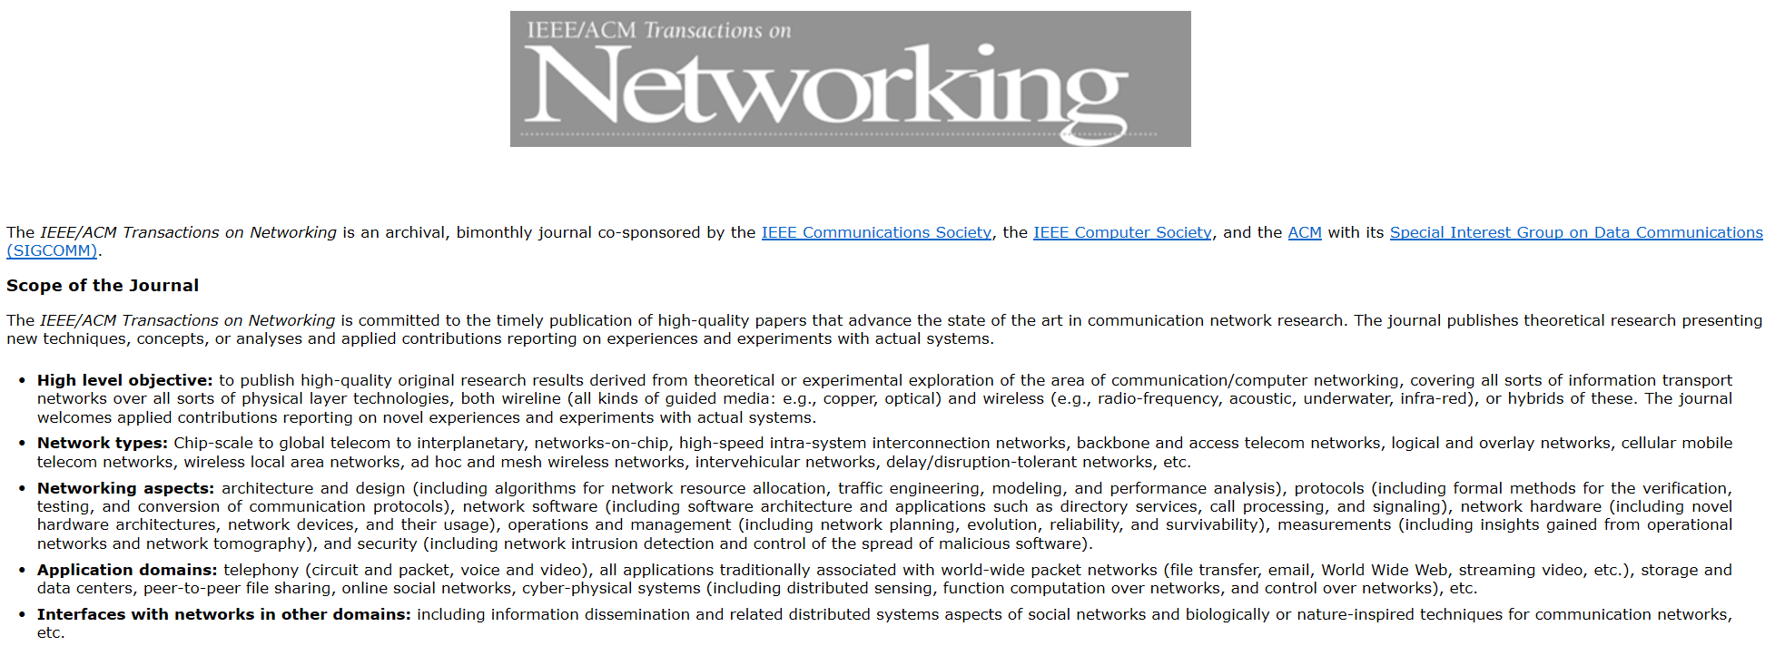
1.Introduction
1.2 Journal
IEEE/ACM TRANSACTIONS ON NETWORKING, VOL. 19, NO. 3, JUNE 2011
Website | http://www.ifp.illinois.edu/ton/
Press | Institute of Electrical and Electronics Engineers Inc.
Country | UNITED STATES

Slide 5
2. Basic Concepts & Formula
Background：
· ISP : Internet Service Provider
profit-seeking
selfish behavior
( Level 3 unilaterally terminated its “settlement free” peering relationship with Cogent )
· Traditional settlement model:
customer/provider relationship
zero-dollar peering relationship
· “which ISP should pay which ISP?”

Slide 6


2. Basic Concepts & Formula
2.1 Shapley Value Definition
Profit = revenue - cost
S = set of ISPs
network system ：N
Number of ISPs = N

Slide 7

2. Basic Concepts & Formula
2.1 Shapley Value Definition
marginal contribution
Shapley value

Slide 8
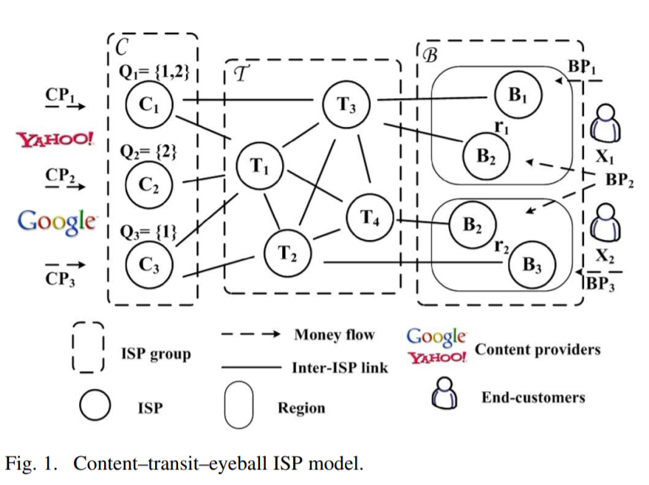

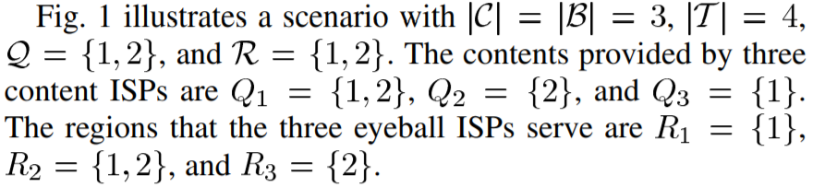
2. Basic Concepts & Formula
2.2 Internet Module

Slide 9
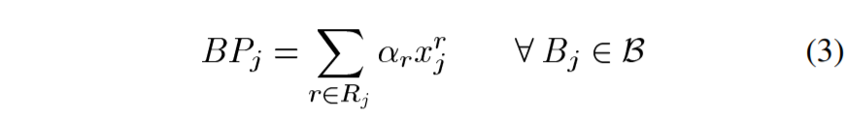
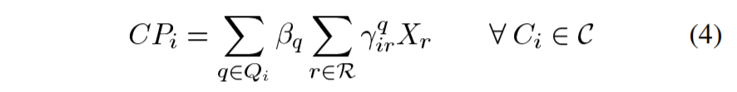




2. Basic Concepts & Formula
2.2 Internet Module
revenue
cost

Slide 10
2. Basic Concepts & Formula
2.3 Other Detailed Concepts
· User Elastic Demand Assumption
· Conservation of Revenue
· Dummy ISP

Slide 11
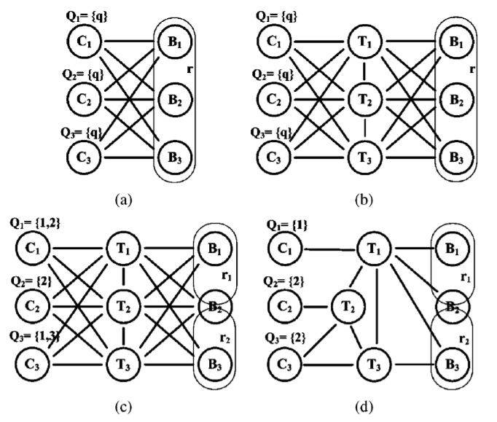
2. Basic Concepts & Formula
2.4 Shapley value / cost distribution

Slide 12
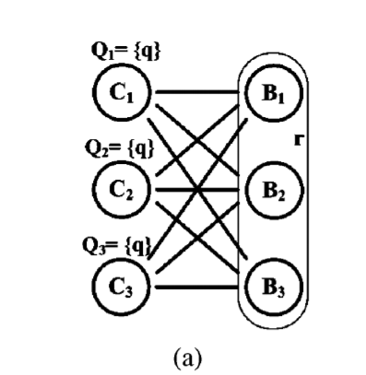

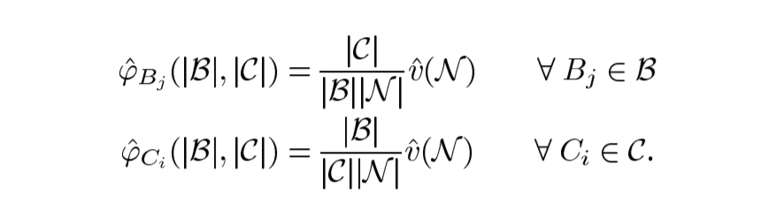
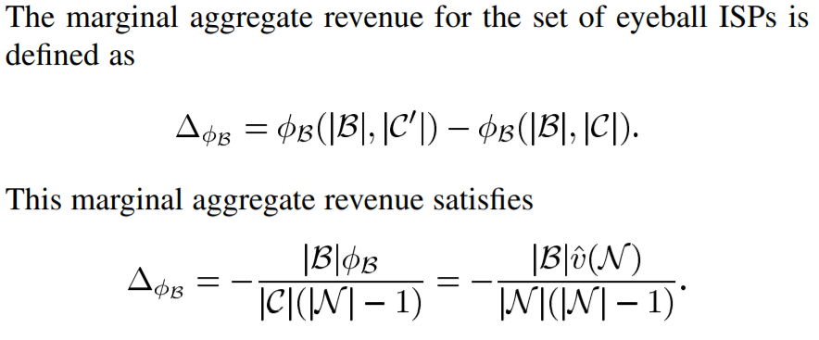

2. Basic Concepts & Formula
A. Content–Eyeball (CE) Model

Slide 13
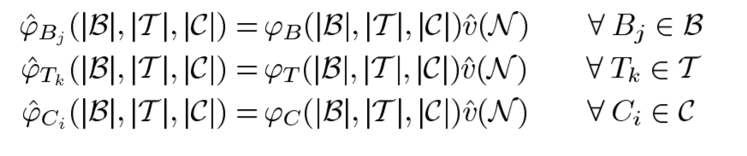
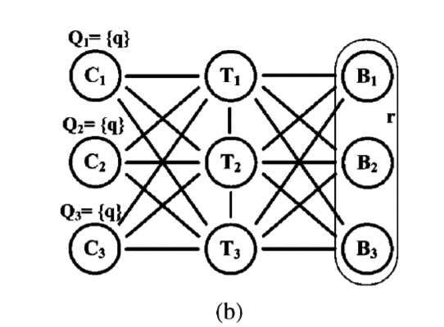
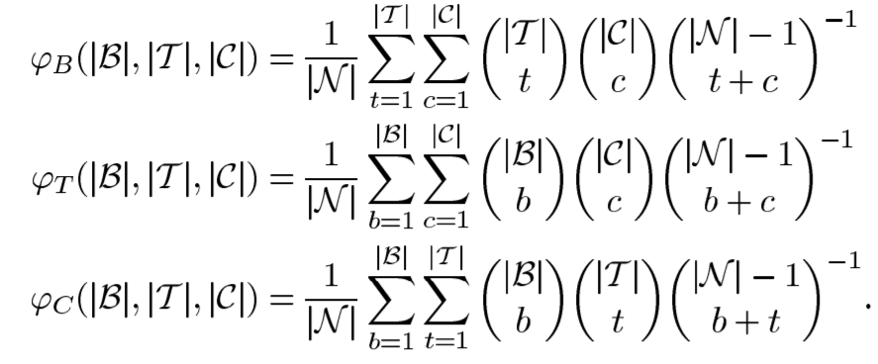
2. Basic Concepts & Formula
B. Content–Transit–Eyeball (CTE) Model

Slide 14
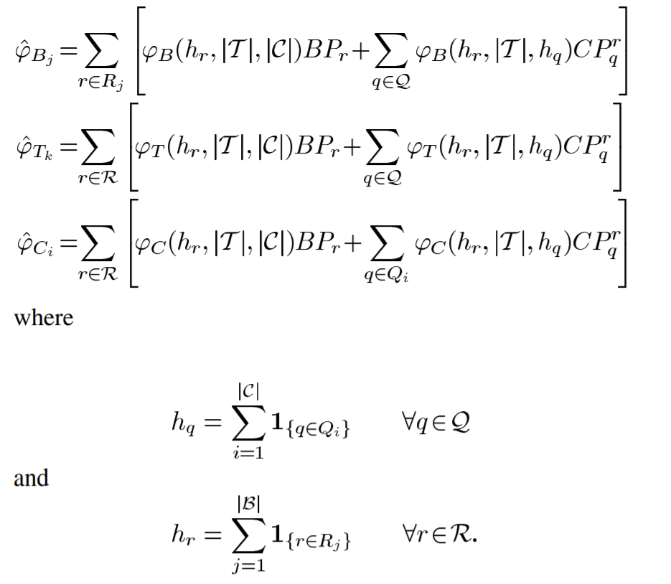
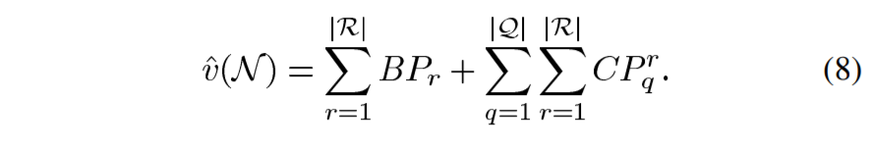
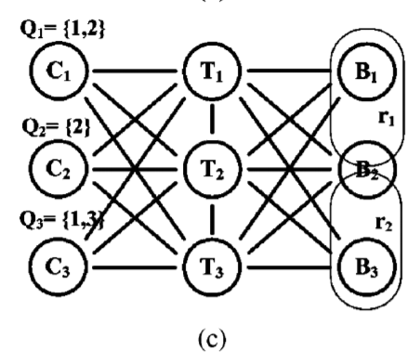
2. Basic Concepts & Formula
C. Multiple Contents and Regions Model
symmetric

Slide 15
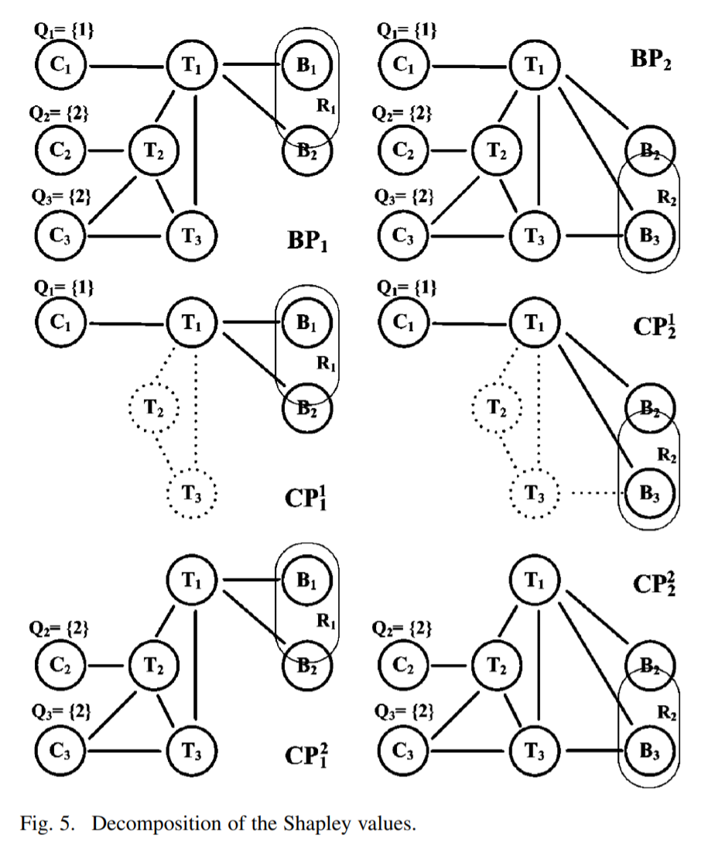
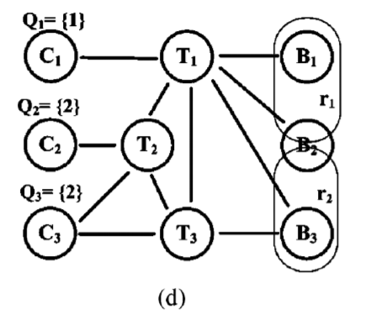
2. Basic Concepts & Formula
D. General Internet Topologies

Slide 16
2. Basic Concepts & Formula
D. General Internet Topologies
Theorem needed：
· dummy ISP
· Conservation of Revenue – canonical
· veto ISP

Slide 17
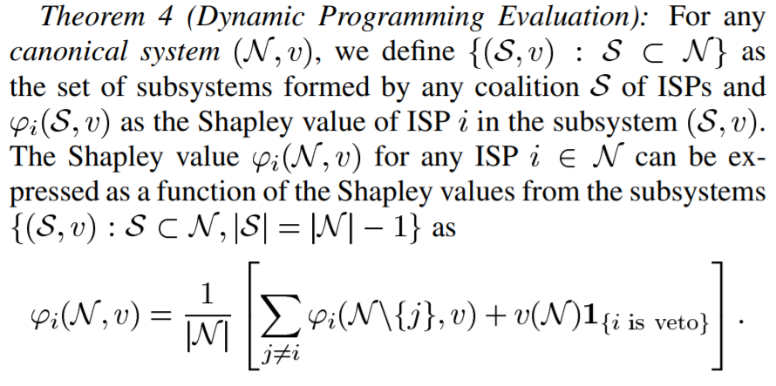
2. Basic Concepts & Formula
D. General Internet Topologies

Slide 18
2. Basic Concepts & Formula
Generalize & Study
Further work：
· Generalized Demand Elasticity
· Connectivity Effects on the Shapley Revenues

Slide 19
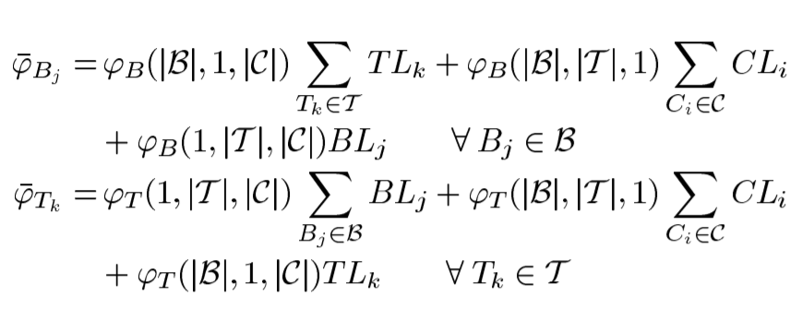
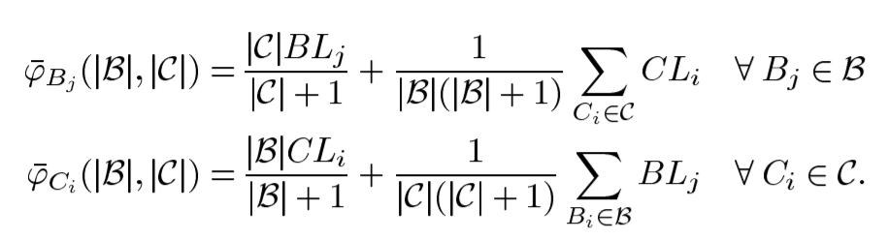
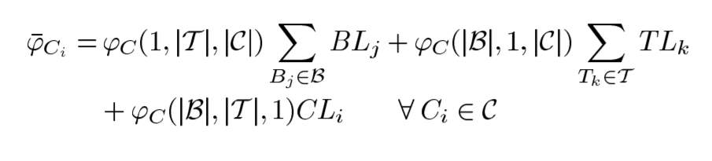
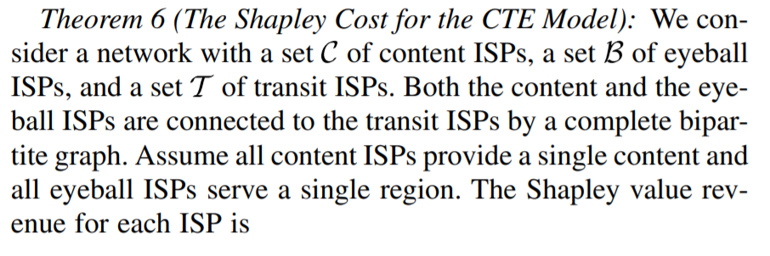
2. Basic Concepts & Formula
2.4 Shapley value / cost distribution
The Shapley Cost for the CTE Model
?????

Slide 20
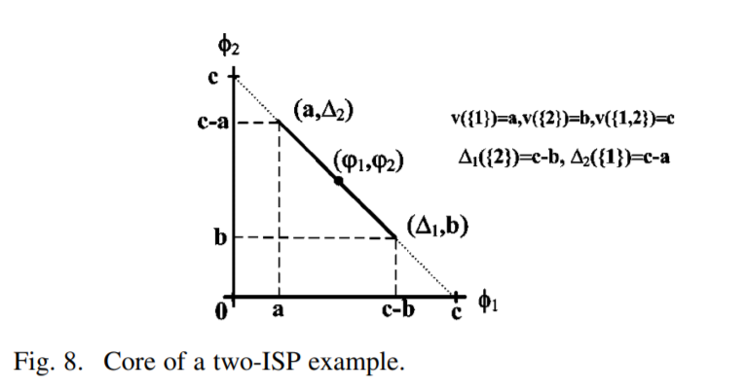
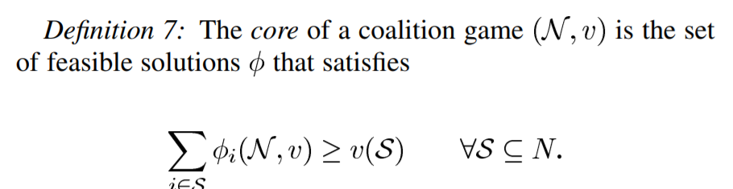
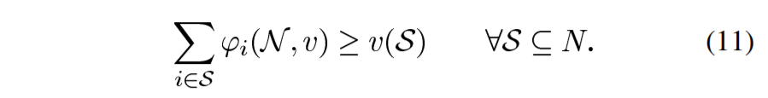
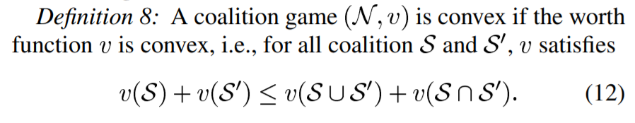
3.Implications
A. Core, Convex Game, and Stability
To be core
divulge topological

Slide 21
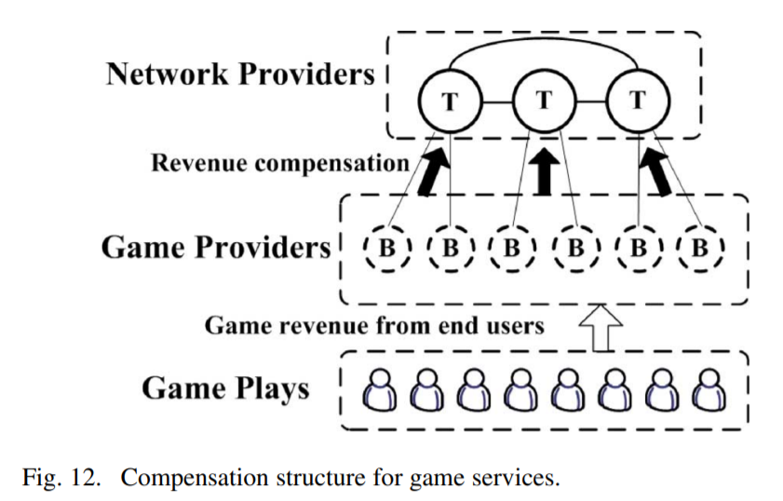
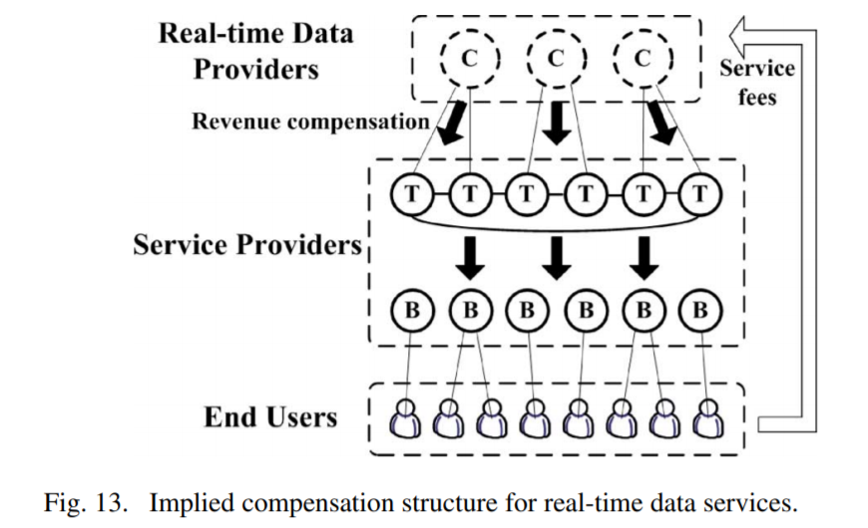
3.Implications
B. Justifications for Stable Bilateral Agreements
coincides with the zero-dollar peering and the customer/provider relationships established from bilateral agreements
C. Justifications for Unstable Bilateral Agreements
deviates from the theoretic Shapley solution severely
located outside the core
unstable.
D. Implications for Differentiated Services
Supporting Gaming Services:
Supporting Real-Time Data Services
compensation

Slide 22
Thanks

