Slide 1
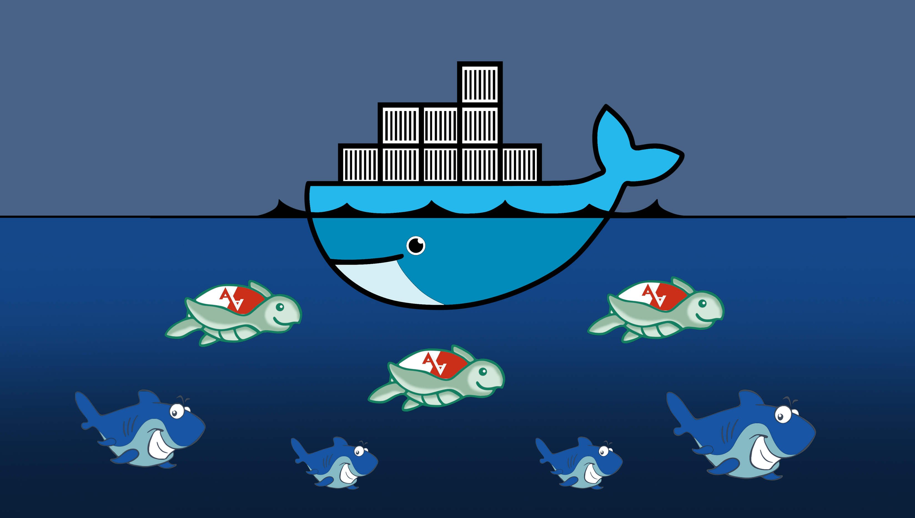
Security on Docker
Automatic security hardening of
Docker containers using MAC, specialized in defending isolation
Diploma Thesis
Fani Dimou

Slide 2

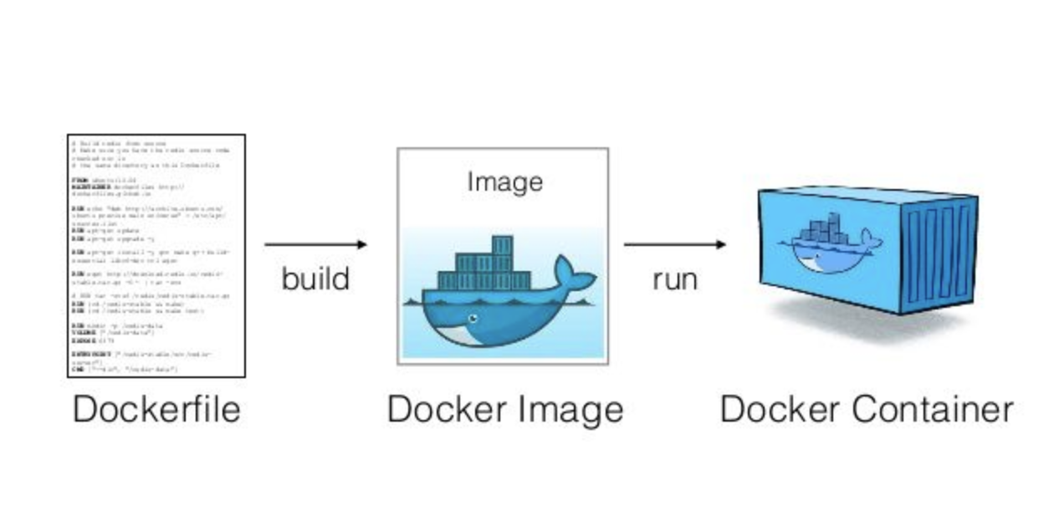
Docker
What is Docker?
A software, released in 2013, that performs operating-system-level virtualization. It is not a standalone software, but a platform to run
and manage software packages called containers.
How it works?
It packages an application and all its dependencies together in the form of a docker container.

Slide 3
Docker
Why all the fuss?
Containers pre-existed docker, but docker presented a new way to use them easily.
Docker VS Virtual Machines
Portability: Packages up code and all its dependencies, applications run in any infrastructure
Speed: No OS to boot; applications are up in seconds
Efficiency: Less OS overhead (CPU, RAM, power), lightweight, no wasting resources
Easy to use
What about Security?
Containers are not as secure as VMs.
Security is a compromise we have to make…
We focus on isolation among host-container and container-container.

Slide 4

Security on Docker
How to secure a docker container?
Use best practices (Dockerfiles, configuring containers etc)
Seccomp
SELinux
AppArmor
AppArmor (Application Armor)
Linux security module
Implements Mandatory Access Control
Supported by docker (security-opt option)
Uses profiles to create a policy for an application
Contains rules to allow and deny actions and access
Path oriented
Human readable profiles

Slide 5
Thesis contribution
Developed an open source software, SecureWilly, that automatically creates AppArmor profiles for any docker project in order to secure the containers and preserve the isolation.
Extensive research on the vulnerable features of docker that can lead to attacks that violate isolation.
Implementation of several examples of breakout container attacks, in the context of ethical hacking, in order to assist security.
Alerting user about the vulnerabilities detected in the docker project, such as privileged mode or entering host’s namespaces.
Creation of AppArmor profiles for an instance of Nextcloud platform (two profiles were created, one for the application of Nextcloud and one for the database that it uses), as experimental evaluation of SecureWilly.

Slide 6

SecureWilly
Open source software
Creates automatically AppArmor profiles for a docker project
Handles single service and multi-service docker projects
Service oriented; profiles adjusted to the task of each service, considering their co-operation too → specific and strict rules for each service
Follows the Principle of Least Privilege → Contains the minimum set of rules needed in order to provide efficiency and security
Efficient profiles, allowing user to complete the tasks specified
Secure profiles, as any redundant actions are blocked

Slide 7
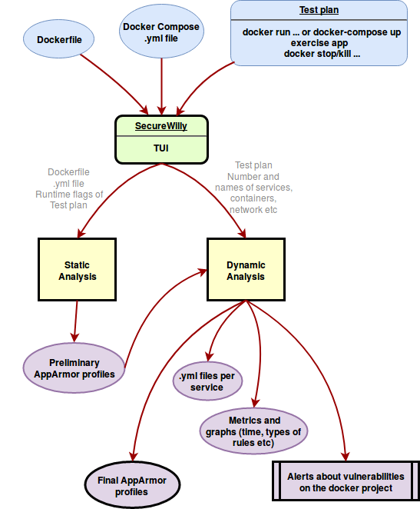
SecureWilly
Input:
Services: amount and names
Dockerfile(s) path(s) / N
Docker-compose.yml path / N
Internal network: name / N
Test plan:
Start container commands: docker start, docker run, docker-compose up
Exercise app’s functionality
Stop container commands: docker stop, docker kill
Output:
AppArmor profiles per service
Alerts on vulnerabilities detected
yml files per service (secondary)
Metrics and graphs about time and the role of each service (secondary)

Slide 8
SecureWilly
Phase 1
Static Analysis Dynamic Analysis
Static Analysis
Static parser exports rules from the initiative code of the docker project.
Creates a preliminary profile that will be used in Dynamic Analysis.
Dynamic Analysis
Loads the preliminary profile in kernel.
Runs docker project
Dynamic parser monitors system logs and extracts new rules
Updates profile until there are no new rules.

Slide 9
Static Analysis
Dockerfile: The “recipe” to build a docker image
VOLUME directories
EXPOSE ports
USER & RUN useradd
RUN chmod file
Docker Compose: Included runtime parameters missing from Dockerfile
Volumes
Expose
Ports
Capabilities add/drop
Ulimits
Devices
Runtime flags: Flags given in docker run commands in test plan
volumes: -v <source host path>:<container’s mountpoint>
expose: –expose <port>
ports: -p <host’s port>:<container’s port>
cap add: –cap-add <capability|ALL>
cap drop: –cap-drop <capability|ALL>
ulimits: –ulimit <resource type>=<soft>:<hard>
devices: –device <host’s device path>:<container’s device path>

Slide 10
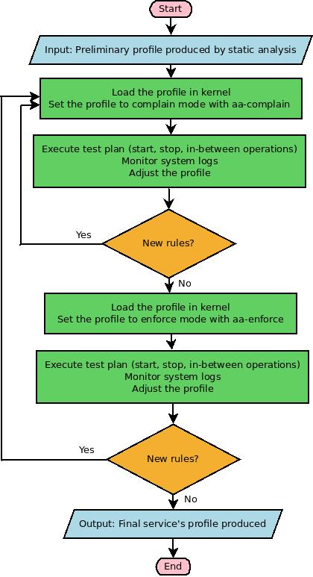
Dynamic Analysis
Complain mode
Allow every action, write denials to system logs
Enforce mode
Block any denied action according to the profile
Loads the preliminary profile in kernel.
Set it to complain mode
Run test plan
Monitors system logs and extracts new rules
Updates profile until there are no new rules.
Do the same for enforce mode

Slide 11
SecureWilly
Demo

Slide 12
SecureWilly
Phase 1 provided:
Efficient profiles → Adjusted to the task described through the test plan
Specific and strict profiles → Least possible rules
But...
Are they secure enough?
Can they protect us from an attack?
How could somebody attack isolation?

Slide 13

Attacks and Vulnerabilities
Phase 2
Detect docker vulnerabilities
Ethical hacking: implement container breakout attacks
Reverse engineering to find rules preventing them

Slide 14
Attacks and Vulnerabilities
1. Running as root
If no User Namespaces are enabled in docker:
Host root == Container root
If running as root on your server is not a best practice, for the same reasons you shouldn’t run anything as root in a container on your server.
To root or not to root?
Don’t use root.
If you need it, try using a user that looks like root, using user namespaces or kernel capabilities.
If this is not enough, use root but make sure you have extra walls of security.

Slide 15
Attacks and Vulnerabilities
2. Kernel Capabilities
  Adding a lot of capabilities, could lead to privilege escalation and eventually root.
  Some capabilities are more crucial than others: SYS_ADMIN, SYS_CHROOT, SETUID etc
  privileged_mode: Gives all capabilities to the container and also lifts all the limitations enforced by the device cgroup controller.
    AppArmor profiles cannot block actions of a privileged container
    SecureWilly alerts user about any containers that use privileged mode

Slide 16
Attacks and Vulnerabilities
3. Disabling Namespaces
  Namespaces are a feaure that partitions kernel resources and provide resource isolation.
  In Docker, all namespaces are enabled by default, except for user ns.
  There are some flags that allow a container to enter host’s namespaces:
  --pid=host, --net=host, –uts=host, –ipc=host, –userns=host (if user namespaces are enabled).
  What about mount namespace?
  Volumes: Sharing host’s filesystem by mounting directories in runtime.
    Combining several of these flags could lead to container breakout attacks. Red hat talks about super privileged containers when mount and one of the other flags are used
    SecureWilly alerts user about any containers that enters a host namespace

Slide 17
Attacks and Vulnerabilities
4. Nsenter tool
  Nsenter breaks into the namespaces of other processes, as soon as it has their pids.
  It does not drop capabilities, so a new shell inside a running process can harm it in great extent, given the right capabilities.
  A container that uses nsenter can commit:
    Breakout to host
    Breakout to another running container (needs access to docker daemon to find the container id of the target container → get pid of container’s process)
    AppArmor profiles protect a container from nsenter attacks committed by another container
Demo
Notes:
Perfect for attackers
Host: init process

Slide 18
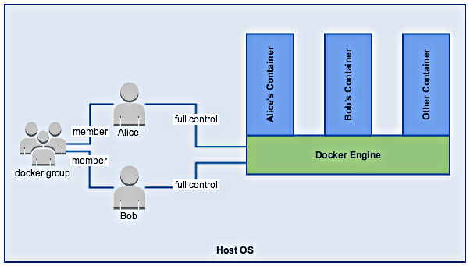
Attacks and Vulnerabilities
5. Access to Docker Daemon
  Who can access the docker
  daemon?
  Members of docker group →
  owner group of docker.sock
  User privilege elevation: Non root
  member of docker group
  acts as root on host
  Container privilege elevation: A
  “regular” container could evolve to
  a “powerful” one. (needs 1 member
  of docker group + mount docker.sock)
  Alice runs non root and no member of docker group user on container, mounts docker.sock
  Bob (or a host user) member of docker group, enters Alice’s container as root and adds her user to docker group.
  Alice re-logins and is member of docker group.
    SecureWilly drops setgid and setuid capabilities if docker.sock is mounted, to block this attack.
Demo

Slide 19
Experimental Evaluation
Experimental Setup
We used the following docker projects to create AppArmor profiles and evaluate SecureWilly:
Benchmarks from a cloud benchmark suite, CloudSuite.
  Media Streaming benchmark (services: server, client, dataset)
  Data Caching benchmark (services: server, client)
Nextcloud: a suite of client-server software for creating and using file hosting services to have total control of private data.
Used a Nextcloud docker instance consisting of a Nextcloud server service and a database service mariadb.

Slide 20
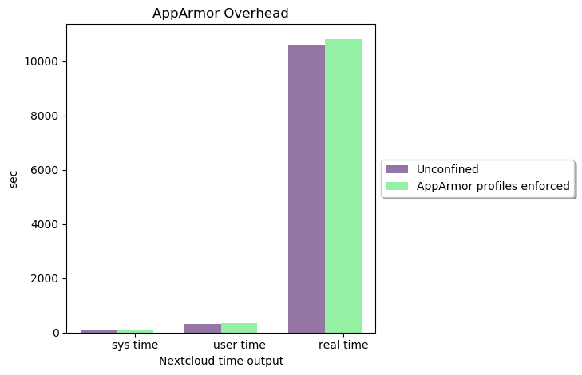
Experimental Evaluation
AppArmor related
1. AppArmor overhead
  Small overhead
  Almost not noticeable
  Confirms AppArmor
intention
2. SecureWilly vs Genprof (official AppArmor generating profile tool):
Genprof is designed for host’s applications → missing file rule, which is needed for a container to access its filesystem on host
Host oriented behaviour – file and path accesses on host
Include profiles → Violates the principle of least privilege, may include redundant rules

Slide 21
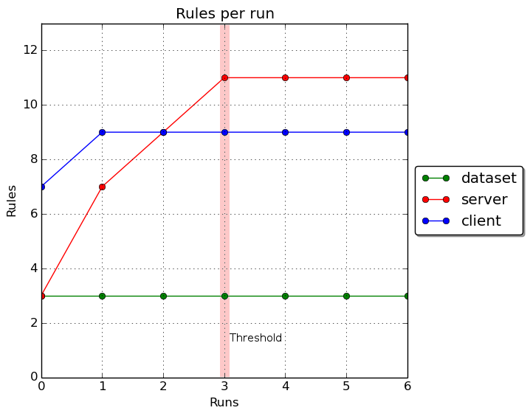
Experimental Evaluation
Performance
Comparing time is useless → Compare amount of runs of test plan.
Media streaming benchmark

Slide 22
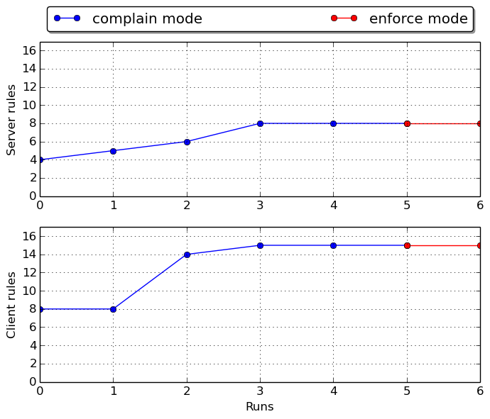
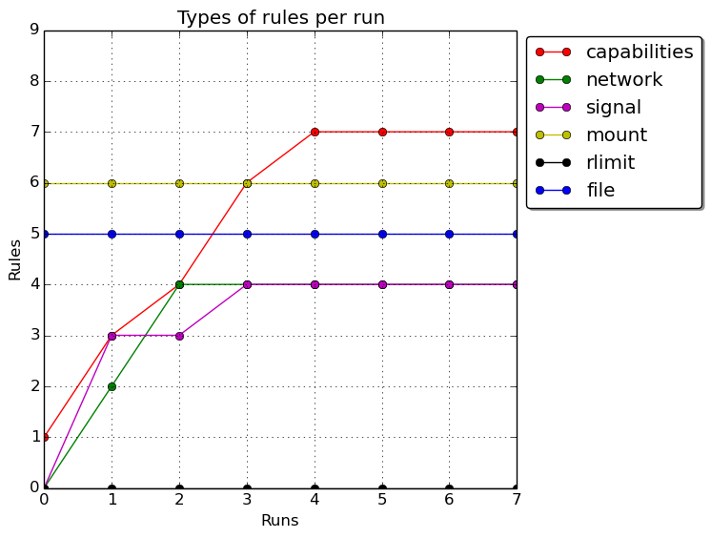
Experimental Evaluation
1st Functionality testing:
Enforce mode inside Dynamic Analysis
Data caching benchmark
Functionality
2nd Functionality testing:
Confirming service’s role through profile rules
Nextcloud - server

Slide 23
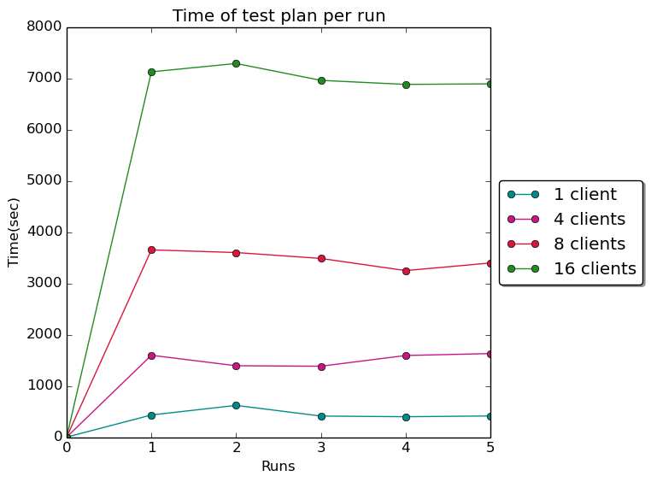
Experimental Evaluation
Scalability
If the given docker project is scalable, so is SecureWilly.
Media streaming benchmark

Slide 24
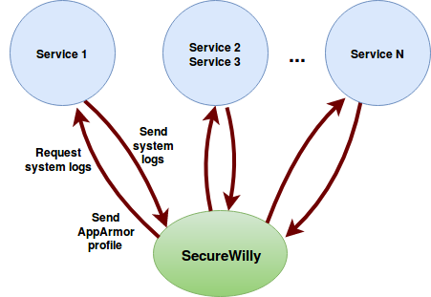
Experimental Evaluation
Distributed Systems
Plans for handling distributed services
The way SecureWilly approaches a docker project makes the development of this option possible

Slide 25
Future Work
Features to fix and integrate:
Extract more rules in static analysis
Include other syntax forms of Dockerfile instructions and Docker Compose options
to static parser.py
More rules to prevent attacks
Alerts about root user in containers
More flexible User Interface
Support interactive test plans of the project, not only script commands
Option of user manually adding rules, through a configuration file
Change python scripts into executables (maybe write programs in Go) so that python interpreter is not a requirement
Fix the conflict of multiple containers using the same image, when a docker-compose file is not provided
Fix clearing volumes by detecting docker project’s volumes and deleting them, instead of using docker volume prune
CI/CD to build releases on GitHub, through Travis CI, which supports open source
projects and Docker
Support distributed services

Slide 26
Future Work
Spread the word...
GSoC accepted to work on NextCloudPi project (expand features on a ready to use Nextcloud image)
One of the tasks I proposed is to use SecureWilly to produce AppArmor profiles for all docker containers used in the project.

Slide 27

Questions

Slide 28

Thank you :)

