Slide 1
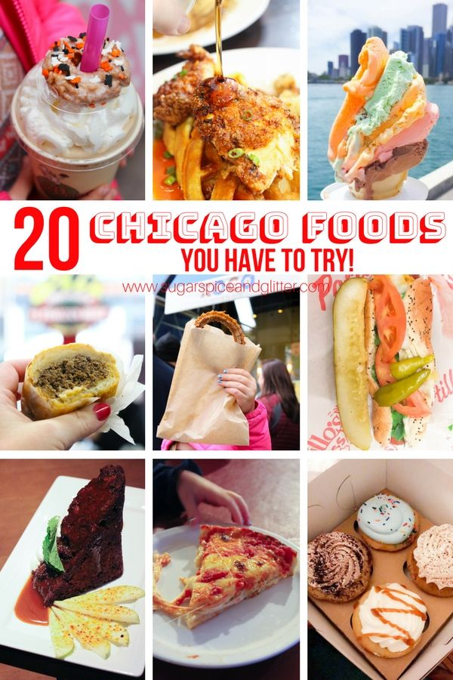
RECOMMENDATION SYSTEM TO START A RESTAURANT BUSINESS IN CHICAGO
MUHAMMAD USMAN KHAN

Slide 2
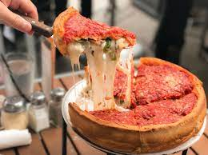
Business Problem
Chicago is the most populous city in the U.S. state of Illinois, and the third most populous city in the United States.
It is an international hub for finance, culture, commerce, industry, education, technology, telecommunications, and transportation.
Chicago's famous cuisine mostly include fast food items like Pizzas, Steak, Fried Chicken, Fries, Hot dogs, etc.
A well reputed food manufacturing company OZ Foods is interested to open a Fast Food restaurant in Chicago and wants recommendations for an appropriate location

Slide 3
Data Sources
Chicago’s 77 community areas data with population from Wikipedia.
Finding the latitude and longitude coordinates of I used the following Data Set from a US website.
Using the website to create a CSV to form a data frame.
I used Foursquare API o find nearby venues and from those venues separating the list of restaurants in each neighborhood, including restaurant type.

Slide 4
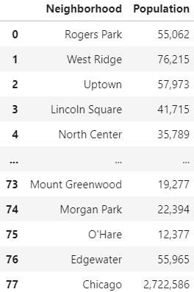
Methodology
Beautiful Soup and Pandas library was used to scrape data and convert them into a useful table containing two columns, (Neighborhood and Population.

Slide 5
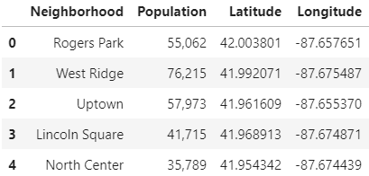
Methodology
Another Pandas data frame was created to find the latitudes and longitude values of the neighborhoods using the CSV file.

Slide 6
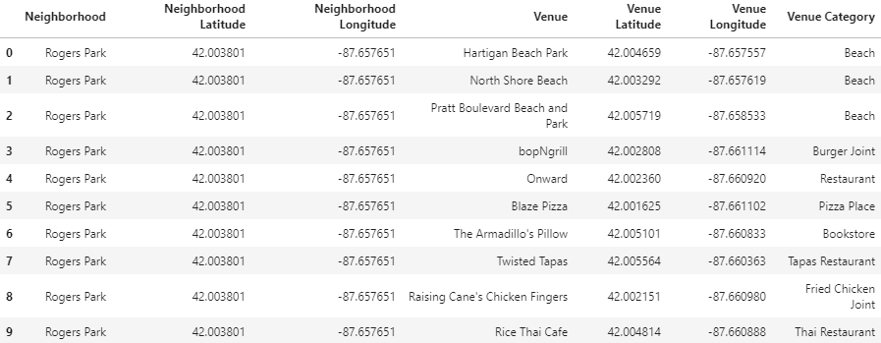
Methodology
Foursquare API is used to explore the neighborhoods and segment them
Foursquare API returns 1874 results with 274 unique categories.

Slide 7
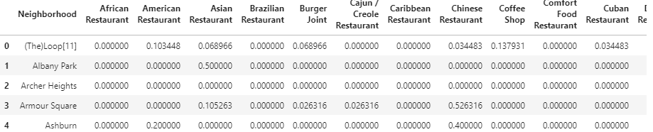
Methodology
Restaurants are extracted from venue category list
The resulting data frame has 49 unique categories or cuisines available in Chicago
one hot encoding is performed on the resulting data frame for each neighborhood
Rows are grouped by neighborhood to determine the frequency of occurrence of each restaurant

Slide 8
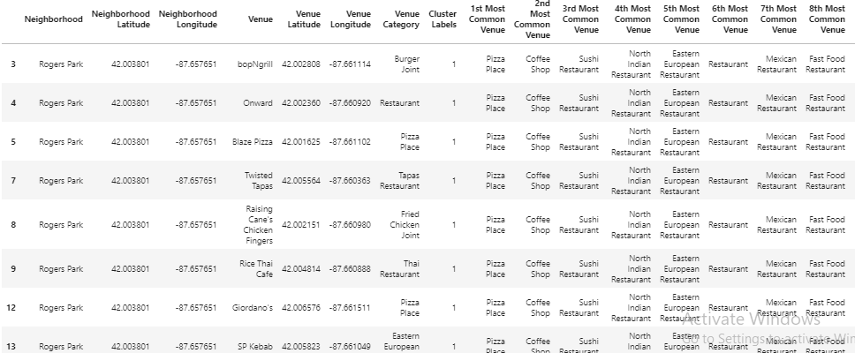
Methodology-Clustering
k-means clustering is performed on the data frame to check the pattern for each neighborhood.
Getting the information about the top ten common restaurants for each neighborhood. The value used for K in this respect is 5.

Slide 9
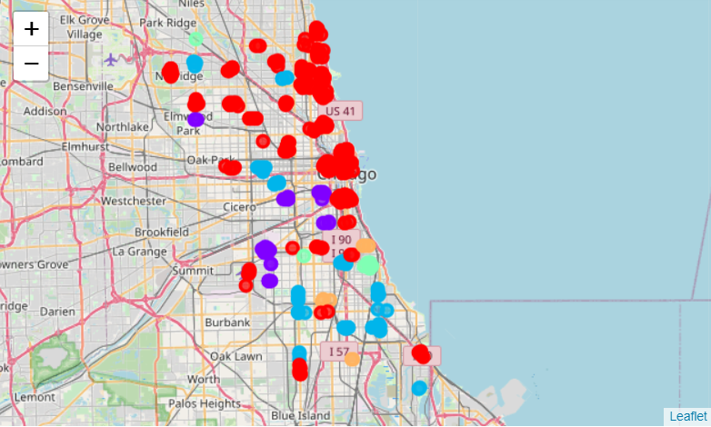
Clustering Results
Each cluster gives unique result:
Cluster 0 (Red) (Most Common: Pizza Place & American Restaurant)
Cluster 1 (Purple) (Most Common: Mexican Restaurant)
Cluster 2 (Blue) (Most Common: Fast Food Restaurants)
Cluster 3 (Green) (Most Common: Coffee Shop)
Cluster 4 (Orange) (Most Common: Fried Chicken Joint (Fast Food))

Slide 10
Discussion
If OZ Foods want to open a restaurant in preferred location and irrespective of cuisine, refer to that neighborhood in specific cluster and chose cuisine with the least common restaurant for better profits
If OZ Foods wants to open a restaurant with a preferred cuisine (Fast Food) and irrespective of location, refer to the cluster with the least number of restaurants with that specific cuisine and select one among the neighborhoods based on company’s preference.
The location can be selected with highest number of population as well as the cuisine that is not popular in that location.

Slide 11
Conclusion
Cluster 0: Most popular cuisine in the cluster is Pizza Place and the American Restaurant. Near North Side seems to be the ideal place considering the fact it possesses a population of 88,893 as well as there is no fast food place, pizza place, burger joint or chicken joint.
Cluster 1: Most popular cuisine in the cluster is Mexican Restaurant. Lower West Side has a population of 32,888 and only a few pizza places are running there making it another ideal location for restaurant.
Cluster 2: Most popular cuisine in the cluster is Fast Food Restaurants. Albany Park, Irving Park both can serve to be excellent places to start the business attracting a population of more than 100,000.
Cluster 3: Most popular cuisine in the cluster is Coffee Shop. Gage Park with 40,873 population seems to be most ideal place in this cluster.
Cluster 4: Most popular cuisine in the cluster is Fried Chicken Joint. Roseland with a population of 42,433 can be a potential location as it contains least number of fast food restaurants, but the most common fried chicken joint restaurant.
Overall, it can deduced that in order to attract more customers and to open the desired fast food restaurant in Chicago, Near North Side would be the most ideal location for OZ Foods to start their business, enhancing the chances of earning

Slide 12
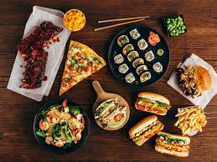
THANK YOU!!!

