Slide 1
Group Comparisons w.r.t different Tests Last week leftover

Slide 2
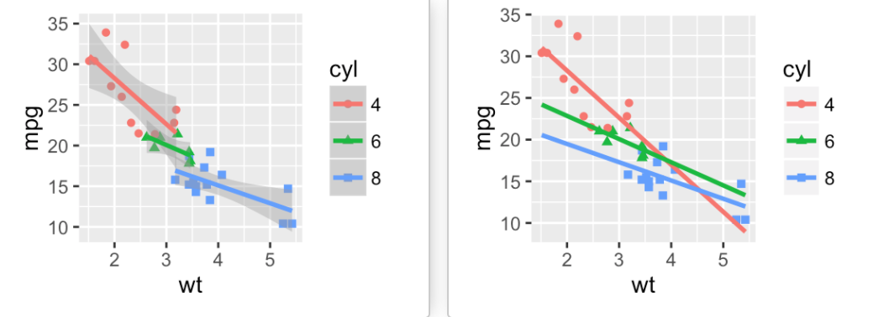
Problem in multi grouping? (last-week) Add regression lines
# Add regression lines
ggplot(mtcars, aes(x=wt, y=mpg, color=factor(cyl), shape=factor(cyl))) + geom_point() + geom_smooth(method=lm)
# Remove confidence intervals and Extend the regression lines
ggplot(mtcars, aes(x=wt, y=mpg, color=factor(cyl), shape=factor(cyl))) + geom_point() + geom_s mooth(method=lm, se=FALSE, fullrange=TRUE)

Slide 3
TASK for Practice
TASK: First take data=USA and put rownames= state (as we did in tutorial). Now using gather command combine all types of crime into one column and name it ‘crime’ and their values in column ‘rate’ and save in variable ‘p’.
Afterwards, create a scatterplot of data=p and put column ‘rate’ on x axis and ‘state’ on y axis. And color them with respect to column ‘crime. And this is how it should look like.

Slide 4
Agenda
Normalization of Data in R
Re-scaling and Standardization
Group comparison of variables within Two groups
Realization of Normality
T-Test and U-Test
Group comparison of variables within multiple groups
Realization of Normality
Anova and Kruskal-wallis TEST

Slide 5
Overview of Project road-map
Today

Slide 6
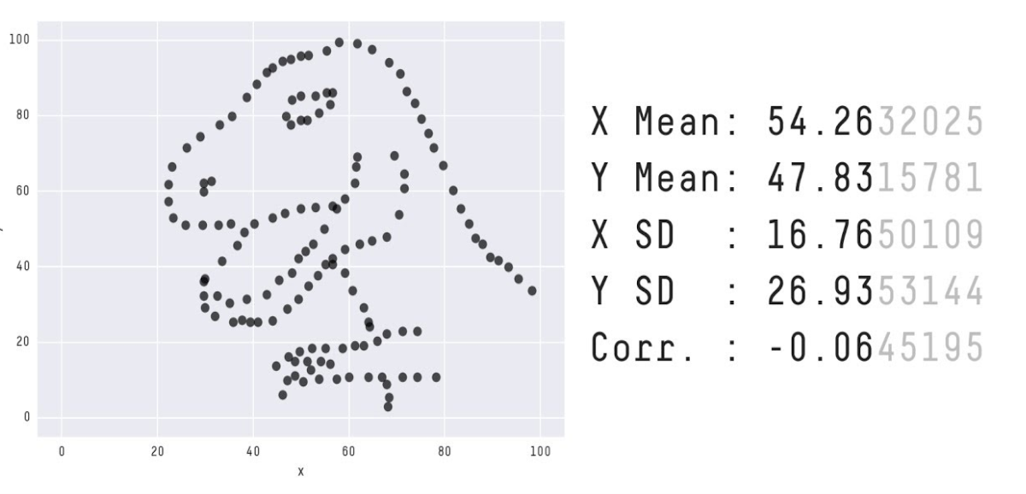
Normalization Elimination of Units of Measurement for Easier Comparison of Data from Different Places
For Example: In Machine Learning, NORMALIZATION is only required when features have widely varying ranges

Slide 7
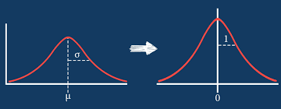

Methods of Normalization
Standardization:
Transforming data into a z-score or t-score i.e. transform data to have a mean of 0 and standard deviation of 1
Feature Scaling:
Rescaling data to have values between 0 & 1

Slide 8
Move to Normalization.R Script
(Take from GITHUB)

Slide 9
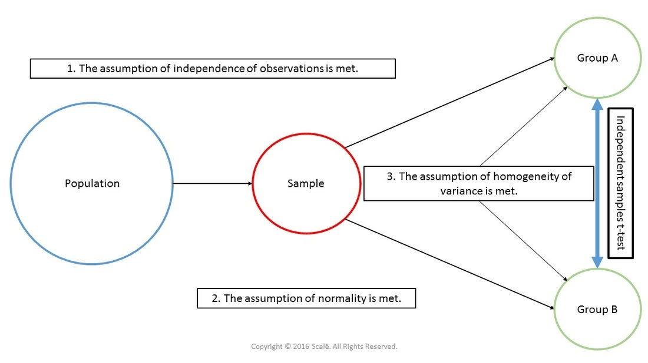
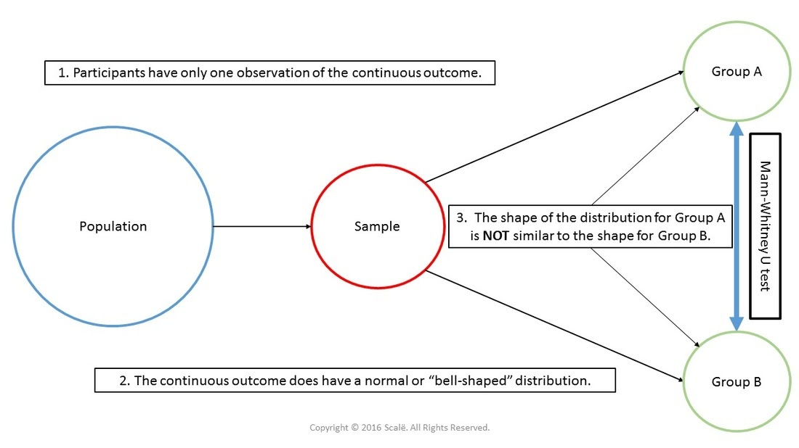
Group Comparison of Variables within 2 Groups
“T-TEST”
“Mann-Whitney U-Test”

Slide 10
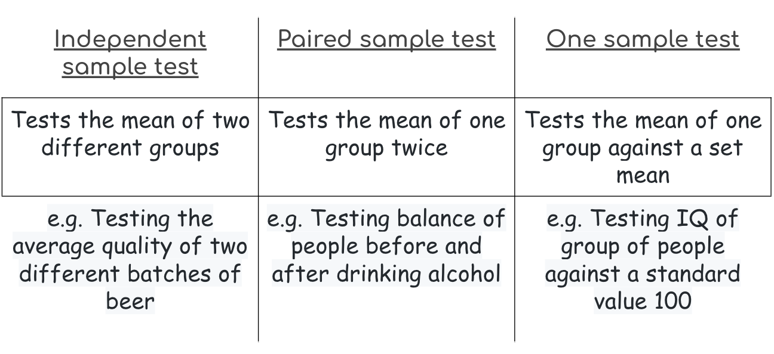
T-Test types for Different Groups

Slide 11
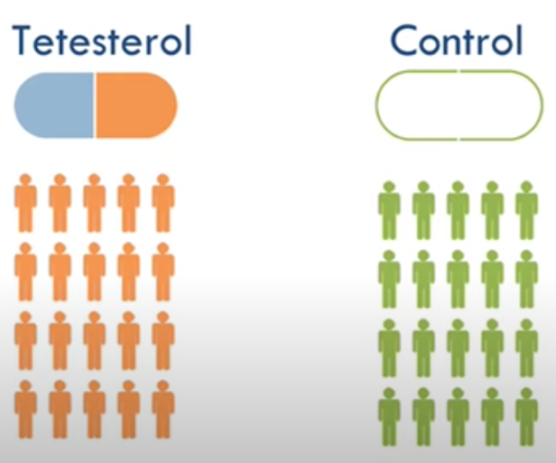
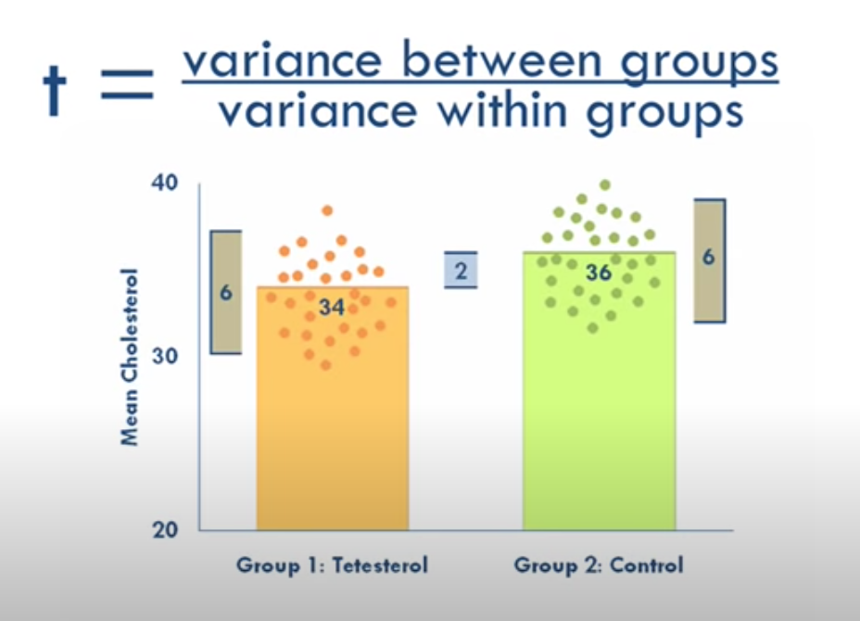
T-Test Example

Slide 12
Limitations in T-test
Results can only be applied to population that resembles the sample. e.g. Cholesterol drug test was conducted for adults, So i can not be true for children.
Sample and Population should be roughly normal in distribution.
Each group should have same number of data points. Otherwise there will be inaccurate results.
All data should be independent.

Slide 13
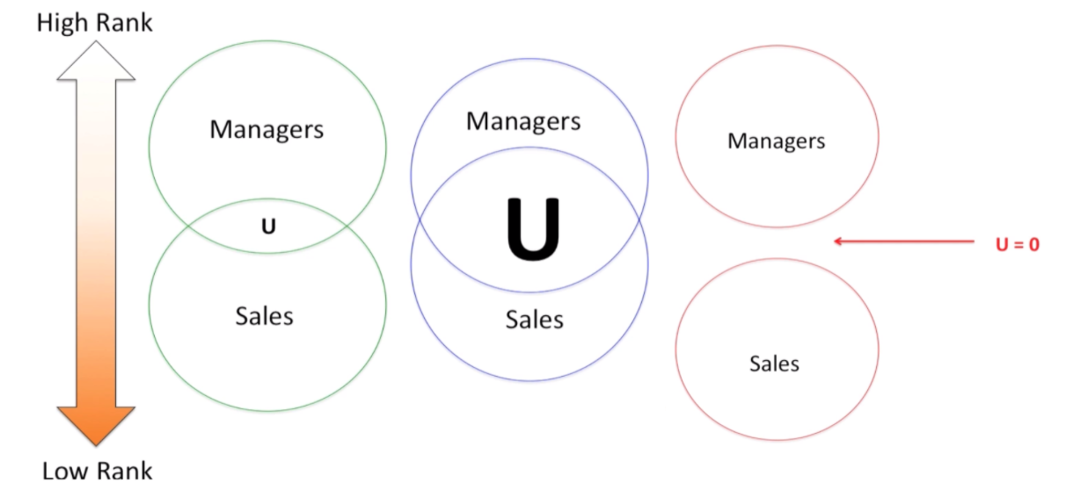
U-Test Example
Smaller U, bigger difference between groups
Larger U, smaller differences between groups
U = 0, no overlapping, completely different

Slide 14
Move to T-Test and U-Test.R Script
(Take from GITHUB)

Slide 15
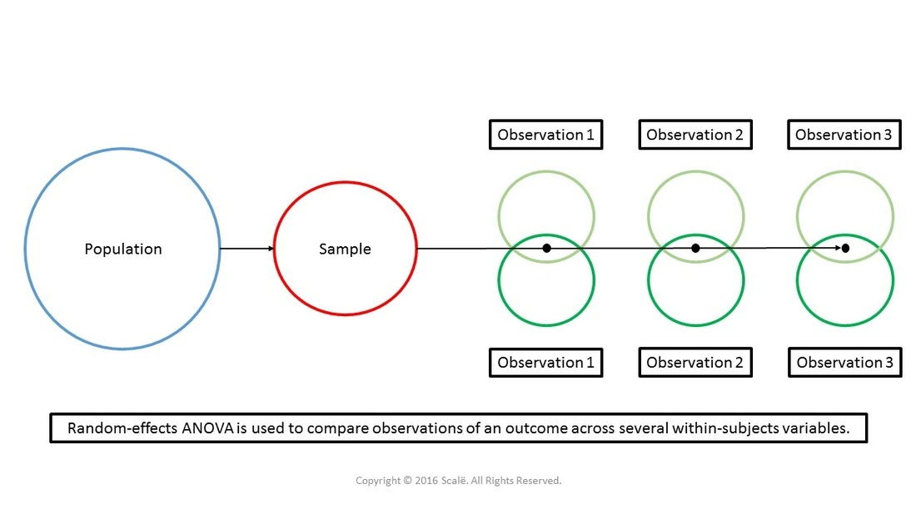
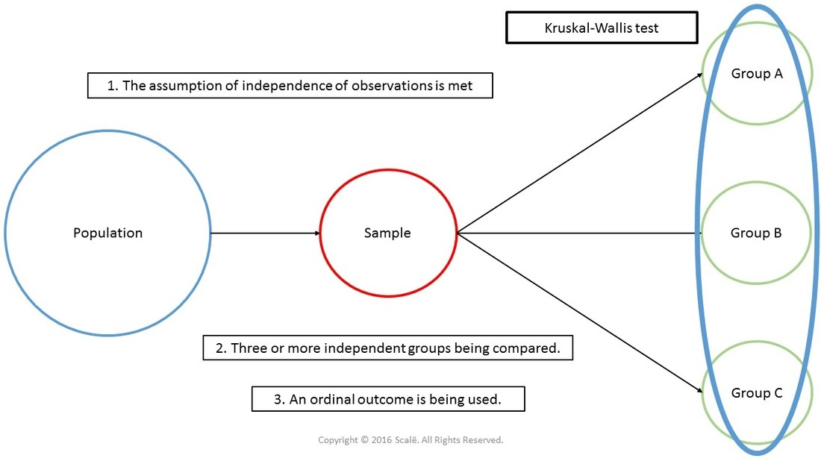
Group comparison of Multiple Groups
“Analysis of Variance (ANOVA) ”
“Kruskal-Wallis-Test (H-Test)”

Slide 16
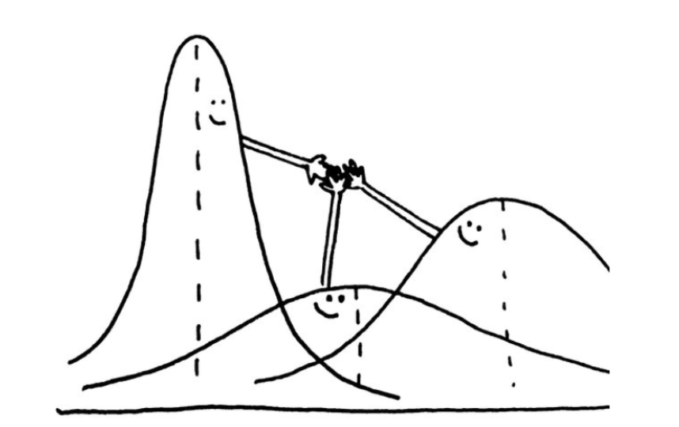
Analysis of Variance (ANOVA)
Analysis of Variance (ANOVA) is a parametric statistical technique used to compare datasets. It is similar in application to techniques such as t-test, in that it is used to compare means and the relative variance between them. However, analysis of variance (ANOVA) is best applied where more than 2 populations or samples are meant to be compared.

Slide 17
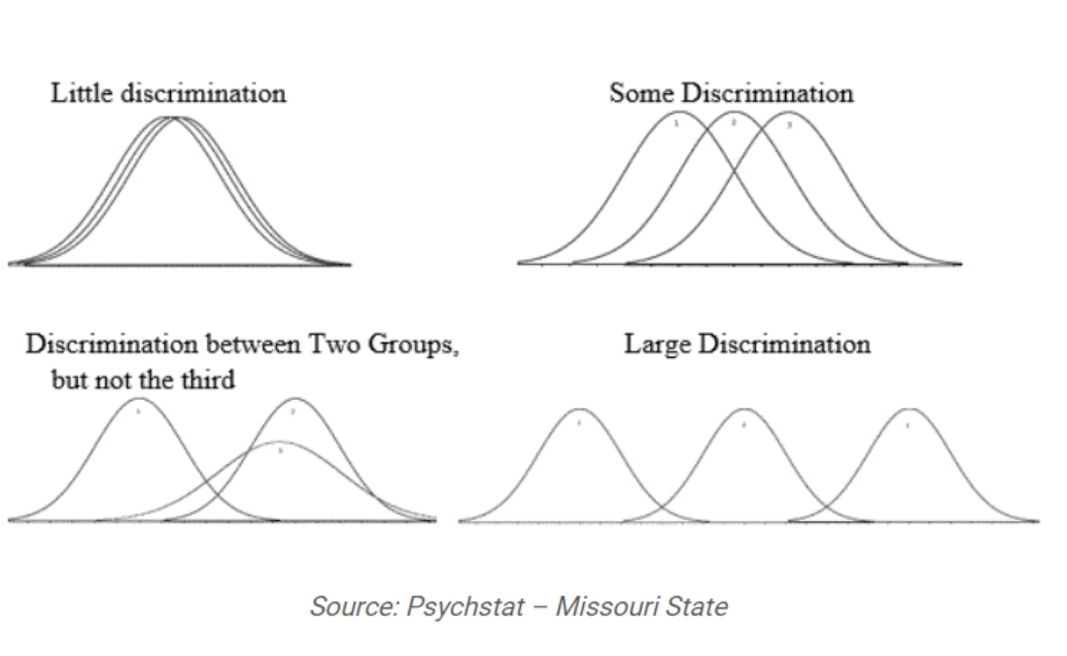
Group Discrimination

Slide 18
Assumptions
Independence of case: Independence of case assumption means that the case of the dependent variable should be independent of the sample. There should not be any pattern in the selection of the sample.
Normality: Distribution of each group should be normal. The Kolmogorov-Smirnov or the Shapiro-Wilk test may be used to confirm the normality of the group.
Homogeneity: Homogeneity means variance between the groups should be the same. Levene’s test is used to test the homogeneity between groups.
If particular data follows the above assumptions, then the analysis of variance (ANOVA) is the best technique to compare the means of two, or more, populations.

Slide 19
Kruskal-Wallis H-test
(sometimes also called the "one-way ANOVA on ranks") is a rank-based nonparametric test that can be used to determine if there are statistically significant differences between two or more groups of an independent variable on a continuous or ordinal dependent variable. It is considered the nonparametric alternative to the one-way ANOVA, and an extension of the Mann-Whitney U test to allow the comparison of more than two independent groups.
It is important to realize that the Kruskal-Wallis H test is an omnibus test statistic and cannot tell you which specific groups of your independent variable are statistically significantly different from each other; it only tells you that at least two groups were different. Since you may have three, four, five or more groups in your study design, determining which of these groups differ from each other is important.

Slide 20
Example
you could use a Kruskal-Wallis H test to understand whether exam performance, measured on a continuous scale from 0-100, differed based on test anxiety levels (i.e., your dependent variable would be "exam performance" and your independent variable would be "test anxiety level", which has three independent groups: students with "low", "medium" and "high" test anxiety levels).

Slide 21
Assumptions
Your dependent variable should be measured at the ordinal or continuous level (i.e., interval or ratio). Examples of ordinal variables include Likert scales (e.g., a 7-point scale from "strongly agree" through to "strongly disagree")
Your independent variable should consist of two or more categorical, independent groups. Typically, a Kruskal-Wallis H test is used when you have three or more categorical, independent groups, but it can be used for just two groups (i.e., a Mann-Whitney U test is more commonly used for two groups)
You should have independence of observations, which means that there is no relationship between the observations in each group or between the groups themselves. For example, there must be different participants in each group with no participant being in more than one group

Slide 22
Move to Anova & Krusskal-wallis .R Script
(Take from GITHUB)

