Slide 1




33rd ACM International Conference on Information and Knowledge Management
October 21-25, 2024
MMPolymer: A Multimodal Multitask Pretraining Framework for Polymer Property Prediction
Fanmeng Wang¹, Wentao Guo², Minjie Cheng¹, Shen Yuan¹, Hongteng Xu¹, Zhifeng Gao³
¹Gaoling School of Artificial Intelligence, Renmin University of China
²Department of Chemistry, University of California, Davis
³DP Technology
October 22, 2024

Slide 2
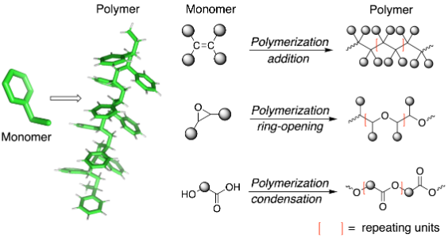
Background
Polymer
Polymers are high-molecular-weight compounds constructed by the covalent bonding of numerous identical or similar monomers.
In the past few decades, they have played an important role in many scientific fields, such as chemistry, material science, and drug design.

Slide 3
Background
Polymer Property Prediction
In this case, achieving accurate prediction of polymer properties has garnered more and more attention due to its significance:
Predicting polymer properties like plasticity and conductivity helps guide the design and development of polymer-based materials.
Predicting polymeric drug carriers’ bio-compatibility and release kinetics is essential for designing effective and safe drugs.
…
However, existing prediction methods heavily rely on the information learned from polymer SMILES sequences (P-SMILES strings) while ignoring 3D structural information, leading to sub-optimal performance.

Slide 4
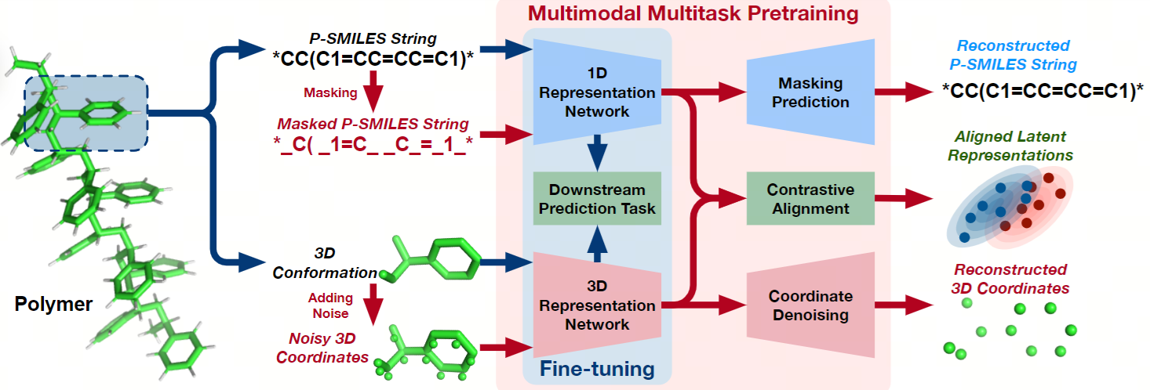
Background
MMPolymer
Typically, the properties of a polymer, such as plasticity, conductivity, bio-compatibility, and so on, are highly correlated with its 3D structure.
Therefore, we propose MMPolymer, a multimodal multitask pretraining framework incorporating polymer 1D sequential and 3D structural information to encourage downstream polymer property prediction tasks.

Slide 5
Our Approach: MMPolymer
Overview
The first work that incorporates 3D structural information into polymer property prediction.
Besides, considering the scarcity of polymer 3D data, we further introduce the "Star Substitution" strategy to extract 3D structural information effectively.
Experiments show that MMPolymer achieves state-of-the-art performance in downstream polymer property prediction tasks.

Slide 6
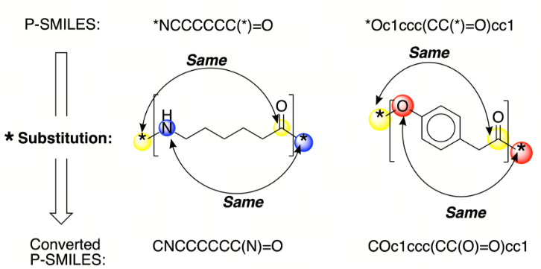
Our Approach: MMPolymer
Star Substitution Strategy
Due to the scarcity of polymer 3D data, we can only leverage the 3D conformation of the corresponding repeating unit to approximate the whole polymer 3D conformation.
In this case, we further introduce the "Star Substitution" strategy to extract 3D structural information effectively.
Star Substitution
The "*" symbol in the P-SMILES string is replaced by the neighboring atom symbol of another "*" symbol

Slide 7
Our Approach: MMPolymer
Star Substitution Strategy
Star Substitution
The "*" symbol in the P-SMILES string is replaced by the neighboring atom symbol of another "*" symbol
Then we use the RDKit tool to generate the 3D conformation based on the converted P-SMILES string.
In this way, the generated 3D conformation can not only reflect 3D structural features within repeating units but also reflect 3D structural features between the repeating units, thus contributing to extracting polymer 3D structural information effectively.

Slide 8


Our Approach: MMPolymer
Multimodal Multitask Pretraining Framework
During pretraining, we firstly mask the P-SMILES string randomly, add noise to the atom coordinates of corresponding 3D conformation, and pass them through the 1D and 3D representation networks, respectively.
Then we learn our MMPolymer based on three pretraining tasks, including 1D Task (predicting masked tokens), 3D Task (recovering clear 3D coordinates), and Contrastive Learning Task (aligning learned 1D and 3D representations):

Slide 9
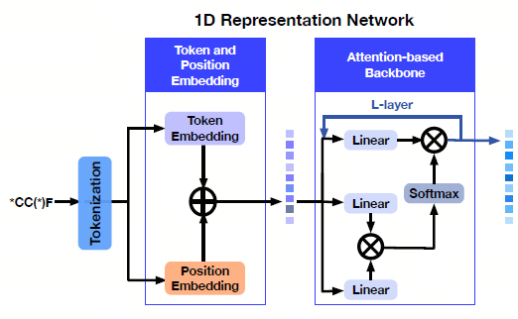
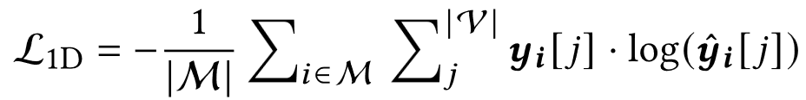
Our Approach: MMPolymer
Multimodal Multitask Pretraining Framework
1D Task
A typical Masked Language Modeling task in NLP.
Approximately 15% tokens in the polymer sequence are randomly masked. These tokens are subjected to three possiblere placement options: they may be replaced with a special token [MASK], a random token, or left unchanged.
Then the 1D representation network is trained to recover the original identity of these masked tokens based on the contextual information provided by the surrounding sequence.

Slide 10
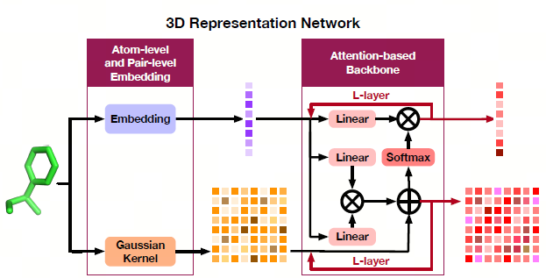
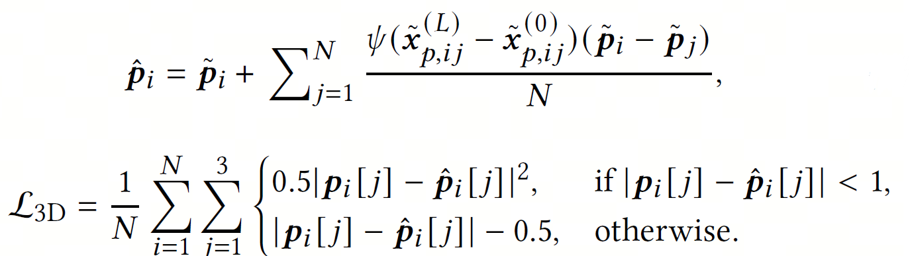
Our Approach: MMPolymer
Multimodal Multitask Pretraining Framework
3D Task
Noise is randomly introduced to atom coordinates of the given 3D conformation, thus generateing corrupted 3D conformation with noisy 3D atom coordinates.
Then the 3D representation network is trained to recover the original 3D atom coordinates from the corrupted 3D conformation.

Slide 11
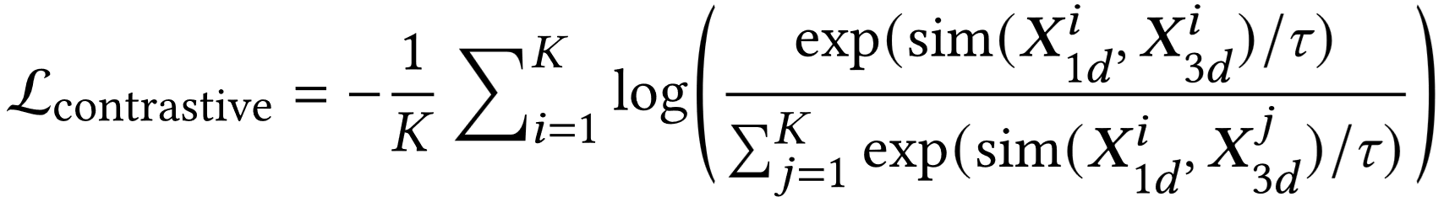
Our Approach: MMPolymer
Multimodal Multitask Pretraining Framework
Contrastive Learning Task
During pretraining, we also employ contrastive learning to align 1D sequential representation learned by 1D representation network and 3D structural representation learned by 3D representation network.
In this way, 1D sequential representation and 3D structural representation of polymers are aligned into a shared space, thus enhancing the coherence and mutual informativeness of these multimodal representations.

Slide 12
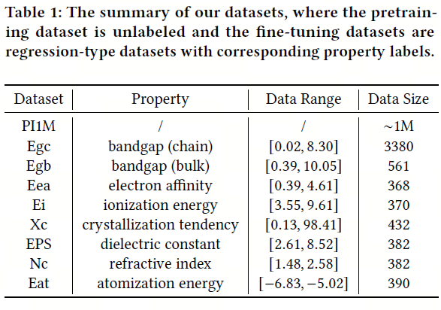
Experiments
Experimental Setup
Datasets
We use the PI1M dataset, which contains about one million unlabeled polymer data, to pretrain our MMPolymer.
The widely used open-source polymer property datasets (denoted as Egc, Egb, Eea, Ei, Xc, EPS, Nc, and Eat, respectively) are used as our fine-tuning datasets.

Slide 13
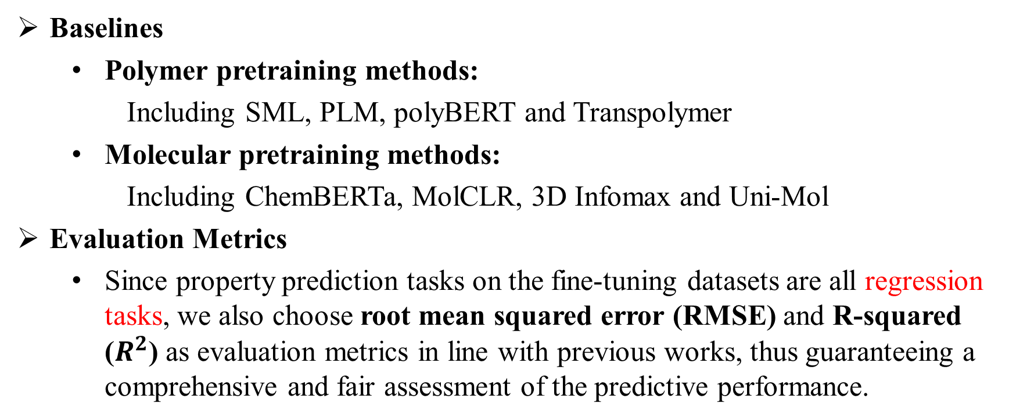
Experiments
Experimental Setup
Baselines
Polymer pretraining methods:
Including SML, PLM, polyBERT and Transpolymer
Molecular pretraining methods:
Including ChemBERTa, MolCLR, 3D Infomax and Uni-Mol
Evaluation Metrics
Since property prediction tasks on the fine-tuning datasets are all regression tasks, we also choose root mean squared error (RMSE) and R-squared ($R^{2}$) as evaluation metrics in line with previous works, thus guaranteeing a comprehensive and fair assessment of the predictive performance.

Slide 14
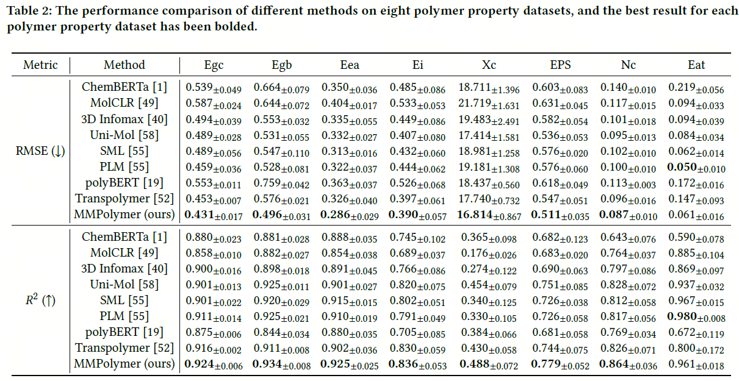
Experiments
Performance
State-of-the-art performance !

Slide 15

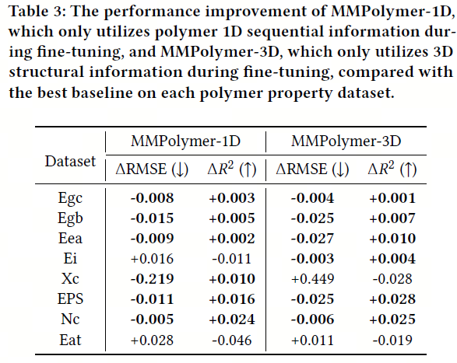
Experiments
Performance
We also explore the predictive capacity of our MMPolymer when only utilizing single modality information (either polymer 1D sequential information or 3D structural information) during fine-tuning.
Great adaptability !

Slide 16
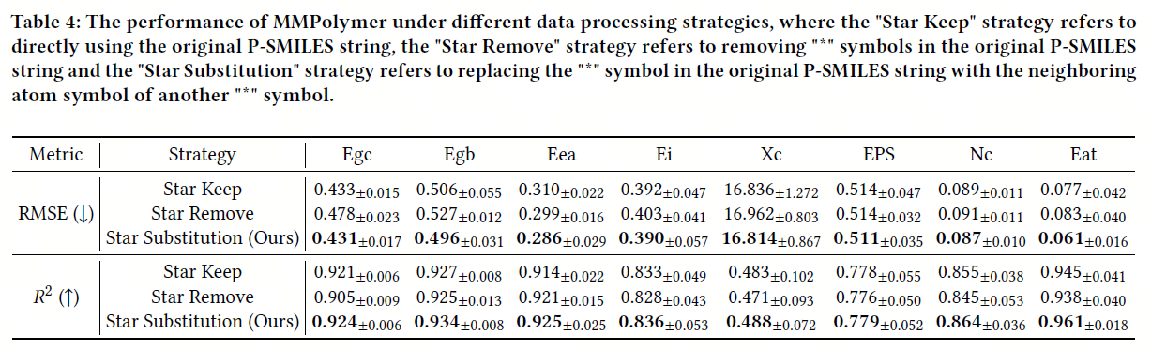
Experiments
Ablation Studies
The effectiveness of our "Star Substitution" strategy

Slide 17
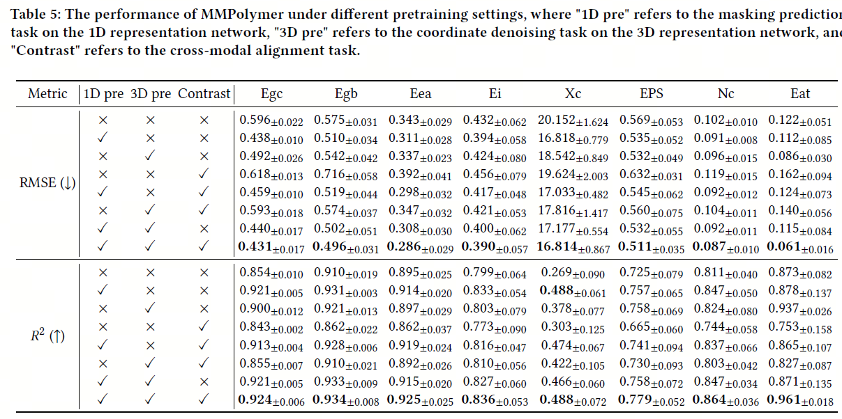
Experiments
Ablation Studies
The effectiveness of our multimodal multitask pretraining paradigm

Slide 18
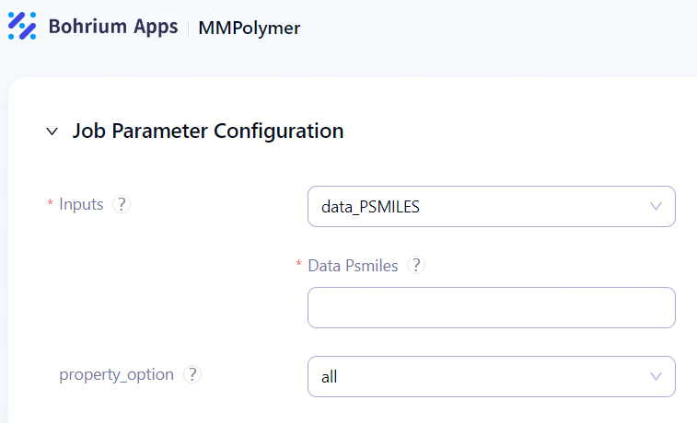
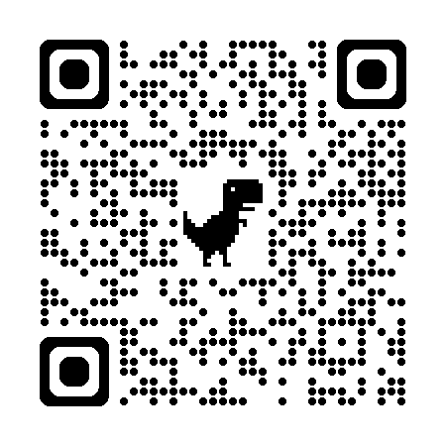
Conclusion
In this work, we present MMPolymer, a multimodal multitask pretraining framework, to predict polymer properties.
Through effectively combining polymer 1D sequential and 3D structural information, MMPolymer can fully capture diverse aspects of polymer data, creating a promising model for downstream polymer property prediction tasks.
The extensive experiments consistently demonstrate that MMPolymer achieves state-of-the-art performance on various polymer property prediction tasks, significantly outperforming existing polymer property prediction methods.
Online Platform
https://bohrium.dp.tech/apps/mmpolymer
Bohrium APP

Slide 19

33rd ACM International Conference on Information and Knowledge Management
October 21-25, 2024
Thank You & QA
Fanmeng Wang
fanmengwang@ruc.edu.cn

