Slide 1
Lets make a Webpage Layout

Slide 2
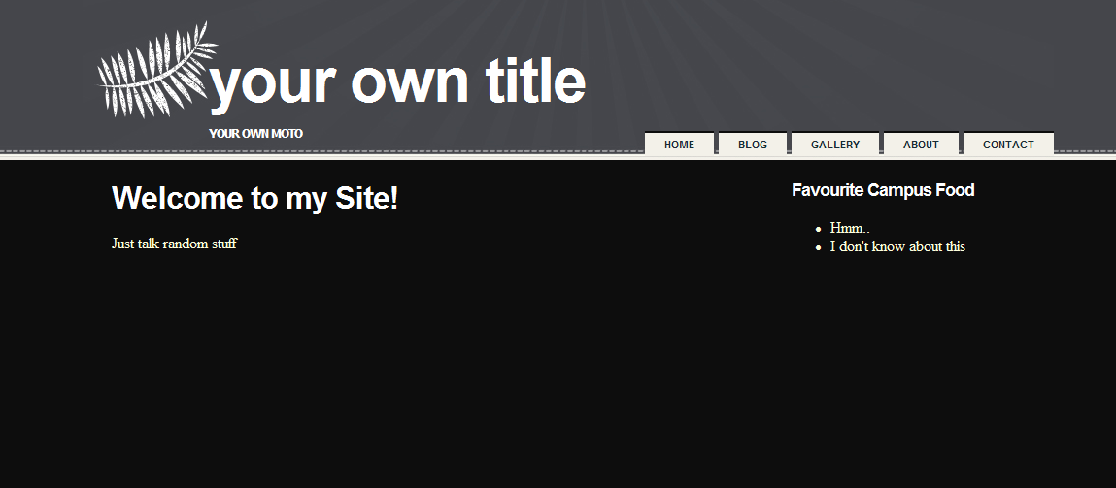
The site should look like this

Slide 3
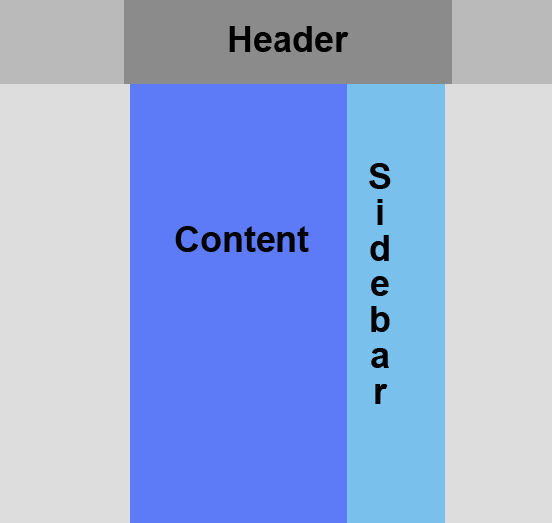
In terms of Layout

Slide 4
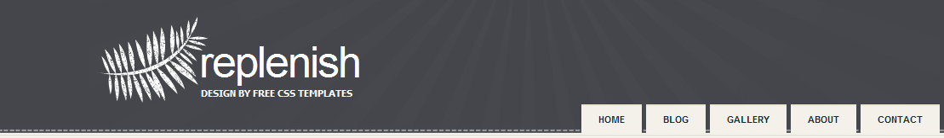
How is the Header made?
There is a background image
The Logo is one big image
The title text is not part of the image
Menu (Using Unordered List)

Slide 5
Create the background
You have the file images\cwback.jpg
That’s your actual background.
It repeats horizontally only, not vertically!
Put this code in your css file.
Removes the extra spaces you get
on the top when you create a page
body
{
margin: 0px;
padding: 0px;
background: #0D0D0D url('../images/cwback.jpg') repeat-x;
}
Repeat this image on the x axis! (horizontally)

Slide 6
Create the Logo
The logo is images\cwlogo.jpg
Put this code in your css file.
The actual size of the image
#header
{
width: 1000px;
height: 170px;
margin: 0px auto;
background-image: url('../images/cwlogo.jpg');
}
Centers this item in the middle
of the page, but only horizontally!

Slide 7
Create the Logo
We have to make use of this #header.
In your html file, you need something that has the id “header”
Put this code right after the body
<div id="header">
</div>

Slide 8
Create the Title text
The text is within the Logo!
And its positioned relative to the Logo image.
Put this in your CSS file:
Needs to be floating!
#title
{
float: left;
padding: 0 0 0 130px;
}
Position relative to the Logo image

Slide 9
Create the Title text
We need to make use of this “title” id now!
And this title, must be inside of the logo!
Put this html within the header div
<div id="title">
<h1> Your Own Title </h1>
<h2> Your Own Moto </h2>
</div>

Slide 10
Create the Title text
The headers are black…
They aren’t positioned nicely
There’s too much spacing in between them
Lets fix them!
Add to the CSS File:

Slide 11
h1 is only affected for title!
#title h1
{
margin: 0;
height: 65px;
padding: 40px 0 0 0px;
text-transform: lowercase;
letter-spacing: -2px;
font-size: 4em;
color: #FFFFFF;
}
#title h2
{
text-transform: uppercase;
color: #FFFFFF;
font-family: Tahoma, Arial, Helvetica, sans-serif;
font-weight: bold;
font-size: 13px;
}
How much space this text should
take up

Slide 12
Create the Menu
In the HTML, the menu is just an unordered list, where each item is link!
The menu has to float on the right side of the Logo, so it has to be inside the header div.
Put this html within the header div
<div id="menu">
<ul>
<li><a href="#">Home</a></li>
<li><a href="#">Blog</a></li>
<li><a href="#">Gallery</a></li>
<li><a href="#">About</a></li>
<li><a href="#">Contact </a></li>
</ul>
</div>

Slide 13
Create the Menu
This menu needs a lot of CSS
#menu { float: right; }
#menu li { display: inline; }
#menu ul {
margin: 0px;
padding: 140px 0px 0px 0px;
list-style: none;
}
#menu a {
display: block;
float: left;
margin-left: 5px;
padding: 8px 20px;
background: #F3F1E9;
text-decoration: none;
text-transform: uppercase;
border-top: 2px solid #0D0D0D;
font-family: Arial, Helvetica, sans-serif;
font-weight: bold;
font-size: 11px;
color: #182C33;
}
The menu has to be floating!
Stacks them horizontally
Positions them on the
bottom of the Logo

Slide 14
Create the body
The body for this is very simple.
On the left side, you have your content
On the right side, you have your side bar, which can have many things
How do we implement this?
Put this in your html inside the body
<div id="page">
<div id="content">
My content
</div>
<div id="sidebar">
My Sidebar
</div>
</div>

Slide 15
Create the body
Now we need the CSS.
Just like the logo, the page and all of its content will always be in the middle, and it will have a fixed size.
#page
{
width: 940px;
margin: 0px auto;
padding: 20px 0 0 0;
}

Slide 16
Setup the Content & Sidebar
Now the content & sidebar are just “page” split into 2.
So we make “content” float on the left with a fixed size, and “sidebar” float on the right with a fixed size.
#content {
float: left;
width: 650px;
margin-bottom: 10px;
}
#sidebar {
float: right;
width: 240px;
margin-bottom: 10px;
}

Slide 17
Add some more CSS
Lets change the default font being used to something more nicer
h1, h2, h3 {
font-family: Arial, Helvetica, sans-serif;
letter-spacing: -1px;
color: #FFFFFF;
}
a {
color: #828170;
}

Slide 18
We’re done!
Lets add some random content to the site
Make your own changes!
<div id="content">
<h1> Welcome to my Site! </h1>
<p> Just talk random stuff </p>
</div>
<div id="sidebar">
<h3> Favorite Campus Food </h3>
<ul>
<li> Hmm... </li>
<li> I don't know about this </li>
</ul>
</div>

