Slide 1
Modeling Cell Polarity
Team “By Chance”
Or
Life is Gambling

Slide 2
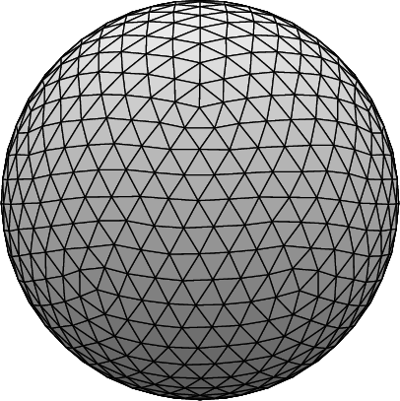
Idea
Represent cell’s membrane as surface made of equally sized compartments with thus equal capacity
Start with reaction part only
Start with treating cytosol as homogenous non-spatial compartment
SysBio Summer School 2016
Group 2
2

Slide 3
Motivation
k₁
+
k₂
k₁
+
k₂
SysBio Summer School 2016
Group 2
3

Slide 4
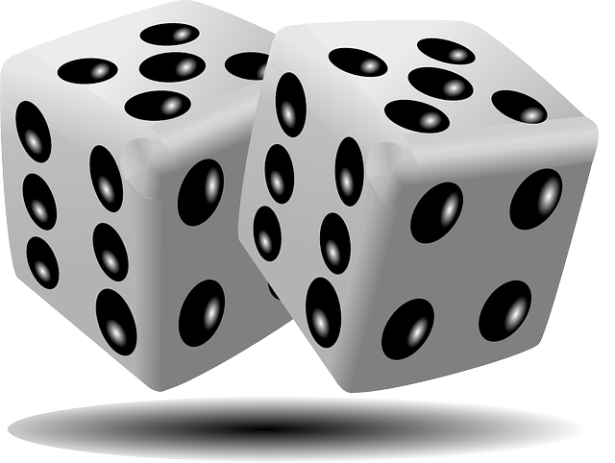
Motivation
k₁
+
k₂
probability ∝ k
k₁
99x
+
1x
+
k₂
SysBio Summer School 2016
Group 2
4

Slide 5
Motivation
Biological relevance
SysBio Summer School 2016
Group 2
5

Slide 6
Algorithm
Gillespie's stochastic simulation algorithm (SSA)
... kinetic Monte Carlo scheme
SysBio Summer School 2016
Group 2
6

Slide 7
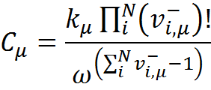
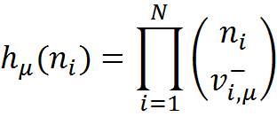
Evaluation of each c_{μ}
N_{Am}, N_{Ac}, N_{Pm}, N_{Pc}
Evaluation of each h_{μ}
Timestep+1
Evaluation of dt
Evaluation of
a_{μ} = h_{μ}*c_{μ}
Evaluation of
p_{μ} = a_{μ}/∑a_{μ}
Random choice
SysBio Summer School 2016
7

Slide 8
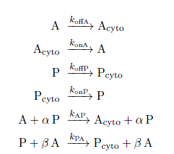
1
2
3
4
5
6
h1,a1,p1
h0,a0,p0
3999 P
4000 P
3000 A
2500 A_{cyto}
2000 P_{cyto}
2001 P_{cyto}
SysBio Summer School 2016
8

Slide 9
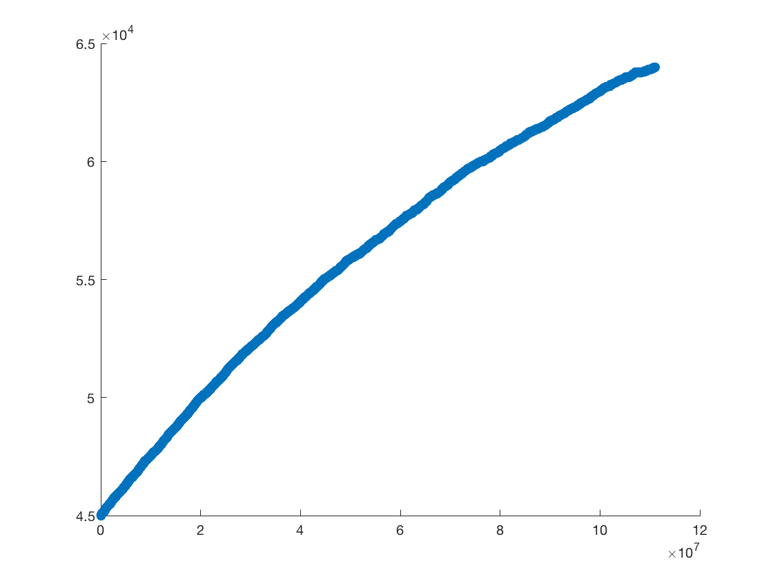
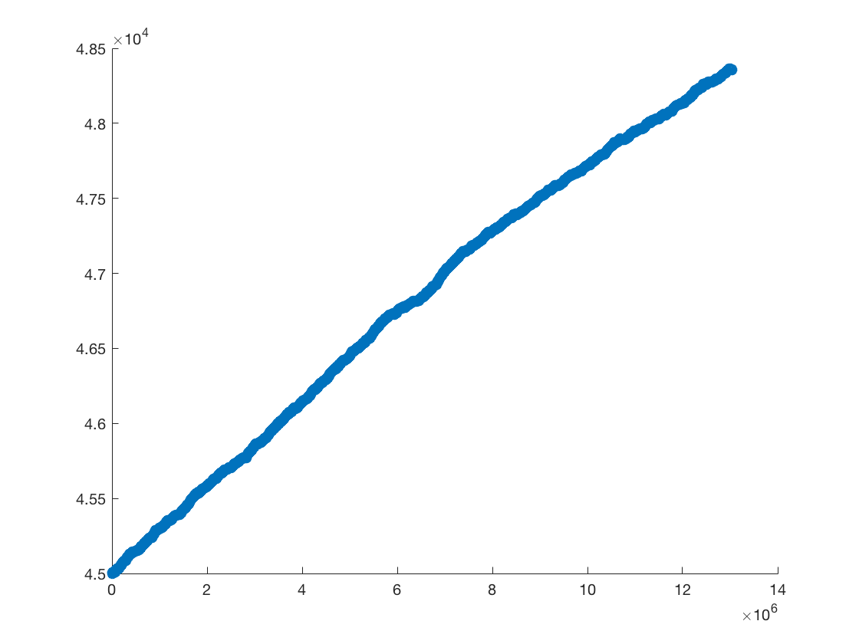
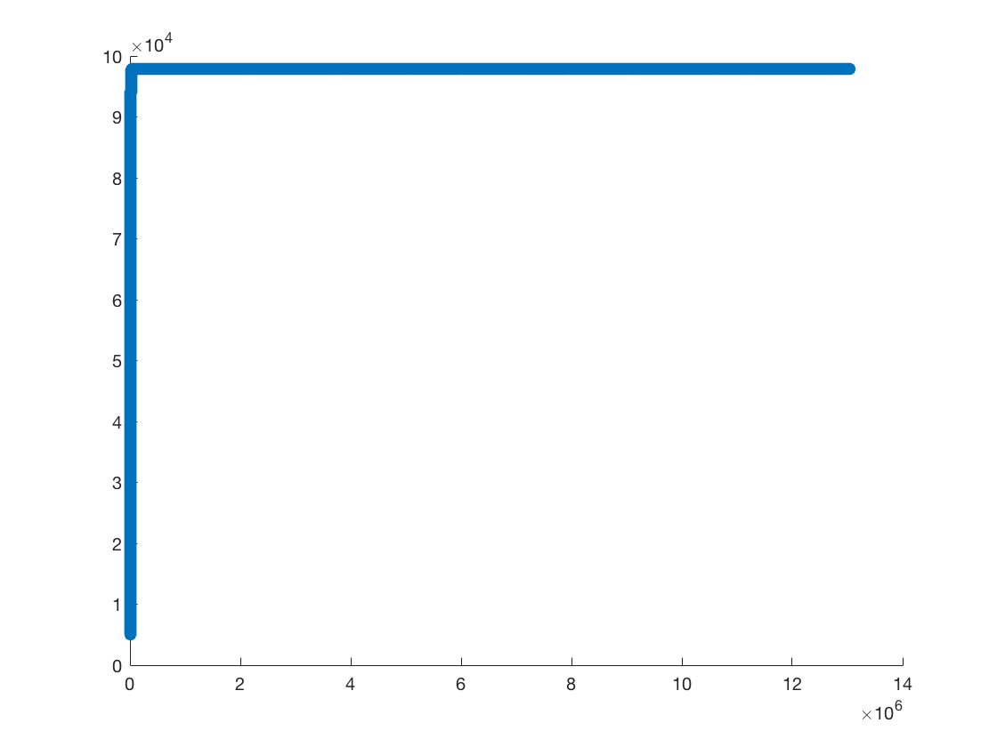
Results
Gillespie algorithm:
a = 1 k_{AP} = 0.004
b = 2 k_{PA} = 0.006
c₀ from data sheet
A_{m}(t)
P_{m}(t)
#
#
t [s]
t [s]
SysBio Summer School 2016
Group 2
9

Slide 10
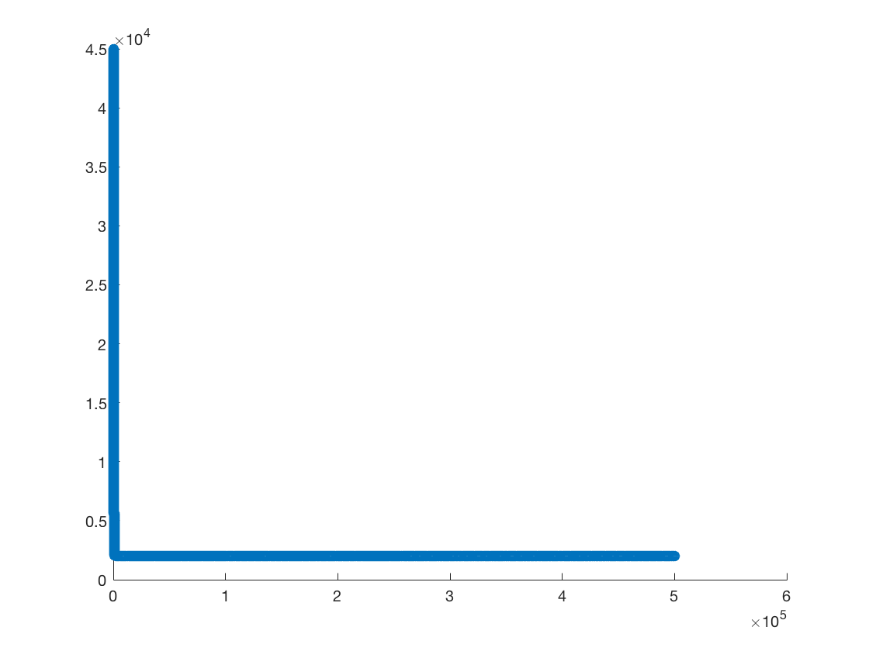
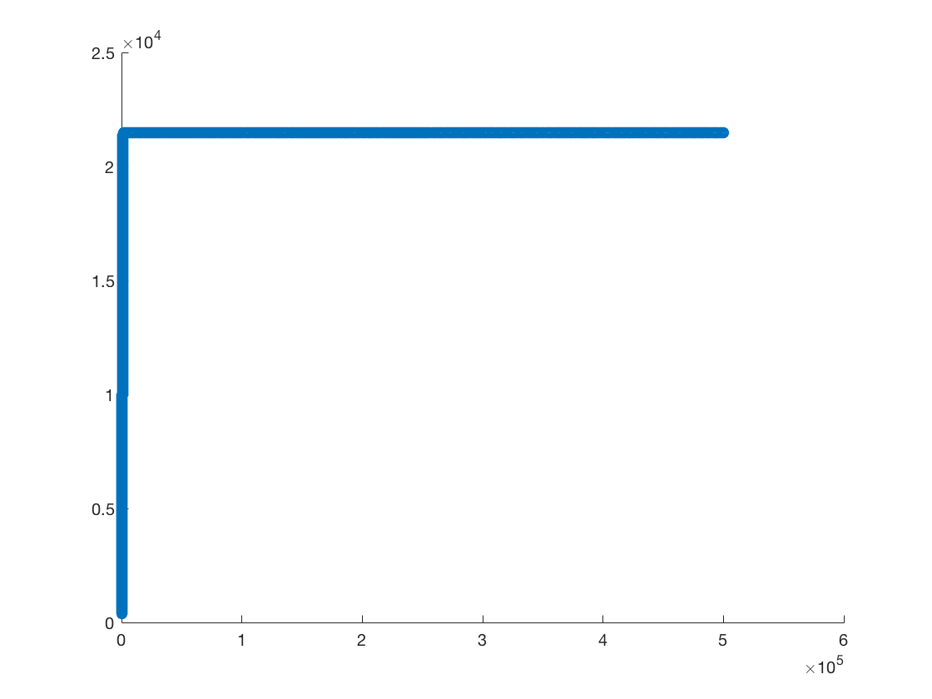
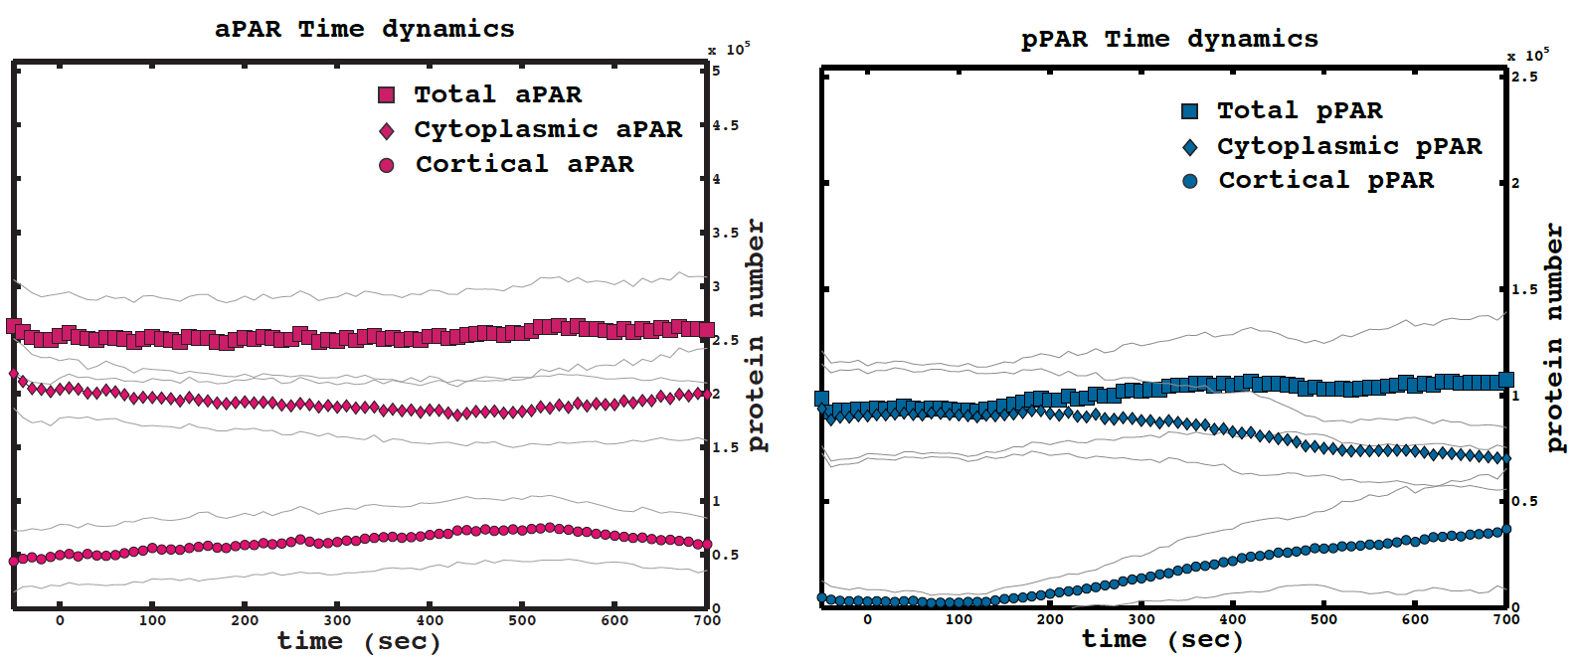
Evaluation of Results
Gillespie algorithm
A_{m}(t)
P_{m}(t)
Euler algorithm
Experimental data
SysBio Summer School 2016
Group 2
10

Slide 11
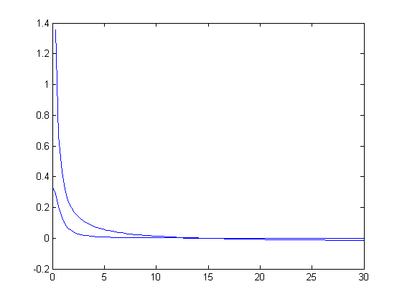
Evaluation of Results
Steady-state analysis:
a = 1
b = 2
k_{AP} = 0.004
k^{PA} = 0.006
A_{m}
P_{m}
SysBio Summer School 2016
Group 2
11

Slide 12
Outlook
1) 1 reservoir contains both cytosol and membrane
2) Add space: N reservoirs to allow diffusion and advection
3) Add limitations: Restrict capacity of reservoirs
4) Add spatial separation: Restrict location of particles and reactions
cytosol
membrane
SysBio Summer School 2016
Group 2
12

Slide 13
Summary
Gillespie's stochastic simulation algorithm (SSA)
Advantages:
Accuracy at single molecule-level
Conservation of mass
Scalable complexity
Probabilities of reactions ∝ probability of collision
It’s fun
Disadvantages:
Computationally expensive (determined by the coupling class of the reaction network)
→ Our algorithm simply needs more fine-tuning
SysBio Summer School 2016
Group 2
13

Slide 14
Summary
SysBio Summer School 2016
Group 2
14

Slide 15
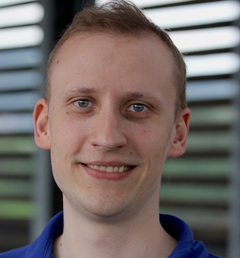
Acknowledgement
Thanks to everyone!
SysBio Summer School 2016
Group 2
15

