Slide 1
Team “By Chance”
Modeling Cell Polarity
Or
The Origin of Life is Gambling

Slide 2
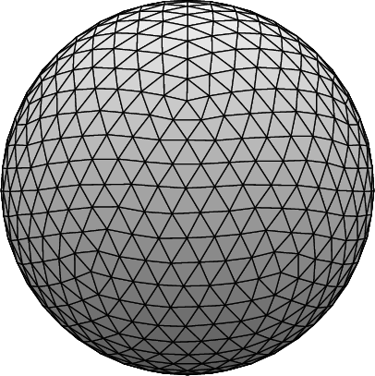
Idea
Represent cell’s membrane as surface made of equally sized compartments with thus equal capacity
Start with reaction part only
Start with treating cytosol as homogenous non-spatial compartment
SysBio Summer School 2016
Group 2
2

Slide 3
Motivation
k₁
+
k₂
k₁
+
k₂
SysBio Summer School 2016
Group 2
2

Slide 4

Motivation
k₁
+
k₂
probability ∝ k
k₁
99x
+
1x
+
k₂
SysBio Summer School 2016
Group 2
2

Slide 5
Motivation
Biological relevance
SysBio Summer School 2016
Group 2
2

Slide 6
Method
SysBio Summer School 2016
Group 2
2

Slide 7
Results
Info on parameters,
Euler to identify stationary state
plots of guispie
SysBio Summer School 2016
Group 2
2

Slide 8
Evaluation of Results
plots of guispie and euler and ed
SysBio Summer School 2016
Group 2
2

Slide 9
Outlook
1) 1 reservoir contains both cytosol and membrane
2) Add space: N reservoirs to allow diffusion and advection
3) Add limitations: Restrict capacity of reservoirs
4) Add spatial separation: Restrict location of particles and reactions
cytosol
membrane
SysBio Summer School 2016
Group 2
2

Slide 10
Summary
SysBio Summer School 2016
Group 2
2

Slide 11
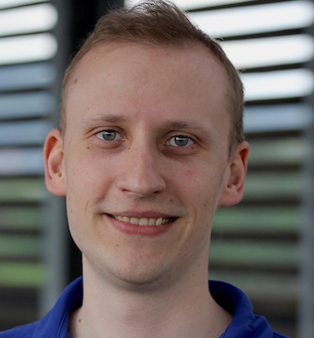
Acknowledgement
Thanks to everyone!
SysBio Summer School 2016
Group 2
2

