Slide 1
记事本APP
姓名：常惠源
学号：21551058
01

Slide 2
01
课题内容
PART ONE
Project Introduction

Slide 3
核心需求
APP
事件分类
事件管理
为具有简约生活态度人群打造的一款记事本APP
03
Notes:
通过互联网的思维做传统意义上的笔记，将原本私有，传播不便的笔记内容，通过互联网的思想，进行放大，是笔记的价值得到最大化

Slide 4
02
系统实现
PART TWO
System Implementation

Slide 5
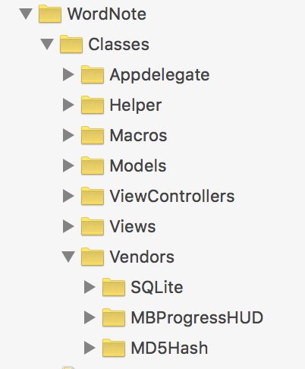
代码组织结构
05

Slide 6
数据存储（CoreDataManagerHelp 单例）
@implementation CoreDataManagerHelp
+ (instancetype)defaultCoreDataManagerHelp{
static CoreDataManagerHelp *help = nil;
static dispatch_once_t onceToken;
dispatch_once(&onceToken, ^{
help = [[CoreDataManagerHelp alloc]init];
});
return help;
}
06

Slide 7
数据存储（新增自定义分类）
- (void)addCutomFileListName:(NSString *)name{
NSEntityDescription *custom = [NSEntityDescription entityForName:@"CustomFile" inManagedObjectContext:self.managedObjectContext];
//根据实体描述创建实体（类）
CustomFile *customFile = [[CustomFile alloc]initWithEntity:custom insertIntoManagedObjectContext:self.managedObjectContext];
customFile.name = name;
customFile.date = [NSDate date];
[self saveManagedObject];
}
07

Slide 8
自定义View（分类输入）
@implementation FileNameView
- (instancetype)initWithFrame:(CGRect)frame{
if (self = [super initWithFrame:frame]) {
self.backgroundColor = [UIColor clearColor];
[self addfileNameField:frame];
}
return self;
}
- (void)addfileNameField:(CGRect)frame{
UIView *view = [[UIView alloc]initWithFrame:frame];
view.alpha = 0.7;
[self addSubview:view];
self.fileNameField = [[UITextField alloc]initWithFrame:CGRectMake(10, 74, frame.size.width - 20, 40)];
self.fileNameField.textAlignment = NSTextAlignmentCenter;
[self.fileNameField becomeFirstResponder];
self.fileNameField.placeholder = @"自定义分类名";
self.fileNameField.font = [UIFont systemFontOfSize:14];
self.fileNameField.backgroundColor = [UIColor whiteColor];
view.backgroundColor = [UIColor blackColor];
[self addSubview:self.fileNameField];
}
08

Slide 9
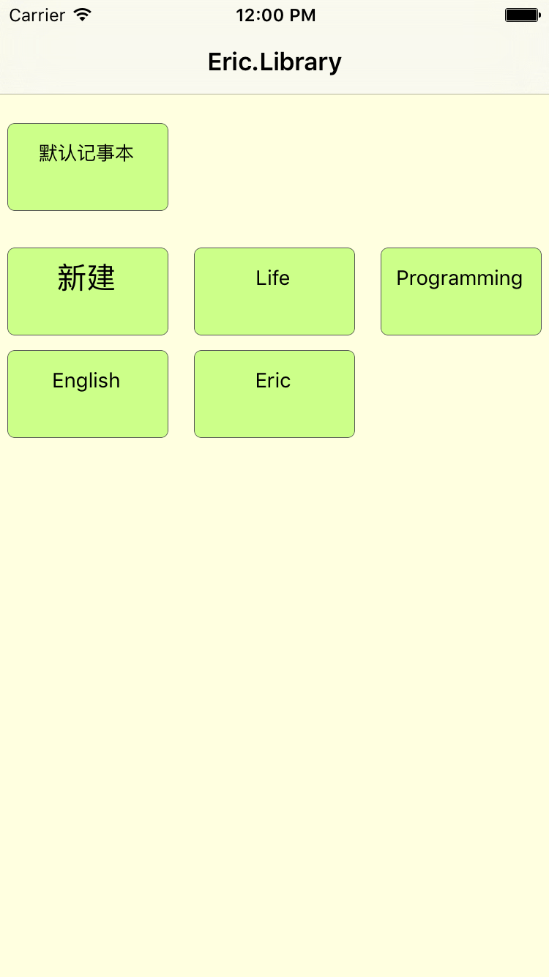
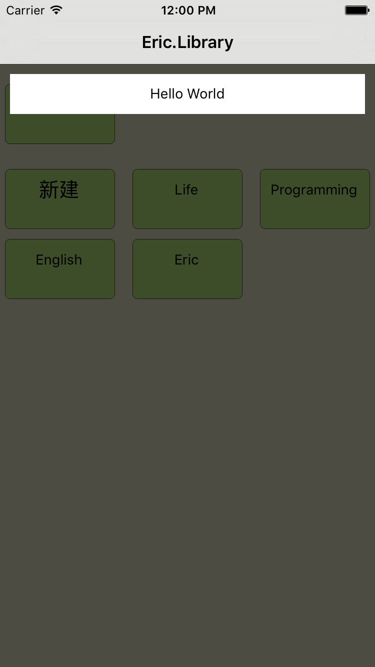
APP截图(一)
09

Slide 10
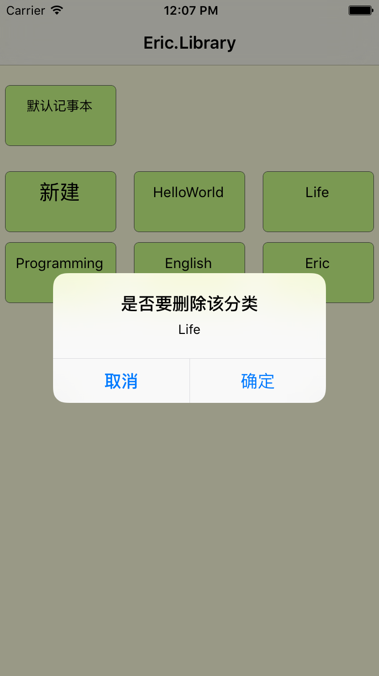
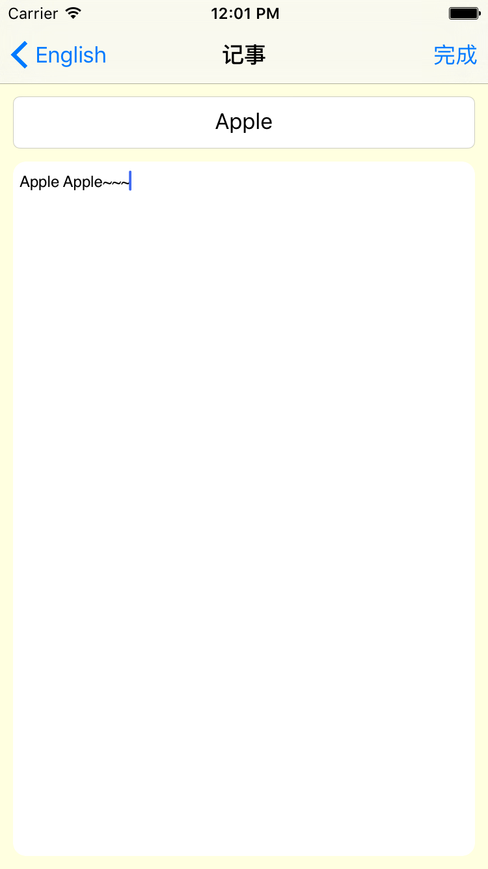
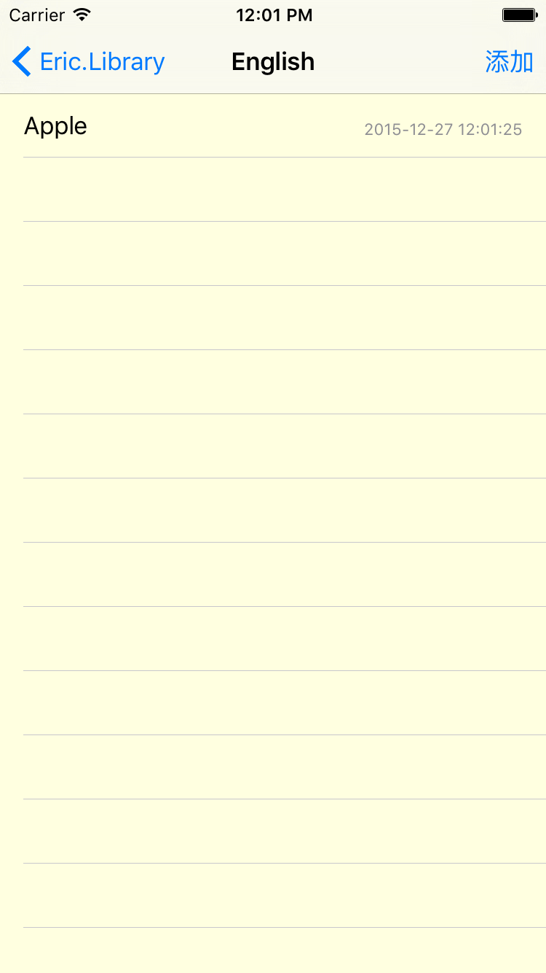
APP截图(二)
10

Slide 11
常惠源
感谢各位聆听
浙江大学
软件学院
Thanks for Listening
Software School,
Zhejiang university

