Slide 1
How to process

Slide 2
How to have a good User Interface
Consistency: The interface should be designed to be consistent across the system
Has the ability to restore : The interface should have reminder - recovery mechanisms when the user makes a mistake

Slide 3
User guide: The interface should be responsive to the user when there are errors and support users in different contexts
Diversity for users: Interfaces should provide appropriate interactions for different users
Intuitive design: The interface is usable right the first time, no training required

Slide 4
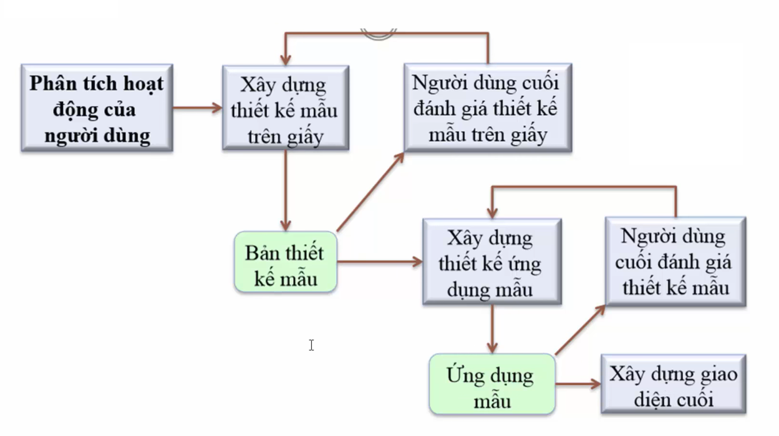
General process diagrams

Slide 5
User analysis
Without knowing what the user wants to do with the system => an effective interface cannot be designed.
The user and the designer must understand each other.
Context => describes the usage scenario. Here is one way to describe the analysis.

Slide 6
Technical analysis
Job Analysis
describes the steps within a job.
Use questionnaires
Ask the user about the work they do

Slide 7
Error message
Error messages are very important, bad error messages will easily make users not want to use the system.
The error message should be: polite, concise, and constructive.

