Slide 1

User Interface Analysis

Slide 2


Defination

Slide 3
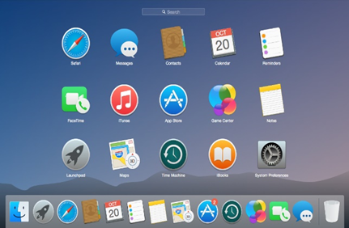
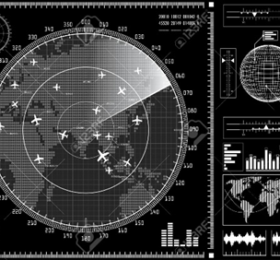
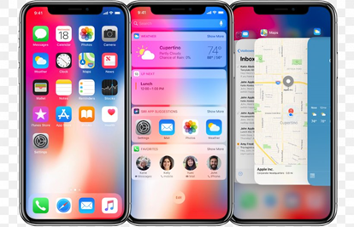
What is User Interface???
User interface is the front-end application view to which user interacts in order to use the software.
User can manipulate and control the software as well as hardware by means of user interface.
Today, user interface is found at almost every place where digital technology exists, right from computers, mobile phones, cars, music players, airplanes, ships etc.

Slide 4
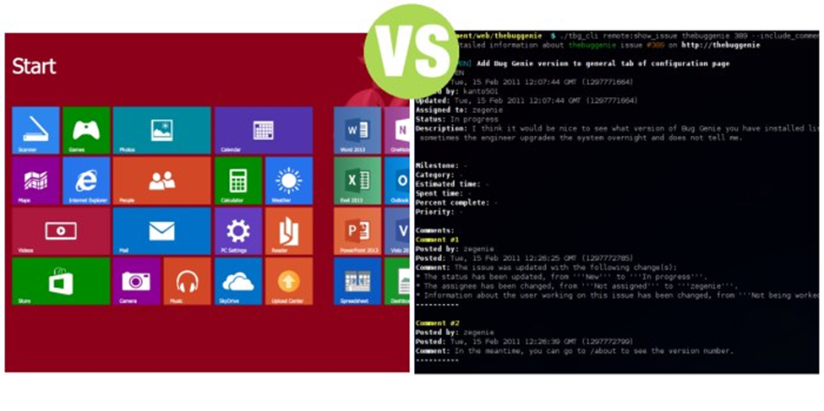
More information
UI provides fundamental platform for human-computer interaction.
UI can be graphical, text-based, audio-video based, depending upon the underlying hardware and software combination. UI can be hardware or software or a combination of both.
The software becomes more popular if its user interface is:
- Attractive
- Simple to use
- Responsive in short time
-Consistent on all interfacing screens
UI is broadly divided into two categories:
- Command Line Interface
- Graphical User Interface

Slide 5

What is User Interface Analysis???
User interface (UI) analysis is an independent elicitation technique in which you study existing systems to discover user and functional requirements.
It’s best to interact with the existing systems directly, but if necessary you can use screenshots.

Slide 6
Purpose

Slide 7

User Interface Analysis for what???
When working with packaged solutions or an existing system, UI analysis can help you identify a complete list of screens to help you discover potential features.
By navigating the existing UI, you can learn about the common steps users take in the system and draft use cases to review with users
UI analysis can reveal pieces of data that users need to see. It’s a great way to get up to speed on how an existing system works
Instead of asking users how they interact with the system and what steps they take, perhaps you can reach an initial understanding by yourself.

Slide 8
How to process

Slide 9
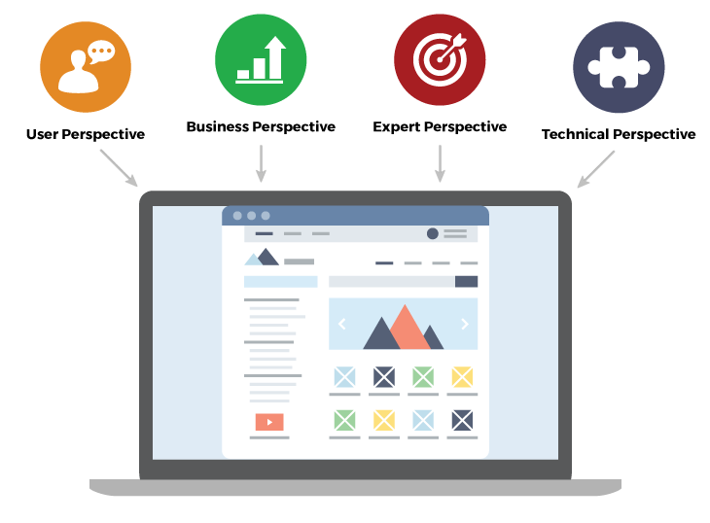
How to have a good User Interface???
Consistency: The interface should be designed to be consistent across the system
Has the ability to restore : The interface should have reminder - recovery mechanisms when the user makes a mistake
User guide: The interface should be responsive to the user when there are errors and support users in different contexts
Diversity for users: Interfaces should provide appropriate interactions for different users
Intuitive design: The interface is usable right the first time, no training required

Slide 10
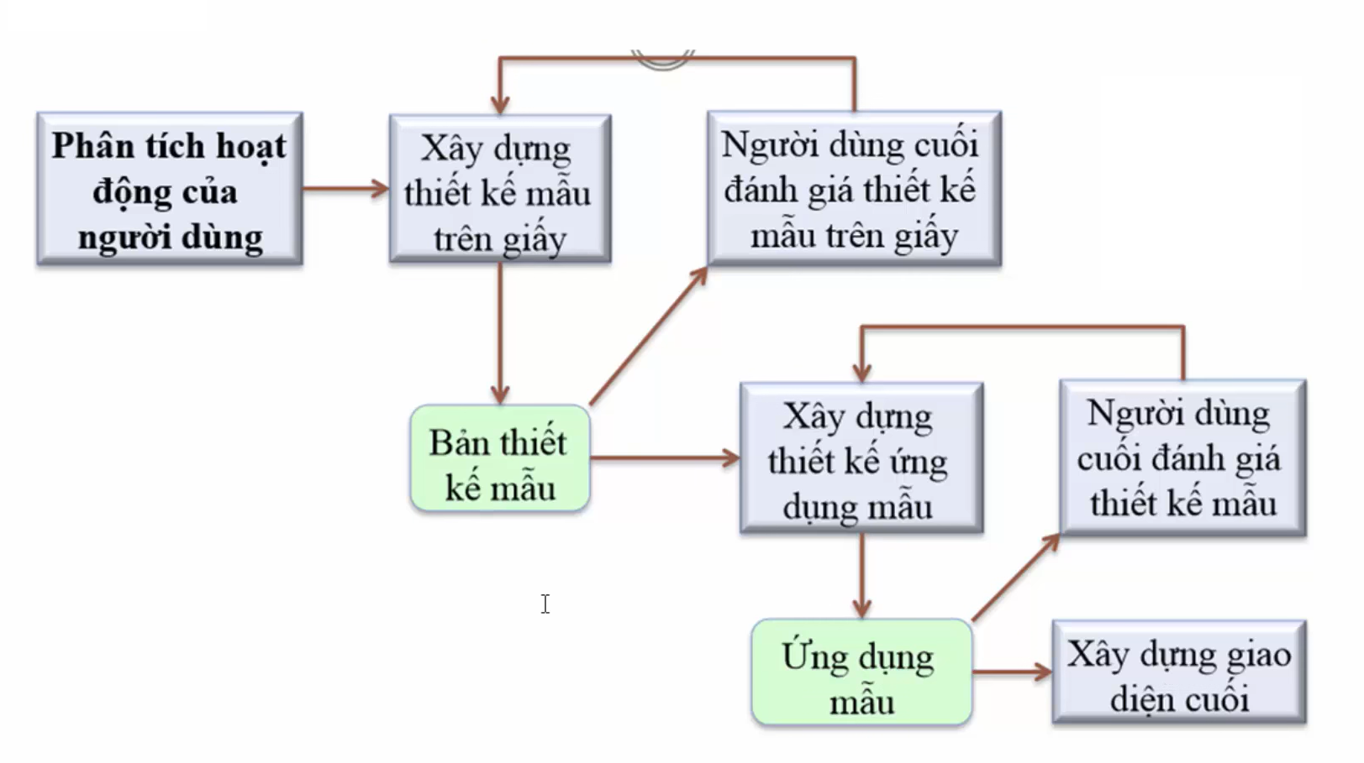
General process diagrams

Slide 11
User analysis
Without knowing what the user wants to do with the system => an effective interface cannot be designed.
The user and the designer must understand each other.
Context => describes the usage scenario. Here is one way to describe the analysis.

Slide 12
Technical analysis
Job Analysis
describes the steps within a job.
Use questionnaires
Ask the user about the work they do

Slide 13
Error message
Error messages are very important, bad error messages will easily make users not want to use the system.
The error message should be: polite, concise, and constructive.

Slide 14
Let’s practice
Get necessary information, analyse user and reconsider system.

Slide 15
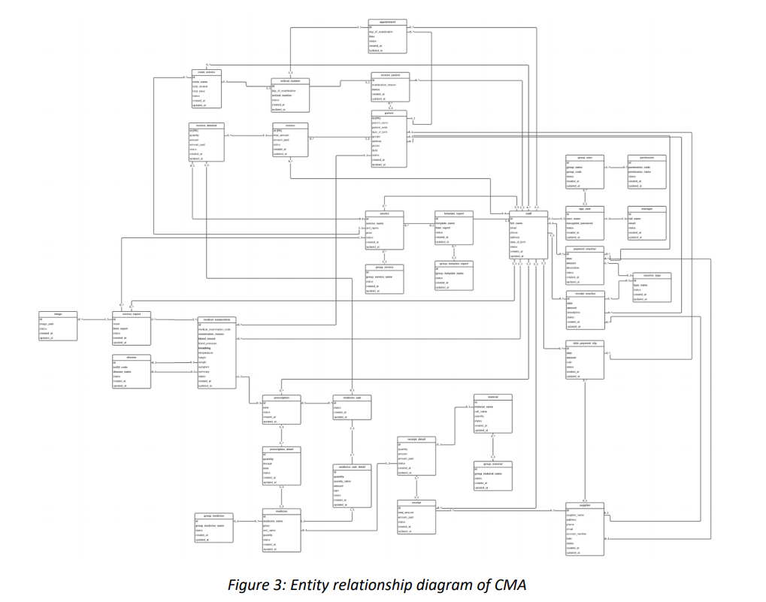
Let’s practice

Slide 16
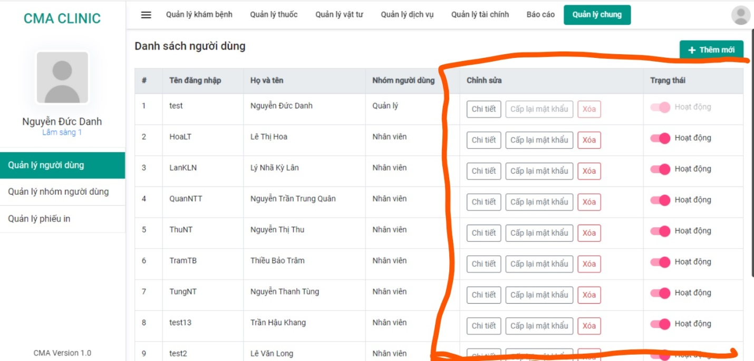
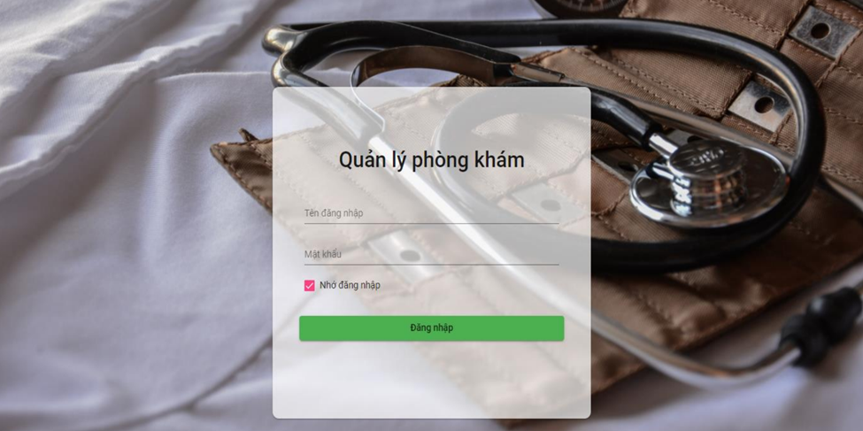
Let’s practice
Example based on assignment :
Specifect list :
- Specific
- Easy to learn
- Avoid error
Form :
- Easy to get accustomed to
- Guide user by provide a
givern form

Slide 17
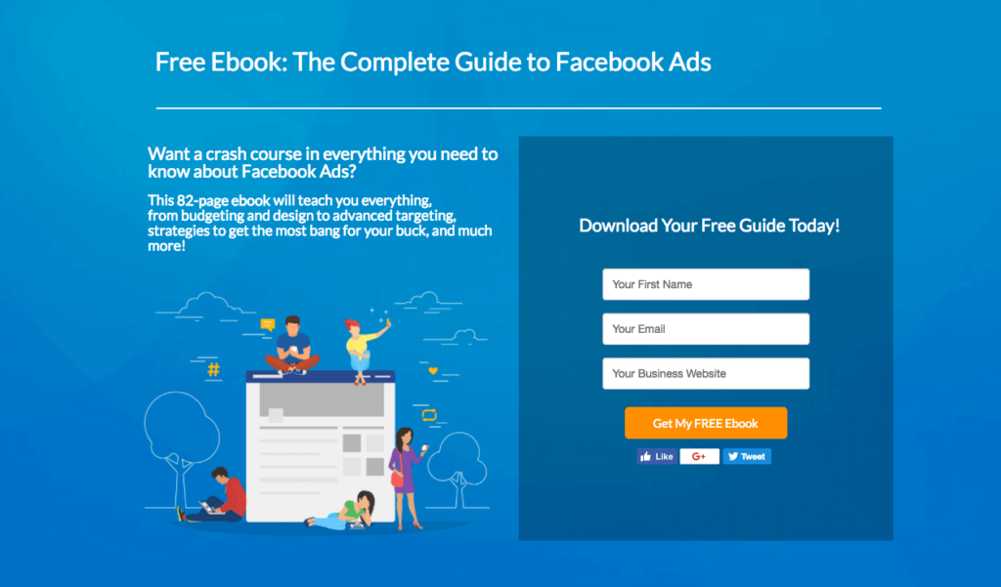
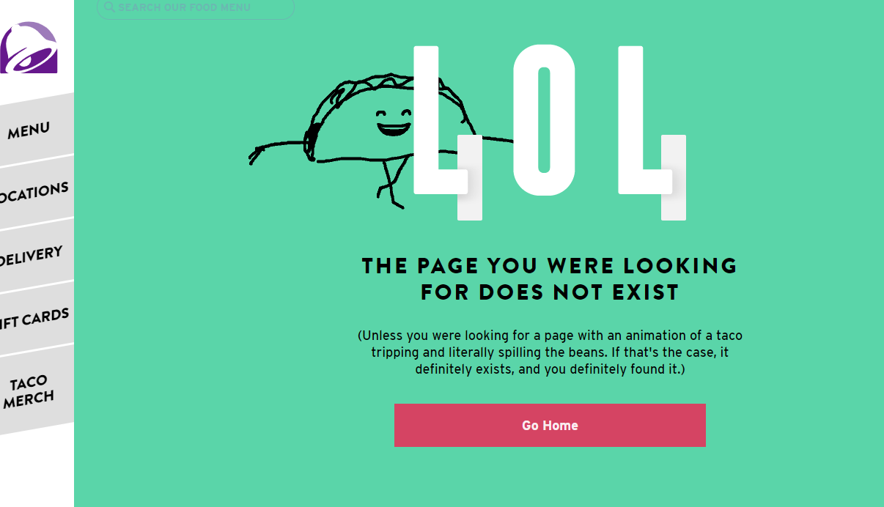
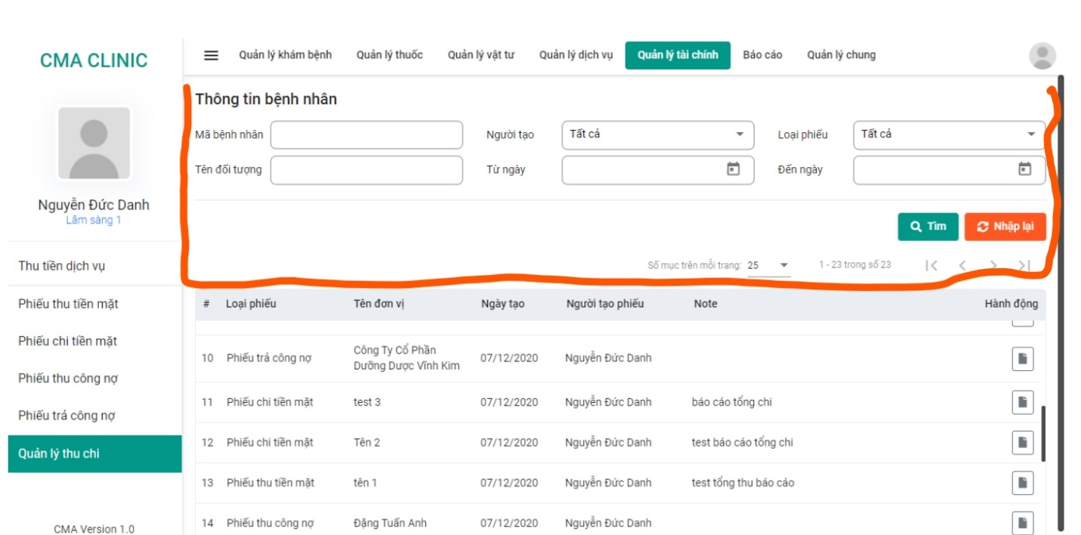
Let’s practice
Example based on assignment :
User natural language :
- Easy to use
- Easy to expand
Show error for users and
guide for new users
Provide users with type of
error and guide them how to
get back and guide them how
to use.

Slide 18
Thank You
Our team
Nguyễn Xuân Quang
Vũ Tiến Khôi
Trần Văn Việt
Bùi Việt Cường
Nguyễn Tiến Việt

