Slide 1
Progress, Reminders, and Consultant Team (PRACT)
Team SET
Emily Ngo, Tobey Tan, Zijin Liu
ITWS 2110 Web Systems Development

Slide 2
What We’ve Done So Far...
Front-End:
PHP
HTML
CSS
JS
Pages:
Login
Profile Info
Teams
Schedule
Admin

Slide 3
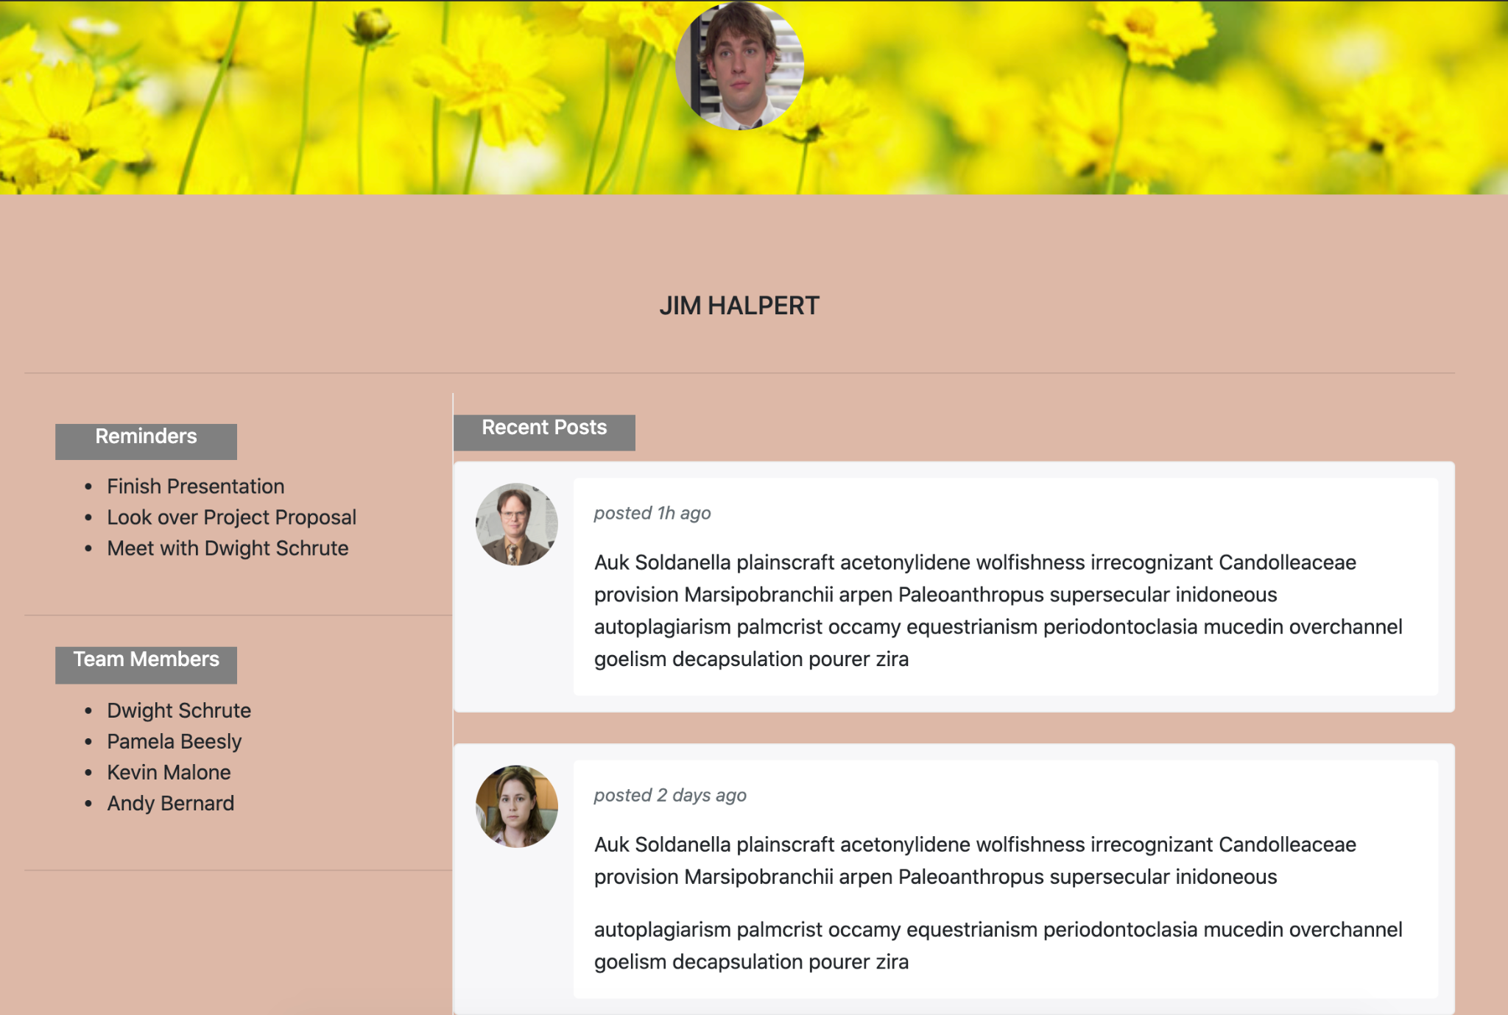
Index Page

Slide 4
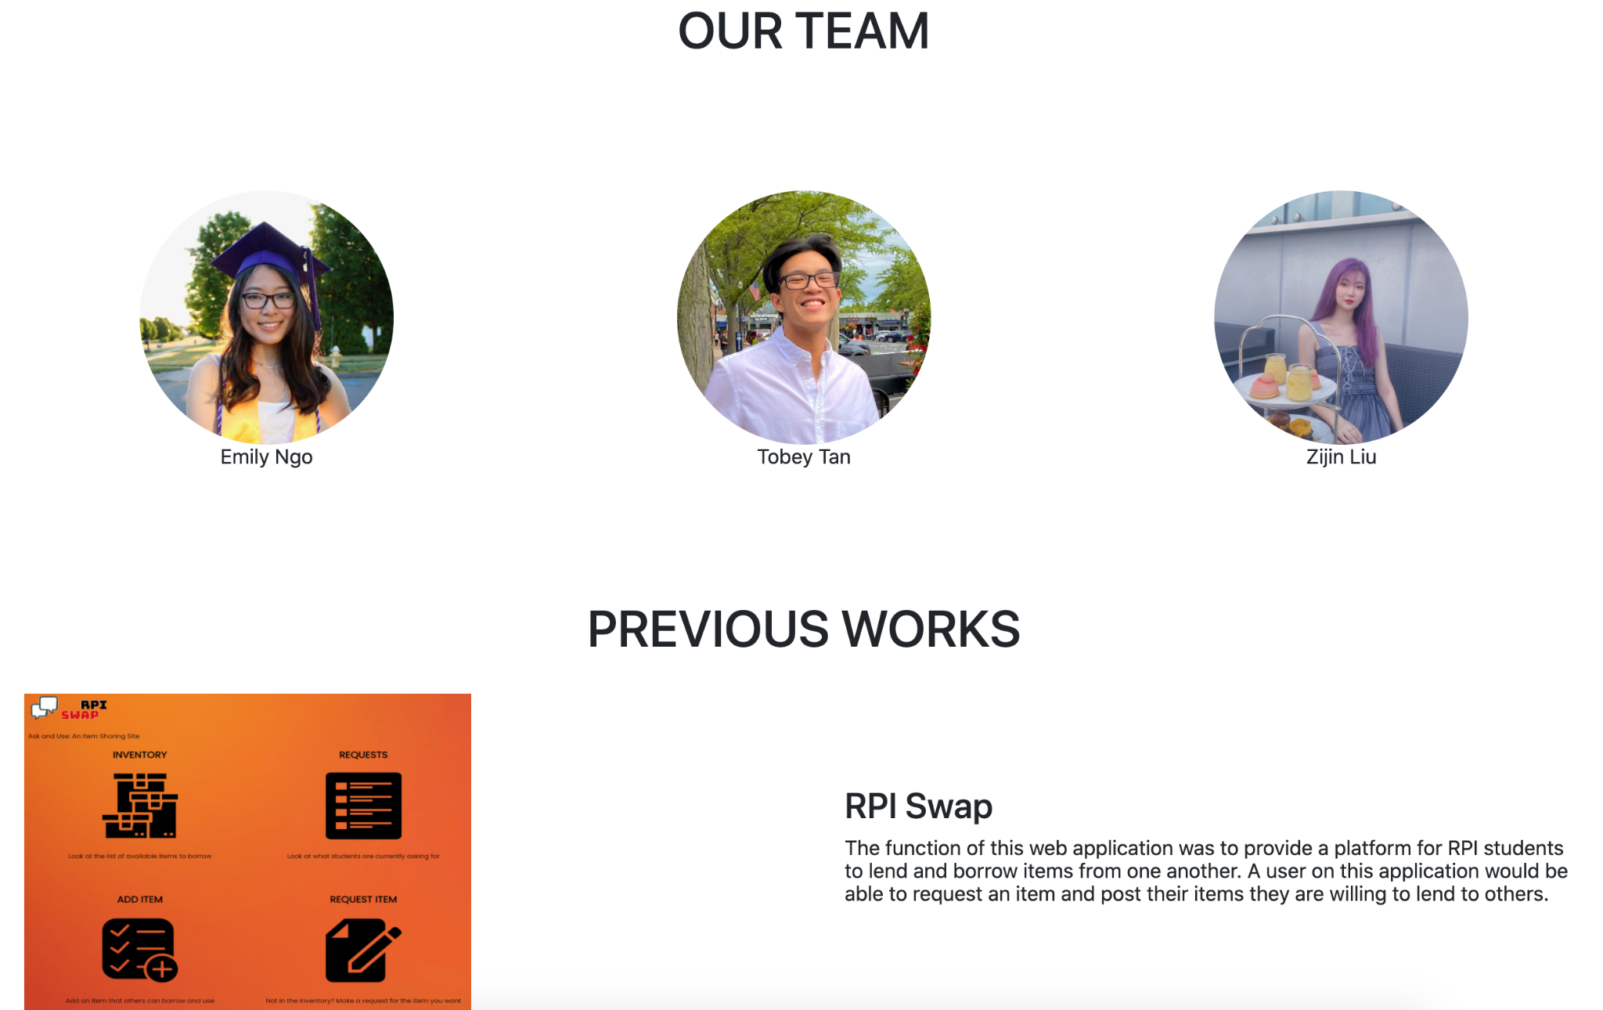
DEVELOPERS - US!

Slide 5
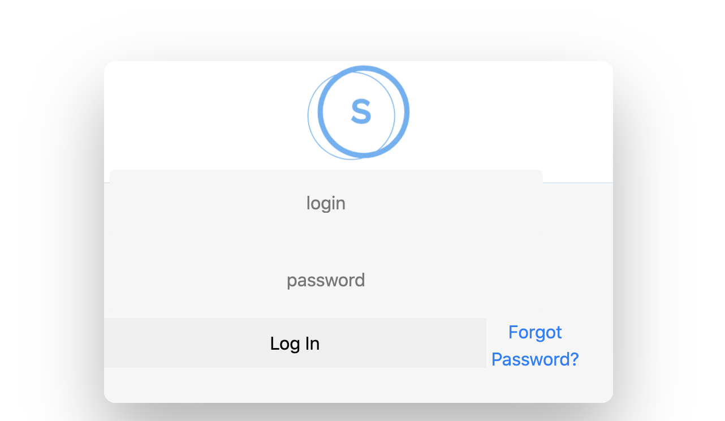
Login Page

Slide 6
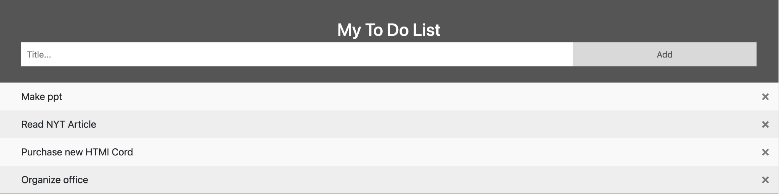
Schedules/Tasks

Slide 7
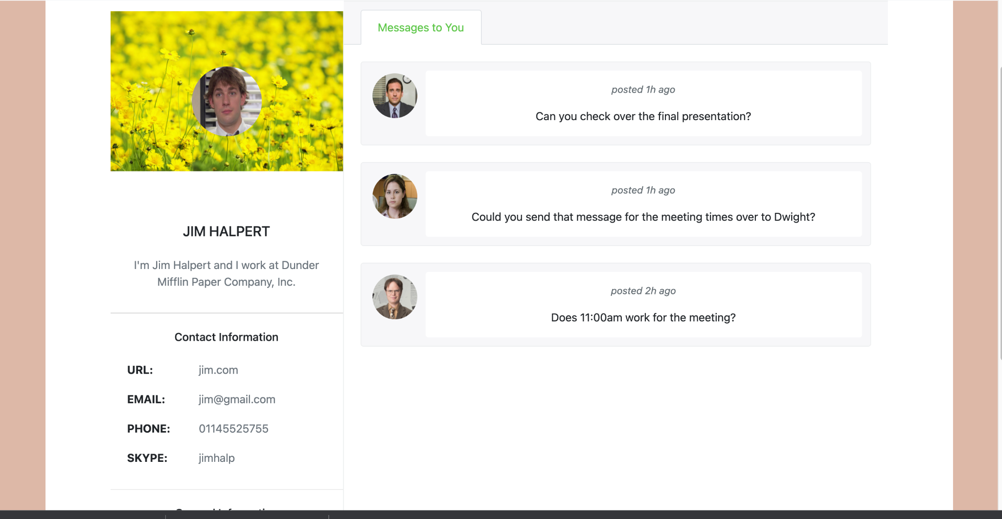
Profiles + Teams Page

Slide 8
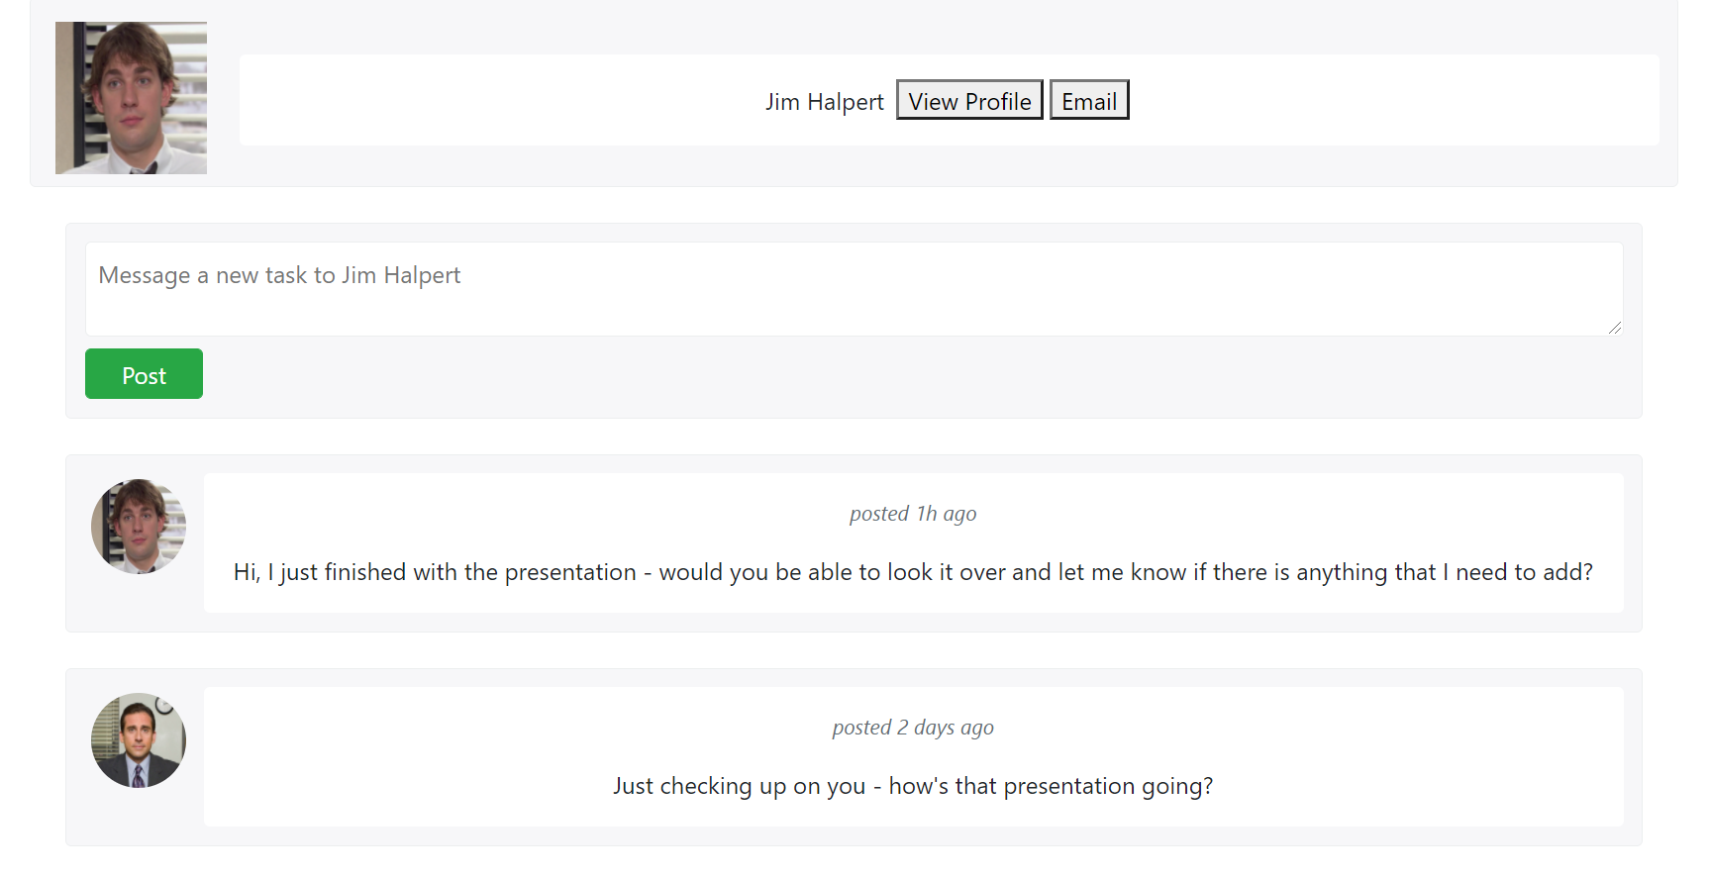
Administrator

Slide 9

DEMO

Slide 10
Future Developments
Back-end
Use PHP and MySQL to store user data
Call data so that it can be displayed in HTML
Potentially restructure some pages, such as making small widgets that can be used on multiple pages

