Slide 1
Section 1 IBM Analytics and Data Science Introduction to Watson Studio

Slide 2
Workshop Agenda – Section 1
Discovering Watson Studio on IBM Cloud
Overview of IBM’s Analytics
IBM Analytics overview
Data Science Experience
Introduction to Notebooks
Watson Studio Team and Collaboration features
Lab 1 : Getting Started with Watson Studio on IBM Cloud
Hands-on lab with Jupyter notebooks
The basics of Data Manipulation in notebooks.
Data cleansing and feature engineering with WatsonStudio Data Refinery

Slide 3
Data handling landscape: Areas of concern
Collect
Organize
Analyze
Where ?
How ?
What ?
Hybrid Data Management
Unified Governance
and Integration
Data Science and
Business Analytics
Identify and Access All Data
Multi-vendor
Catalog and Manage
Access Policies Data Masking
Descriptive Predictive Prescriptive
Coders and Non-Coders

Slide 4
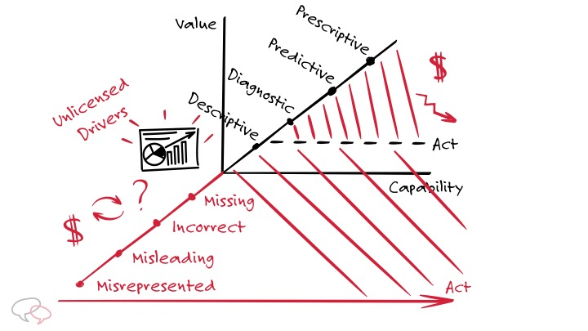
Flavors of Data Science: turning Data into Information, Insights and Actions
Descriptive and Diagnostics:
WHAT happened?
Visualization, Reporting, Dashboards
WHY did it happen ?
Data Exploration, Analysis
Predictive:
What WILL happen next?
Forecasts and previsions
Machine Learning (incl. Deep Learning)
Prescriptive:
What should we do ?
Actionable Insights
Optimization (Operational Research, Constraint Programming)

Slide 5






IBM Data Science: Workflow
What is our plan?
IBM Planning Analytics
Planning
Planning, budgeting, and
forecasting
What should we do?
What happened?
IBM Decision Optimization
IBM Watson Studio
Prescriptive
Governance & Trusted Data
Descriptive
Collaborate for maximum business
value, informed by advanced analytics
Get in touch with reality, a
single source of the truth, visibility
What will happen next?
Why did it happen?
IBM Watson ML
IBM Flow Modeler (SPSS)
IBM Watson Studio
Data Augmentation and
Contextualization
Unstructured Data
Predictive
Understand the most likely future
scenario and its business implications
IBM Cognos Analytics
Structured Data
Understanding why something
happened is a critical step
Diagnostic
Notes:
All of you have seen this diagram which represents the DSBA Vision. But, this is also our pattern in another form, and THIS is our differentiator as well. This “ring diagram” as it’s called is the basis for our storytelling, the scenarios we are going to craft for our prospects, and being able to relate this story to our prospects, their business, and the value that IBM brings is the key to our success. We will revisit this later in this session.
--------------
IBM is unique in its ability to deliver on this lifecycle of turning data into insight and insight into action. IBM Planning Analytics provides a market leading tool for building your business plans, this integrates with Cognos Analytics that lets you track actuals and compare to your plans. Watson Analytics provides the smart data discovery component that can help you understand why you may be tracking on or off plan. SPSS or Data Science Experience provide leading predictive analytics capabilities including forecasting and prescriptive analytics such as optimization. These capabilities complement and are integrated with business planning to enable constraint based planning and forecasting.
This system is based upon trusted data and a governance process to ensure that the insights for crucial decisions can be relied on.

Slide 6

IBM Data Science Cloud Platform and AI
Enabling the AI Ladder with Watson Studio
AI all starts with [potentially massive] amounts of data
Data Science
& Business
Analytics
Analyze
AI
Hybrid Data Management
Collect
Machine Learning
Analytics
Unified Governance & Integration
Organize
Data
The “AI Ladder”
5
Notes:
These platforms align with the AI ladder. To make it easy to remember, you can associate them to Collect your data, Organize your data and Analyze your data.

Slide 7
Punch lines
“Data does not mean information”
EDA: Exploratory Data Analysis
Turn data into information
Turn information into insights
Turn insights into actions

Slide 8
Real-life example
Store management app
Gather historical sales figures, per item
Cleanse, filter, consolidate data
Analyze, Visualize
Enrich (calendar, weather, customer surveys, NLU, …)
Derive predictions
Data gathering apps
In-Store sales, consolidation across several stores, stocks
Collect customer feedback & behavior (through surveys, loyalty apps, …)
Provide store management application (sales, stocks, staffing, …)
Stocks management, Supply chain, replenishment, …

Slide 9
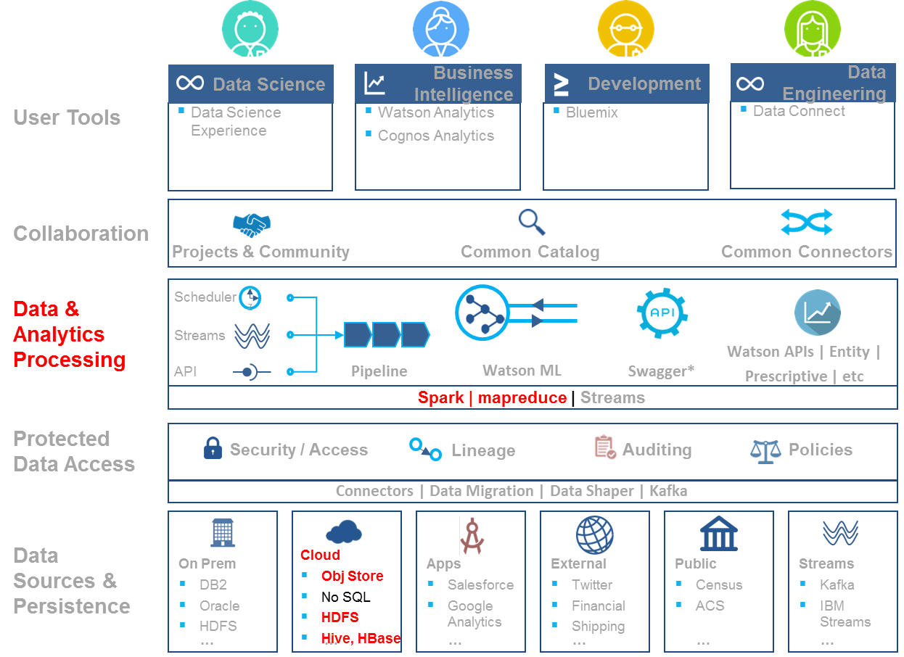
In Context of Watson Data Platform (WDP)
Watson Studio
Cognos Analytics Dashboard
IBM Cloud
PAAS`
Containers
Watson Knowledge Catalog

Slide 10

Watson Studio: The Tools of the Trade

Slide 11

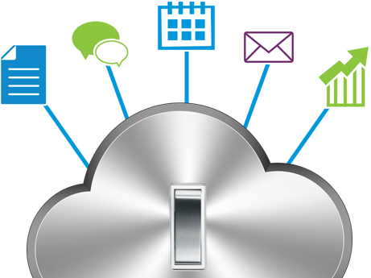
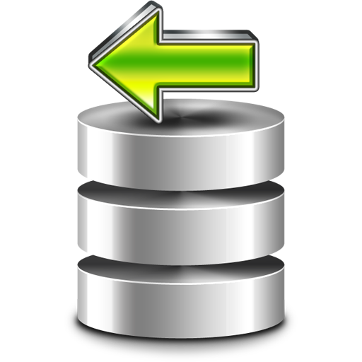
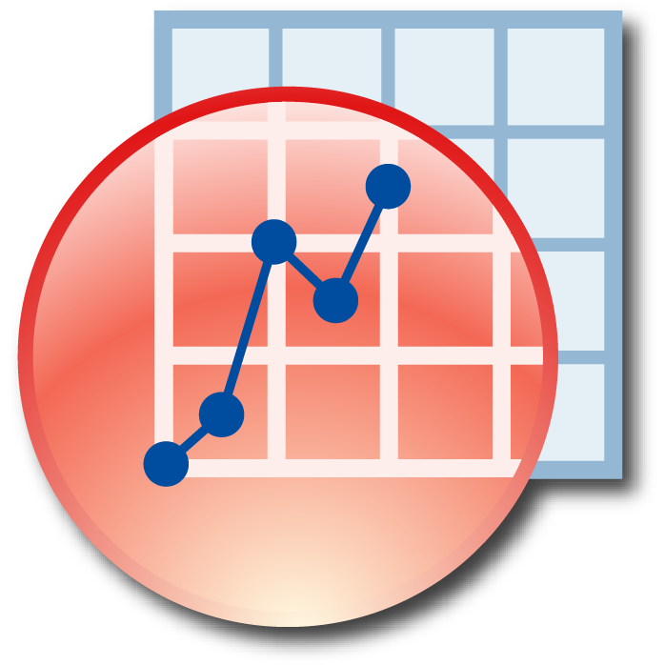

A Data Science Application Life Cycle
How does it work?
Clearly Articulate Use Case
Gather all the Data
Prepare Data
Digital
Application
Evaluate
Machine Learning

Slide 12





What is Watson Studio?
Watson Studio provides a IBM Cloud-based environment for Data Science
Federates Data Science Analysis resources under a single workbench
Compute resources
Runtime environments for notebooks
Spark Service integration
Storage resources
Cloud Object Storage
Machine Learning
Collaborative Tooling for Data Exploration, Analysis and Machine Learning
Programming environments: Jupyter and R Studio
Interactive UI-driven tools
Data Refinery
Flow Modeler
Runtime and Deployment

Slide 13
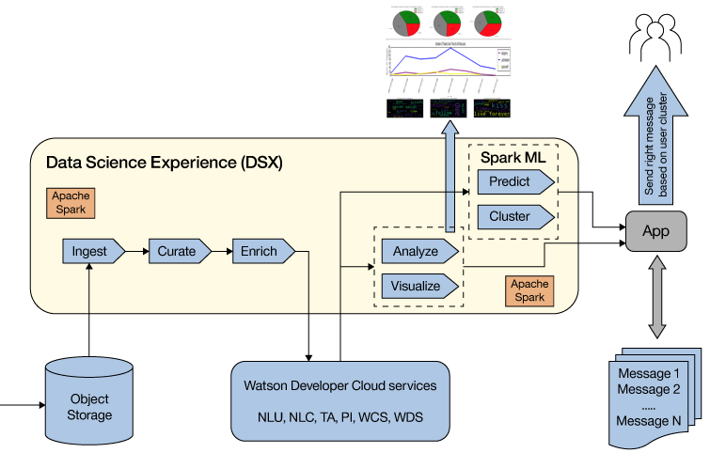

Watson Studio end-to-end flow
Watson Studio
Data Exploration
Feature Engineering
Production
Monitor
Machine Learning
Evaluate

Slide 14



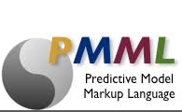

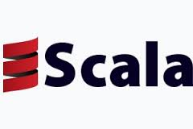





Watson Studio Environment – Components
BUILD
DEPLOY
RUNTIME
Monitoring & Alerting
Model retraining
KPI Dashboards
Model Refactoring
Security
ML Wizard
XGBoost
DATA
Object
STORAGE
DATABASES
HADOOP

Slide 15
Components of Watson Studio
Tools provided by the IBM Watson Studio. Some of the tools are based on or leverage open source and can interoperate with other platforms.
Jupyter Notebooks: Notebooks are used by data scientists to clean, visualize, and understand data. DSX uses Jupyter Notebooks, but notebooks come in different flavors. In DSX you code your notebooks mainly in Python or Scala.
Object Storage: DSX a part of the IBM Cloud and Watson Data Platform provides integrated Object Storage used to store large amounts of data
Apache Spark ML: Spark ML is a library for building ML pipelines on top of Apache Spark. Spark ML includes algorithms and APIs for supervised and unsupervised machine learning problems.
IBM Watson ML: Watson ML is a service for deploying ML models and making predictions at runtime. Watson ML provides a REST API to your ML models which can be called directly from your application or your middleware.
IBM Data Refinery Flow: UI-driven data cleansing ETL and feature engineering pipeline which are managed and deployable.
IBM Flow Modeler: Interactive UI-driven tool to build managed deployable machine learning pipelines, addressing SPSS, SparkML or Deep Learning frameworks.
IBM Dashboards: UI-driven interactive dashboard building capability, which can be published
IBM Streaming Flows: UI-driven streaming analytics that can act on real-time streaming data.

Slide 16
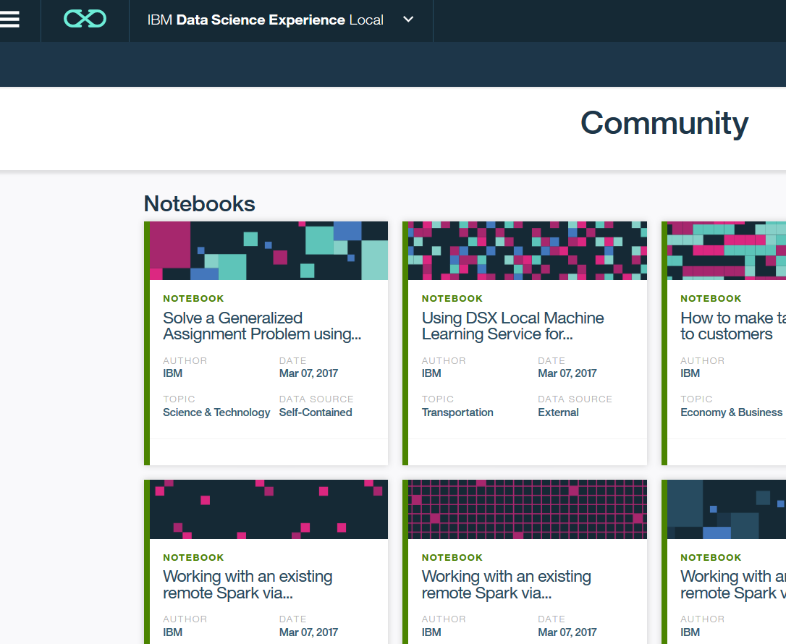
IBM Watson Studio – Deployment Models
Self-contained and extendable platform for developing and deploying analytics applications
Works with multiple run-times, multiple data sources, user management, model management and supports adding additional libraries
Deployment Options
As a cloud offering – Watson Studio
As an on-premises solution – DSX Local

Slide 17
Positioning by Forrester
https://www.ibm.com/blogs/watson/2018/09/ibm-named-a-leaderin-forrester-predictive-analytics-and-machine-learning-report/
https://pbs.twimg.com/media/DmlzqbUU8AAWZWb.jpg

Slide 18
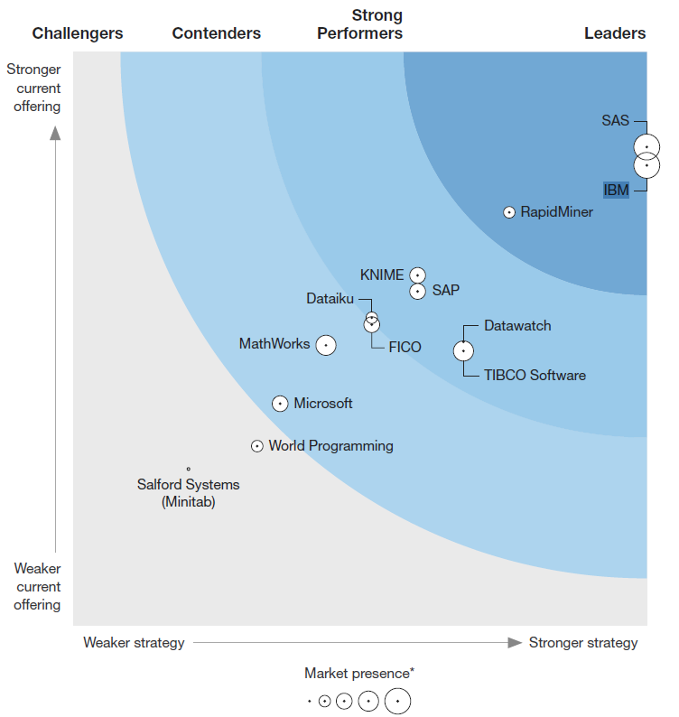
IBM Data Science platform - Leadership
Forrester Wave 2018-Q3 - Predictive Analytics & Machine Learning (PAML)
https://reprints.forrester.com/#/assets/2/73/RES141374/reports
“Multimodal” Is One Of Three PAML Segments Identified By Forrester:
Multimodal PAML solutions provide the widest breadth of workbench tools. These solutions offer multiple user-interface paradigms and the broadest set of workbench tools, such as graphical
user interfaces (GUIs), configuration wizards, automation, and coding environments. Many of these solutions also provide tools for non-data scientists to build data pipelines, create machine learning
models, and collaborate with data science teams. This PAML market segment is what we have
evaluated in this Forrester Wave.
Source: https://www.gartner.com/doc/reprints?id=1-3TKD8OH&ct=170215&st=sb
http://www.developerweek.com/awards/2017-devies-award-winners/

Slide 19



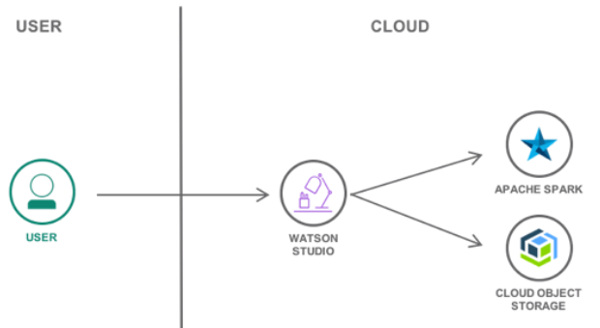
Notebooks in Watson Studio
Notebooks are interactive, executable Data Science Environments
Jupyter for Python-based code
R Studio for R language
Zeppelin (DSX Local) for mixed-language (Scala, Python, …)
Notebooks can contain documentation, code, visualizations
Can be shared within a team
Leverage Watson Studio’s analytics infrastructure
Data Sources: Watson Data Platform, Cloud Object Storage
Compute resources: Spark, SparkML, Hadoop, GPUs
The main element handled in a notebook is the DataFrame
Think of it as a table of data organized in columns and rows

Slide 20
Notebooks programming elements
Data processing libraries
Python libraries: numpy, scikit-learn (ML), …
DataFrames: Tabular-form structures
Pandas: python, in-memory of the notebook’s python VM
Spark DataFrames: distributes data and computations in the Spark cluster
Spark libraries: pySpark, SparkSQL,SparkML, …
Visualization libraries
Standard Python libraries: matplotlib, bokeh, …
Programmatic coding of graphical representations, quite static
IBM Watson Studio provides additional open-sourced libraries
PixieDust: for interactive graphical data exploration
Brunel: ‘Zero to Visualization in Sixty Seconds’
Watson Studio Dashboards

Slide 21
Lab enhancements to-do
Lab Refinery: add column to compute l/100km from mpg
Pandas:
df.dtypes, df.describe(), df.info()
%whos magic

Slide 22
Time for Lab 1
Objectives:
Tour of Watson Studio collaborative environment
Use Data Refinery ETL for data cleansing and feature engineering
Get a first-hand grasp of what’s a Python Notebook
We use 3 different datasets
Cars characteristics, NYC bike rentals for Jan 2017, Great Outdoors fictious sales
Lab material available at https://ibm.box.com/v/WatsonStudio-WS
Lab1-GettingStarted.pdf
Use the `GoSales_Tx_Analysis.ipynb` notebook file in ‘Hands-On Labs\Lab1-GettingStarted’

Slide 23
Thank You philippe.gregoire@fr.ibm.com

Slide 24
Notices and Disclaimers
Copyright © 2016 by International Business Machines Corporation (IBM). No part of this document may be reproduced or transmitted in any form without written permission from IBM.
U.S. Government Users Restricted Rights - Use, duplication or disclosure restricted by GSA ADP Schedule Contract with IBM.
Information in these presentations (including information relating to products that have not yet been announced by IBM) has been reviewed for accuracy as of the date of initial publication and could include unintentional technical or typographical errors. IBM shall have no responsibility to update this information. THIS DOCUMENT IS DISTRIBUTED "AS IS" WITHOUT ANY WARRANTY, EITHER EXPRESS OR IMPLIED. IN NO EVENT SHALL IBM BE LIABLE FOR ANY DAMAGE ARISING FROM THE USE OF THIS INFORMATION, INCLUDING BUT NOT LIMITED TO, LOSS OF DATA, BUSINESS INTERRUPTION, LOSS OF PROFIT OR LOSS OF OPPORTUNITY. IBM products and services are warranted according to the terms and conditions of the agreements under which they are provided.
IBM products are manufactured from new parts or new and used parts. In some cases, a product may not be new and may have been previously installed. Regardless, our warranty terms apply.”
Any statements regarding IBM's future direction, intent or product plans are subject to change or withdrawal without notice.
Performance data contained herein was generally obtained in a controlled, isolated environments. Customer examples are presented as illustrations of how those customers have used IBM products and the results they may have achieved. Actual performance, cost, savings or other results in other operating environments may vary.
References in this document to IBM products, programs, or services does not imply that IBM intends to make such products, programs or services available in all countries in which IBM operates or does business.
Workshops, sessions and associated materials may have been prepared by independent session speakers, and do not necessarily reflect the views of IBM. All materials and discussions are provided for informational purposes only, and are neither intended to, nor shall constitute legal or other guidance or advice to any individual participant or their specific situation.
It is the customer’s responsibility to insure its own compliance with legal requirements and to obtain advice of competent legal counsel as to the identification and interpretation of any relevant laws and regulatory requirements that may affect the customer’s business and any actions the customer may need to take to comply with such laws. IBM does not provide legal advice or represent or warrant that its services or products will ensure that the customer is in compliance with any law

Slide 25
Notices and Disclaimers Con’t.
Information concerning non-IBM products was obtained from the suppliers of those products, their published announcements or other publicly available sources. IBM has not tested those products in connection with this publication and cannot confirm the accuracy of performance, compatibility or any other claims related to non-IBM products. Questions on the capabilities of non-IBM products should be addressed to the suppliers of those products. IBM does not warrant the quality of any third-party products, or the ability of any such third-party products to interoperate with IBM’s products. IBM EXPRESSLY DISCLAIMS ALL WARRANTIES, EXPRESSED OR IMPLIED, INCLUDING BUT NOT LIMITED TO, THE IMPLIED WARRANTIES OF MERCHANTABILITY AND FITNESS FOR A PARTICULAR PURPOSE.
The provision of the information contained h erein is not intended to, and does not, grant any right or license under any IBM patents, copyrights, trademarks or other intellectual property right.
IBM, the IBM logo, ibm.com, Aspera®, Bluemix, Blueworks Live, CICS, Clearcase, Cognos®, DOORS®, Emptoris®, Enterprise Document Management System™, FASP®, FileNet®, Global Business Services ®, Global Technology Services ®, IBM ExperienceOne™, IBM SmartCloud®, IBM Social Business®, Information on Demand, ILOG, Maximo®, MQIntegrator®, MQSeries®, Netcool®, OMEGAMON, OpenPower, PureAnalytics™, PureApplication®, pureCluster™, PureCoverage®, PureData®, PureExperience®, PureFlex®, pureQuery®, pureScale®, PureSystems®, QRadar®, Rational®, Rhapsody®, Smarter Commerce®, SoDA, SPSS, Sterling Commerce®, StoredIQ, Tealeaf®, Tivoli®, Trusteer®, Unica®, urban{code}®, Watson, WebSphere®, Worklight®, X-Force® and System z® Z/OS, are trademarks of International Business Machines Corporation, registered in many jurisdictions worldwide. Other product and service names might be trademarks of IBM or other companies. A current list of IBM trademarks is available on the Web at "Copyright and trademark information" at: www.ibm.com/legal/copytrade.shtml.

