Slide 1
Section 3 Big Data and Spark

Slide 2
Workshop Agenda – Section 3
Watson Studio and Spark
BigData considerations
Storage and Persistence
Distributed Data Processing with Spark Overview
Spark support in Watson Studio
Lab 3 : Leveraging Spark with Watson Studio

Slide 3
Data Persistence in review

Slide 4






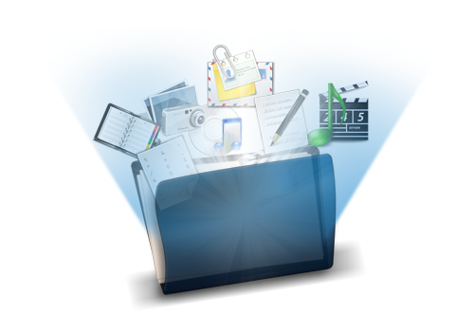
Quick review: Data Storage options
‘Traditional’ [fixed] structured storage
Fixed-structure tables, SQL queries
Typically: DB2, Informix
No-SQL storage
Collections of semi-structured data (JSON format) -> BigData
Typically: Cloudant, MongoDB (by Compose), Hadoop HDFS, …
‘Object’ storage
Unstructured data Files of all sorts (text, images, sound, …)
Long-term ‘cold’ data storage
Data In Motion vs Data at Rest
Streaming data: DB2 Streams, Kafka, DB2 Event Store, …
Messaging&Queuing, caching: Redis (Compose), Rabbit MQ, Kafka

Slide 5

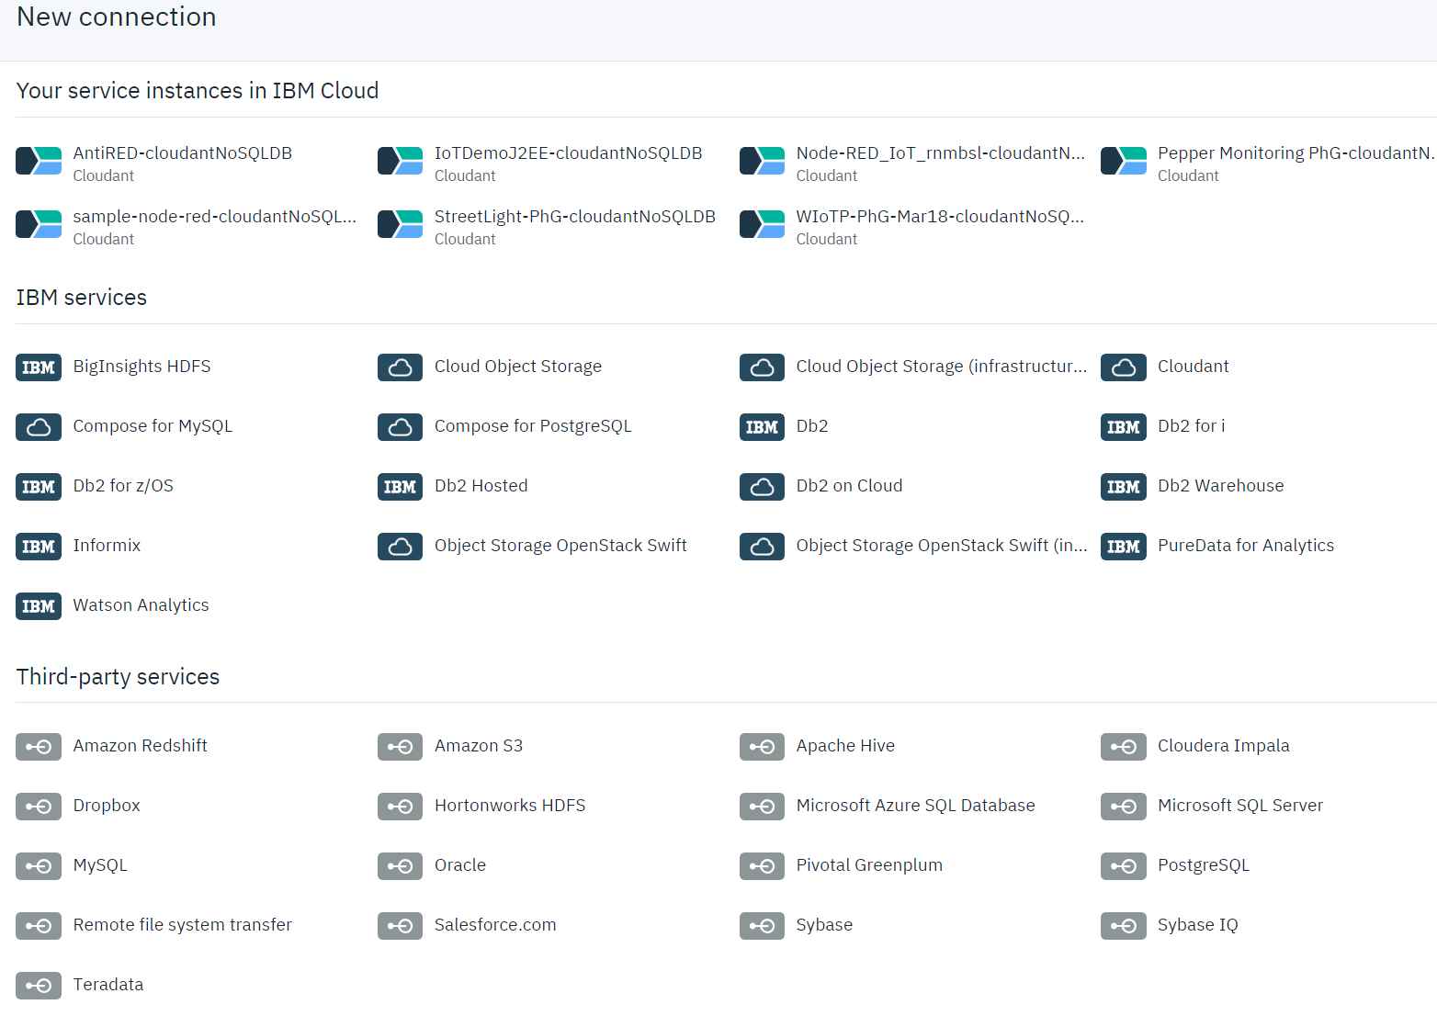
Watson Studio and Data Management
Watson Studio leverages IBM Cloud Object Storage (COS)
COS storage used for non-database storage
Can leverage many data sources as well through the Data Catalog
FILE Object
STORAGE

Slide 6
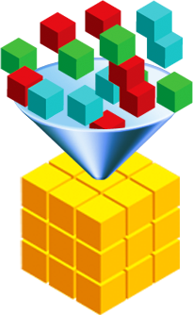
Data Science and Data Storage
Data Science Analysis needs structured data to operate on
The first goal of DS will be to structure the data
No-SQL to ‘ DataFrames’
Unstructured (text, images, sound, …) to categories, tags, …
BigData
The problem of Big Data is that it’s big, not for storage but for processing
Need to scale processing
Classical vertical vs horizontal scaling techniques
Bigger machines vs more machines
Split & stitch the workload:
Map – Reduce: Hadoop and HDFS (BigInsights->HortonWorks)
Spark: in-memory distributed big data

Slide 7
Big Data
What makes Big Data different than regular data
The 5 Vs of Big Data:
Volume: unprecedented volumes generated
Velocity: fast-changing and augmenting data, in volume and structure
Variety: mostly unstructured or semi-structured data
Veracity: need to assess and assert the truthfulness and completeness
=> Value: Need to generate (business) value from this data
Recommendation Engines
When Big Data meets ML

Slide 8






Big Data: Hadoop
Hadoop in 2 terms:
Map-Reduce
Example: compute an average on very large data set
Split data set in n [equal] parts: map
compute the averages (shuffle)
then average the [weighted] averages: reduce
Not all problems can be split easily
There is more to Hadoop than this simplification:
Several subprojects, of which HDFS is the main one
map
AVG
AVG
AVG
r
e
d
AVG(AVG)

Slide 9
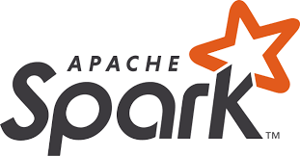
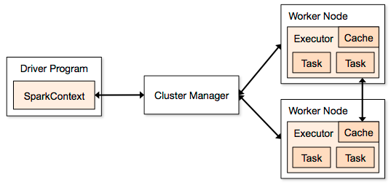
Big Data: Spark
Spark: builds on top of Hadoop
Spark is an open source in-memory application framework for
distributed data processing
iterative analysis
on massive data volumes
Designed to overcome Hadoop storage-bound limitations
In-memory distributed Executor
Resilient Distributed Datasets (RDDs)
Lazy-evaluation and lazy copy operations
Built-in libraries optimized for distributed workloads
Spark SQL -> distributed data processing
Spark ML -> distributed Machine Learning
Streaming, GraphX

Slide 10
Spark Engines in Watson Studio
There are several ways to get Spark engines in Watson Studio
IBM Analytics Engine
Apache Spark service
Lite/Free version offers 2 executors
Spark environments
Customizable capacity
IBM Watson Studio Spark Environments Generally Available!
https://medium.com/ibm-watson/ibm-watson-studio-spark-environments-generally-available-f3dda78d3668

Slide 11


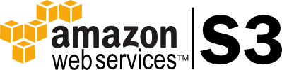
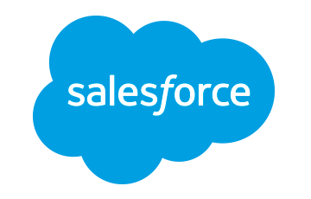




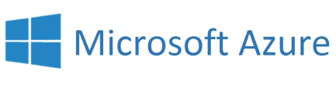






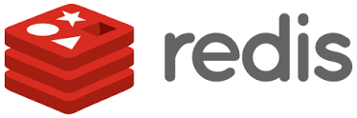
Spark technology environment
executes SQL statements
performs streaming analytics using micro-batches
common machine learning and statistical algorithms
distributed graph processing framework
Execute R
Statistical code against Spark Code
Spark SQL
Spark Streaming
MLlib (machine learning)
GraphX (graph)
SparkR
general compute engine, handles distributed task dispatching, scheduling and basic I/O functions
Spark Core Engine
large variety of data sources and formats can be supported, both on premise or cloud
BigInsights (HDFS)
Cloudant
dashDB
SQL DB
Object Storage
…many others
IBM CLOUD
OTHER CLOUD
CLOUD APPS
ON-PREMISE
Notes:
Where and how things fit together Note we are focused today on Spark SQL and MLlib stay tuned for more (hence the bolding for today)
Spark – has a core engine and set of libraries which consist of these 5 libraries
Where data comes from almost many different data sources ranging from relational, swift storage file system,,,
Spark – complements Hadoop – Collaboration

Slide 12





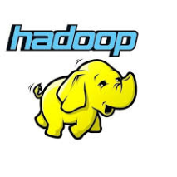

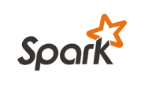



Watson Studio leverages Spark and Hadoop
Environment for deploying analytics applications
Also provides a foundation for Watson Data Platform services
IBM Analytics Engine

Slide 13
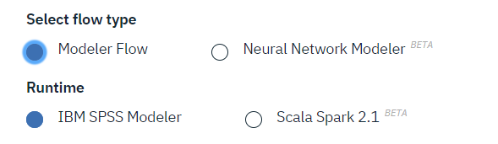
Watson Studio Flow Modeler
Watson Studio recently introduced a Flow Modeler capability:
Interactively build UI-driven Machine Learning flows
Support for 3 programming models:
SPSS flows
The flows build on the cloud are interoperable with the on-premises SPSS Modeler flows
Watson ML flows
Watson ML specific operators
Deep Learning flows
Produces TensorFlow, Keras, … code for Neural Networks

Slide 14
Lab 3: Spark and Flow Modeler
This lab sequence will introduces Spark processing capabilities from a Jupyter Notebook:
Use Spark RDD to read and shape a large dataset (1.2GB)
Then SparkSQL DataFrames to perform higher-level operations
Lab material available at https://ibm.box.com/v/WatsonStudio-WS
Hands-On Labs\Lab3-Spark\Lab3-Spark.pdf

Slide 15
Thank You philippe.gregoire@fr.ibm.com

Slide 16
Notices and Disclaimers
Copyright © 2016 by International Business Machines Corporation (IBM). No part of this document may be reproduced or transmitted in any form without written permission from IBM.
U.S. Government Users Restricted Rights - Use, duplication or disclosure restricted by GSA ADP Schedule Contract with IBM.
Information in these presentations (including information relating to products that have not yet been announced by IBM) has been reviewed for accuracy as of the date of initial publication and could include unintentional technical or typographical errors. IBM shall have no responsibility to update this information. THIS DOCUMENT IS DISTRIBUTED "AS IS" WITHOUT ANY WARRANTY, EITHER EXPRESS OR IMPLIED. IN NO EVENT SHALL IBM BE LIABLE FOR ANY DAMAGE ARISING FROM THE USE OF THIS INFORMATION, INCLUDING BUT NOT LIMITED TO, LOSS OF DATA, BUSINESS INTERRUPTION, LOSS OF PROFIT OR LOSS OF OPPORTUNITY. IBM products and services are warranted according to the terms and conditions of the agreements under which they are provided.
IBM products are manufactured from new parts or new and used parts. In some cases, a product may not be new and may have been previously installed. Regardless, our warranty terms apply.”
Any statements regarding IBM's future direction, intent or product plans are subject to change or withdrawal without notice.
Performance data contained herein was generally obtained in a controlled, isolated environments. Customer examples are presented as illustrations of how those customers have used IBM products and the results they may have achieved. Actual performance, cost, savings or other results in other operating environments may vary.
References in this document to IBM products, programs, or services does not imply that IBM intends to make such products, programs or services available in all countries in which IBM operates or does business.
Workshops, sessions and associated materials may have been prepared by independent session speakers, and do not necessarily reflect the views of IBM. All materials and discussions are provided for informational purposes only, and are neither intended to, nor shall constitute legal or other guidance or advice to any individual participant or their specific situation.
It is the customer’s responsibility to insure its own compliance with legal requirements and to obtain advice of competent legal counsel as to the identification and interpretation of any relevant laws and regulatory requirements that may affect the customer’s business and any actions the customer may need to take to comply with such laws. IBM does not provide legal advice or represent or warrant that its services or products will ensure that the customer is in compliance with any law

Slide 17
Notices and Disclaimers Con’t.
Information concerning non-IBM products was obtained from the suppliers of those products, their published announcements or other publicly available sources. IBM has not tested those products in connection with this publication and cannot confirm the accuracy of performance, compatibility or any other claims related to non-IBM products. Questions on the capabilities of non-IBM products should be addressed to the suppliers of those products. IBM does not warrant the quality of any third-party products, or the ability of any such third-party products to interoperate with IBM’s products. IBM EXPRESSLY DISCLAIMS ALL WARRANTIES, EXPRESSED OR IMPLIED, INCLUDING BUT NOT LIMITED TO, THE IMPLIED WARRANTIES OF MERCHANTABILITY AND FITNESS FOR A PARTICULAR PURPOSE.
The provision of the information contained h erein is not intended to, and does not, grant any right or license under any IBM patents, copyrights, trademarks or other intellectual property right.
IBM, the IBM logo, ibm.com, Aspera®, Bluemix, Blueworks Live, CICS, Clearcase, Cognos®, DOORS®, Emptoris®, Enterprise Document Management System™, FASP®, FileNet®, Global Business Services ®, Global Technology Services ®, IBM ExperienceOne™, IBM SmartCloud®, IBM Social Business®, Information on Demand, ILOG, Maximo®, MQIntegrator®, MQSeries®, Netcool®, OMEGAMON, OpenPower, PureAnalytics™, PureApplication®, pureCluster™, PureCoverage®, PureData®, PureExperience®, PureFlex®, pureQuery®, pureScale®, PureSystems®, QRadar®, Rational®, Rhapsody®, Smarter Commerce®, SoDA, SPSS, Sterling Commerce®, StoredIQ, Tealeaf®, Tivoli®, Trusteer®, Unica®, urban{code}®, Watson, WebSphere®, Worklight®, X-Force® and System z® Z/OS, are trademarks of International Business Machines Corporation, registered in many jurisdictions worldwide. Other product and service names might be trademarks of IBM or other companies. A current list of IBM trademarks is available on the Web at "Copyright and trademark information" at: www.ibm.com/legal/copytrade.shtml.

