Slide 1

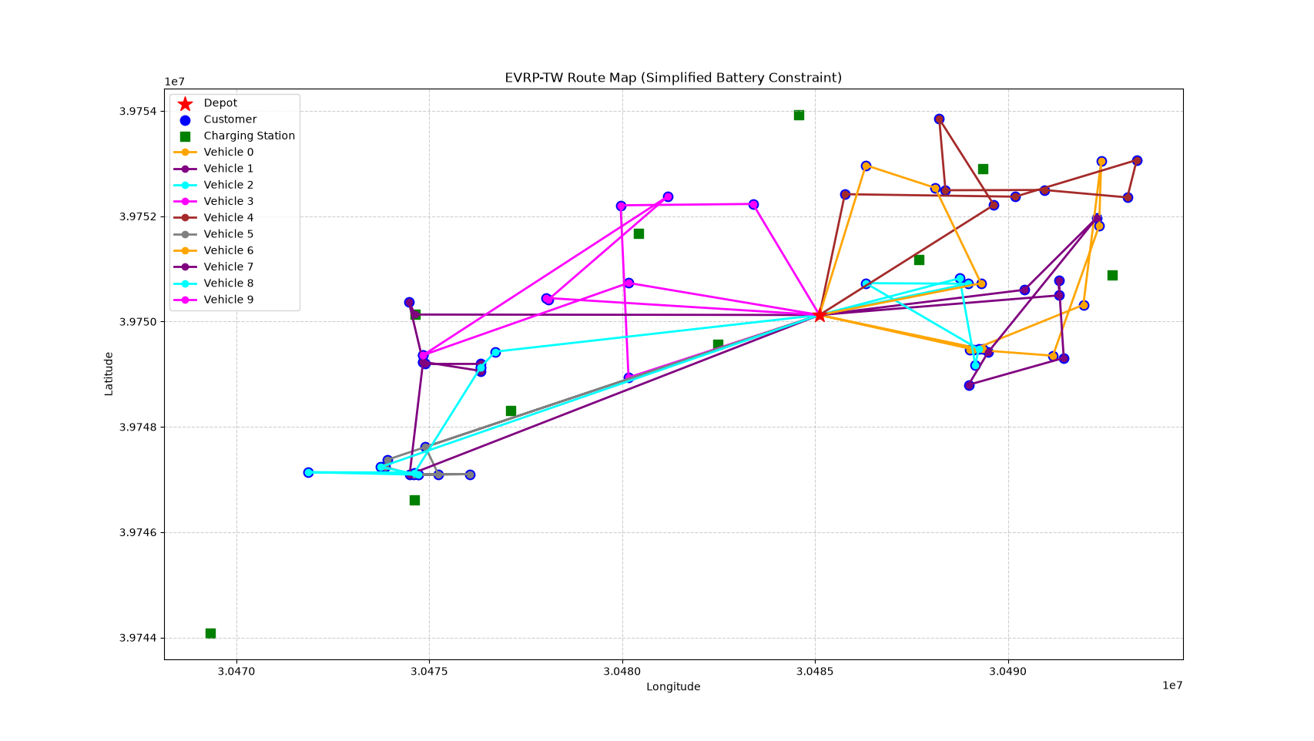
Vehicle Routing Optimization
From Heuristics to Deep Reinforcement Learning
A Comparative Study on CVRP, VRPTW and EVRP-TW
Department of XYZ (Full Name)
Background
Methods
Vehicle routing: serve customers from a depot
CVRP: limited vehicle load
VRPTW: customer time windows
EVRP-TW: battery and charging stations
Goal: minimum total travel distance
OR-Tools: route model with dimensions
load / time / energy limits
PyVRP: population-based search
POMO: multiple starts, shared baseline
RL4CO: PyTorch + Lightning framework
Experiment 1: CVRP Comparison
Route at Critical Battery
Instance | Solver | Objective | Gap
A-n32-k5 | PyVRP | 784 | 0%
A-n32-k5 | OR-Tools | 784 | 0%
A-n55-k9 | PyVRP | 1073 | 0%
A-n55-k9 | OR-Tools | 1110 | 3.45%
Known optima: 784 / 1073. PyVRP reaches both; OR-Tools gap on the medium instance.
Experiment 2: Battery Sensitivity
Instance | Battery | Feasible | Objective | Stations
C20 | no limit | Yes | 12939 | 0
C20 | 697 (critical) | Yes | 12939 | 0
C20 | 696 | No | - | -
C60 | no limit | Yes | 30142 | 2
C60 | 921 (critical) | Yes | 30520 | 2
C60 | 920 | No | - | -
Figure: C60 route at critical battery (921 kWh), including two charging station visits.
Critical capacity: 697 (C20), 921 (C60). Objective +1.25% at C60. Stations also serve as time adjustment points.
Research Line
Traditional solvers: OR-Tools, PyVRP
Learning-based method: POMO + RL4CO
Datasets: Augerat CVRP, ESOGU EVRP-TW
POMO + RL4CO
Current Status
Custom environment: src/POMO_Test_2.py
generator: random instances
env: reset / step / reward
mask: hard constraints
multi-start node selection
Solution check included
Environment ready, basic functions tested
POMO training on EVRP-TW: next step
Future Work
Train POMO on EVRP-TW instances
Compare with OR-Tools baseline
Real charging behavior at stations
Use ESOGU real data
Baseline Test: TSP20
GPU available: True
Training reward: -4.017
Validation reward: -3.952
Model parameters: 1.3 M
Conclusion: PyVRP strong on classical CVRP; OR-Tools flexible for EVRP-TW; learning-based environment ready for the next stage.
San Zhang (20333333): For team submissions, provide details of every team member.
Supervisor: If there is no supervisor, please delete this line.

