Slide 1
EXPLORING THE ASSOCIATION BETWEEN ECONOMIC GROWTH AND POVERTY IN GLOBAL CONTEXT
Team member: Fan Yang, Arnold Murwira

Slide 2
Research Question
Is there a relationship between economic growth and poverty?
Objective: This research explores whether economic growth consistently lowers poverty worldwide
Method: Uncover insights through statistical analysis and visualization techniques
Importance: Identify effective strategy and policymaking for poverty reduction.

Slide 3
Introduction
Brief Background Material:
In <Journal of Economic Growth>, article “Growth is Good for the Poor” have emphasizes the importance of economic growth in poverty reduction (e.g., Dollar & Kraay, 2002).
However, the relationship between economic growth and poverty is complex and influenced by various factors, including Schooling(Education), Geographic size etc. (Ravallion, 2001).

Slide 4
Data description
Size:
Country(92) * Time span in Years(10) * Variables ct (14) = 12880
Type: Numeric
Scale: Ratio, Nominal
years: 10
Period:2007-2016
Data source:The World Bank. (n.d.). World Bank Open Data. Retrieved from https://data.worldbank.org/

Slide 5
Platform&Tools
Data Source:
The World Bank database was used to acquire comprehensive reliable data.
Data Processing:
Excel was used for data cleaning and normalization to ensure data consistency.
Statistical & Machine Learning Modeling:
Excel was the chosen tool for constructing statistical models and developing machine learning models
Data Visualization:
Tableau provided the platform for creating dynamic and interactive visualizations.

Slide 6
Table of independent variables:
Name | Scale | Type | Example | Control variable | Rationale
GDP growth (annual %) | ratio | numeric | 3.33842794733555 | N | GDP growth reflects economic expansion
Foreign direct investment, net outflows (% of GDP) | ratio | numeric | 0.182397393890958 | N | FDI outflows can indicate domestic companies' strength and their ability to expand abroad
Exports of goods and services (% of GDP) | ratio | numeric | 35.9034235358326 | N | Exports reflect a country's integration into the global market and its economic health
Imports of goods and services (% of GDP) | ratio | numeric | 47.572713 | N | Imports reflect consumer and business demand
Tax Revenue (% of GDP) | ratio | numeric | 17.48323356 | N | Higher tax revenue might imply greater income and profit from people and business
Land area (sq. km) | Nominal | numeric | 743390 | Y | Control Geographic size
Life expectancy at birth, total (years) | Nominal | numeric | 82.190243902439 | Y | Control overall health
Government expenditure on education, total (% of GDP) | ratio | numeric | 4.7664098739624 | Y | Control overall education
Population, total | Nominal | numeric | 32889025 | Y | Control population size
Region | Nominal | String | Asia | Y | Different regions may exhibit unique economic and social characteristics

Slide 7
Table of dependent variables:
Name | Scale | Type | Example | Rationale
Poverty headcount ratio at $2.15 a day (2017 PPP) (% of population) | ratio | Numeric | 54.5 | This indicator directly measures the proportion of the population living in poverty
Gross domestic savings (% of GDP) | ratio | Numeric | 11.188304 | This measures how much money people are saving
GNI per capita, PPP (current international $) | Nominal | Numeric | 10450.0 | Gross National income: how much people make on average
Unemployment, total (% of total labor force) (modeled ILO estimate) | ratio | Numeric | 18.28 | Unemployment rate is a primary indicator of the labor market's health and have a direct correlation with poverty levels.

Slide 8
Hypothesis
Hypothesis 1: There is a negative correlation between GDP growth and Poverty rate.
Rationale: When a country's economy expands, it often means more jobs and better wages, which can decrease the number of people living in poverty.
Hypothesis 2: There is a negative correlation between foreign direct investment (FDI) and Poverty rate.
Rationale: FDI can bring more business activity and job opportunities to a country, which may help reduce the number of people living in poverty.
Hypothesis 3: There is a negative correlation between imports and unemployment rate.
Rationale: Higher imports can stimulate job growth in sectors like retail and transportation, potentially reducing unemployment rates.
Hypothesis 4: There is a positive correlation between exports and average income per person.
Rationale: Higher exports typically indicate strong economic growth and great demand for goods and services which can lead to higher wages and overall prosperity
Hypothesis 5: lower tax revenue are associated with lower unemployment rate.
Rationale: Lower tax revenues can increase consumer spending and business investment, leading to job creation and a decrease in unemployment rates.

Slide 9
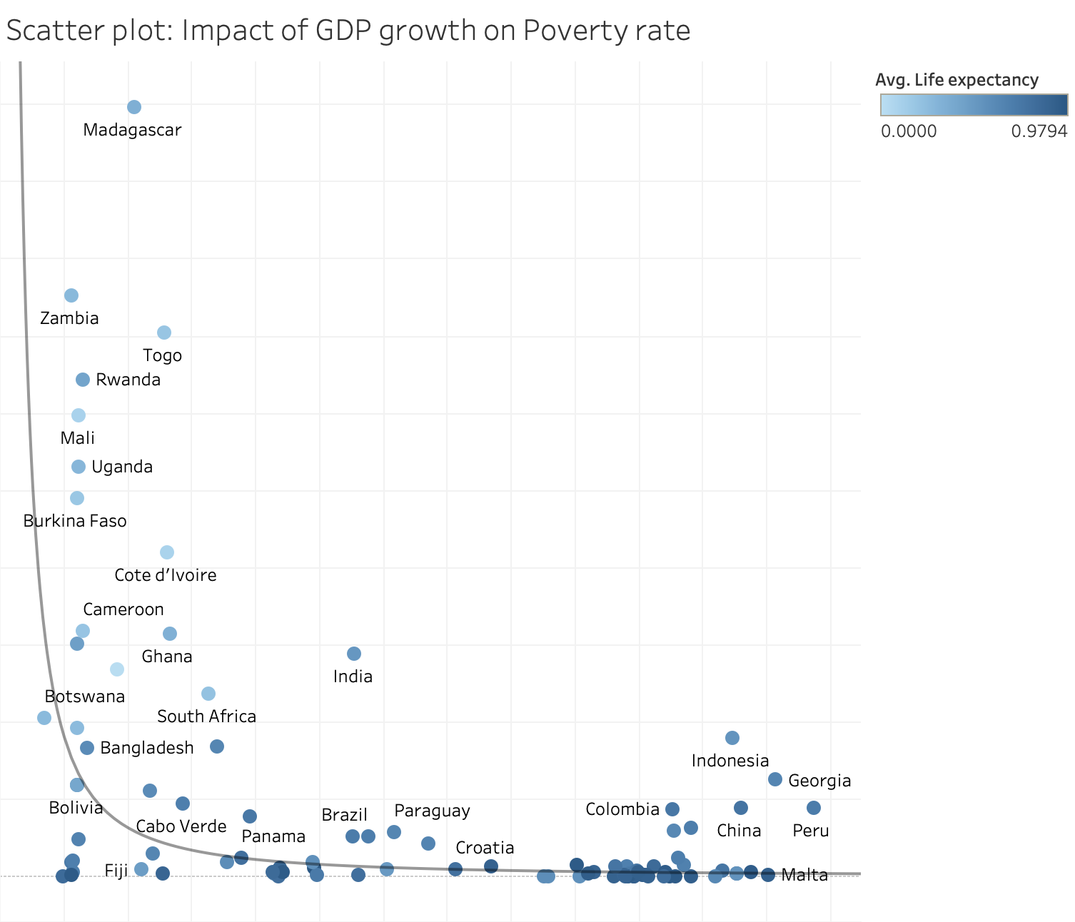
Impact of GDP growth on Poverty
A Scatter plot that visualized the relationship between GDP growth and Poverty headcount ratio with life expectancy represented through the color intensity.
Countries with higher GDP growth rates tend to have lower poverty headcounts, while also illustrating that countries with higher life expectancy tends to have lower poverty headcount ratio.
With a p value < 0.0001, The graph reveals that there’s a strong indication that the null hypothesis can be rejected.
Poverty headcount (Normalized)
GDP Growth (Normalized)

Slide 10
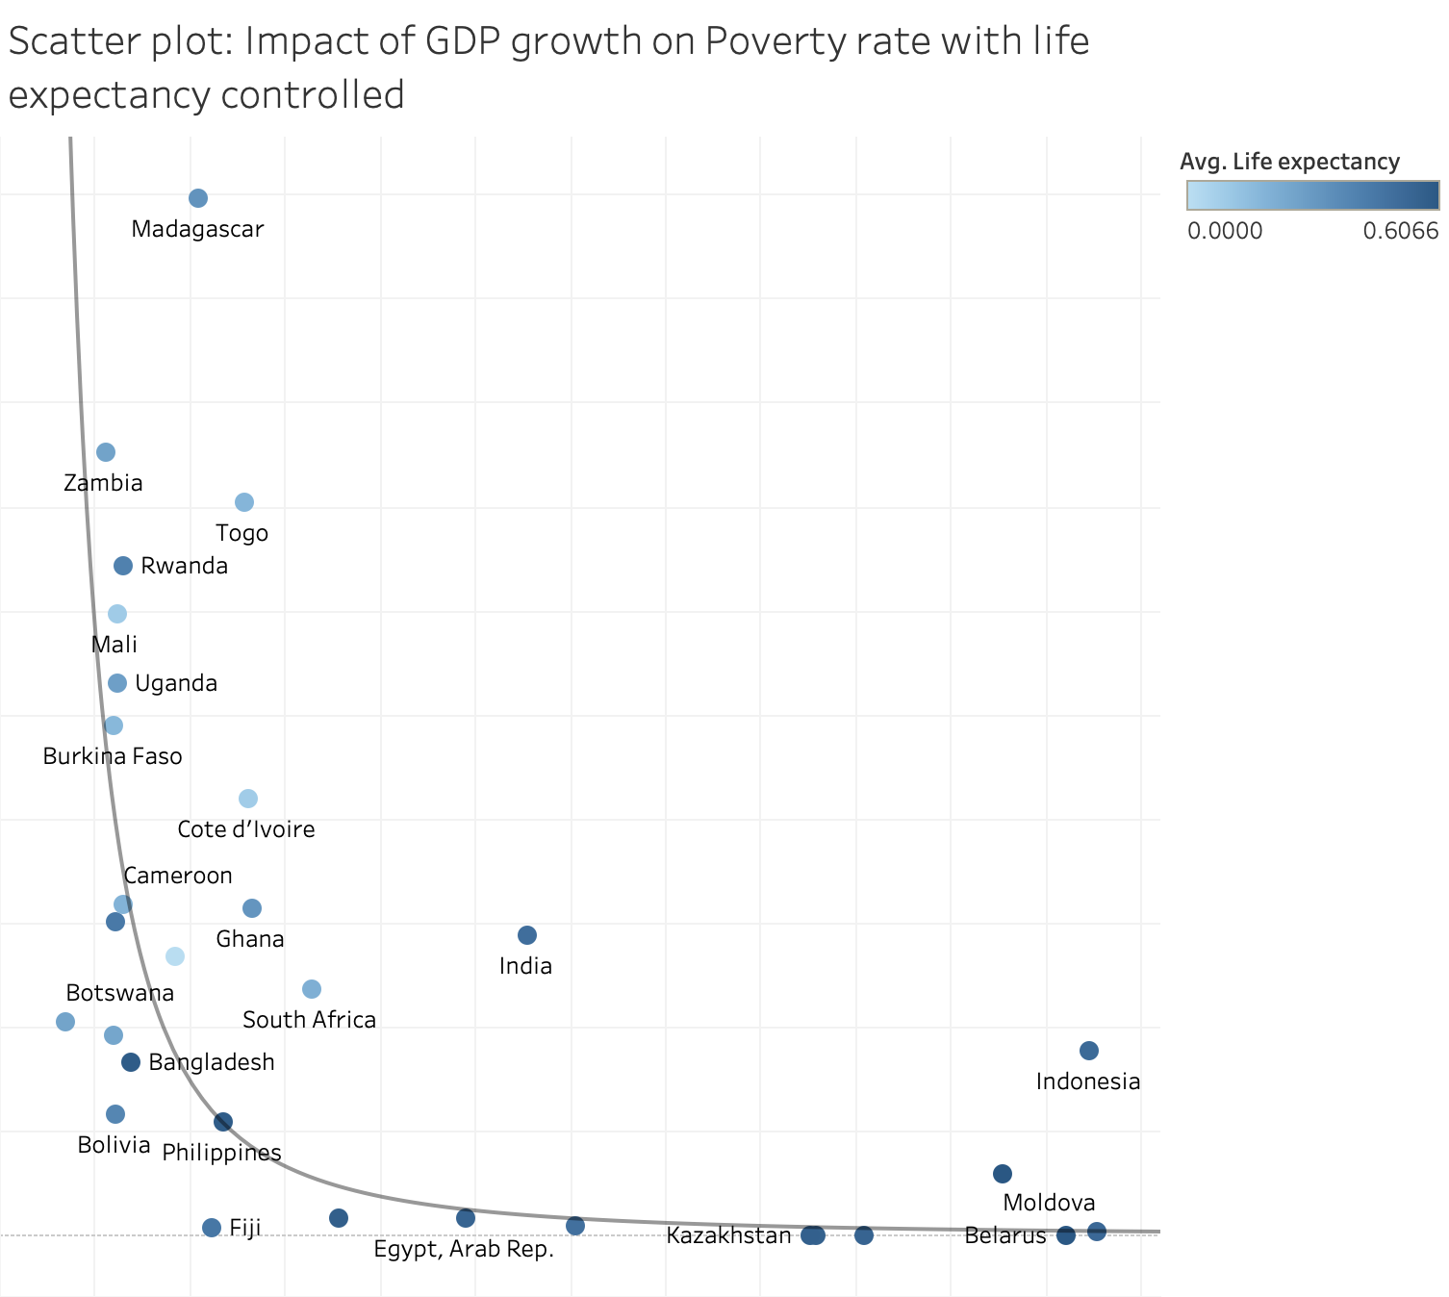
Impact of GDP growth on Poverty
Scatter plot without countries that have high life expectancy (greater than 0.6 after normalization)
Reduced r square value from 0.33 to 0.51
Controlling life expectancy has led to a more accurate representation of the relationship between GDP growth and poverty

Slide 11
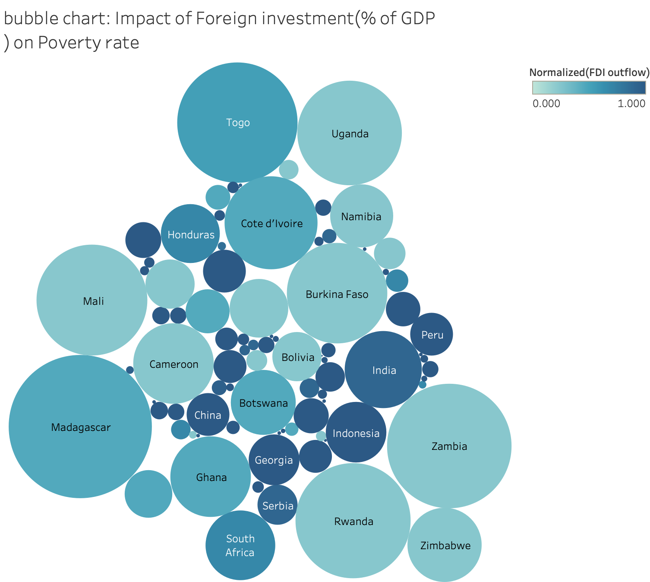
Impact of FDI(Foreign Direct Investment) on poverty
A bubble chart that visualized the relationship between FDI outflow and Poverty headcount ratio.
The chart indicates that countries with darker shades, which represent a higher FDI outflow, tend to have smaller bubble suggesting a lower poverty rate.
Encourage FDI outflows for poverty reduction: providing incentives for foreign businesses such as tax breaks or subsides.

Slide 12
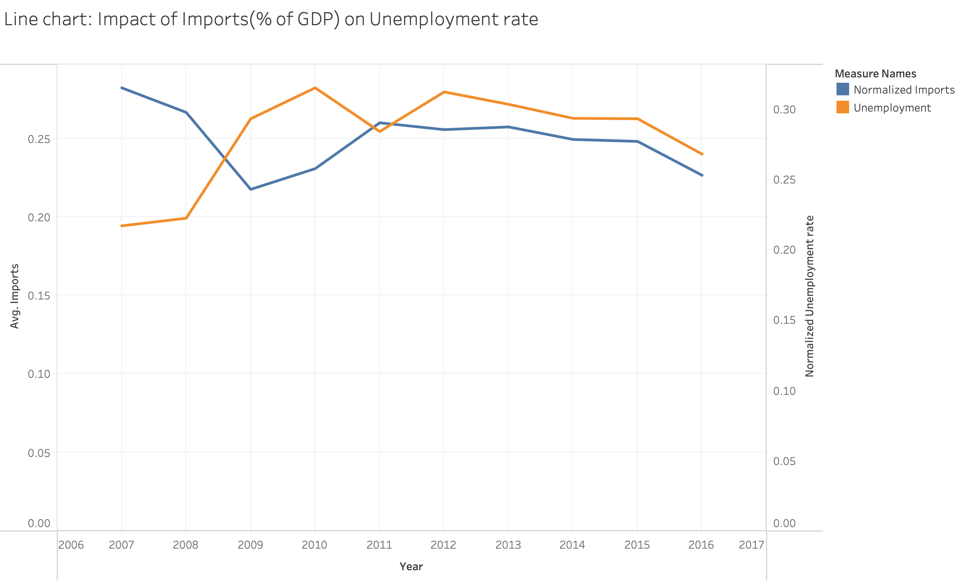
Impact of Imports on Unemployment rate
A line chart compares the trends of average imports and average unemployment rate from 2006 to 2017.
The chart shows that over the years, there seems to be an inverse relationship between the average imports and the average unemployment rate; generally, as imports increase, the unemployment rate decreases, and vice versa.
Promoting imports might be an effective strategy for unemployment reduction.

Slide 13
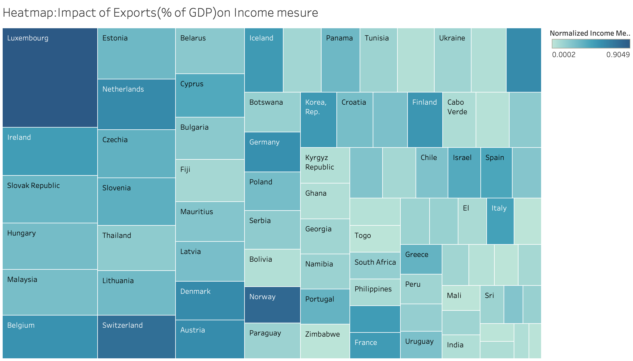
Impact of Exports on Gross National Income
A heatmap that visualized the relationship between Exports and Gross National Income
The chart indicates that countries with darker shades, which represent a higher percentage of Exports, tend to have bigger size of square suggesting a higher Gross National Income.
Enhancing Exports sectors for income improvement: strategies such as diversify trade policies, fostering better trade relations.

Slide 14
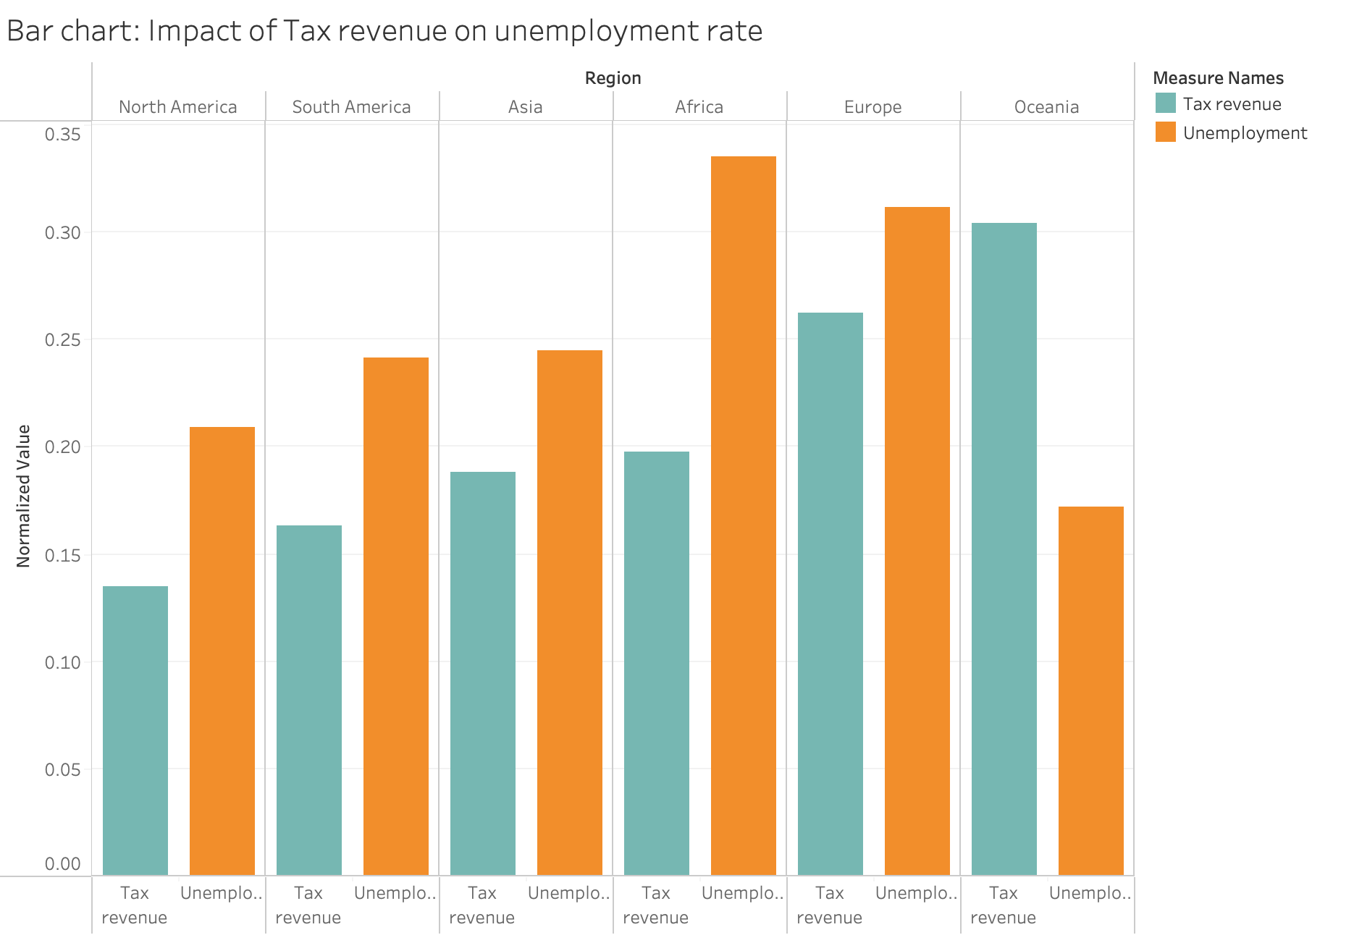
Impact of Tax revenue on Unemployment rate
A bar chart that visualized the relationship between tax revenue and unemployment rates across different regions
The chart shows regions with lower tax revenues generally tends to have lower unemployment rate, while Oceania as an exception
Consider adjusting tax policies to enhancing employment rate such as lowering tax burdens.

Slide 15
Conclusion
Economic growth appears to have a positive impact on poverty reduction, influenced by factors such as life expectancy and geographic size.
Increasing GDP growth and FDI outflow appears to support poverty rate reduction.
Imports of goods and services and tax revenue may have impact on job creation, but the benefits may not be evenly distributed across different regions.
Countries with higher exports appears to have higher average income per person.

Slide 16
Implications
Strengthen efforts to increase GDP growth through innovation, infrastructure development as there are expected correlation with poverty reduction
Encourage FDI outflows for poverty reduction: providing incentives for foreign businesses such as tax breaks or subsides.
Promoting imports might be an effective strategy for unemployment reduction.
Enhancing Exports sectors for income improvement: strategies such as diversify trade policies, fostering better trade relations.
Consider adjusting tax policies to enhancing employment rate such as lowering tax burdens.

Slide 17
Scope & Limitations
Scope:
This project investigates direct relationships between economic growth indicators GDP growth, FDI, exports, imports, Tax revenue and their corresponding influence on poverty measures.
This project develops visualizations using Tableau, offering findings and insights, aiming to educate and inform policymaking.
Limitations:
Data availability
unmeasured data from world bank.

Slide 18
Future research
Subgroup Analysis:
Exploring how the relationship between economic growth and poverty is influenced by social factors, such as gender, culture, and age distribution, to address inequality.
More variables:
Including additional variables such as technological innovation, natural resources environmental factors, and political stability to create a more research

Slide 19
References
Dollar, D., & Kraay, A. (2002). Growth is Good for the Poor. Journal of Economic Growth, 7(3), 195–225. https://doi.org/10.1023/A:1020139631000
Ravallion, M. (2001). Growth, Inequality, and Poverty: Looking Beyond Averages. World Development, 29(11), 1803–1815. https://doi.org/10.1016/S0305-750X(01)00081-7
The World Bank. (n.d.). World Bank Open Data. Retrieved from https://data.worldbank.org/

