Slide 1
EXPLORING THE ASSOCIATION BETWEEN ECONOMIC GROWTH AND POVERTY IN GLOBAL CONTEXT
Team member: Fan Yang, Arnold Murwira

Slide 2
Research Question
Is there a relationship between economic growth and poverty?
Objective: This research explores whether economic growth consistently lowers poverty worldwide
Method: Uncover insights through statistical analysis and visualization techniques
Importance: Identify effective strategy and policymaking for poverty reduction.

Slide 3
Importance
Brief Background Material:
In <Journal of Economic Growth>, article “Growth is Good for the Poor” have emphasizes the importance of economic growth in poverty reduction (e.g., Dollar & Kraay, 2002).
However, the relationship between economic growth and poverty is complex and influenced by various factors, including Schooling(Education), Geographic size etc. (Ravallion, 2001).

Slide 4
Hypothesis & variables
Hypothesis: There is a negative correlation between Economic growth and Poverty indicators
When a country’s economic expands it often means more jobs and better wages and overall prosperity.
Independent Variables:
GDP growth (annual %)
Foreign direct investment, net outflows (% of GDP)
Exports of goods and services (% of GDP)
Imports of goods and services (% of GDP)
Tax Revenue (% of GDP)
Land area (sq. km)
Life expectancy at birth, total (years)
Government expenditure on education, total (% of GDP)
Population, total
Region
Dependent Variables:
Poverty headcount ratio at $2.15 a day (2017 PPP) (% of population)
Gross domestic savings (% of GDP)
GNI per capita, PPP (current international $)
Unemployment, total (% of total labor force) (modeled ILO estimate)

Slide 5
Data description
Size:
Country(92) * Time span in Years(10) * Variables ct (14) = 12880
Type: Numeric
Scale: Ratio, Nominal
years: 10
Period:2007-2016
Data source:The World Bank. (n.d.). World Bank Open Data. Retrieved from https://data.worldbank.org/

Slide 6
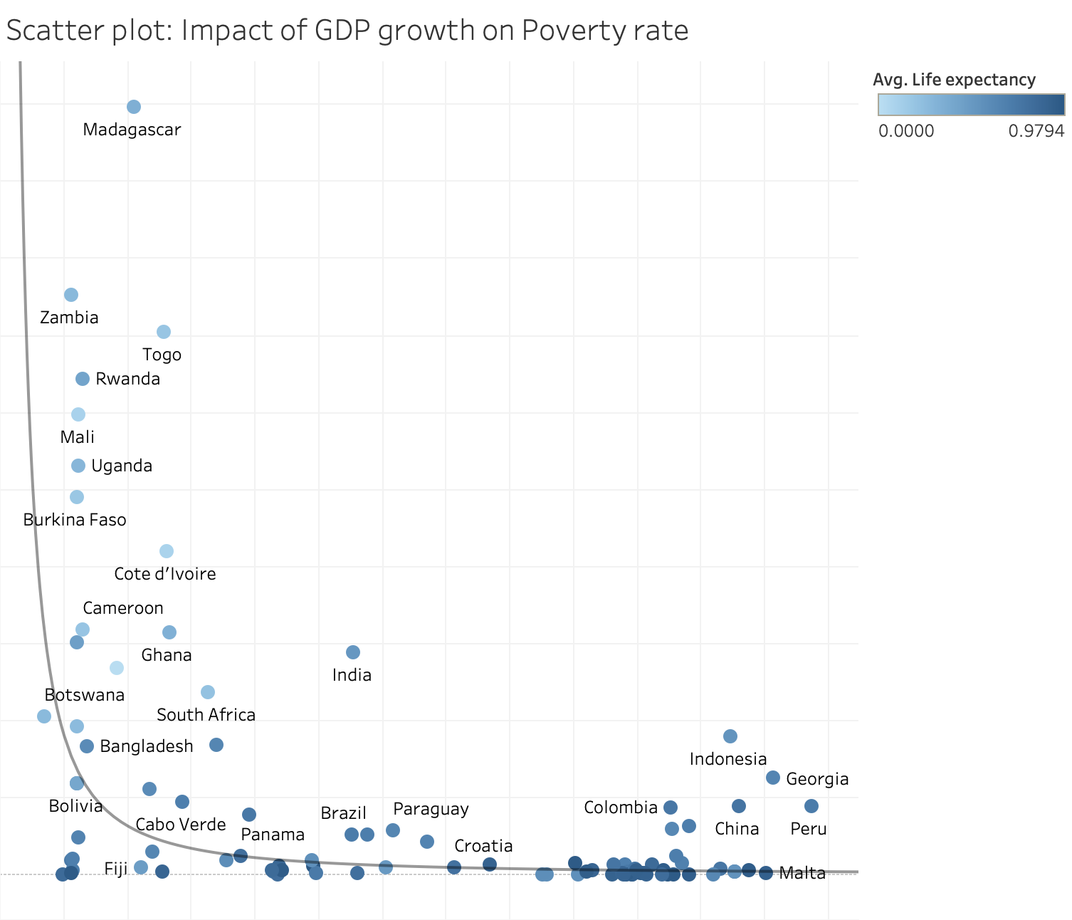
Impact of GDP growth on Poverty
A Scatter plot that visualized the relationship between GDP growth and Poverty headcount ratio with life expectancy represented through the color intensity.
Countries with higher GDP growth rates tend to have lower poverty headcounts, while also illustrating that countries with higher life expectancy tends to have lower poverty headcount ratio.
With a p value < 0.0001, The graph reveals that there’s a strong indication that the null hypothesis can be rejected.
Poverty headcount (Normalized)
GDP Growth (Normalized)

Slide 7
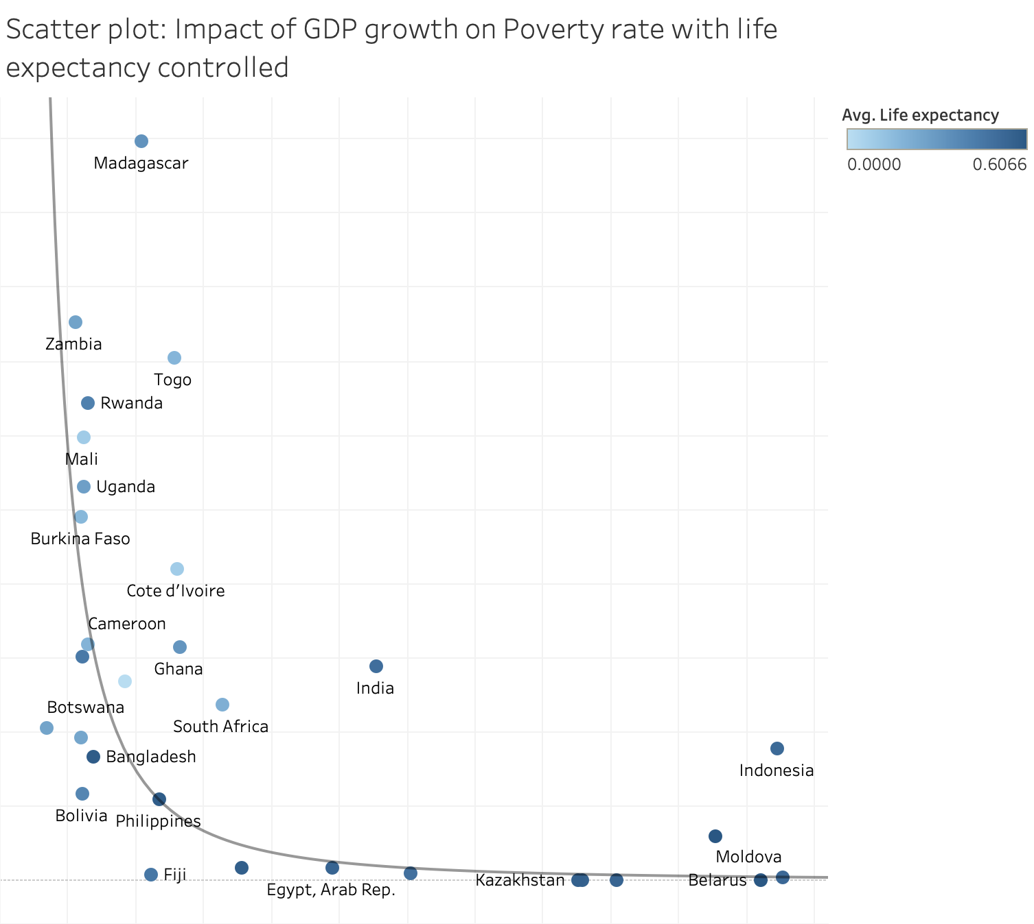
Impact of GDP growth on Poverty
Scatter plot without countries that have high life expectancy (greater than 0.6 after normalization)
Reduced r square value from 0.33 to 0.51
Controlling life expectancy has led to a more accurate representation of the relationship between GDP growth and poverty

Slide 8
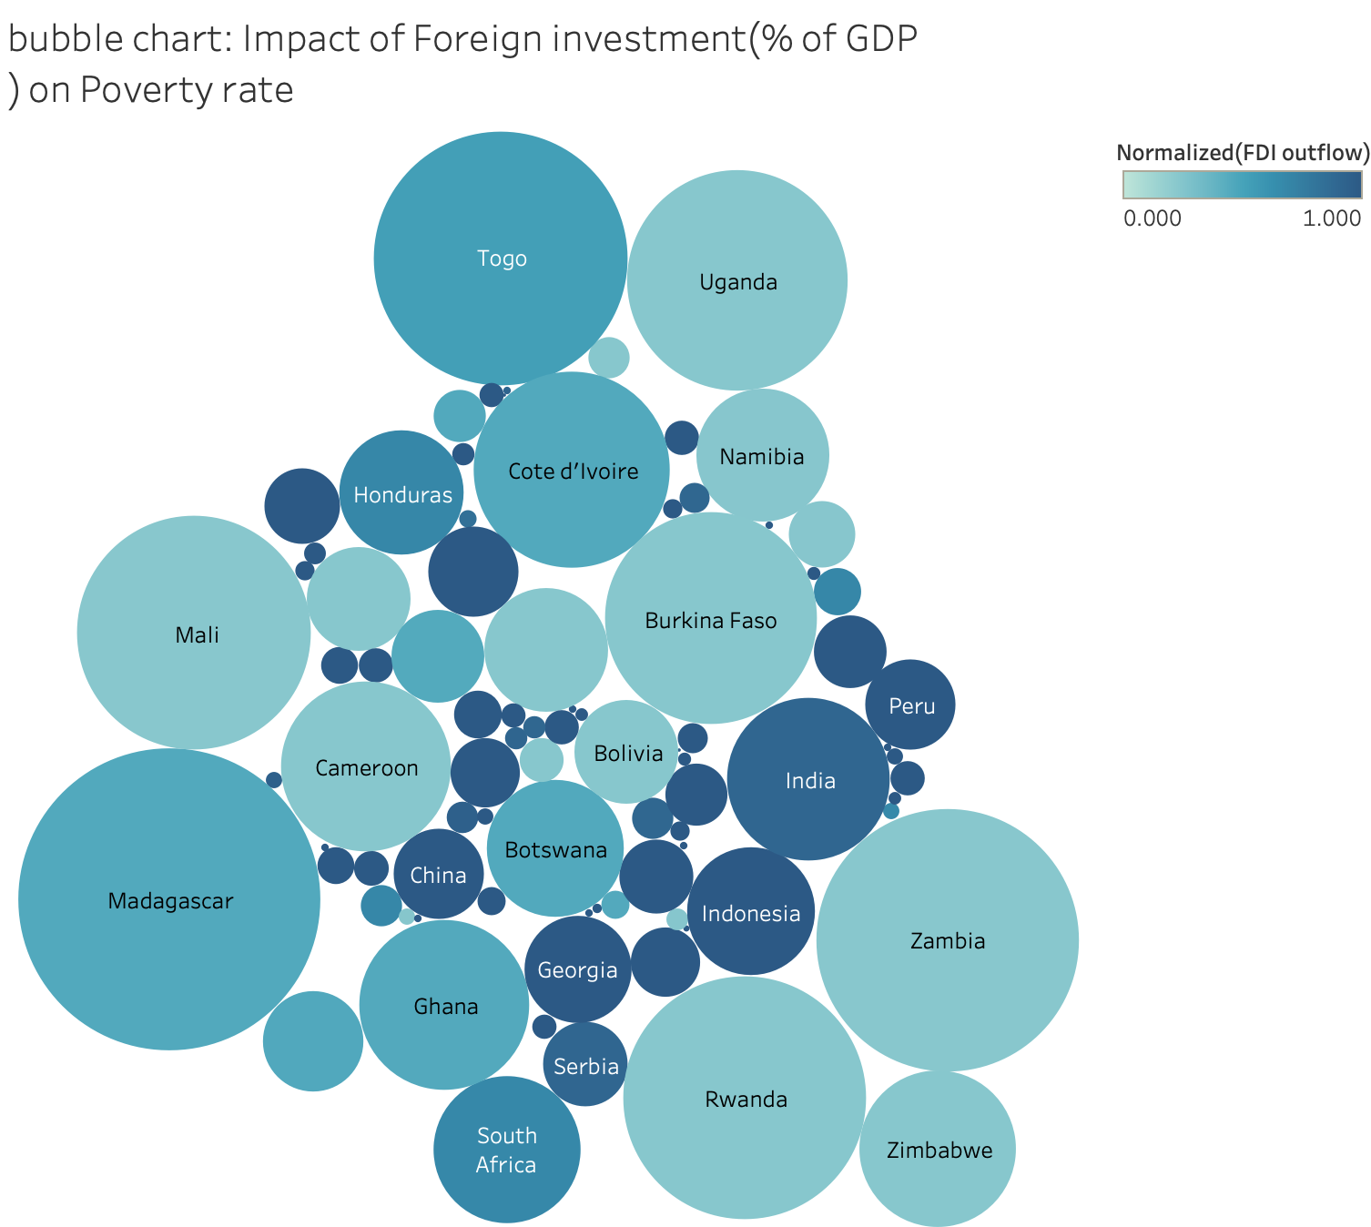
Impact of FDI(Foreign Direct Investment) on poverty
A bubble chart that visualized the relationship between FDI outflow and Poverty headcount ratio.
The chart indicates that countries with darker shades, which represent a higher FDI outflow, tend to have smaller bubble suggesting a lower poverty rate.
Encourage FDI outflows for poverty reduction: providing incentives for foreign businesses such as tax breaks or subsides.

Slide 9
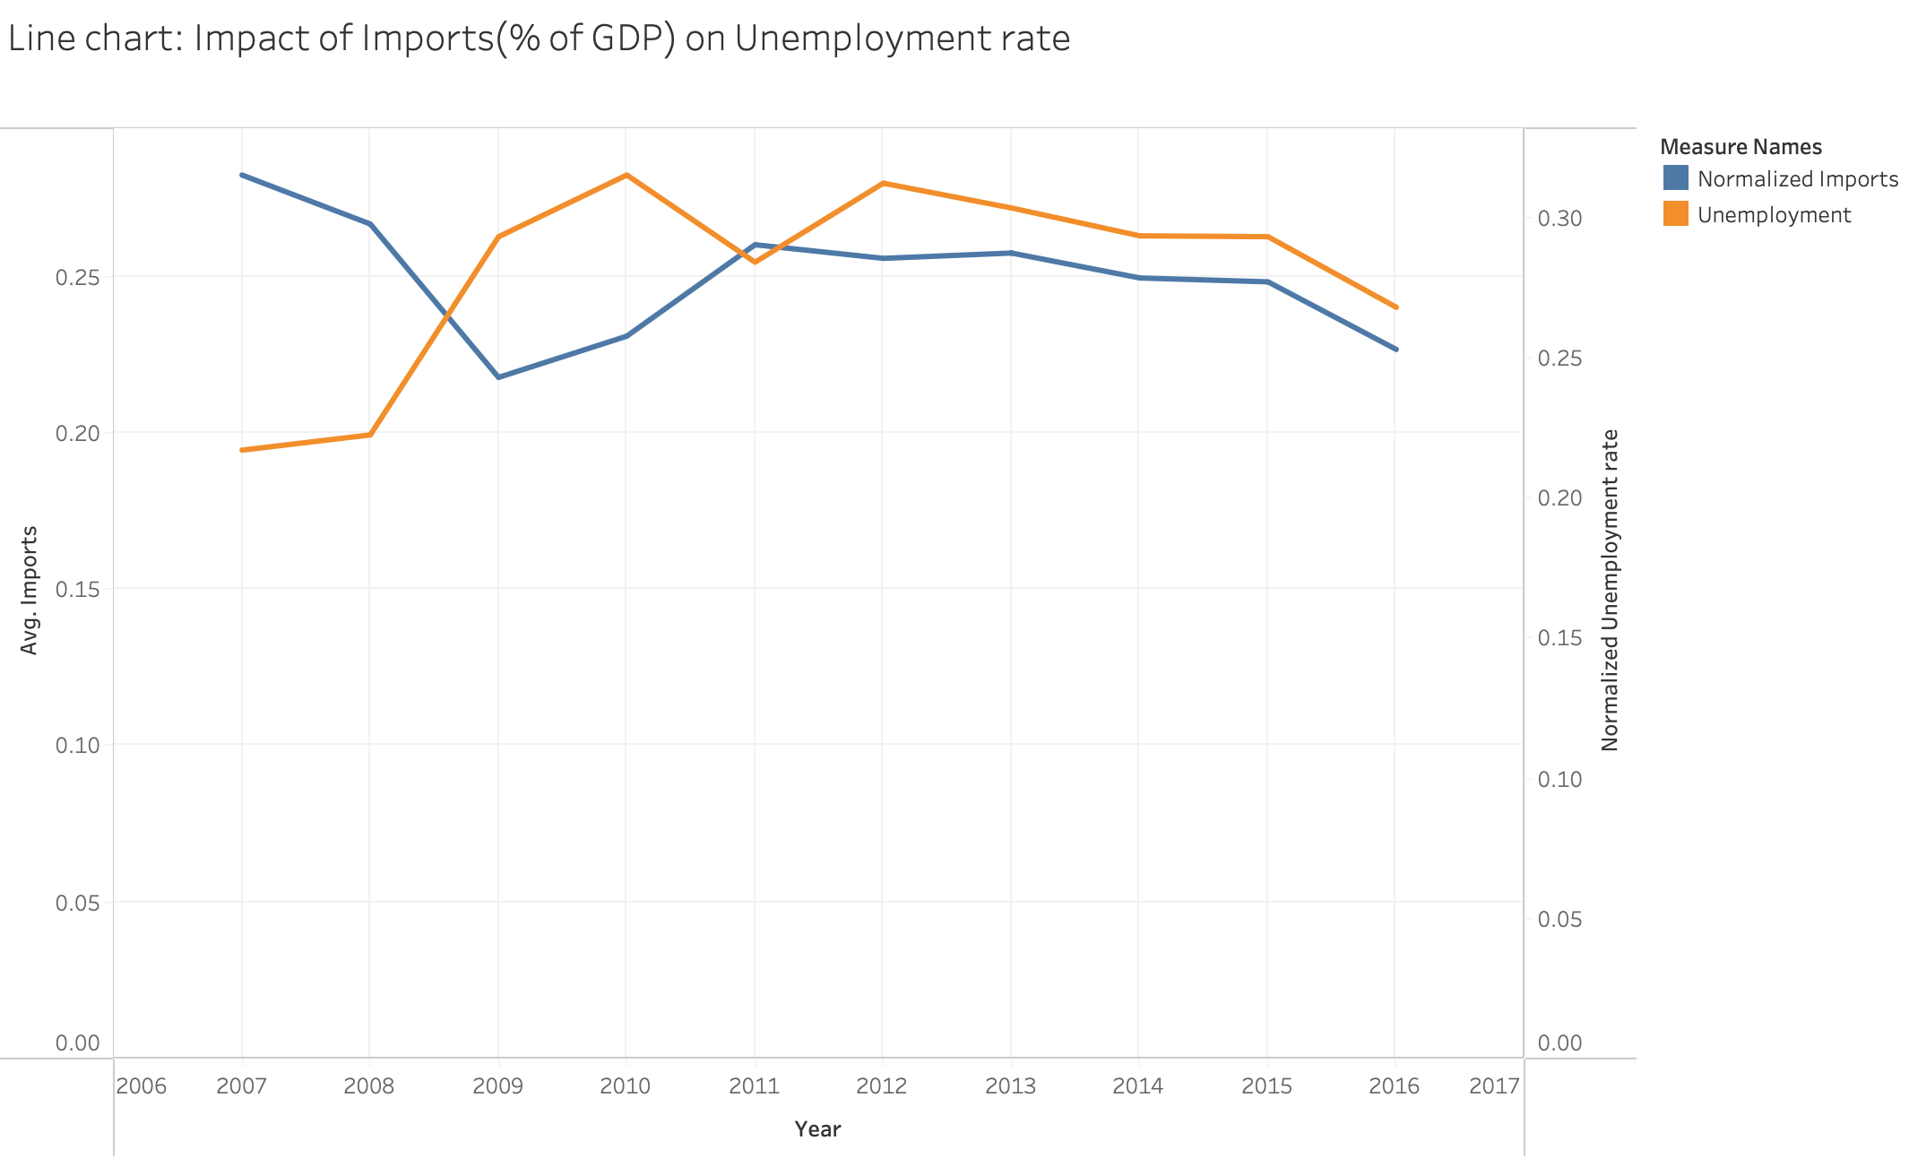
Impact of Imports on Unemployment rate
A line chart compares the trends of average imports and average unemployment rate from 2006 to 2017.
The chart shows that over the years, there seems to be an inverse relationship between the average imports and the average unemployment rate; generally, as imports increase, the unemployment rate decreases, and vice versa.
Promoting imports might be an effective strategy for unemployment reduction.

Slide 10
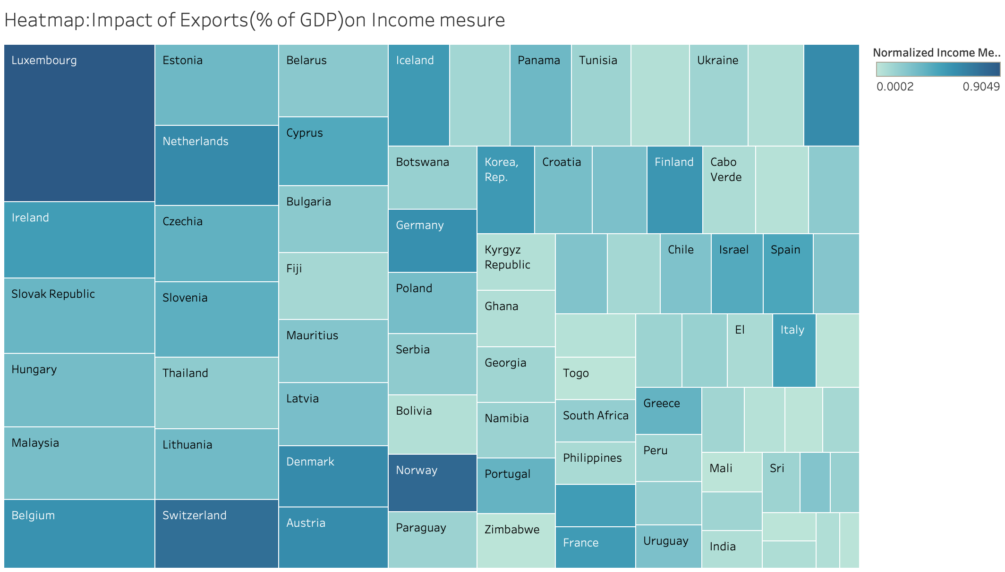
Impact of Exports on Gross National Income
A heatmap that visualized the relationship between Exports and Gross National Income
The chart indicates that countries with darker shades, which represent a higher percentage of Exports, tend to have bigger size of square suggesting a higher Gross National Income.
Enhancing Exports sectors for income improvement: strategies such as diversify trade policies, fostering better trade relations.

Slide 11
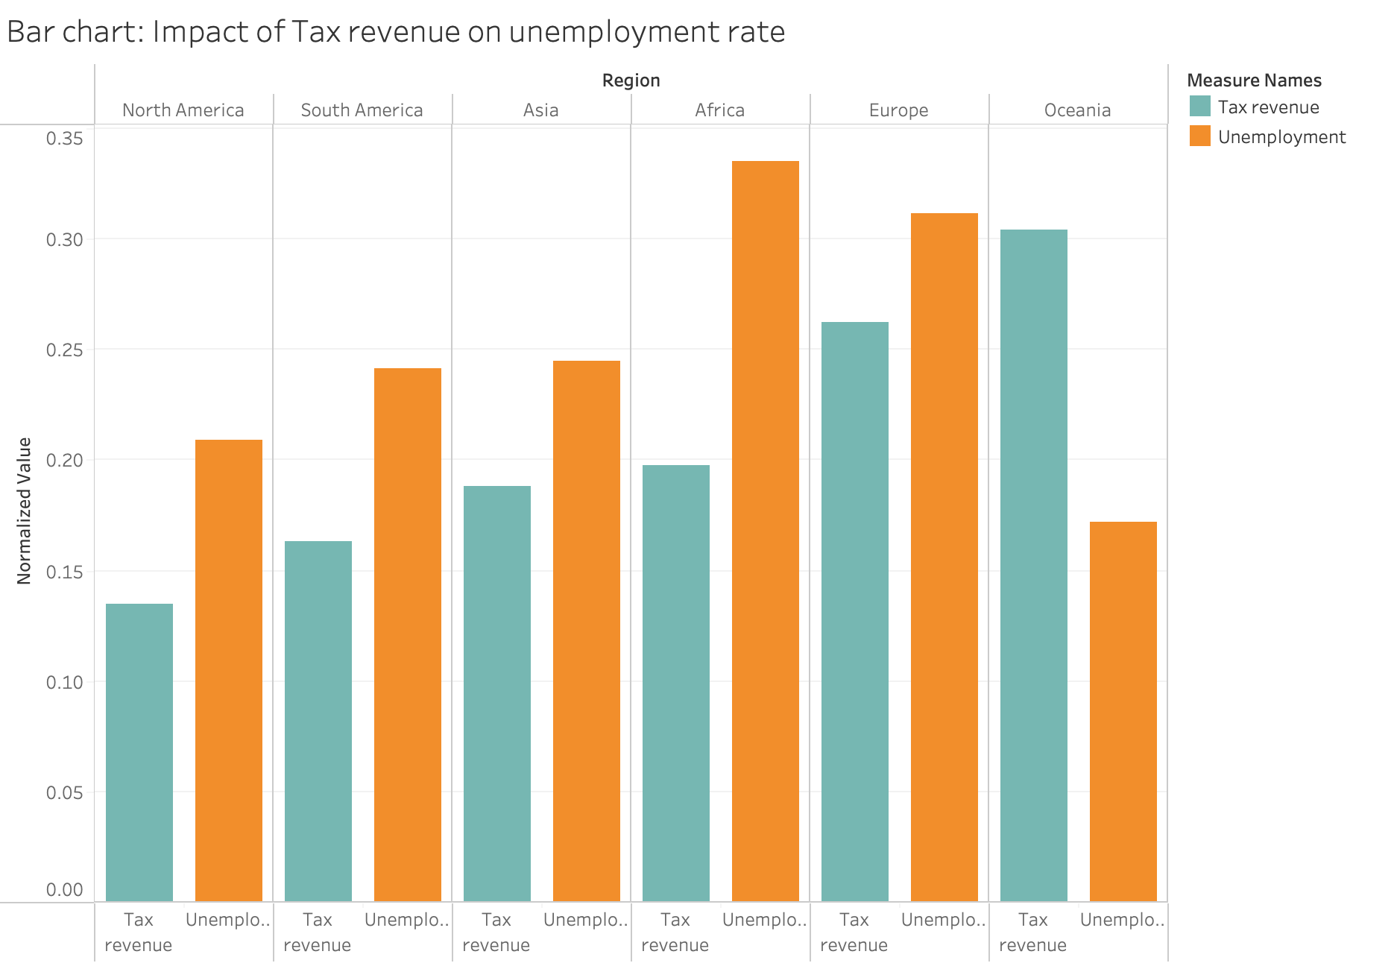
Impact of Tax revenue on Unemployment rate
A bar chart that visualized the relationship between tax revenue and unemployment rates across different regions
The chart shows regions with lower tax revenues generally tends to have lower unemployment rate, while Oceania as an exception
Consider adjusting tax policies to enhancing employment rate such as lowering tax burdens.

Slide 12
Conclusions
Economic growth appears to have a positive impact on poverty reduction, influenced by factors such as life expectancy and geographic size.
Increasing GDP growth and FDI outflow appears to support poverty rate reduction.
Imports of goods and services and tax revenue may have impact on job creation, but the benefits may not be evenly distributed across different regions.
Countries with higher exports appears to have higher average income per person.

Slide 13
Implications
Strengthen efforts to increase GDP growth through innovation, infrastructure development as there are expected correlation with poverty reduction
Encourage FDI outflows for poverty reduction: providing incentives for foreign businesses such as tax breaks or subsides.
Promoting imports might be an effective strategy for unemployment reduction.
Enhancing Exports sectors for income improvement: strategies such as diversify trade policies, fostering better trade relations.
Consider adjusting tax policies to enhancing employment rate such as lowering tax burdens.

Slide 14
Scope & Limitations
Scope:
This project investigates direct relationships between economic growth indicators GDP growth, FDI, exports, imports, Tax revenue and their corresponding influence on poverty measures.
This project develops visualizations using Tableau, offering findings and insights, aiming to educate and inform policymaking.
Limitations:
Data availability
Future study:
Including additional variables such as technological innovation, natural resources environmental factors, and political stability to create a more research

