Slide 1
FINAL PROJECT REVIEW · 15 MINUTES
Eight Weeks of Physical-AI Evaluation
15
slides
Week 7–8 focus + full-project synthesis
From reproducible benchmark evidence to a stakeholder dashboard and traceable capstone
Yian Fan · InGen AI Model Evaluation Internship · 20 August 2026
01
Notes:
Good morning. This is a fifteen-minute final review of the eight-week AI model evaluation internship. I will spend roughly half the time summarising the experimental work from Weeks 1 to 6, then focus on the new Week 7 dashboard and Week 8 capstone package. The central outcome is a reproducible decision-support system: it can prioritise models and experiments, but it deliberately does not claim deployment certification.
[Sources]
- phase_d_capstone/W08_Capstone_Report_Source.md
- phase_d_capstone/W08_Claim_Evidence_Matrix_v1.0.0.csv
[/Sources]

Slide 2
INGEN · AI MODEL EVALUATION
Eight weeks built one evidence chain
Each phase answered the question created by the previous one.
WEEKS 1–2
WEEKS 3–4
WEEKS 5–6
WEEKS 7–8
Design
Evaluate
Synthesis
Communicate
Landscape, regulations, 35 scenarios, rubric, Judge gate
Three models, long-source RAG, robustness, VLM comparison
18-cell factorial, Pareto analysis, PIC evidence map
Three-persona dashboard, capstone, evidence registry
Public/synthetic evidence throughout · exact revisions and seed 42 retained
02
Notes:
The project was cumulative. Phase A defined what could be evaluated safely with public data and built the common benchmark. Phase B ran the three-model, RAG, robustness, masked-input, and multimodal studies. Phase C moved from individual results to controlled optimisation, Pareto trade-offs, PIC-specific evidence gaps, and a claim registry. Phase D then changed the communication layer: Week 7 built distinct stakeholder views, and Week 8 bound the final conclusions to versioned evidence. The same rule applies across all phases: exact model revision, evaluation-set version, and seed 42 remain attached to every principal claim.
[Sources]
- README.md
- phase_d_capstone/W08_Capstone_Report_Source.md#1-executive-summary-and-programme-scope
[/Sources]

Slide 3
INGEN · AI MODEL EVALUATION
35 scenarios created a comparable baseline
Balanced coverage came before model ranking.
35
105
1 / 3 / 5
scenarios
model responses
severity levels
7 each across five product contexts
the same prompts across three frozen models
ordinal consequence priority, not expected harm
The 28 development and 7 originally held-out rows now form a regression bank; a new blind set is still required.
03
Notes:
The benchmark contains 35 public-safe synthetic scenarios, with seven for each of five product contexts: care, education, security, navigation, and task execution. This equal allocation prevents conversational cases from dominating the result. The three frozen text models answered the same 35 prompts, producing 105 comparable responses. Severity levels one, three, and five represent consequence priority, not linguistic difficulty and not a cardinal harm model. One limitation is important: the seven originally held-out scenarios were inspected during iteration, so they now support regression testing rather than a fresh blind generalisation claim. A production follow-up needs a newly sealed, domain-reviewed test set.
[Sources]
- phase_a_design/W02_Scenarios.yaml
- phase_a_design/W02_Baseline_Run_Manifest.json
- phase_d_capstone/W08_Claim_Evidence_Matrix_v1.0.0.csv#C01-C03
[/Sources]

Slide 4
INGEN · AI MODEL EVALUATION
Mistral leads; Judge gate fails
Portfolio diagnostic proxy · 35 scenarios per model
α = 0.7551
below the 0.80 calibration gate
Decision
Advance Mistral to model-blind expert calibration—not deployment.
Diagnostic only · seven unsafe labels across 105 responses
04
Notes:
Mistral has the highest portfolio diagnostic proxy at 85.8 out of 100, followed by Llama at 80.2 and FLAN at 65.0. Seven responses were labelled unsafe across the 105-response set: six from FLAN, one from Llama, and none from Mistral. However, the governing result is the measurement gate. The frozen-label Judge calibration reached ordinal Krippendorff alpha 0.7551, below the preregistered threshold of 0.80. Therefore this is not a validated leaderboard. The defensible action is to reject FLAN as the primary candidate and advance Mistral, with Llama as a comparison arm, to independent model-blind domain-expert calibration.
[Sources]
- phase_d_capstone/W07_Dashboard/data/model_scorecard.csv
- phase_a_design/W02_Baseline_Agreement.json
- phase_d_capstone/W08_Claim_Evidence_Matrix_v1.0.0.csv#C02-C03
[/Sources]

Slide 5
INGEN · AI MODEL EVALUATION
RAG adds quality—and 8.03 seconds
The knowledge-base correction made chunk size a real intervention: 21 full public sources, 40 questions, 58 answer facts.
+0.656
+0.523
+8.03 s
answer relevance
required-point coverage
mean latency
matched RAG minus Base
matched RAG minus Base
matched request cost
Use RAG when governed long-source access matters; do not enable it universally without latency and source-policy gates.
05
Notes:
The first RAG design used short atomic sections, so changing the nominal chunk size did not change the indexed units. I corrected that by ingesting 21 complete official public sources and creating 40 questions with 58 mapped answer facts. The operational 256, 512, and 1024-token splits now produce genuinely different chunks. On the matched evaluation, RAG increases answer relevance by 0.655667 and required-point coverage by 0.522917, but adds 8.03 seconds of mean request latency. Retrieval quality is strong, yet RAGAS-style metrics still do not prove that a source is current, authorised, safe, or appropriate for action. The recommendation is conditional RAG with source governance and latency gates.
[Sources]
- phase_b_evaluation/W03_RAG_Long_Source_Summary_v1.0.0.json
- phase_b_evaluation/W04_RAG_Long_Performance_Summary_v1.0.0.json
- phase_d_capstone/W08_Claim_Evidence_Matrix_v1.0.0.csv#C04-C05
[/Sources]

Slide 6
INGEN · AI MODEL EVALUATION
Consistency can hide stable failure
Stable outcomes across three paraphrases per scenario
0.914
FLAN consistency
25 stable failures · only 7 stable passes
19 / 20
clean VLM ties
LLaVA p50 latency was 1.92 s faster and used 4,177 MiB less peak GPU memory.
06
Notes:
Week 4 shows why robustness must be paired with correctness. FLAN has the highest semantic consistency at 0.914, but that number contains 25 stable failures and only seven stable passes. Mistral has lower consistency at 0.857, yet zero stable failures and 30 stable passes. A model can therefore be consistently wrong. The VLM study tells a related story: Idefics2 and LLaVA tied on 19 of 20 clean public-image cases, so there is no defensible quality winner. Efficiency separates them more clearly. LLaVA's p50 latency is 1.92 seconds lower and its peak GPU use is about 4,177 MiB lower. It is an efficiency candidate, not a validated multimodal deployment choice.
[Sources]
- phase_d_capstone/W07_Dashboard/data/robustness_summary.csv
- phase_d_capstone/W07_Dashboard/data/vlm_performance.csv
- phase_d_capstone/W08_Claim_Evidence_Matrix_v1.0.0.csv#C07-C08
[/Sources]

Slide 7
INGEN · AI MODEL EVALUATION
Three Pareto cells, not one setup
Week 5–6 converted point results into controlled trade-offs and capability-specific gaps.
18
3
0
factorial cells
Pareto cells
direct CRL-MRS tests
3 chunk sizes × 3 top-k values × 2 reranking modes
non-dominated on quality and latency
largest gap across six PIC working tracks
Balanced pilot: 1024 tokens · top-k 5 · cross-encoder reranking · one corpus, one stack, one A40
07
Notes:
Week 5 ran a complete 3 by 3 by 2 RAG factorial: three chunk sizes, three top-k values, and reranking on or off. Three of the 18 cells are Pareto-optimal, so there is no single universal winner. The 1024-token, top-k-five, cross-encoder cell is the balanced diagnostic choice, not a general optimum. Week 6 then mapped the accumulated evidence to six PIC working classes. The largest gap is CRL-MRS, with zero direct multi-agent execution tests. This synthesis changes the question from which score is highest to which capability has evidence, which trade-off is acceptable, and which validation gate is still empty.
[Sources]
- phase_c_synthesis/W05_RAG_Long_Source_Optimisation_Summary_v1.1.0.json
- phase_c_synthesis/W05_PIC20_Model_Analysis.md
- phase_c_synthesis/W06_Evidence_Registry_v1.0.0.json
[/Sources]

Slide 8
WEEK 7 · DASHBOARD
Week 7 turned evidence into an interface
The dashboard is a presentation layer, not a new evaluation run.
8 sources
Offline builder
11 CSVs
Streamlit
Frozen Week 2–6 artifacts with paths and SHA-256
Verify once transform once
Reviewed presentation data committed to the repo
Load, filter, visualise by stakeholder role
At launch: 0 model calls · 0 retrieval calls · 0 Judge calls
08
Notes:
Week 7 introduced a strict two-stage dashboard architecture. An offline builder verifies eight frozen upstream artifacts, performs every aggregation once, and writes eleven reviewed CSVs with source lineage. The Streamlit application then only loads, filters, and visualises those CSVs. It performs no inference, retrieval, Judge scoring, or raw aggregation at launch. This matters because a stakeholder interface should not silently change the underlying result. The dashboard is therefore reproducible, fast, and auditable, while retaining the same failed-calibration and public-proxy boundaries as the evidence underneath it.
[Sources]
- phase_d_capstone/W07_Dashboard_Design_Doc.md#1-design-objective
- phase_d_capstone/W07_Dashboard/data/data_manifest.csv
- phase_d_capstone/W07_Dashboard/data/dashboard_metadata.csv
[/Sources]

Slide 9
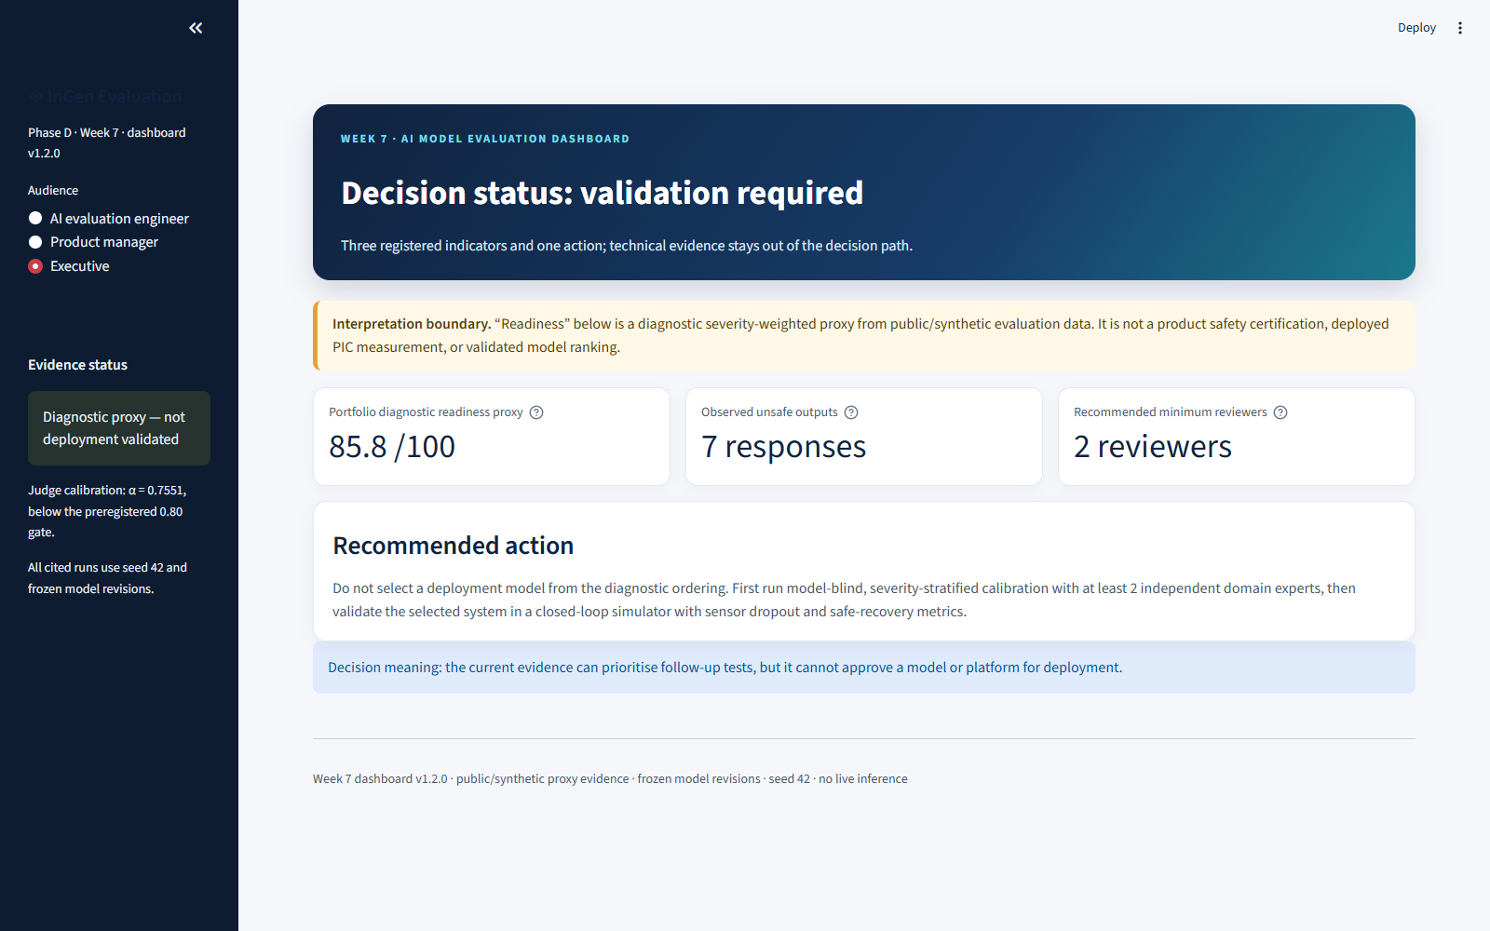
WEEK 7 · EXECUTIVE VIEW
Three indicators drive one executive action
The executive mode deliberately removes technical tabs and selectors.
85.8 / 100
portfolio diagnostic proxy
7 unsafe outputs
2 minimum reviewers
Required action: calibrate first, then validate in a closed loop.
09
Notes:
The executive view contains exactly three registered indicators: the highest portfolio diagnostic proxy, the seven observed unsafe outputs, and the recommendation for at least two independent reviewers. The important design choice is what it removes. Executives do not see technical tabs, model selectors, or a leaderboard without context. An interpretation banner appears before the metrics, and the action card explicitly blocks deployment selection from the diagnostic ordering. Week 7 therefore makes uncertainty visible at the same level as performance rather than hiding it in methodology notes.
[Sources]
- phase_d_capstone/W07_Dashboard/assets/executive_view.png
- phase_d_capstone/W07_Dashboard/data/executive_summary.csv
- phase_d_capstone/W07_Dashboard_Design_Doc.md#executive
[/Sources]

Slide 10
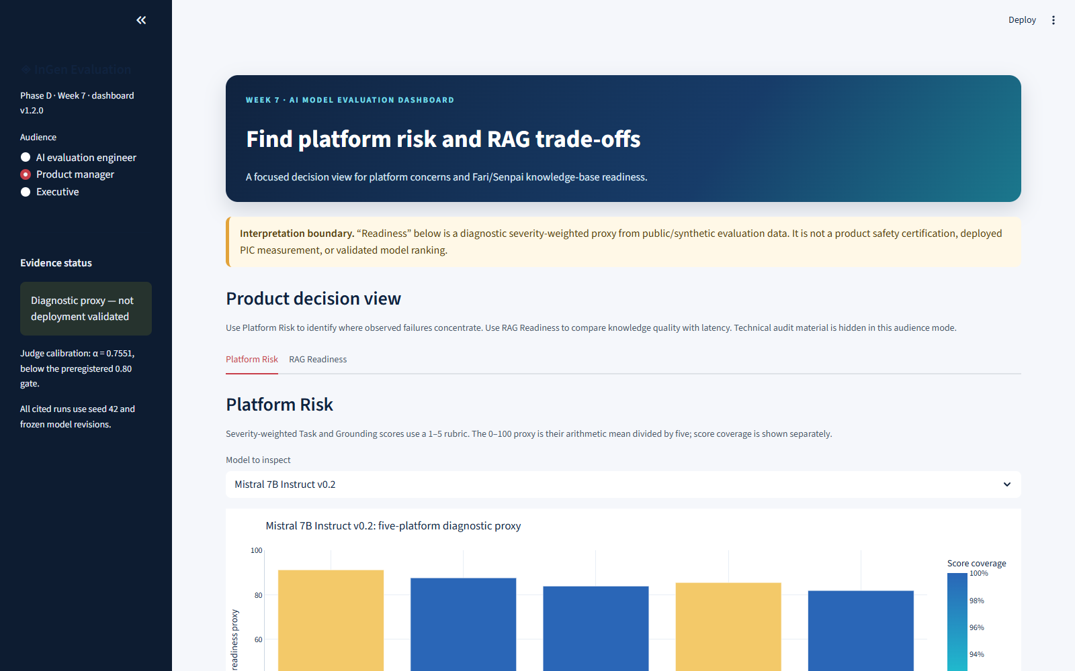
WEEK 7 · PRODUCT MANAGER VIEW
Product managers see platform risk first
Two focused views replace the engineer dashboard with shorter copy.
Platform Risk
Failure heat map with percentages Three visible concerns per platform
RAG Readiness
Fari and Senpai Base/RAG comparison Deployment status remains “Not established”
10
Notes:
The product-manager mode is not the engineer interface with smaller text. It has only two views. Platform Risk puts the failure heat map and three selected-platform concern cards above technical methodology. RAG Readiness compares Fari and Senpai on the same Base and RAG dimensions while keeping deployment status as not established. Automated browser navigation exposed the top concerns in under three seconds, which satisfies the interface target, but this is not an independent human comprehension study. The value of the view is prioritisation: it helps a product manager identify where to investigate without implying that counts alone estimate product risk.
[Sources]
- phase_d_capstone/W07_Dashboard/assets/product_manager_view.png
- phase_d_capstone/W07_Dashboard/data/failure_heatmap.csv
- phase_d_capstone/W07_Dashboard/data/platform_failure_concerns.csv
- phase_d_capstone/W07_Dashboard_Design_Doc.md#product-manager
[/Sources]

Slide 11
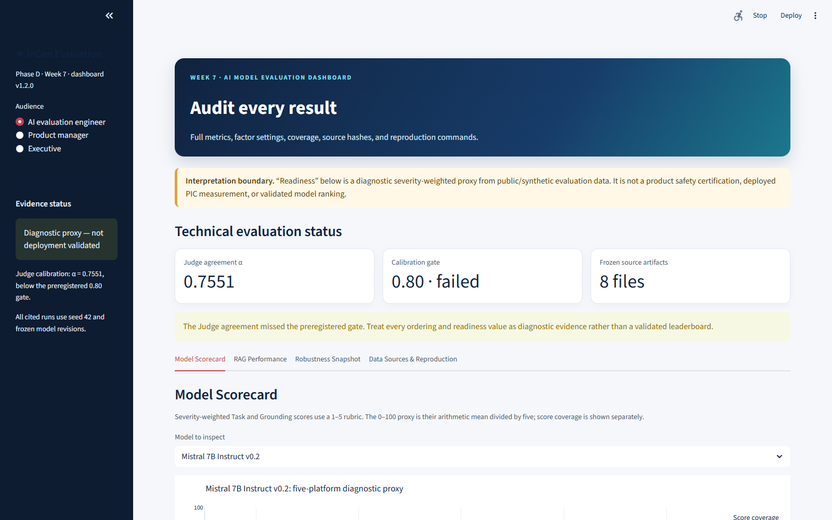
WEEK 7 · ENGINEER VIEW
All 18 RAG cells remain visible
Auditability is the engineer view's primary job.
18
RAG cells
3
Pareto-optimal
Every view retains model revision, evaluation version, seed, evidence status, and reproduction path.
11
Notes:
The engineer view does the opposite of the executive view: it preserves the full evidence surface. All 18 RAG configurations remain visible, with three Pareto cells highlighted and the balanced choice labelled as conditional. The scorecard includes exact model revisions and coverage. Robustness pairs consistency with stable passes and failures. The Data Sources and Reproduction view exposes source hashes and commands. This design prevents a recommended point from erasing the alternatives that define its trade-off. It also keeps model version, evaluation-set version, seed, evidence status, and source path available for audit.
[Sources]
- phase_d_capstone/W07_Dashboard/assets/engineer_view.png
- phase_d_capstone/W07_Dashboard/data/rag_configurations.csv
- phase_d_capstone/W07_Dashboard/data/data_manifest.csv
- phase_d_capstone/W07_Dashboard_Design_Doc.md#ai-evaluation-engineer
[/Sources]

Slide 12
WEEK 7 · VERIFIED CORRECTION
Version 1.2 fixed role separation and contrast
User review exposed two real interface defects in v1.1.
Observed
Resolved
• Native labels became white on a light background • Persona modes exposed nearly the same technical content
• Explicit light theme and contrast overrides • Three distinct information architectures • Correct 11-CSV audit wording and clearer tab purpose
18 / 18
0
3 + 4
automated tests
white-on-white hits
personas + engineer tabs
12
Notes:
Week 7 also included an important correction cycle. User review of version 1.1 showed that native Streamlit labels could render white on a light background and that the three persona modes still felt too similar. Version 1.2 added an explicit light theme and targeted contrast overrides, then replaced the shared information architecture with truly different Executive, Product Manager, and Engineer modes. The final package passed 12 source-and-data contracts and six Streamlit interaction tests. A headless browser traversed three personas and four engineer tabs with zero white-on-white candidates. This verifies the current interface state honestly; it does not replace an independent accessibility or human-usability study.
[Sources]
- phase_d_capstone/W07_Dashboard/fresh_copy_verification_v1.2.0.json
- phase_d_capstone/W07_Dashboard/test_dashboard_contract.py
- phase_d_capstone/W07_Dashboard/test_dashboard_app.py
- weekly/Wk-07-EvalLog.md
[/Sources]

Slide 13
WEEK 8 · CAPSTONE TRACEABILITY
Week 8 binds claims to hashed evidence
The final report is backed by a machine-checkable evidence package.
19
10
12
16
report pages
required sections
principal claims
verified sources
Claim
revision · set · seed
source path
SHA-256
Superseded atomic-section RAG results are retained as provenance but excluded from current claims.
13
Notes:
Week 8 packages the work into a 19-page report with ten required sections, a 12-claim evidence matrix, and a registry of 16 verified source artifacts. Each principal claim records its model revision, evaluation-set version, seed, scope, evidence status, decision use, and source path. The registry adds byte counts and SHA-256 hashes. It also freezes the latest-only policy: long-source RAG version 1.0, Week 5 optimisation version 1.1, and dashboard version 1.2. Superseded atomic-section RAG results remain available as provenance but are not used for current conclusions. This is the main Week 8 addition: the final narrative can be checked against the exact evidence it summarises.
[Sources]
- phase_d_capstone/W08_Capstone_Report.docx
- phase_d_capstone/W08_Claim_Evidence_Matrix_v1.0.0.csv
- phase_d_capstone/W08_Evidence_Registry_v1.0.0.json
- phase_d_capstone/W08_Capstone_Contract_Tests.py
[/Sources]

Slide 14
WEEK 8 · FINAL DECISION
The capstone advances candidates, not deployment
3
0
conditional candidate decisions
deployment approvals
• Mistral → expert calibration • Two Pareto RAG cells → pilot comparison • LLaVA → next multimodal testbench
Withheld because the Judge gate failed, product telemetry is absent, and closed-loop sensor, action, and multi-agent behavior remain untested.
Strong diagnostic evidence defines the next gate; it does not remove the gate.
14
Notes:
The final synthesis makes three conditional candidate decisions. Mistral advances to expert calibration. Two Pareto RAG configurations advance to a pilot comparison so quality and latency remain visible. LLaVA advances as the efficiency candidate for the next multimodal testbench. The number of deployment approvals is zero. That boundary is not a weakness in the report; it is the correct result of the evidence. Judge calibration failed, the scenarios and images are public proxies, product telemetry is absent, and no closed-loop sensor, action, or multi-agent system was measured. The capstone turns these limits into explicit gates rather than burying them in a final limitations paragraph.
[Sources]
- phase_d_capstone/W08_Capstone_Report_Source.md#9-final-recommendations-and-deployment-gates
- phase_d_capstone/W08_Claim_Evidence_Matrix_v1.0.0.csv#C12
- phase_d_capstone/W08_Final_Readout_QA.md
[/Sources]

Slide 15
FINAL SYNTHESIS
Decision system—not a certificate
Ready now
Next validation gates
• Reproducible benchmark and evidence registry • Conditional model and RAG candidate prioritisation • Three-persona dashboard with visible uncertainty
1. Model-blind domain-expert calibration 2. Closed-loop sensor dropout and safe recovery 3. Production RAG drift, access, and adversarial tests 4. CRL-MRS cooperative execution under message loss
The project’s main contribution is not one more score. It is a controlled way to decide what the score is allowed to mean—and what must be tested next.
15
Notes:
To conclude, the project now has a reproducible benchmark, frozen evidence registry, controlled RAG optimisation, PIC-specific gap map, stakeholder dashboard, and final capstone package. These artifacts are ready to prioritise candidates and design the next evaluation. Four gates remain. First, calibrate ratings with independent model-blind domain experts on a new sealed set. Second, replace text masking and static images with closed-loop sensor dropout and safe-recovery tests. Third, test production RAG under access policy, drift, stale or conflicting documents, adversarial insertions, multiple seeds, and another hardware target. Fourth, build the missing CRL-MRS multi-agent execution benchmark. The main contribution is not one more score; it is a controlled way to decide what the score is allowed to mean and what must be tested next.
[Sources]
- phase_d_capstone/W08_Retrospective.md
- phase_d_capstone/W08_Capstone_Report_Source.md#10-limitations-extension-plan-and-conclusion
- weekly/Wk-08-Final-EvalLog.md
[/Sources]

