Slide 1
Testing

Slide 2
Testing scientific software
There have been a number of methodologies for testing:
Waterfall
Test-driven development
The waterfall methodology feels natural:
Gather requirements -> Design –> Implement –> Test
But this is suboptimal:
Misinterpretations of the requirements are only uncovered at the end, after time has been spent implementing code
It increases the chances of cutting corners on testing or reduced time spent on writing tests
De-emphasizes the importance of testing

Slide 3
Testing scientific software
Instead, we could put the testing first…
Testing should be done in the beginning of any project and can be thought of as an extension of the requirements gathering process.
We write unit tests that clearly state what the given output should be:
The form of the output (e.g. a np.ndarray)
The value of an output (e.g. assert(x == 1)), an approximate value or within some bounds
Special consideration is given to edge cases.
We then write code that only passes the tests, reducing the potential for misinterpretation.
Since they have a simple structure, they can be a form of documentation for the codebase, and help to refactor code more efficiently (very helpful in the case of high churn).

Slide 4
The reality of scientific life
We have to be practical…
The PhD supervisor provides a high-level description of some simulation to be implemented (probably scrawled on a napkin).
PhD student 1 turns this description into unit tests.
PhD student 2 writes code that passes the unit tests and identifies an edge case that was missing from the unit tests
PhD student 1 updates the unit tests to clarify the edge case situation.
PhD student 3 profiles the code and identifies a bottleneck in the implementation.
PhD student 4 joins the team after a while, creates a branch, and figures out a way to refactor the code, but finds out that the optimization breaks one of the unit tests.
Although ideal…this isn’t practical!
Notes:
While adhering to the tenets of TDD is rewarding in the long-term, it’s not always possible in a research environment, especially with machine learning software. My advice would be to just apply it selectively to those parts of your project where you think you can. More and more journals are requiring it on their checklist for submitted code, so it is a good idea to have some unit testing for crucial parts of code. So here is the absolute ideal way to go about this.

Slide 5
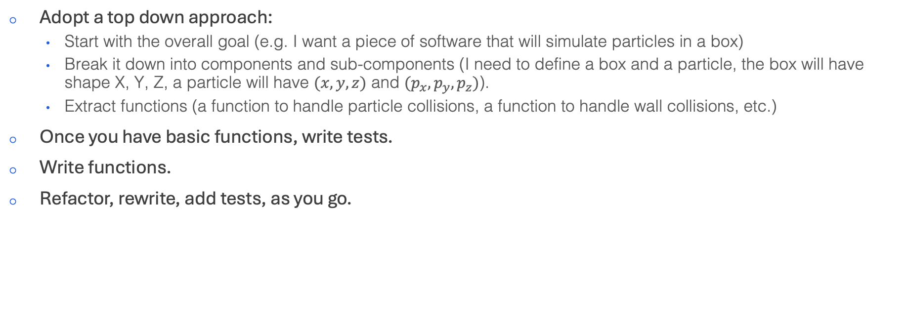
Recommended design approach
We have to be practical…
Adopt a top down approach:
Start with the overall goal (e.g. I want a piece of software that will simulate particles in a box)
Break it down into components and sub-components (I need to define a box and a particle, the box will have shape X, Y, Z, a particle will have $(x, y, z)$ and $(p_{x}, p_{y}, p_{z})$).
Extract functions (a function to handle particle collisions, a function to handle wall collisions, etc.)
Once you have basic functions, write tests.
Write functions.
Refactor, rewrite, add tests, as you go.

Slide 6
Simple example
Make a matrix symmetric:
def make_symmetric(A: np.ndarray, bin: bool = False) -> np.ndarray:
W = np.zeros(A.shape)
if bin:
for i in range(A.shape[0]):
for j in range(i, A.shape[1]):
if A[i, j] or A[j, i]:
W[i, j] = 1
W[j, i] = 1
else:
for i in range(A.shape[0]):
for j in range(i, A.shape[1]):
if A[i, j] or A[j, i]:
val = (A[i, j] + A[j, i]) / 2
W[i, j] = val
W[j, i] = val
return W
def test_make_symmetric(self):
W = np.array([[0, 1, 0],
[0, 0, 1],
[1, 0, 0]])
result = make_symmetric(W)
self.assertIsInstance(result, np.ndarray)
self.assertEqual(result.shape, W.shape)
self.assertTrue(np.allclose(result, result.T))

Slide 7
Documentation and styling

Slide 8
Docstrings
We use typing and docstrings to help with readability
A docstring provides three things:
A high-level overview of what the function does.
The arguments.
The output (either returned objects or exceptions).
There are a number of conventions for docstrings:
"""
This is an example of Google style. This is the default in VSCode.
Args:
param1: This is the first param.
param2: This is a second param.
Returns:
This is a description of what is returned.
Raises:
KeyError: Raises an exception.
"""
"""
This is an example of reST style. This is the default in PyCharm.
:param param1: this is a first param
:param param2: this is a second param
:returns: this is a description of what is returned
:raises keyError: raises an exception
"""
Notes:
Personally I prefer the Google style. We can actually set this by default in VSCode. Then when we type “””, we will get an autofilled docstring for us. PyCharm will also do this

Slide 9
Typing
You should always include type hints for your functions!
They are a way to specify the expected types of arguments and return values
They have no impact on the code runtime, so you should always include them!
Benefits
Readability
Catches type-related errors
Better IDE support and autocompletion
Type hints for users
Example:
Example types:
str
int
float
bool
list, tuple, set, dict
Optional[type]
Union[type1, type2, …]
Any
None
def greeting(name: str) -> str:
return 'Hello ' + name
Notes:
Static type checkers

