Slide 1
Developing with Poetry

Slide 2
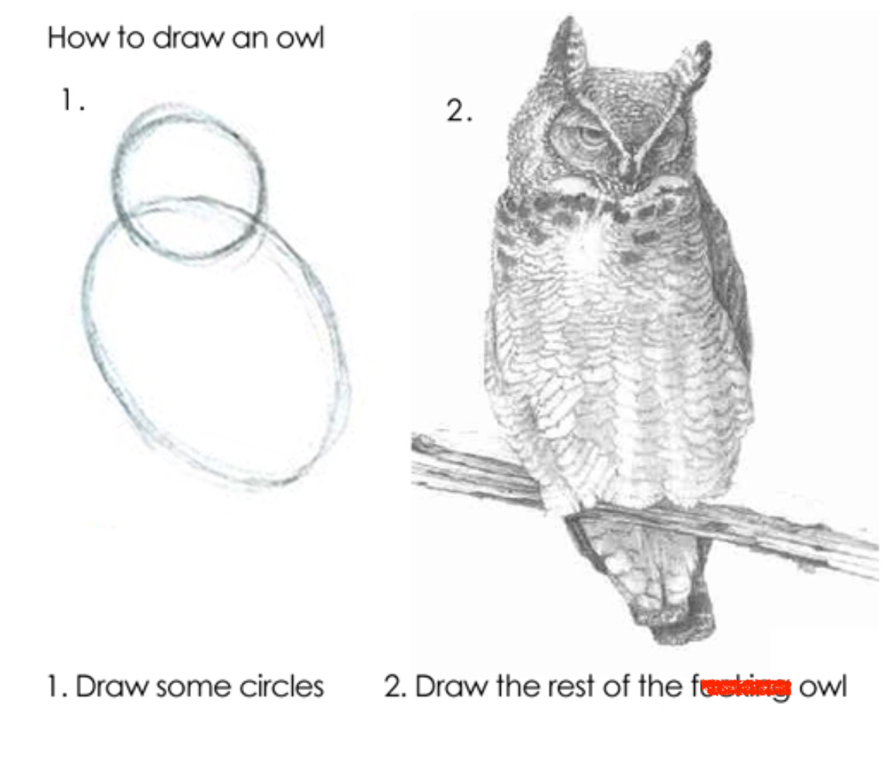
The landscape
The publishing and packaging landscape can be confusing…
The Python Software Foundation surveyed over 8k people on packaging:
Most people think packaging is too complex.
An overwhelming majority prefers using just a single tool.
Most people also think the existence of multiple tools is not beneficial for the Python packaging ecosystem.
Virtually everyone would prefer a clearly defined official workflow.
Over 50% of responses think tools for other ecosystems are better at managing dependencies and installing packages.

Slide 3
Source, eggs and wheels
How is python code distributed?
Source distribution
Contains all the source code (*.py files), any data, and a setup.py file.
Easy to build using $ python setup.py sdist and easy to install
Security risks
Difficult to maintain across platforms and versions
Must be strictly python code
Built distribution
Includes egg and wheel formats, but the standard is the wheel
Essentially a ZIP file which contains the source files
Able to specify platforms, versions, etc.

Slide 4
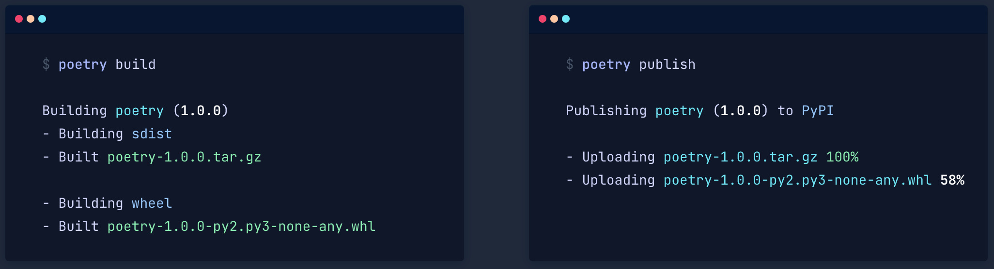
Poetry
We want to make life easy!
Poetry is a tool for managing dependencies and environments, and for packaging in Python.
Adding dependencies is straight-forward, and Poetry will automatically keep track of compatibilities.
Building, publishing and installing packages is straightforward.

Slide 5
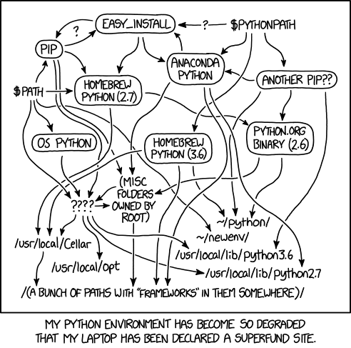
What about Anaconda/Conda
We want to make life easy!
Anaconda is very “heavy” piece of software.
Most of the time, people don’t use it correctly.
If you do have to use conda, use miniconda.
For this workshop, we will use:
Poetry
venv (standard with python)
Pip (standard with python)

Slide 6
How to use Poetry
Way #1 – start off your project the right way
:~$ poetry new my-project
my-project
├── pyproject.toml
├── README.md
├── my_project
│ └── __init__.py
└── tests
└── __init__.py
Initializing a new project is easy
Standard files and directory structure is created for you
Adding packages is easy:
:~$ poetry add numpy
Poetry will automatically update your toml file
Poetry will also manage your virtual environment if you have already created one

Slide 7
How to use Poetry
Way #2 – Initializing a pre-existing project
This way is a little more involved, and we will cover it in the practical sessions:
Poetry init
You will then follow some instructions to create your toml file
I recommend always starting off your projects in the right way – assuming that you will always be writing significant pieces of software!
By default, Poetry will create a virtual environment.
“Poetry will detect and respect an existing virtual environment that has been externally activated.
To take advantage of this, simply activate a virtual environment using your preferred method or tooling, before running any Poetry commands.”

Slide 8
The toml file
The toml file is the control center for your project
Metadata
Name, version, description, authors, licensing, included packages
Dependency management
The libraries you need for the project
Development libraries
Build system configuration
What tools are used to build the project
Script configuration
CLI entry points
Notes:
The toml file is the control center for your python project.

