Slide 1
Digital Image Processing Technologies & Applications
Image Enhancement (Spatial Filtering)

Slide 2
Contents
In this lecture we will look at spatial filtering techniques:
Basic of spatial filtering
Smoothing spatial filters
Smoothing linear filters
Order-statistics filters
Sharpening spatial filters
1st derivative filters
2nd derivative filters

Slide 3
Basic of spatial filtering
Neighbourhood operations simply operate on a larger neighbourhood of pixels than point operations.
Neighbourhoods are mostly a rectangle around a central pixel.
Any size rectangle and any shape filter are possible.
Origin
y
(x, y)
Neighbourhood
x
Image f (x, y)

Slide 4
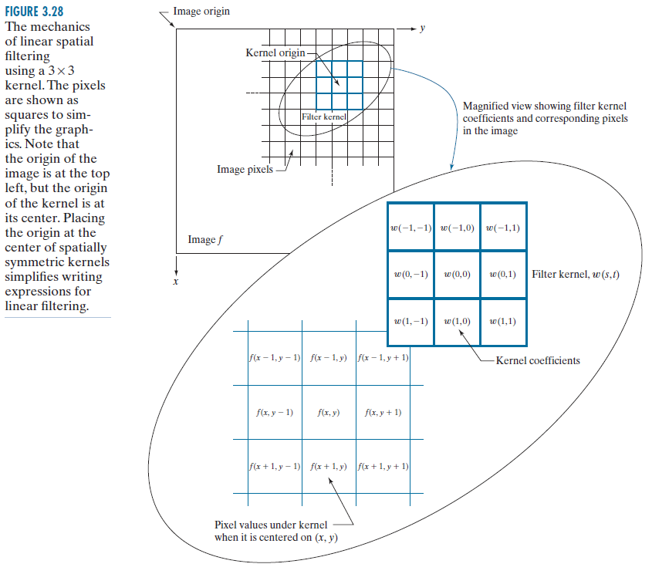
Basic of spatial filtering
Use of spatial masks for image processing (spatial filters)
Linear filters
Correlation
Convolution
Nonlinear filters

Slide 5
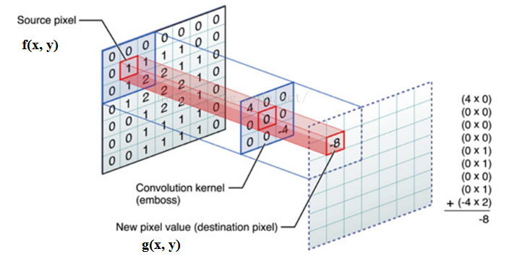
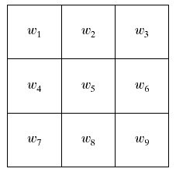
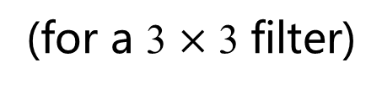
Spatial linear filtering
Spatial Correlation:
(for a 3 $×$ 3 filter)

Slide 6
Spatial linear filtering
Spatial Convolution:
The mechanics of spatial convolution are the same, except that the correlation kernel is rotated by 180⁰.
Thus, when the values of a kernel are symmetric about its center, correlation and convolution yield the same result.

Slide 7
Strange Things Happen At The Edges!
At the edges of an image we are missing pixels to form a neighbourhood
Origin
y
e
e
e
Image f (x, y)
e
e
e
e
x

Slide 8
Strange Things Happen At The Edges! (cont…)
There are a few approaches to dealing with missing edge pixels:
Omit missing pixels
Can add extra code and slow down processing
Pad the image
Typically with either all white or all black pixels
Replicate border pixels
Truncate the image

Slide 9
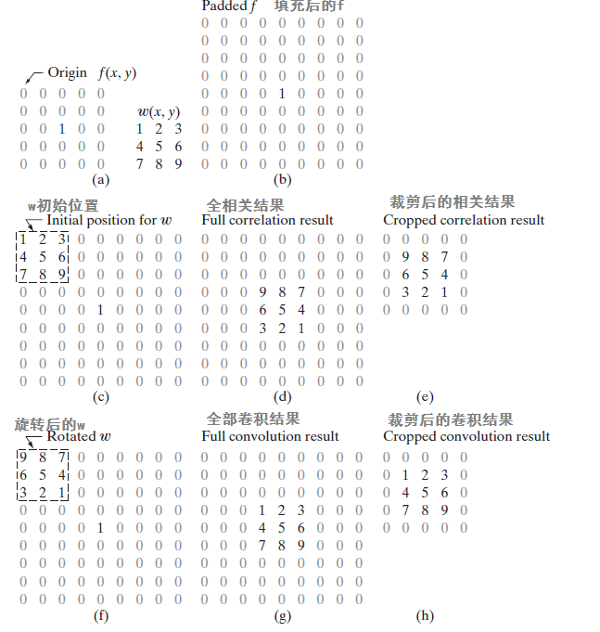
Spatial linear filtering
Often, spatial filtering algorithms are based on correlation and thus implement Eq. 1 instead. To use the algorithm for correlation, we input w into it; For convolution, we input w rotated by 180⁰
The opposite is true for an algorithm that implements 2
Thus, either Eq. 1 or Eq. 2 can be made to perform the function of the other by rotating the filter kernel
(1)
(2)

Slide 10
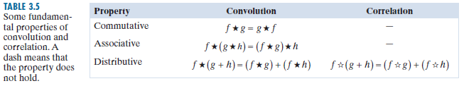

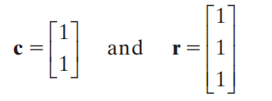
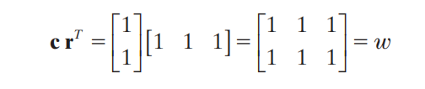
Spatial linear filtering
SEPARABLE FILTER KERNELS
A 2-D function G(x, y) is said to be separable if it can be written as the product of two 1-D functions, G1(x) and G2(y); that is, G(x,y)= G1(x) G2(y). A spatial filter kernel is a matrix, and a separable kernel is a matrix that can be expressed as the outer product of two vectors. For example, the 2 3 * kernel

Slide 11

Spatial linear filtering
If we have a kernel w that can be decomposed into two simpler kernels, such that w=w1*w2, then it follows from the commutative and associative properties that
For an image of size MN and a kernel of size mn, implementation convolution requires on the order of MNmn multiplications and additions. But, if the kernel is separable, then the first convolution, w1 f, requires on the order of MNm, the convolution of w2 with the result requires MNn such operations, for a total of MN(m+n) multiplication and addition operations. Thus, the computational advantage of performing convolution with a separable, as opposed to a nonseparable, kernel is defined as
For a kernel of modest size, say 11⋅11, the computational advantage (and thus execution-time advantage) is a respectable 5.5.

Slide 12
Spatial smoothing filtering
Used for noise reduction and blurring (removal of small details prior to large object extraction, bridging small gaps in lines).
Smoothing linear filters
Order-statistics filters

Slide 13
Smoothing linear Filters
Also called averaging filter
Simply average all of the pixels in a neighbourhood around a central value
Especially useful in removing noise from images
Also useful for highlighting gross features
¹/₉ | ¹/₉ | ¹/₉
¹/₉ | ¹/₉ | ¹/₉
¹/₉ | ¹/₉ | ¹/₉

Slide 14
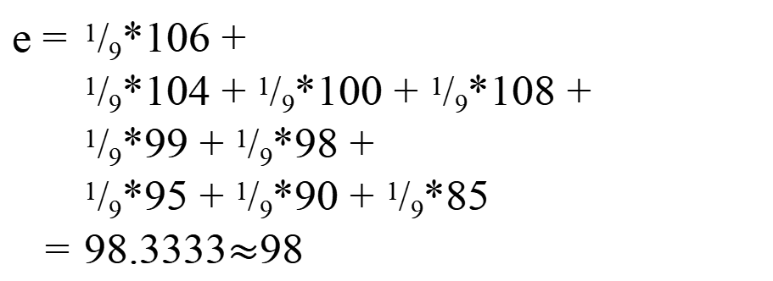
Smoothing linear Filters
Origin
y
104
100
108
¹/₉
¹/₉
¹/₉
99
106
98
*
¹/₉
¹/₉
¹/₉
95
90
85
¹/₉
¹/₉
¹/₉
Original Image Pixels
Filter
¹/₉
¹/₉
¹/₉
Simple 3*3 Neighbourhood
104
100
108
3*3 Smoothing Filter
¹/₉
¹/₉
¹/₉
99
106
98
¹/₉
¹/₉
¹/₉
95
90
85
e = ¹/₉*106 + ¹/₉*104 + ¹/₉*100 + ¹/₉*108 + ¹/₉*99 + ¹/₉*98 + ¹/₉*95 + ¹/₉*90 + ¹/₉*85
= 98.3333$≈$98
x
Image f (x, y)
The above is repeated for every pixel in the original image to generate the smoothed image.

Slide 15
Smoothing linear Filters
¹/₉
¹/₉
¹/₉
¹/₉
¹/₉
¹/₉
¹/₉
¹/₉
¹/₉

Slide 16
Smoothing linear Filters
More effective smoothing filters can be generated by allowing different pixels in the neighbourhood different weights in the averaging function:
Pixels closer to the central pixel are more important
Often referred to as a weighted averaging
¹/₁₆ | ²/₁₆ | ¹/₁₆
²/₁₆ | ⁴/₁₆ | ²/₁₆
¹/₁₆ | ²/₁₆ | ¹/₁₆
Weighted averaging filter

Slide 17
Smoothing linear Filters
This process results in an image with reduced sharp transitions in gray levels.
Because random noise typically consists of sharp transitions in gray levels, the most obvious application of smoothing is noise reduction.
Averaging filters have the undesirable side effect that they blur edges.
A major use of averaging filters is in the reduction of “irrelevant” detail in an image.

Slide 18
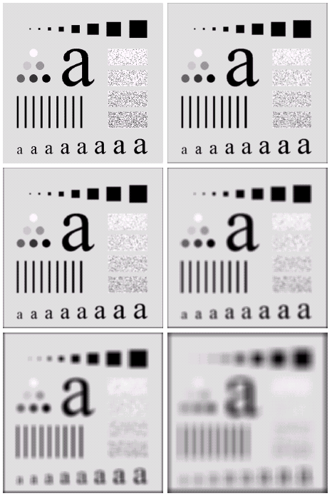
Smoothing linear Filters
The image at the top left is an original image of size 500*500 pixels.
The subsequent images show the image after filtering with an averaging filter of increasing sizes:
3, 5, 9, 15 and 35.
Notice how detail begins to disappear.
Exam: average.m

Slide 19
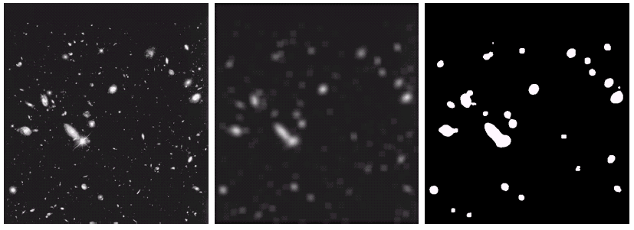
Smoothing linear Filters
By smoothing the original image we get rid of lots of the finer detail which leaves only the gross features for thresholding.
Original Image
Smoothed Image
Thresholded Image
Exam: hubble.m

Slide 20
Smoothing linear Filters
Exam: word.m

Slide 21
Order-statistics filters
Order statistics filters are nonlinear spatial filters whose response is based on ordering the pixels in the area of filter.
Some typical operations include:
Min: Set the pixel value to the minimum in the neighbourhood
Max: Set the pixel value to the maximum in the neighbourhood
Median: The median value of a set of numbers is the midpoint value in that set (e.g. for a 3*3 neighbourhood, with grey level (10,20,20,20,15,20,20,25,100), then we can order them in (10,15,20,20,20,20,20,25,100), 20 is the median. Sometimes the median works better than the average

Slide 22
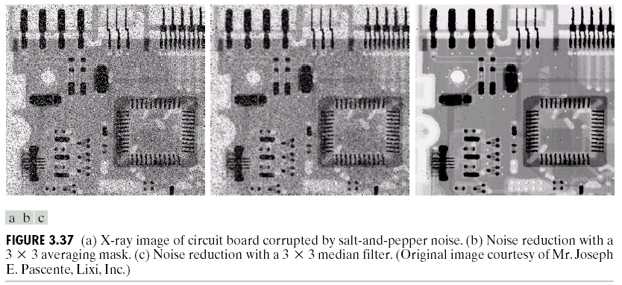
Order-statistics filters
Original Image With Noise
Image After Averaging Filter
Image After Median Filter
Exam: order.m

Slide 23
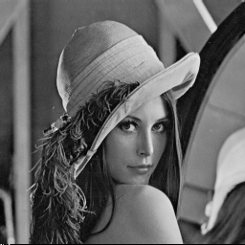
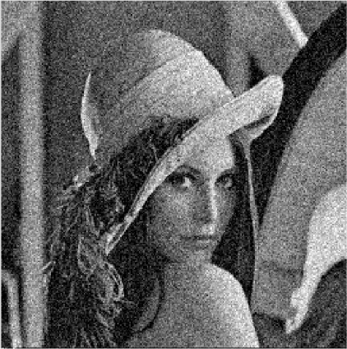
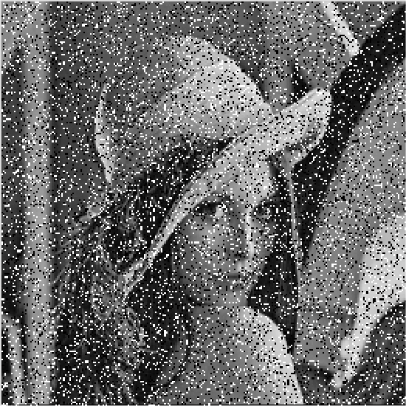

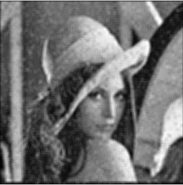


Order-statistics filters
a
b
c
Exam: order2.m
d
e
f
g
(a) Lena; (b) Gaussian noise；(c) Salt and pepper noise; (d) and (e) Smoothing with square average filter on (b) and (c), respectively; (f) and (g) 5×5 median filter on (b) and (c), respectively.

Slide 24
Order-statistics filters
Filtering is often used to remove noise from images.
Sometimes a median filter works better than an averaging filter.
Median filter are particularly effective in the presence of impulse noise, also called salt-and-pepper noise.

Slide 25
Max and Min Filter
Max Filter:
Min Filter:
Max filter is good for pepper noise and min is good for salt noise.

Slide 26
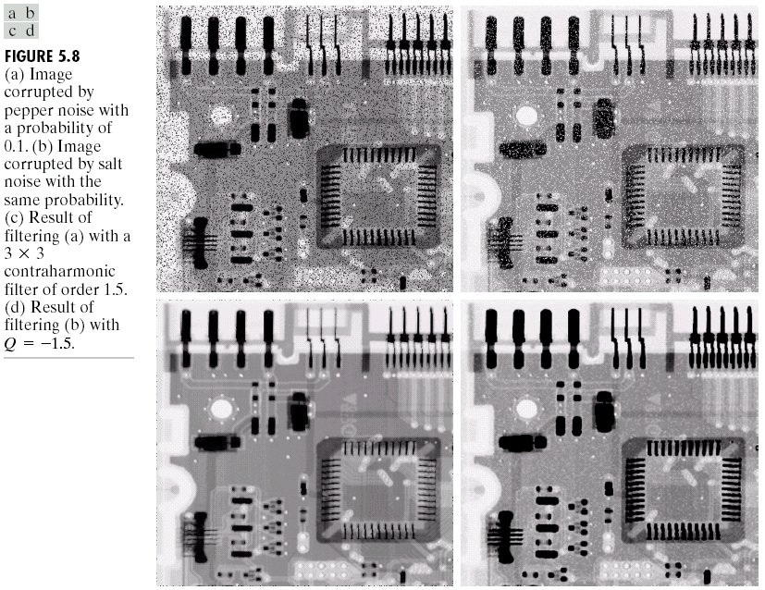
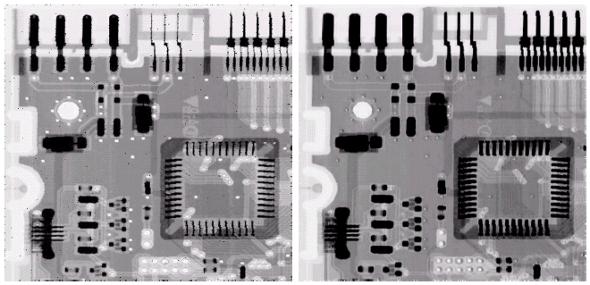
Noise Removal Examples (cont…)
For max filter, it will remove pepper noise, but it also removed some dark pixels from the borders of dark objects.
The same as min filter, it will remove some white points around the border of light objects.
Image Corrupted
By Pepper Noise
Image Corrupted
By Salt Noise
Result Of Filtering Above With A 3*3 Max Filter
Result Of Filtering Above With A 3*3 Min Filter
Example: maxminfilter.m

Slide 27
Order-statistics filters
Other typical filter masks

Slide 28
Adaptive Filters
The filters discussed so far are applied to an entire image without any regard for how image characteristics vary from one point to another.
The behaviour of adaptive filters changes depending on the characteristics of the image inside the filter region.
An increase in filter complexity.
We will take a look at the adaptive median filter.

Slide 29
Adaptive Median Filtering
The median filter performs relatively well on impulse noise as long as the spatial density of the impulse noise is not large (P_{a} and P_{b} are less than 0.2).
The adaptive median filter can handle much more spatially dense impulse noise, and also performs some smoothing for non-impulse noise.
An additional benefit of the adaptive median filter is that it seeks to preserve detail while smoothing non-impulse noise.
The key insight in the adaptive median filter is that the filter size changes depending on the characteristics of the image.

Slide 30
Adaptive Median Filtering (cont…)
Remember that filtering looks at each original pixel image in turn and generates a new filtered pixel.
First examine the following notation:
z_{min} = minimum grey level in S_{xy}
z_{max} = maximum grey level in S_{xy}
z_{med} = median of grey levels in S_{xy}
z_{xy} = grey level at coordinates (x, y)
S_{max} = maximum allowed size of S_{xy}

Slide 31
Adaptive Median Filtering (cont…)
The key to understanding the algorithm is to remember that the adaptive median filter has three purposes:
Remove impulse noise
Provide smoothing of other noise
Reduce distortion, by not changing these intermediate-level points. (not excessive thinning or thickening of object boundaries)

Slide 32
Adaptive Median Filtering (cont…)
Level A: A1 = z_{med} – z_{min}
A2 = z_{med} – z_{max}
If A1 > 0 and A2 < 0, Go to level B
Else increase the window size
If window size ≤ S_{max} repeat level A
Else output z_{med}
Level B: B1 = z_{xy} – z_{min}
B2 = z_{xy} – z_{max}
If B1 > 0 and B2 < 0, output z_{xy}
Else output z_{med}
Z_{med} is an impulse?
Z_{xy} is an impulse?

Slide 33
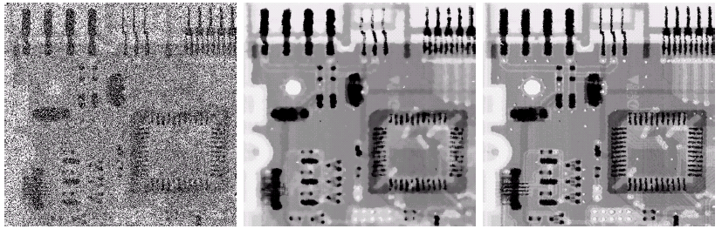
Adaptive Filtering Example
Image corrupted by salt and pepper noise with probabilities P_{a} = P_{b}=0.25
Result of filtering with a 7 * 7 median filter
Result of adaptive median filtering with s_{max} = 7
Choice of maximum allowed window size depends on the application. It should be increased as the density of the impulse increases.
A reasonable value can be estimated by experiment with various sizes of standard median filter.

Slide 34
Sharpening Spatial Filters
Previously we have looked at smoothing filters which remove fine detail.
Sharpening spatial filters seek to highlight fine detail:
Remove blurring from images
Highlight edges
Averaging is analogous to integration and causes blurring, so differentiation is expected to have opposite results and sharpen an image.
smoothing ~ integration
sharpening ~ differentiation

Slide 35
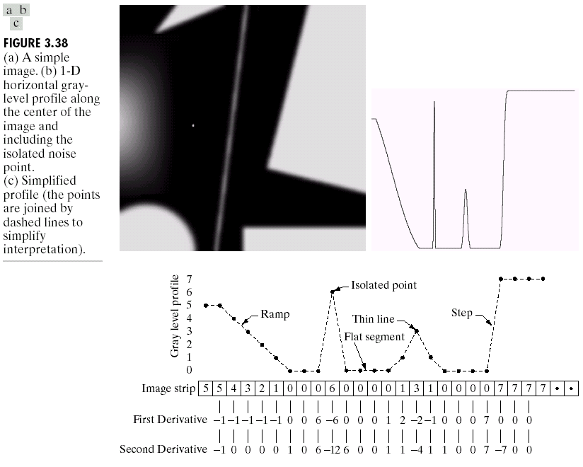
Spatial Differentiation
Differentiation measures the rate of change of a function.
Let’s consider a simple one dimensional example. The formula for the 1st derivative of a function is as follows:

Slide 36
1st Derivative (cont…)
First derivative:
0 in constant gray segments
Non-zero at the onset of steps or ramps
Non-zero along ramps
5 | 5 | 4 | 3 | 2 | 1 | 0 | 0 | 0 | 6 | 0 | 0 | 0 | 0 | 1 | 3 | 1 | 0 | 0 | 0 | 0 | 7 | 7 | 7 | 7
 | -1 | -1 | -1 | -1 | -1 | 0 | 0 | 6 | -6 | 0 | 0 | 0 | 1 | 2 | -2 | -1 | 0 | 0 | 0 | 7 | 0 | 0 | 0

Slide 37
2nd Derivative
The formula for the 2nd derivative of a function is as follows:
Simply takes into account the values both before and after the current value.

Slide 38
2nd Derivative (cont…)
Second derivative:
0 in constant gray segments.
Non-zero at the onset and end of steps or ramps.
0 along ramps of constant slope.
5 | 5 | 4 | 3 | 2 | 1 | 0 | 0 | 0 | 6 | 0 | 0 | 0 | 0 | 1 | 3 | 1 | 0 | 0 | 0 | 0 | 7 | 7 | 7 | 7
 | -1 | 0 | 0 | 0 | 0 | 1 | 0 | 6 | -12 | 6 | 0 | 0 | 1 | 1 | -4 | 1 | 1 | 0 | 0 | 7 | -7 | 0 | 0

Slide 39
1st & 2st Derivative (cont…)
Comparing the 1st and 2nd derivatives we can conclude the following:
1st order derivatives generally produce thicker edges.
2nd order derivatives have a stronger response to fine detail e.g. thin lines, and isolated points.
1st order derivatives have stronger response to grey level step.
2nd order derivatives produce a double response at step changes in grey level.

Slide 40
Using Second Derivatives For Image Enhancement
The 2nd derivative is more useful for image enhancement than the 1st derivative
Stronger response to fine detail
Simpler implementation
We will come back to the 1st order derivative later on
The first sharpening filter we will look at is the Laplacian
Isotropic
One of the simplest sharpening filters
We will look at a digital implementation

Slide 41
The Laplacian
The Laplacian is defined as follows:
where the partial 2st order derivative in the x direction is defined as follows:
and in the y direction as follows:

Slide 42
The Laplacian (cont…)
So, the Laplacian can be given as follows:
We can easily build a filter based on this
0
1
0
1
-4
1
0
1
0

Slide 43
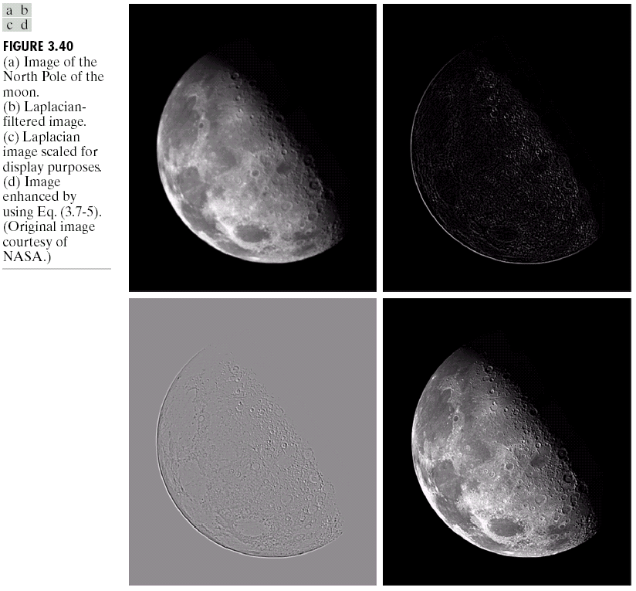
The Laplacian (cont…)
Applying the Laplacian to an image we get a new image that highlights edges and other discontinuities
Original Image
Laplacian Filtered Image
Laplacian Filtered Image Scaled for Display

Slide 44
But That Is Not Very Enhanced!
The result of a Laplacian filtering is not an enhanced image.
We have to do more work in order to get our final image.
Subtract the Laplacian result from the original image to generate our final sharpened enhanced image.
Laplacian Filtered Image Scaled for Display

Slide 45
Laplacian Image Enhancement
-
=
Original Image
Laplacian Filtered Image
Sharpened Image
Exam: laplacian.m
In the final sharpened image, edges and fine detail are much more obvious.

Slide 46
Simplified Image Enhancement
The entire enhancement can be combined into a single filtering operation:

Slide 47
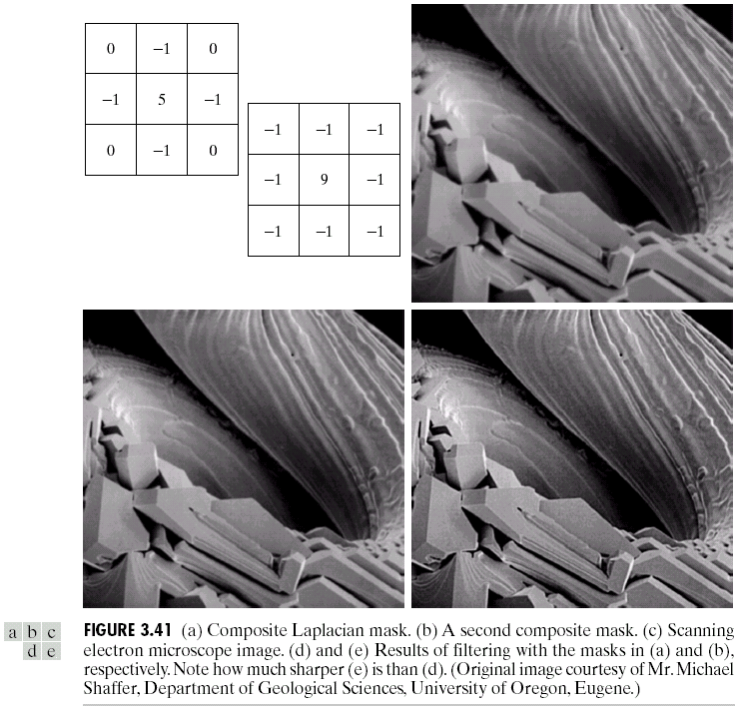
Simplified Image Enhancement (cont…)
This gives us a new filter which does the whole job for us in one step.
0
-1
0
-1
5
-1
0
-1
0

Slide 48
Variants On The Simple Laplacian
There are lots of slightly different versions of the Laplacian that can be used:
0
1
0
1
1
1
Simple Laplacian
Variant of Laplacian
1
-4
1
1
-8
1
0
1
0
1
1
1
-1
-1
-1
-1
9
-1
-1
-1
-1

Slide 49
Variants On The Simple Laplacian

Slide 50
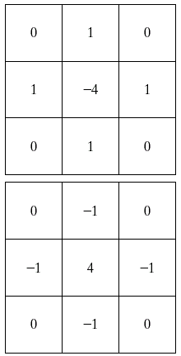
Variants On The Simple Laplacian
Two definitions of Laplacian: one is the negative of the other
Accordingly, to recover background features:
I: if the center of the mask is negative
II: if the center of the mask is positive

Slide 51
High Boost Filtering
High boost filtering:
I: if the center of the mask is negative
II: if the center of the mask is positive
When A=1, it is the standard Laplacian filtering, as the value of A increase past 1, the contribution of the sharpening process becomes less and less important.

Slide 52
High Boost Filtering
One of the principal applications of boost filtering is when the input image is darker than desired.
By varying the boost coefficient, it generally is possible to obtain an overall increase in average gray level of the image.
1
1
1
1
-8
1
1
1
1

Slide 53
1st Derivative Filtering
Implementing 1st derivative filters is difficult in practice.
For a function f(x, y) the gradient of f at coordinates (x, y) is given as the column vector:

Slide 54
1st Derivative Filtering (cont…)
The magnitude of this vector is given by:
For practical reasons this can be simplified as:

Slide 55
1st Derivative Filtering (cont…)
The simplest 1st Derivative Filtering:
Approximation:
z₁
z₂
z₃
z₄
z₅
z₆
z₇
z₈
z₉

Slide 56
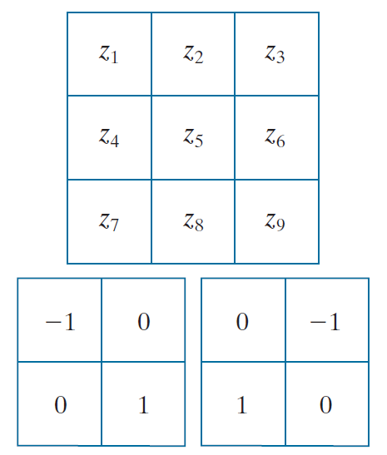
1st Derivative Filtering (cont…)
Roberts uses:
Approximation (Roberts Cross-Gradient Operators):

Slide 57

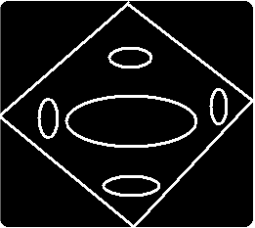
1st Derivative Filtering (cont…)
Image sharpening by gradient

Slide 58
1st Derivative Filtering (cont…)
There is some debate as to how best to calculate these gradients but we will use:
Based on the previous equations we can derive the Sobel Operators.
z₁
z₂
z₃
z₄
z₅
z₆
z₇
z₈
z₉
-1
-2
-1
-1
0
1
0
0
0
-2
0
2
1
2
1
-1
0
1

Slide 59
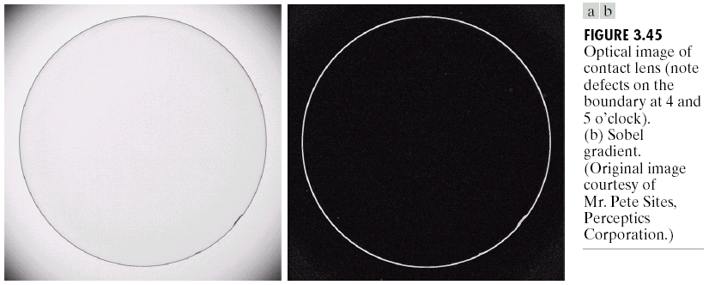
Sobel Example
Sobel filters are typically used for edge detection
An image of a contact lens which is enhanced in order to make defects (at four and five o’clock in the image) more obvious

Slide 60
Sobel Example
Exam: sobel2.m

Slide 61
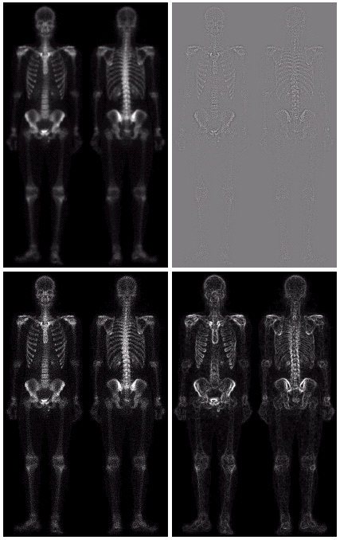
Combining Spatial Enhancement Methods
Successful image enhancement is typically not achieved using a single operation.
Rather we combine a range of techniques in order to achieve a final result.
This example will focus on enhancing the bone scan to the right.

Slide 62
Combining Spatial Enhancement Methods (cont…)
Image (d) smoothed with a 5*5 averaging filter
(a)
Laplacian filter of bone scan (a)
(b)
by subtracting Sharpened version of bone scan achieved (a) and (b)
(c)
Sobel filter of bone scan (a)
(d)

Slide 63
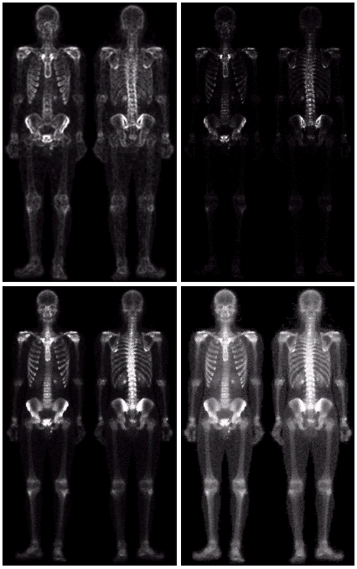
Combining Spatial Enhancement Methods (cont…)
Result of applying a power-law trans. to (g)
(h)
Sharpened image which is sum of (a) and (f)
(g)
The product of (c) and (e) which will be used as a mask
(f)
(e)

Slide 64
Combining Spatial Enhancement Methods (cont…)
Compare the original and final images

Slide 65
Summary
In this lecture we have looked at the idea of spatial filtering and in particular:
Basic of spatial filtering
Smoothing spatial filters
Smoothing linear filters
Order-statistics filters
Sharpening spatial filters
1st derivative filters
2nd derivative filters
Next time we will looking at other image enhancement methods in frequency domain.

