Slide 1

Group 8 Demo
Haoran Fan

Slide 2



QoS with Queuing Algorithm
Traffic Classification
Source/Destination IP Address
Protocols
…
QoS Level Priority
Different types of traffic…

Slide 3
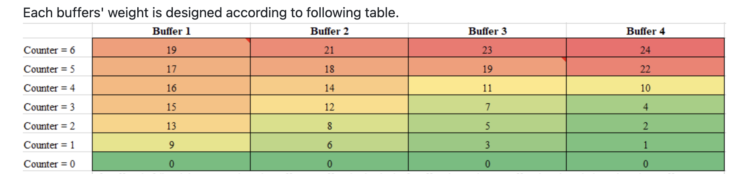
QoS with Queuing Algorithm
QoS Level Priority
4 Queues
With individual counters
Assign with different weight values

Slide 4
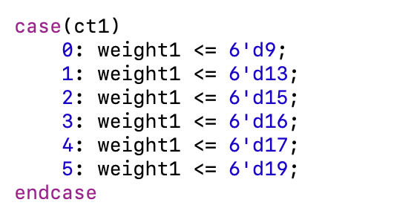
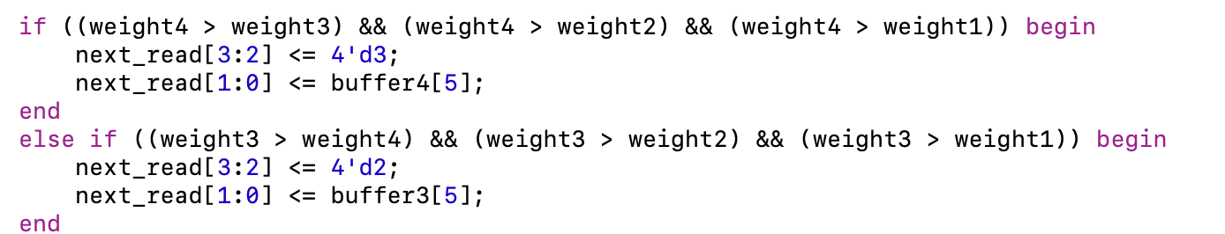
QoS with Queuing Algorithm

Slide 5
Next Step
Weight Hardcode? Could it be dynamic?
IP Address based?
Port based?
How to determine the weight values for each queues’counter?
Training like lab 10 ann?

Slide 6
PROPOSED EXPERIMENT
Configuration:
Testbed: traffic generator + normal .
Metrics: Throughput, latency, CPU usage
Potential Results:
Throughput comparison vs software firewall
Low CPU usage compared to software firewall
Low Latency

