Slide 1

PV197 - Project
Tomáš Repák

Slide 2
My approach

Slide 3
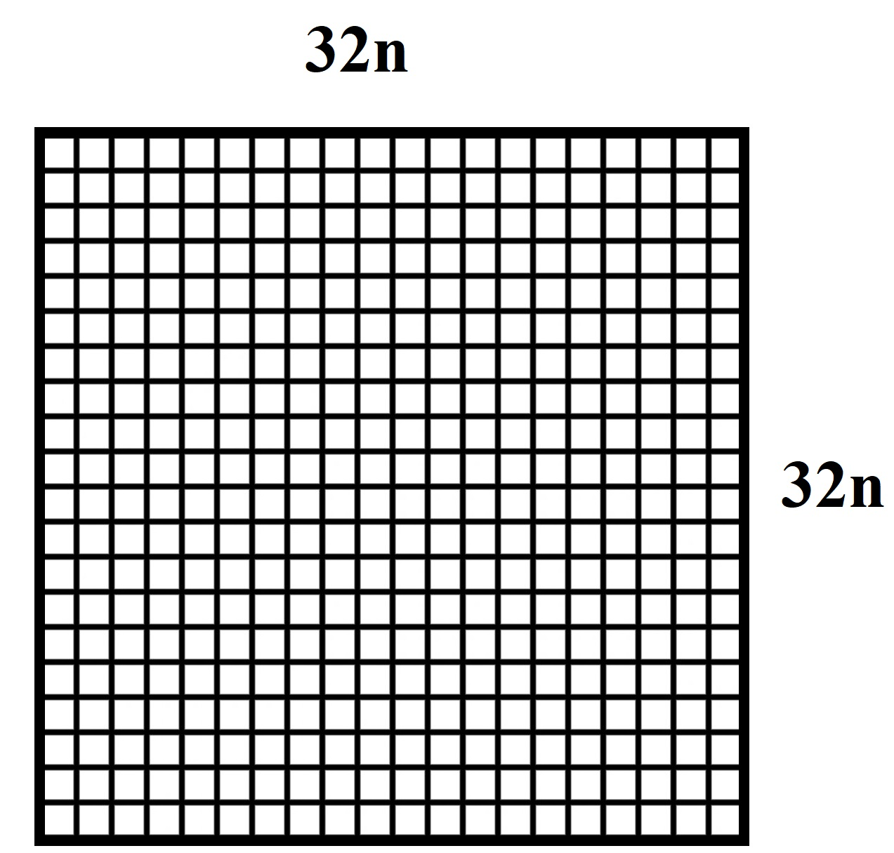
Input of size N x N (N is a multiple of 32)
Determine kernel grid of size N x (N / BLOCK)
Calculate update for each row segment
1

Slide 4
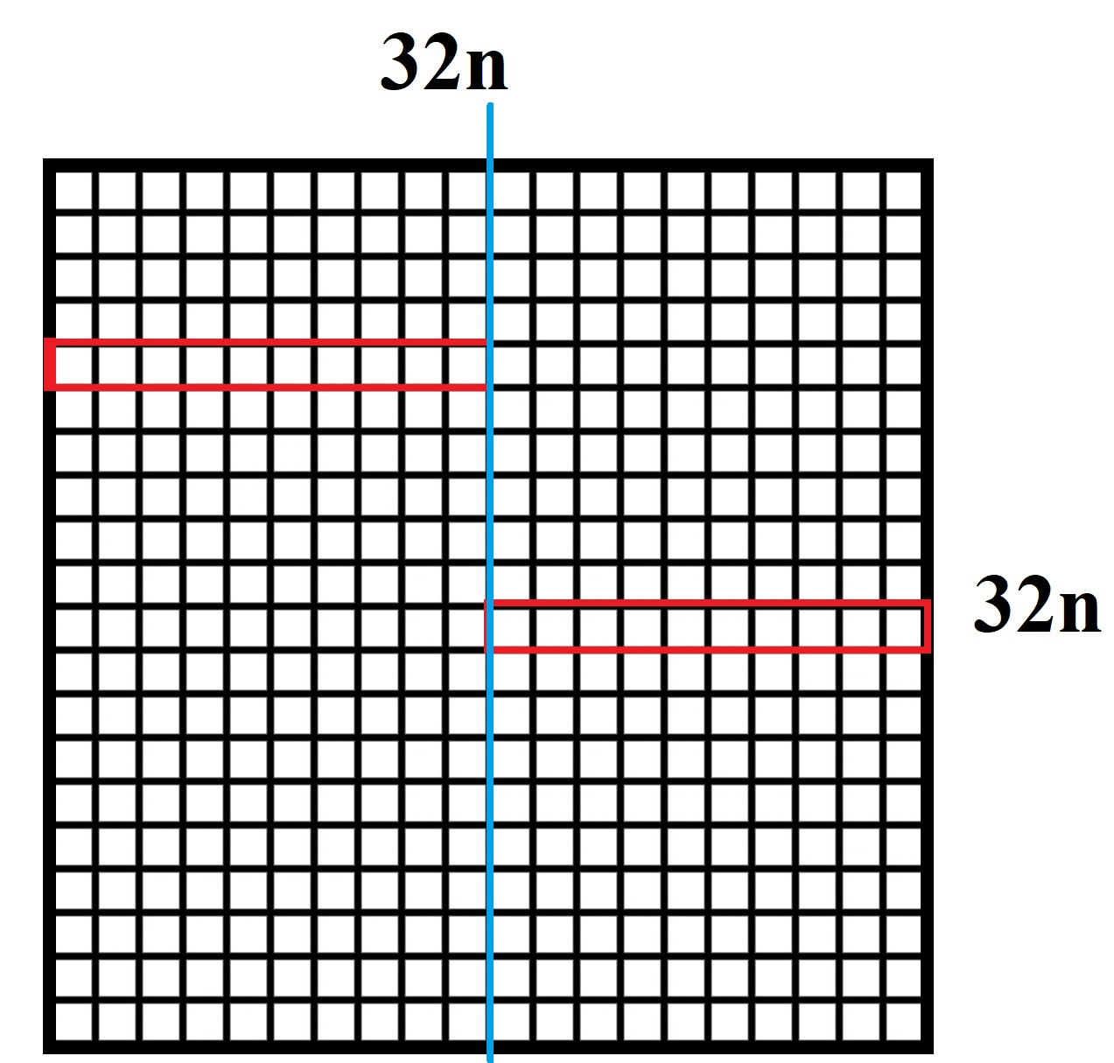
Row segments that are computed in parallel
Boundary of one block / row segment

Slide 5
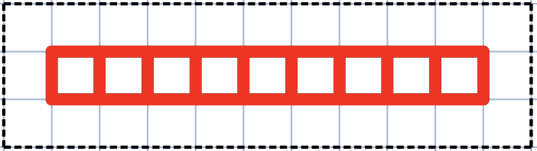




Fetch "neighborhood" of the currently computed row segment from global memory into shared memory
Initialize to zeros, if anything is out of bounds (the row segment is close to a city boundary) it will not get updated.
__shared__ int neighborhood [3][BLOCK + 3]

Slide 6
Fetch "neighborhood" of the currently computed row segment from global memory into shared memory
Initialize to zeros, if anything is out of bounds (the row segment is close to a city boundary) it will not get updated.
__shared__ int neighborhood [3][BLOCK + 3]
After everything is fetched, we can quickly compute the update for each element in the row segment.

Slide 7
After computing the update
It is not efficient to write each result independently from each thread because of uncoalesced and unsynchronized access to global memory.
Declare another array in shared memory
__shared__ int result[BLOCK + 3]
We will store the update of each element of row segment here
Only one "flush" to global memory after we finish computing all of the elements – this ensures coalesced access.

Slide 8
After computing the update
It is not efficient to write each result independently from each thread because of uncoalesced and unsynchronized access to global memory.
Declare another array in shared memory
__shared__ int result[BLOCK + 3]
We will store the update of each element of row segment here
Only one "flush" to global memory after we finish computing all of the elements – this ensures coalesced access.
N = 2048, ITERS = 100
Performance ~18k mevals/s

Slide 9



Pitfalls
Heavily global memory bound

Slide 10

Pitfalls
Heavily global memory bound

Slide 11

Pitfalls
Heavily global memory bound

Slide 12

Pitfalls
Heavily global memory bound

Slide 13
Pitfalls
Heavily global memory bound
Same happens for the other side and for almost every row segment

Slide 14




Explored optimizations
const __restrict__
On-demand loading of out-of-block values

Slide 15
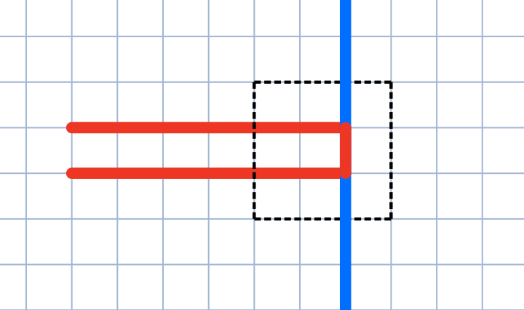
Explored optimizations
const __restrict__
On-demand loading of out-of-block values

Slide 16
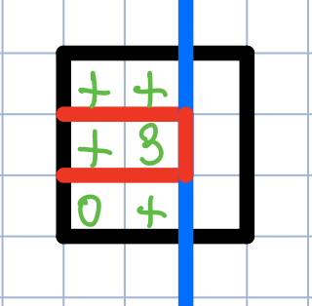
Explored optimizations
const __restrict__
On-demand loading of out-of-block values

Slide 17
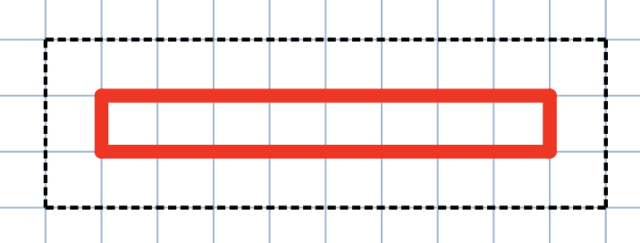
Explored optimizations
const __restrict__
On-demand loading of out-of-block values
Add more lanes and use "cyclic buffer" for neighborhood

Slide 18

Explored optimizations
const __restrict__
On-demand loading of out-of-block values
Add more lanes and use "cyclic buffer" for neighborhood

Slide 19

Explored optimizations
const __restrict__
On-demand loading of out-of-block values
Add more lanes and use "cyclic buffer" for neighborhood

Slide 20

Explored optimizations
const __restrict__
On-demand loading of out-of-block values
Add more lanes and use "cyclic buffer" for neighborhood

Slide 21

Explored optimizations
const __restrict__
On-demand loading of out-of-block values
Add more lanes and use "cyclic buffer" for neighborhood

Slide 22
Explored optimizations
const __restrict__
On-demand loading of out-of-block values
Add more lanes and use "cyclic buffer" for neighborhood

Slide 23
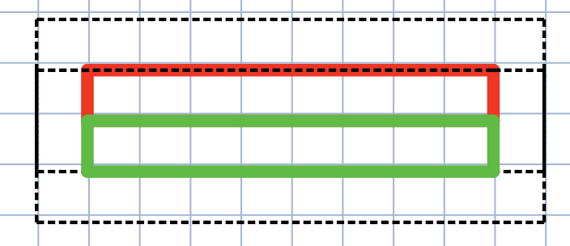
Explored optimizations
const __restrict__
On-demand loading of out-of-block values
Add more lanes and use "cyclic buffer" for neighborhood
Neighborhood[0] = Neighborhood[1]
Neighborhood[1] = Neighborhood[2]
Neighborhood[2] = in[position]

Slide 24
Explored optimizations
const __restrict__
On-demand loading of out-of-block values
Add more lanes and use "cyclic buffer" for neighborhood
Neighborhood[0] = Neighborhood[1]
Neighborhood[1] = Neighborhood[2]
Neighborhood[2] = in[position]
Using vector reduction instead of atomicAdd()
Using texture memory for faster access

Slide 25
Optimization that actually worked
One of my later kernels was (suprisingly) computationaly underutilized

Slide 26
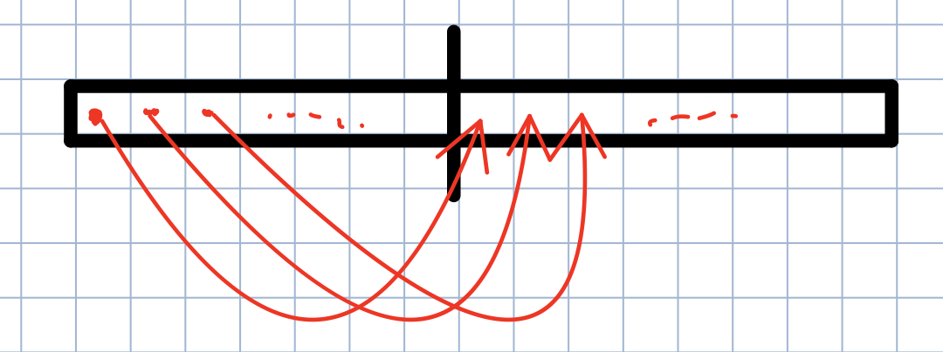
Optimization that actually worked
One of my later kernels was (suprisingly) computationaly underutilized
Assign more work to a single thread
Int offset = blockDim.x >> 1

Slide 27
Optimization that actually worked
One of my later kernels was (suprisingly) computationaly bound
Assign more work to a single thread
Int offset = blockDim.x >> 1
neighborhood[0][threadIdx.x + 1] = blockIdx.y != 0 ? in[(y-1)*n + x] : 0;
neighborhood[0][threadIdx.x + 1 + offset] = blockIdx.y != 0 ? in[(y-1)*n + x + offset] : 0;

Slide 28
Proposed optimalization
Only a theoretical approach. I tried it and got it working, but only with N = 32
Complicated

Slide 29



The problem is global memory

Slide 30
Then do not load them :)

Slide 31
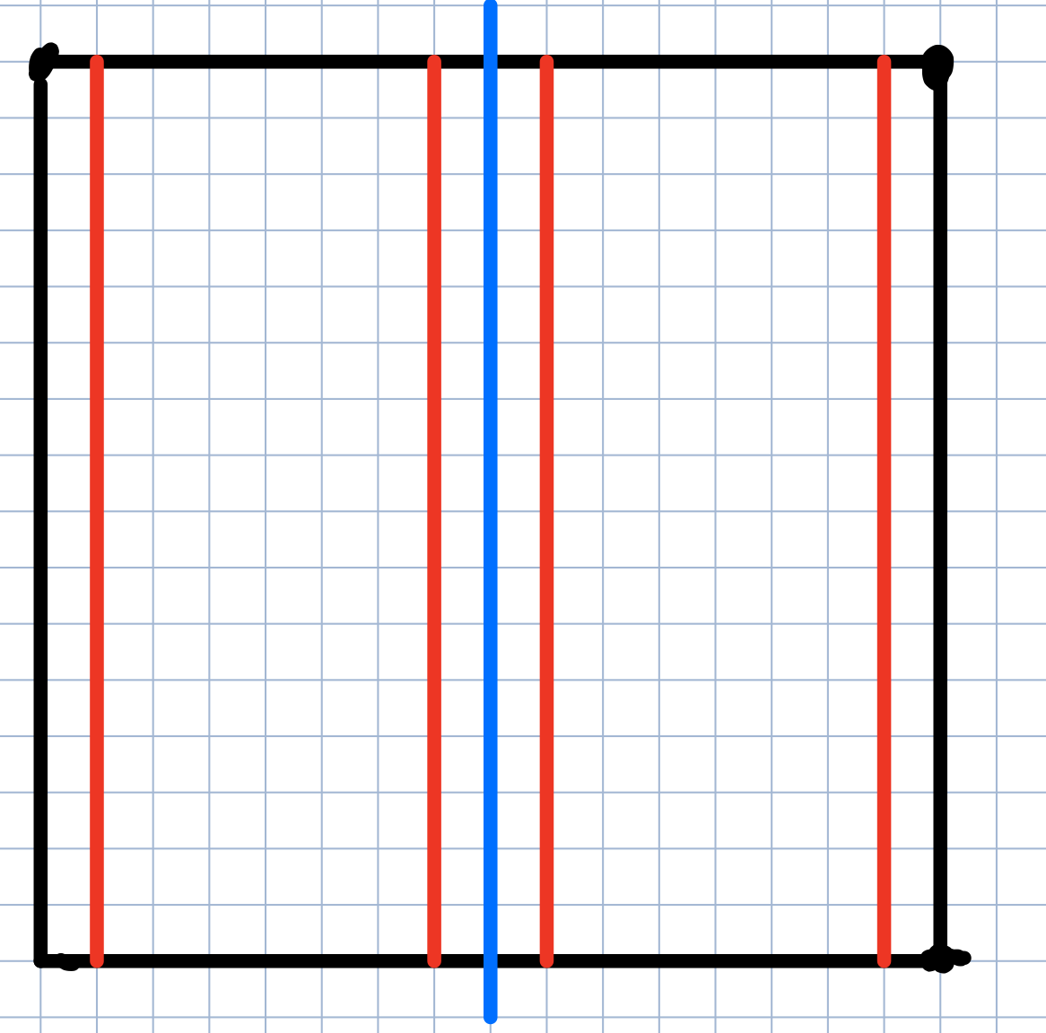

Compute these without overextending to another memory part
Block boundary
The idea of "neighborhood" does not change. We only do it in a more memory-friendly way.
We load this row segment from global memory

Slide 32
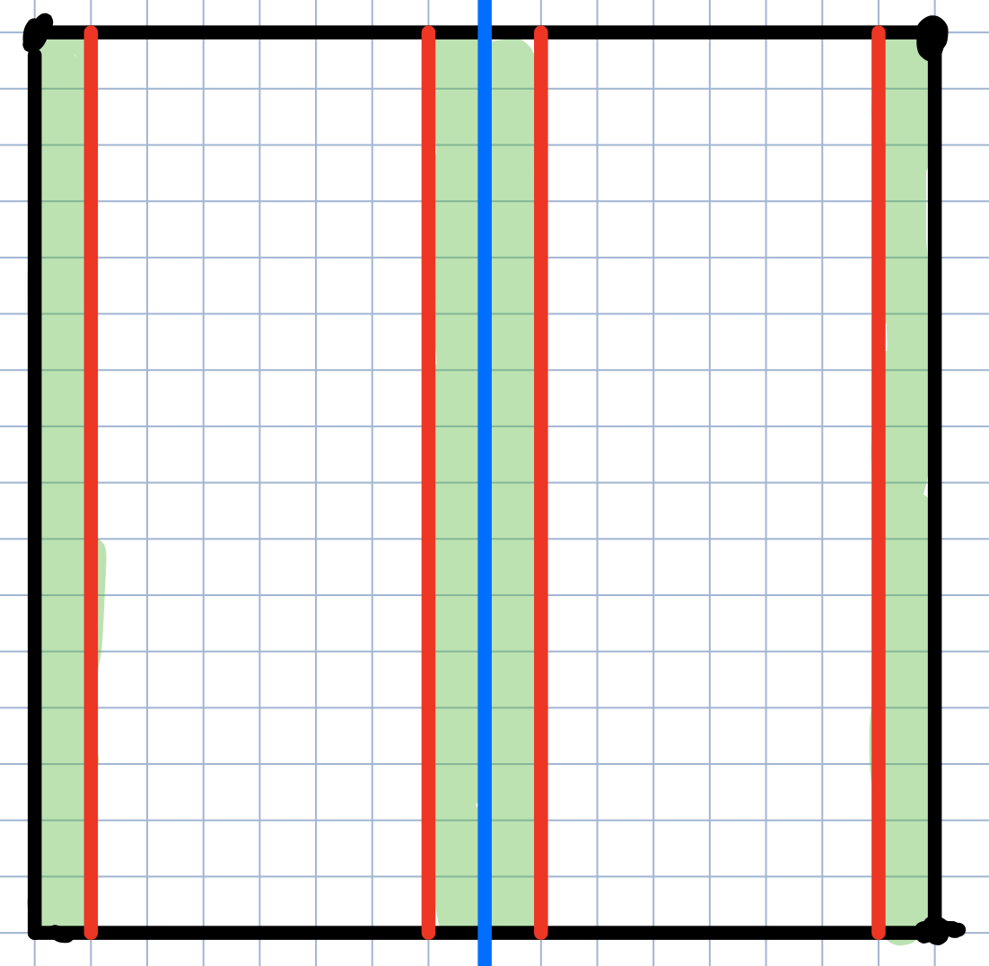
Compute these without overextending to another memory part
Block boundary
We cannot compute these without exploring the neighboring values. They, however, overextend to another region of the memory.

Slide 33
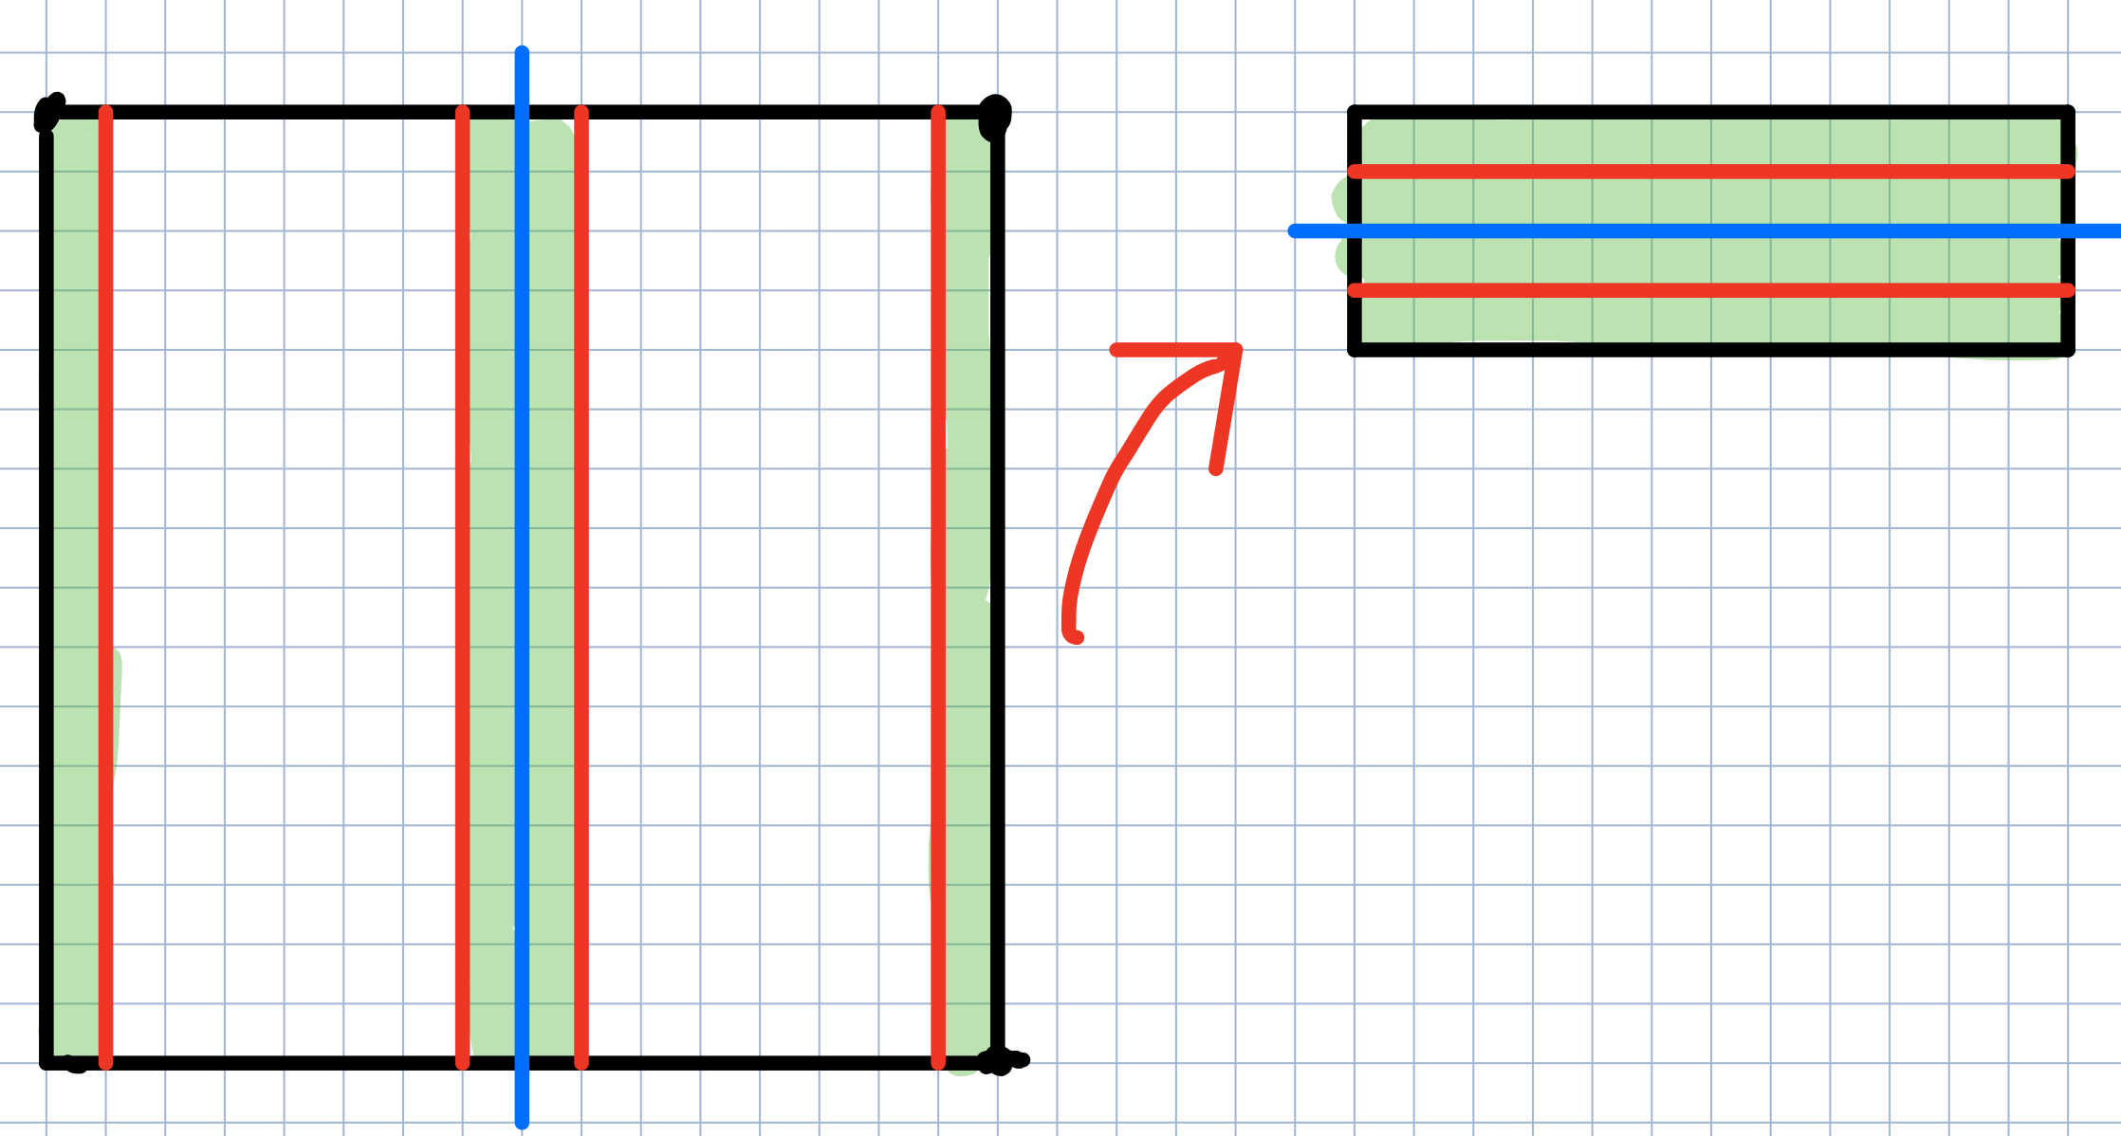

Slide 34
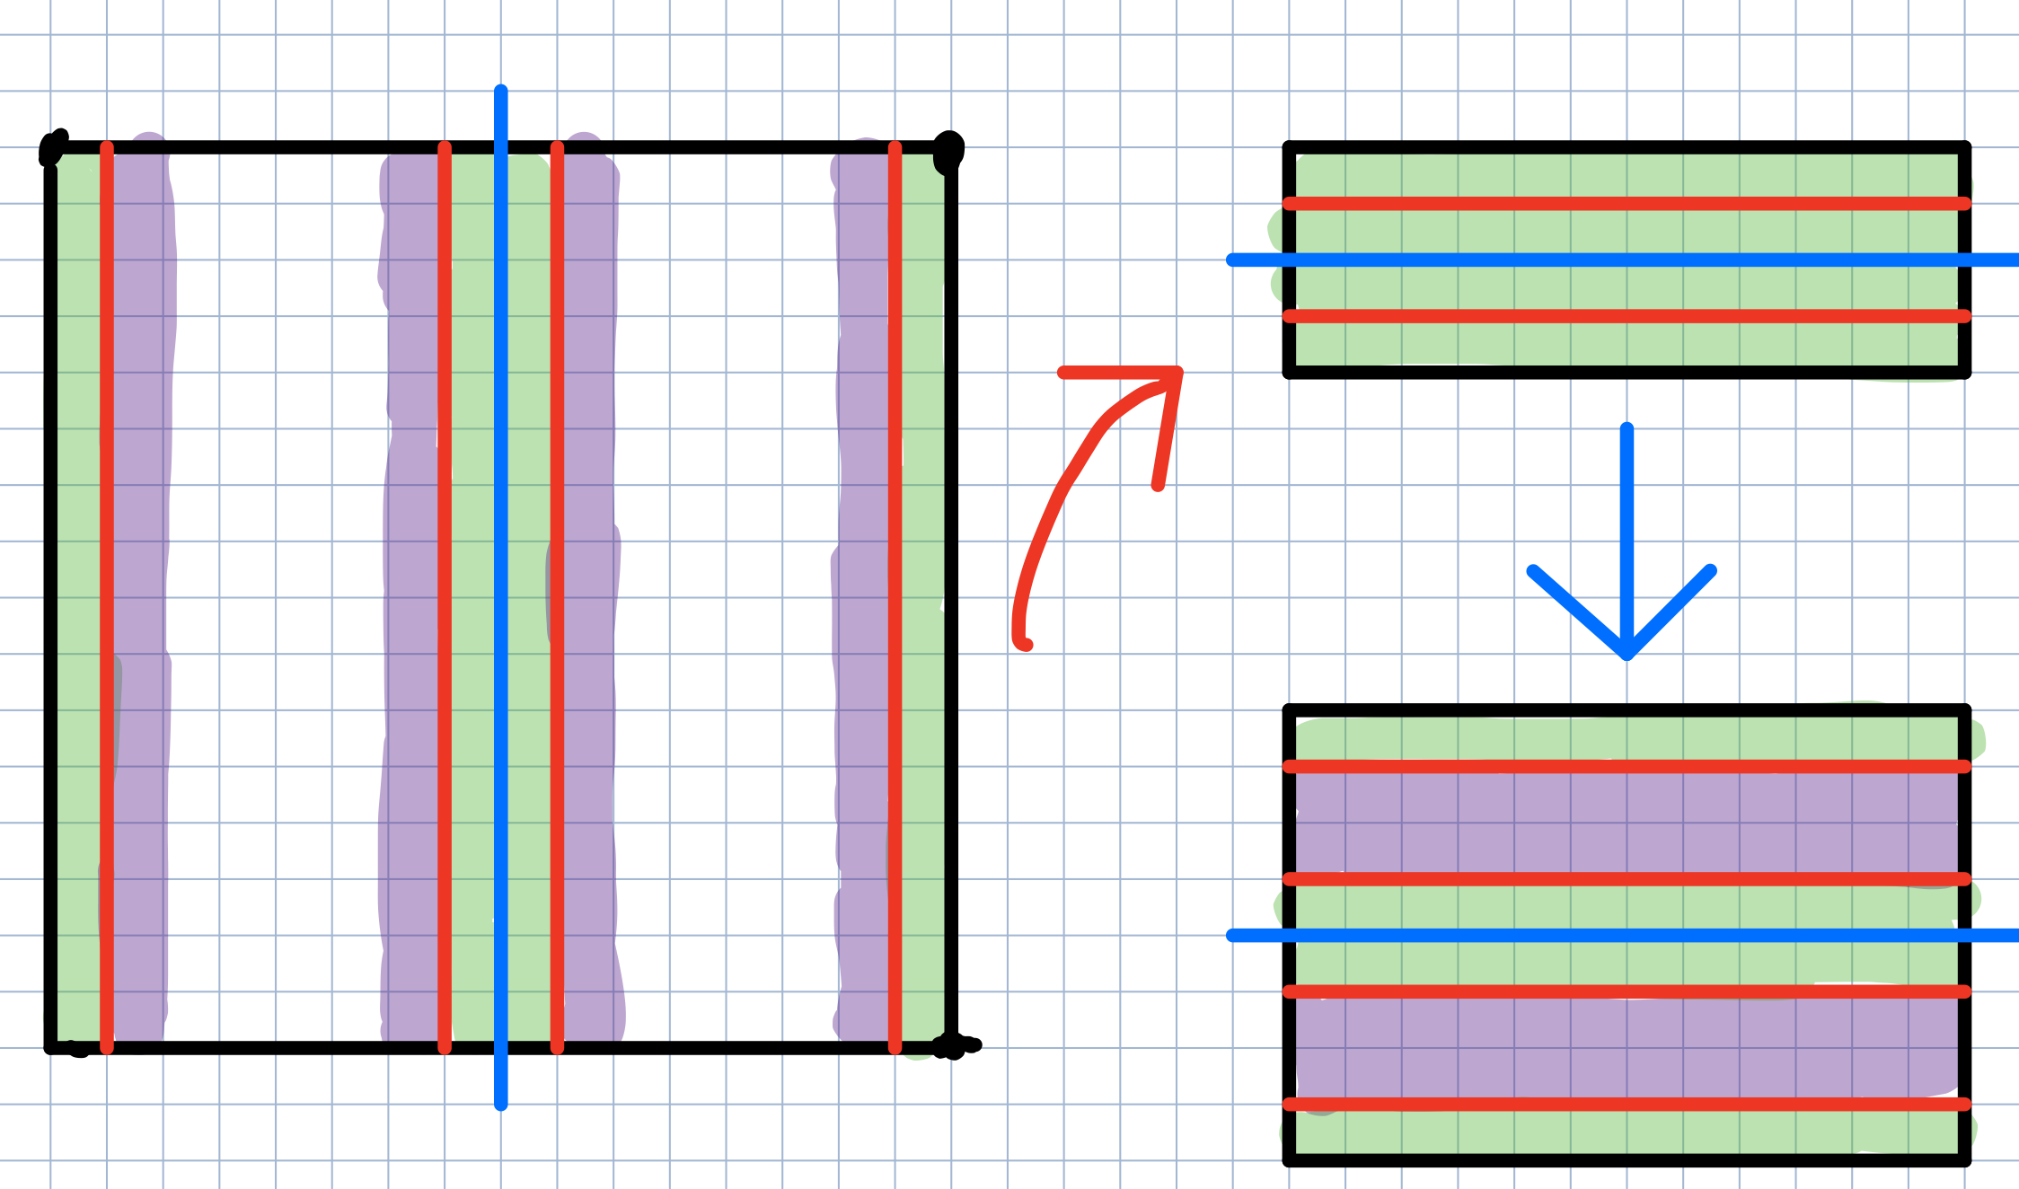

Slide 35
+
We do not overextend to another partitions of the memory
We can compute the second matrix efficiently – row wise
Second matrix has size (N / BLOCK) * 4 x N
-
We are using even more global memory

Slide 36
Performance notes
Initial version -O2: 7847.043945
Removed redundant position computing and "in" array access -O2: 8299.672852
Shared memory, data locality exploit 8351.838867
Shared memory, data locality, padding in shared mem 8984.913086
Shared memory, data locality, padding in shared mem, no red. write 8999.825195
different access pattern (Doesnt work on all N) 16015.130859
works for all inputs N*32 16909.503906
const __restrict__ 16935.658203
loading from glob. mem on demand 16709.480469
assign more work to one thread (Not on demand) 17649.894531
flushed write to global mem. (less on RTX, more on GTX) 17801.730469
BLOCK 256 ***17954.650391***

Slide 37
Thank you for attention!

