Slide 1
Bike-Sharing Demand
& Operational Insights
Presented by : Farheen Farooque
01

Slide 2
01 / AT A GLANCE
Executive summary: demand has a clear daily rhythm
58,304
92%
140
58.3
RENTAL RECORDS
REGISTERED RIDERS
PEAK-HOUR AVERAGE
AVERAGE PER HOUR
Across 1,000 hourly observations
Share of recorded rentals
At approximately 17:00
Across observed hours
WHAT THE DATA SUGGESTS
MANAGEMENT TAKEAWAY
Plan capacity around the morning and evening commute peaks.
Use time-of-day patterns for staffing and bike availability first. Treat the results as directional: this workbook covers only the first 1,000 hourly records, not a full year.
Registered riders make up the large majority of recorded demand.
Weather is associated with demand differences; rainy conditions show lower averages.
02

Slide 3
02 / SCOPE & METHOD
What was analysed — and what was not
DATA SNAPSHOT
IMPORTANT LIMITATION
1,000 hourly observations in the merged dataset.
The data spans roughly six weeks, ending in mid-February 2011. It cannot support reliable conclusions about annual seasonality or long-term growth.
Observed dates: 01 Jan 2011 to 14 Feb 2011.
Fields include hour, date, weather, temperature, humidity, casual riders, registered riders and total count.
Counts are treated as rental observations, not revenue or unique customers. Correlation is descriptive and does not establish causation.
Existing workbook calculations and pivot summaries were used alongside the merged records.
Approach: descriptive analysis • hourly averages • weather comparisons • correlation review
03

Slide 4
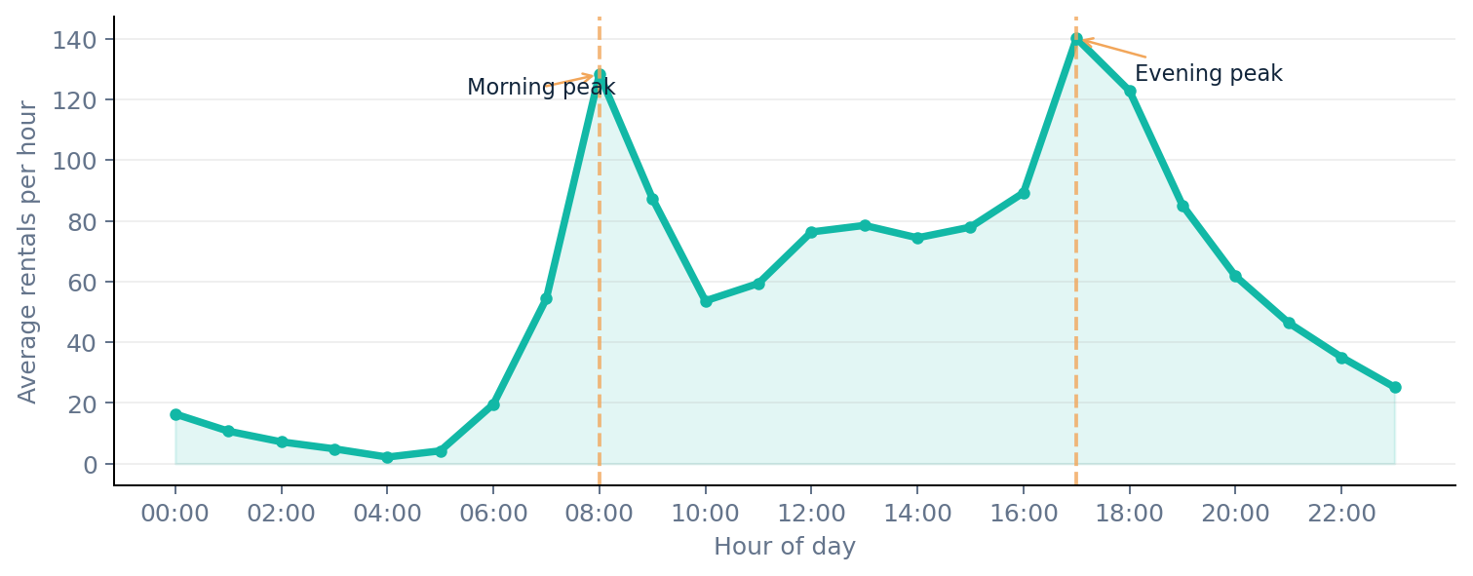
03 / DEMAND PATTERN
Demand peaks align with commute periods
128 average rentals
Morning peak • 08:00
140 average rentals
Evening peak • 17:00
Action: prioritise bike redistribution, service checks and frontline coverage before these peaks.
Chart shows mean total count by hour across the observed records.
04

Slide 5
04 / CUSTOMER MIX
Registered riders are the core demand segment
Registered 53,383 (91.6%)
Casual 4,921 (8.4%)
53,383
4,921
58,304
REGISTERED RENTALS
CASUAL RENTALS
TOTAL RENTALS
Recurring base to protect
Potential trial / conversion
Observed dataset total
Business implication: protect availability and reliability for repeat riders, while testing targeted offers that convert casual users into regular users.
05

Slide 6
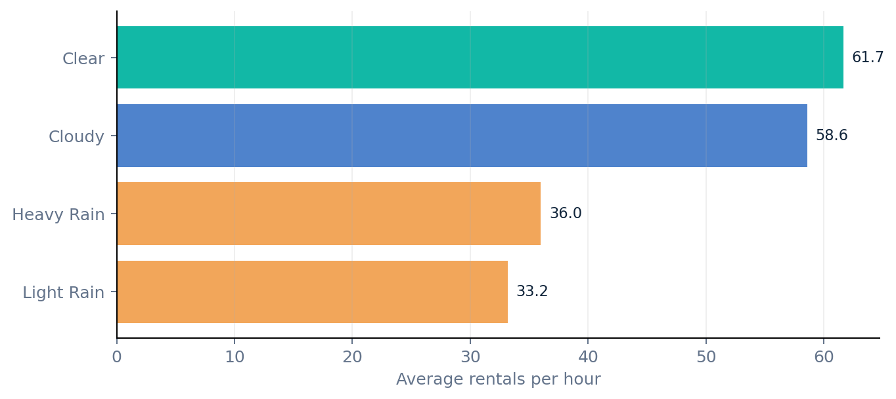
05 / ENVIRONMENTAL FACTORS
Weather conditions are linked with lower observed demand
46% lower
Average count in light rain vs clear
Action: use weather forecasts to adjust staffing and fleet placement, while validating the pattern on a larger dataset.
Weather groups are uneven in size; heavy-rain observations are especially limited.
06

Slide 7
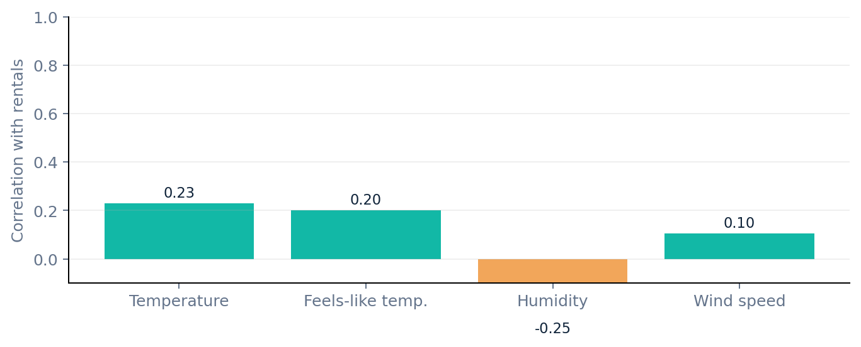
06 / DRIVER ANALYSIS
Temperature shows the strongest relationship in this sample
r = 0.23
Temperature vs total count
Interpretation: warmer observations tend to coincide with more rentals in this sample. Weather, time and calendar effects may overlap, so correlation is not proof of cause.
Pearson correlations computed from the available hourly observations.
07

Slide 8
07 / RECOMMENDATIONS
Recommended actions: start with the controllable levers
01
Prepare for peak hours
Stage bikes and schedule service coverage ahead of 08:00 and 17:00.
02
Use weather-aware operations
Adjust redistribution and staffing when rain is forecast; measure the impact.
Retain registered riders
Prioritise reliability, availability and quick resolution of service issues.
03
04
Test casual-to-member conversion
Pilot targeted offers during lower-demand periods and compare conversion rates.
Each action should be tested with a baseline, a defined owner and a measurable outcome.
BIKE-SHARING DEMAND | ANALYTICS BRIEF
08

Slide 9
08 / IMPLEMENTATION
Turn this analysis into a repeatable operating cadence
NEXT 2 WEEKS
NEXT 30 DAYS
ONGOING
Validate the signal
Run focused pilots
Track outcomes
Refresh with complete historical data
Test peak-hour bike staging
Availability during peak periods
Check missing values and date coverage
Compare rainy vs clear-day operations
Hourly demand forecast error
Confirm peak-hour patterns by day type
Pilot registered-rider retention offers
Repeat usage and conversion rate
Success principle: move from descriptive insights to controlled experiments, then scale what measurably improves service and customer outcomes.
09

Slide 10
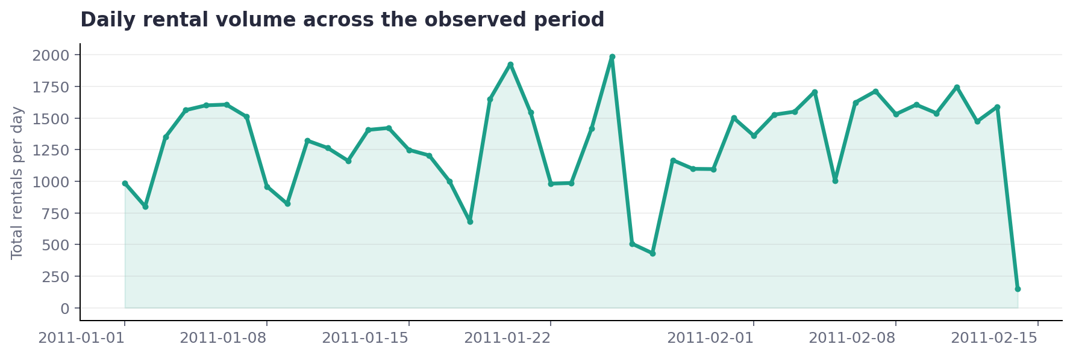
09 / WORKBOOK GRAPH
Daily demand changes meaningfully from day to day
KEY TAKEAWAY
Daily totals range from 151 to 1,985 rentals in this sample. Use daily monitoring to spot unusual demand and plan capacity.
11

Slide 11
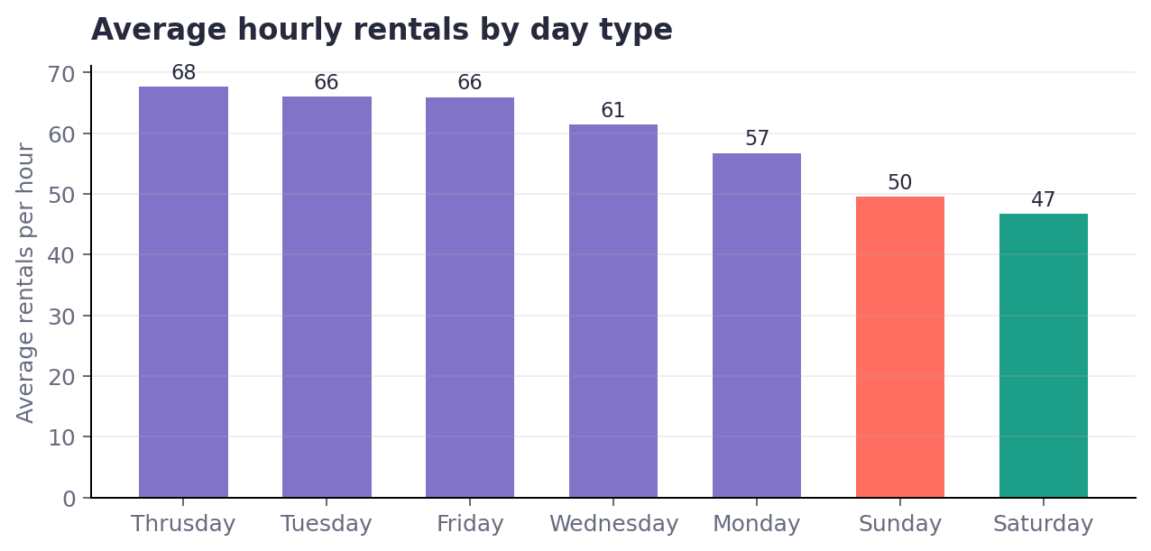
10 / WORKBOOK GRAPH
Day type provides another lens on demand
KEY TAKEAWAY
Thrusday has the highest average hourly count in this sample, while Saturday is lowest. Validate this pattern before making recurring staffing changes.
12

Slide 12
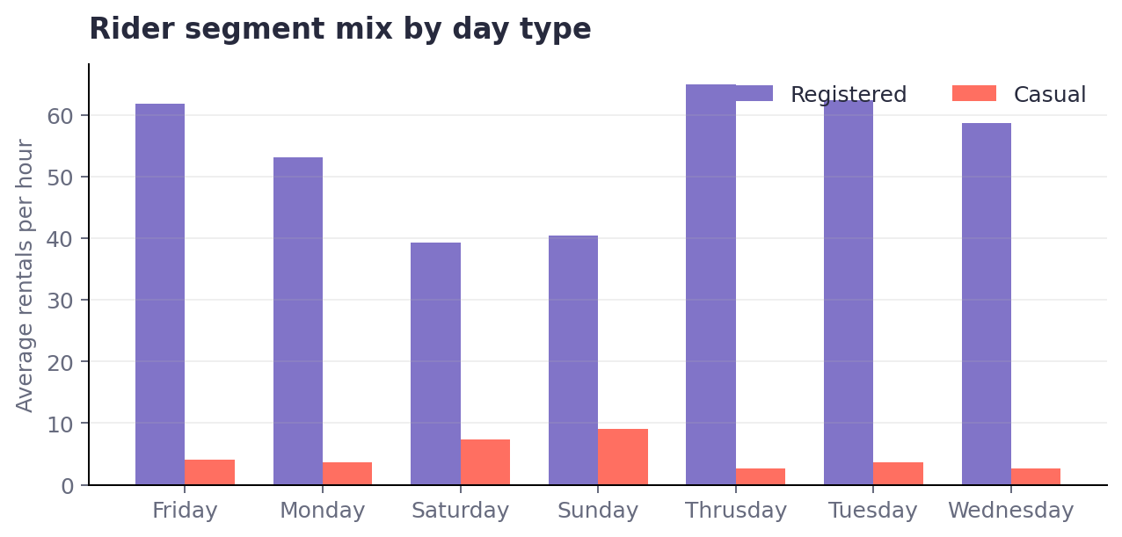
11 / WORKBOOK GRAPH
Registered and casual riders behave differently
KEY TAKEAWAY
Compare rider segments by day type before targeting offers. Registered riders represent the core base, while casual usage may offer opportunities for trial and conversion.
13

Slide 13
CLOSING MESSAGE
Make demand patterns
work for the operation.
The clearest immediate opportunity is better peak-hour readiness, supported by weather-aware planning and a stronger focus on registered riders.
Thank you
10

