Slide 1
Evidential Deep Learning for Open Set Action Recognition
Group: 5
20101592 Fardin Bin Rahman
20201214 Ilmy Islam
21101197 Mayesha Tabassum

Slide 2
Introduction
DeepMind
Evidential Uncertainty Calibration (EUC) and Contrastive Evidential Debiasing (CED)
Deep Evidential Action Recognition Approach

Slide 3
Related Work
Open Set Recognition
Deep Learning Uncertainty
Video Action Recognition

Slide 4
Approach
Deep Evidential Action Recognition
Evidential Uncertainty Calibration
Contrastive Evidence Debiasing

Slide 5
Dataset
UCF-101
HMDB-51
MiT-v2

Slide 6
Experiments
Evaluation Protocol
Implementation Details

Slide 7
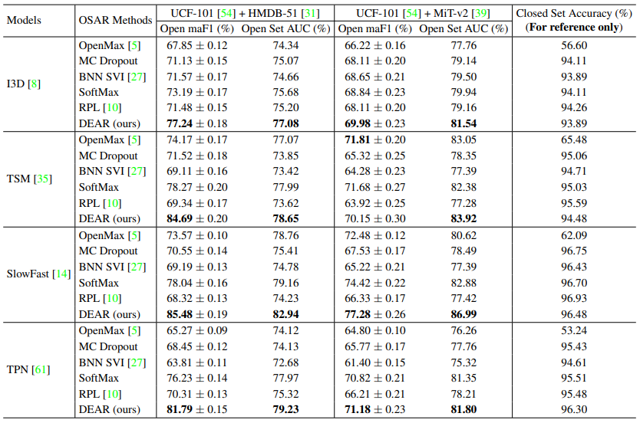
Experiments
Comparison
Ablation Study

Slide 8
Conclusion
Conducting Evidential Deep Learning (EDL)
Extensive experimental results

