Slide 1
PS8a tips

Slide 2
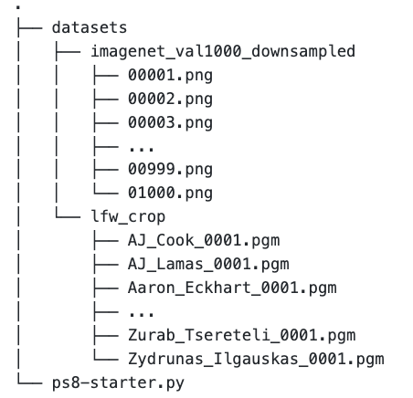
Setup
Installing New Packages
You need to install scikit-learn, a Python machine learning library
Command: pip install -U scikit-learn
Datasets
Download dataset from the Box folder
Unzip and organize the file structure

Slide 3
Task 1 (TODO 0~4)
Loading datasets from file
Perform PCA and transform data to PCA space
Plot eigenfaces (PCA components)

Slide 4
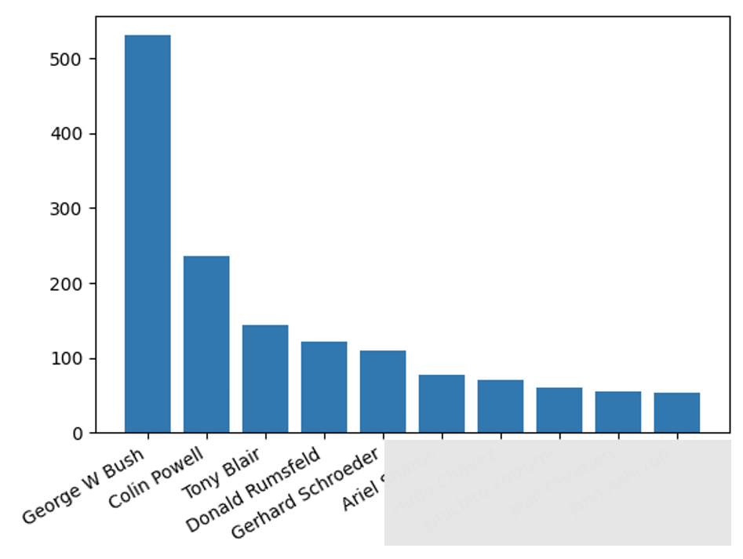
Loading Data
Finding top 10 occurred people
Find occurrences using functions like numpy.count_nonzero
Sort by occurrence using sorted().
dict.items() can make your dictionary iterable to feed in sorted().
Plotting
You can use matplotlib.pyplot.bar to plot the histogram

Slide 5
PCA (Principal Component Analysis)
Lecture notes: 1202 CVE Notes Page 3. In this task, you will use it to reduce the dimensionality of the cropped LFW dataset.
First create an object of sklearn’s PCA class:
pca = sklearn.decomposition.PCA(…)
Fit and transform:
pca.fit(X) fit the model with X
pca.transform(X) apply dimensionality reduction to X
Accessing principal components:
pca.components_

Slide 6
Task 2 (TODO 5~7)
Training a classifier
Train classifier using different number of principal components

Slide 7
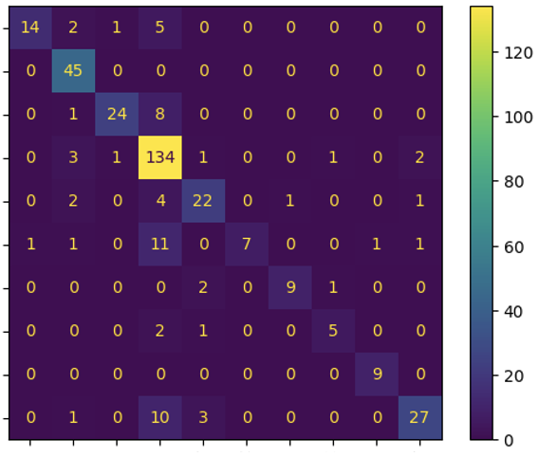
Training Classifier
Sklearn offers a great number of classifiers.
SVM can be a safe choice if you are not sure.
You will need to present you results on the testing set using the Confusion matrix.
After that, try modify number of components of PCA and record performance change of the classifier.
True label
Predicted label

