Slide 1
Visual Odometry
Aman Chulawala, Mansi Sarawata , Rohan Chandrasekar, Vigknesh Rajan
24-787 Final Project Presentation
December 8th, 2022
Notes:
Main title: 40 pt. Arial
Presenter Name: 16 pt. Arial
Presenters Title: 16 pt. Arial Italic

Slide 2
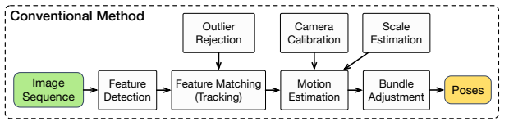
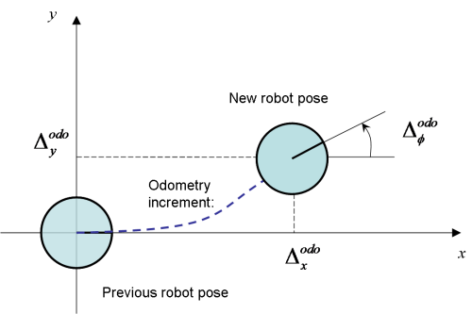
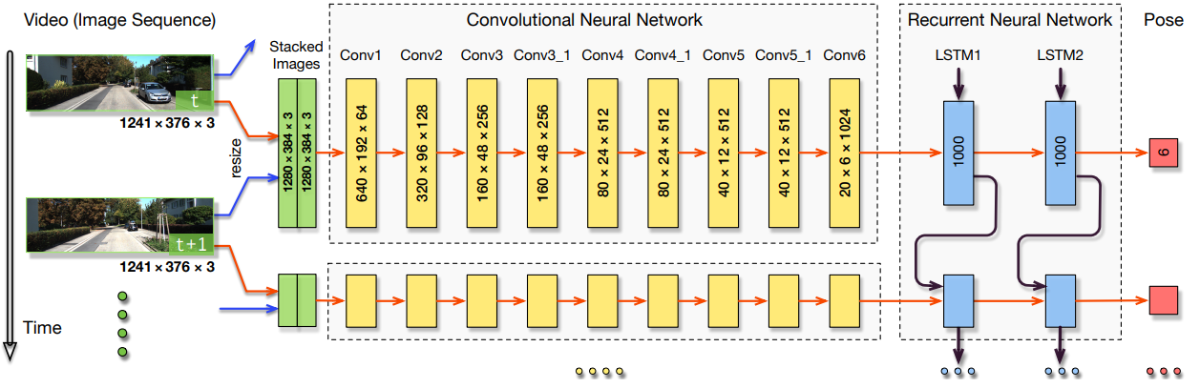
Background
New pose
Potential Drawbacks
Dependent on modules like camera calibration
Previous pose
Visual Odometry
Estimating Position & Orientation using Sequential Images
Our Approach
CNN+RNN
Trained End-to-End

Slide 3
Learning Workflow
KITTI
Dataset
Stereo SGBM
Estimated trajectory
Visual Odometry
Literature Review
Comparison with ground truth
KITTI
Dataset
CNN+RNN
Estimated trajectory

Slide 4
Model Overview and Traininh Hyperparameters
We pass a sequence of images to our convolutional neural network.
Our model has nine convolutional layers, where each layer consists of convolution, the Leaky-ReLU activation function and finally we use dropout to drop a few nodes.
The output is then passed to an LSTM, to get the final output.
The translation loss and the rotational loss are then computed by comparing the final output with the ground truth.
Dataset = KITTI Visual Data Colored
Training Sequence = Sequence 1
Number of Neurons per Layer = 500
Epochs = 25
Batch Size = 5
Learning Rate = 0.001

Slide 5
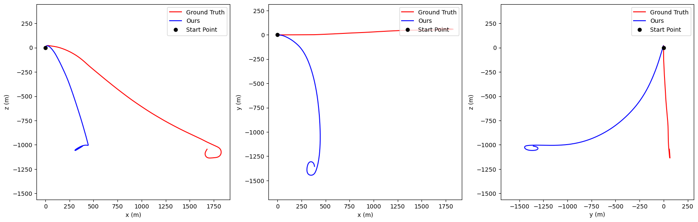
Results of Sequence 1
X, Y, Z Positions

Slide 6
Thank You
Q&A
Notes:
Main title: 40 pt. Arial
Presenter Name: 16 pt. Arial
Presenters Title: 16 pt. Arial Italic

